Slide 1
Here is a source discussing various types of IR sensors coding.
https://www.phidgets.com/docs/IR_Remote_Control_Primer
Most we deal with are “3.1 1. Pulse Distance Modulation (PDM) or Space Encoding“, and is discussed in these slides
Warning: Sony IR controllers are different than this and usually use “3.2 2. Pulse Width Modulation (PWM) or Pulse Encoding”

Slide 2
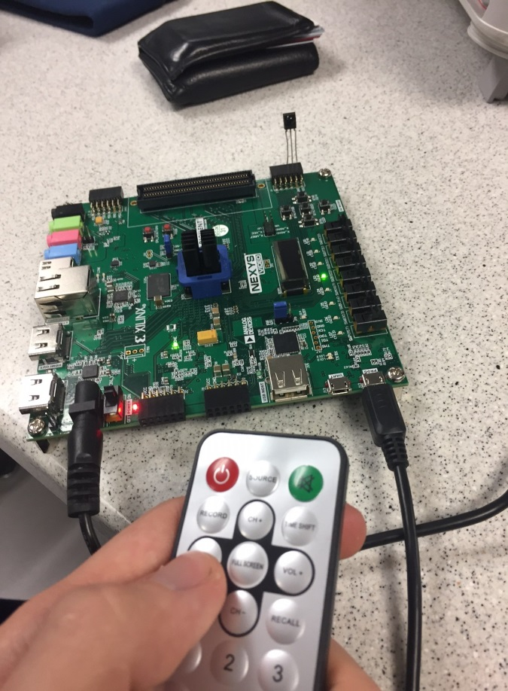
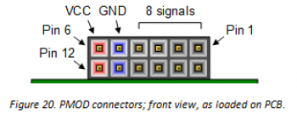

Clever way to hook up IR sensor!
left = data; center = ground; right = Vcc
TSSOP 34838 IR Sensor

Slide 3
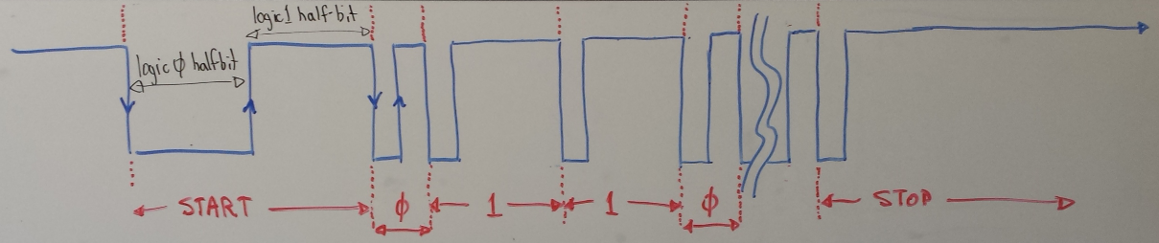
Typically a max of 32-bits
Example timing for Dr York’s IR controller
Start 1st halfbit = ~4368 nano-sec
Start 2nd halfbit = ~4368 nano-sec
Data 1st halfbit = ~510 nano-sec
Data 2nd half bit has the information
Data 2nd halfbit for logic 0 = ~510 nano-sec
Data 2nd halfbit for logic 1 = ~1620 nano-sec
Stop 1st halfbit = ~4368 nano-sec
Stop 2nd halfbit = very, very long
Decoding this is similar to HW#8;
For Dr York’s controller: follow the up/down edges 32 times (or until 2nd halfbit is much greater than 1620 nano-sec), at each rising edge beginning a Data 2nd half-bit, restart a counter, stop counter on falling edge, if time < 1000 nano-sec, then store a ‘0’, else store a ‘1’, in a shift register

Slide 4
Every companies controller usually have different codes and timings
How to get the codes and timings?
Use a Logic Analyzer!

