Slide 1
1
2
3
LOAD IMAGE
DRAW IMAGE
HELP
4
LOAD/DRAW MAZE TO START
Notes:
This window acts as the main menu. It allows the user to either load an image or draw an image.
This button allows the user to load a maze from an image file. They will be asked to select the file via a file browser, and then the file will be opened and analysed.
This button allows the user to create a maze from scratch, using the drawing software. They will be asked to specify the width and height of the image in pixels, as well as a name for the maze. The design for the drawing software is detailed later.
This button is used to display helpful messages to the user. It will pop up a dialogue box that explains the purpose of every button currently on screen.
This is the canvas. It will either display helpful messages to the user or display the maze in its current state. For the main menu, it will display the message “Load/draw maze to start”

Slide 2
1
2
RETURN HOME
HELP
3
MAZE 50% LOADED
Notes:
This window is used when a task is currently being threaded. It is used when in the states: ‘creating’, ‘drawing’, ‘editing’, ‘selecting’, and ‘finding’.
This button allows the user to return to the main menu. It causes the threaded process to be quit.
This button is used to display helpful messages to the user. It will pop up a dialogue box that explains the purpose of every button currently on screen.
The canvas will display text messages from the update.txt file. It will read the file and display the contents on the screen.

Slide 3
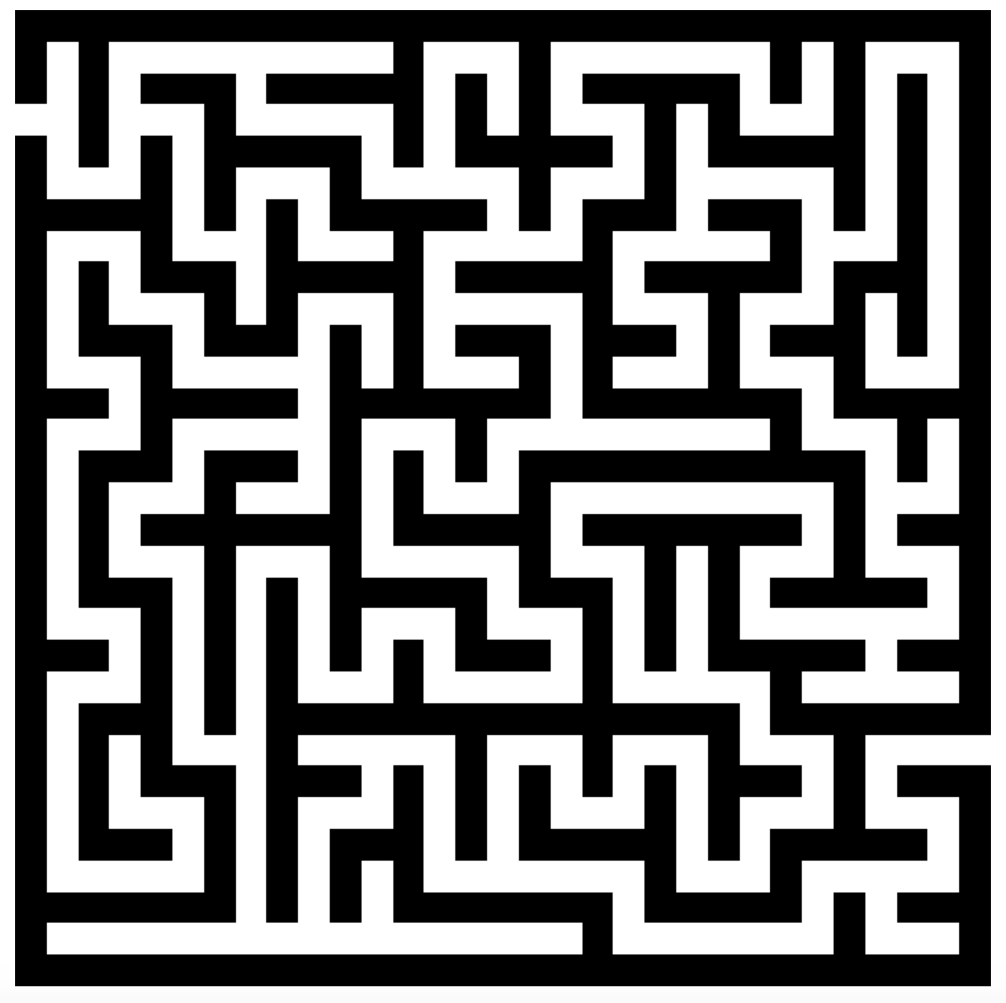
1
2
3
4
5
6
7
EDIT
INVERT
SELECT POINTS AUTOMATICALLY
SELECT MANUAL POINTS
VIEW LARGER
RETURN HOME
HELP
8
Notes:
This window is used during the ‘image’ state. It displays the analysed image to the screen.
This button is used to edit the maze. Pressing it opens up a Processing window used to edit the maze.
This button inverts the maze and reloads this window, swapping path and wall cells in the maze.
This button auto-selects the end points for the user, using the algorithm detailed earlier.
This button opens up a Processing window that allows the user to select the end points themselves.
This button opens a window that displays the image on the canvas in a larger format. This is handled by the OS, so on a mac the image will be displayed by Preview.
This button allows the user to return to the main menu.
This button is used to display helpful messages to the user. It will pop up a dialogue box that explains the purpose of every button currently on screen.
This displays the maze grid to the screen once the image has been analysed. A 0 in the maze grid (path) is represented by a white square, with a 1 (wall) represented by a black square.

Slide 4
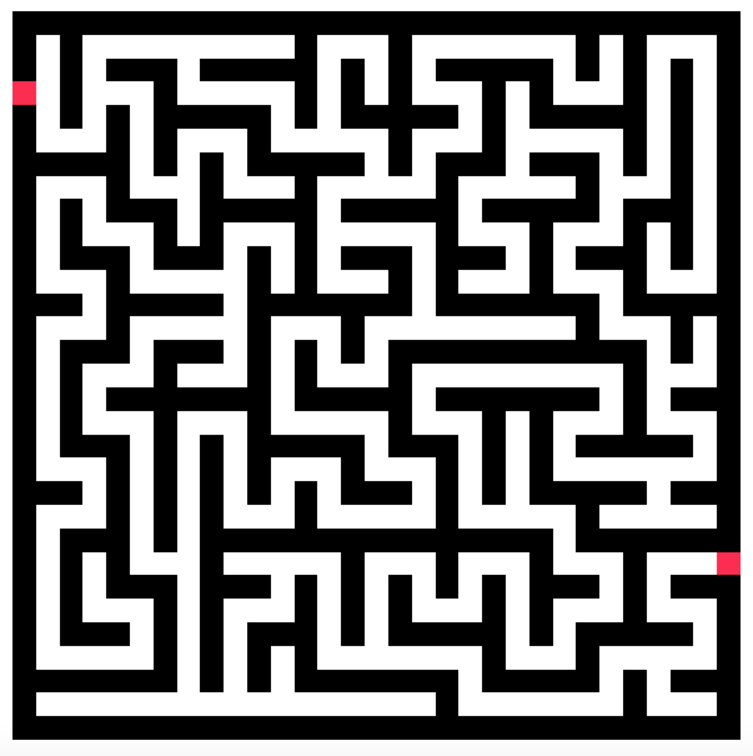
1
2
3
4
5
GO BACK
VIEW LARGER
SOLVE MAZE
RETURN HOME
HELP
6
Notes:
This window is used during the ‘points’ state. It displays the end points and maze to the user.
This button allows the user to go back a stage, so that they can either select different end points or edit the maze. It goes back to the ‘image’ state.
This button opens a window that displays the image on the canvas in a larger format.
This button causes the program to solve the maze between the two selected end points.
This button allows the user to return to the main menu.
This button is used to display helpful messages to the user. It will pop up a dialogue box that explains the purpose of every button currently on screen.
This displays the maze grid and end points to the user. The end points are displayed in red.

Slide 5
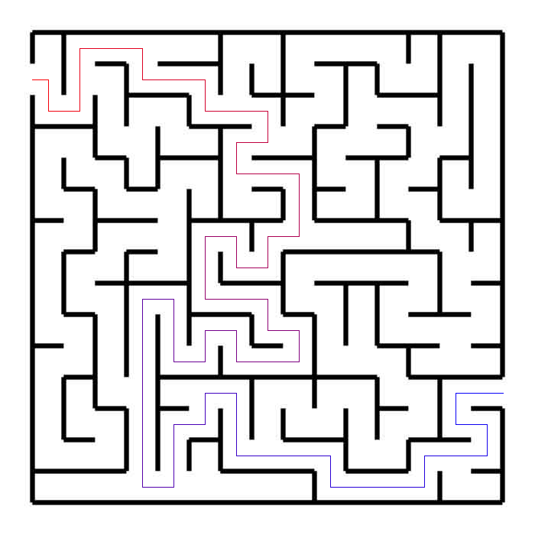
1
2
3
4
5
6
GO BACK
SAVE MAZE
CHANGE COLOURS
VIEW LARGER
RETURN HOME
HELP
7
Notes:
This window displays the solved maze to the user. It is used during the ‘path’ state.
This button allows the user to go back to the ‘image’ state, so that they can either select different end points or edit the maze.
This button saves the image currently displayed on the screen. It saves the maze in the form ‘example-path.png’ where ‘example.png’ was the original image.
This button opens a window that displays the image on the canvas in a larger format.
This button allows the user to return to the main menu.
This button is used to display helpful messages to the user. It will pop up a dialogue box that explains the purpose of every button currently on screen.
The image displayed on the screen is the original image with the path drawn over the top. If the maze has been edited or drawn from scratch, the original image is not used and a new maze image is created by using the maze grid, with a 1 being drawn as a black square and a 0 a white square.

Slide 6
Press ‘Load Image’ to load a maze from an image file. You will be asked to select the file via a file browser.
Press ‘Draw Maze’ to create a maze from scratch, using drawing software. You will be asked to specify the width and height of the image in pixels, as well as a name for the maze.

Slide 7
The maze is currently being analysed and converted into a binary grid. If you would like to return to the main menu and stop this analysis, press ‘Return Home’.

Slide 8
Press ‘Edit Maze’ to edit the maze using drawing software. It will open up a new window – follow the instructions there.
Press ‘Invert Maze’ to invert black and white pixels. This is used when the walls are of a lighter colour than the path in the original image.
Press ‘Select Points Manually’ to select the start and end of the route through the maze yourself.

Slide 9
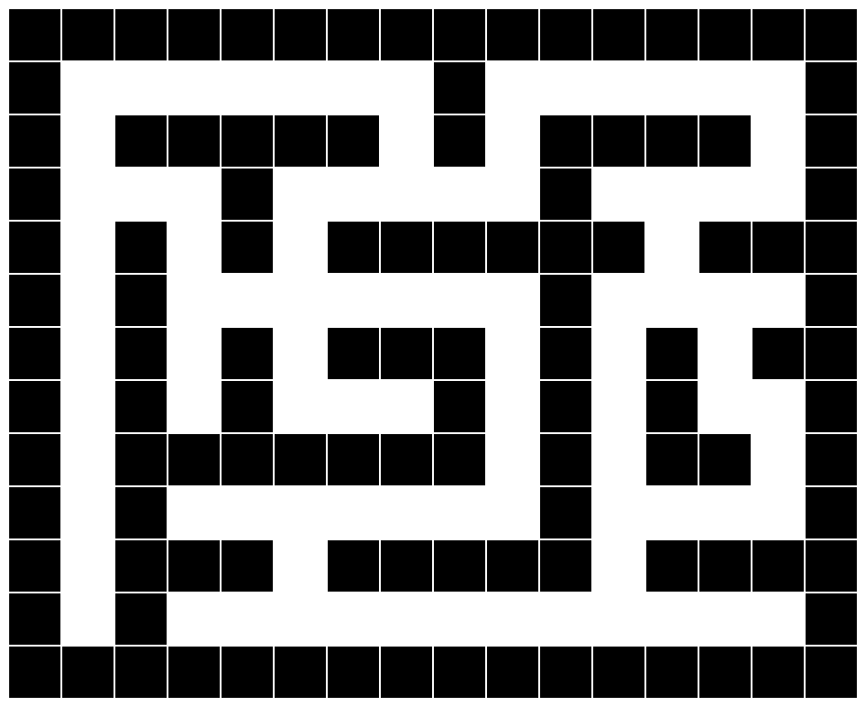
1
2
PRESS Z TO ZOOM IN
PRESS X TO ZOOM OUT
Notes:
This window will be used to edit mazes, draw mazes and select the end points.
This is the main canvas. It will draw the maze onto the screen. The size and position of the maze depends on the zoom and the scale used selected by the user. Also, the width of the walls will reflect the width of the walls in the original image. If the original wall width is narrow, the displayed width will also be narrow.
This is the information window. It can be toggled on and off (hidden and displayed) using the ‘h’ key. It is slightly transparent so that the maze can be seen behind.

