Slide 1

Capstone1
Risk Insights
For Key Node.js Libraries
Danilo Briceno
Analyzing SBOM data, OSV reports, outdated libraries, and unauthored libraries to assess risk in key Node.js open-source projects.
danbreu.com
Notes:
Open-source libraries are essential for building software today.
However, with millions of libraries available, there’s always a risk that some may be compromised.
My name is Danilo Briceno, and for my first capstone project, I analyzed the risks in key open-source Node.js projects.

Slide 2
TOPIC
Analysis of software libraries used by key open-source projects in node.js
Correlation between libraries with vulnerabilities, lacking authorship and not updated.
Identify high-risk open-source projects based on key risk indicators.
Notes:
I chose this project because software supply chain security has become a major concern for developers, especially after recent incidents with a significant global impact.
At the same time, the industry is moving toward better solutions, such as using SBOMs to identify risks early and respond more quickly.
In this project, I will analyze the libraries used by key open-source projects and look at three things:
1) vulnerabilities,
missing authorship,
, and outdated libraries.
Finally, we will show which projects pose the greatest risk using clear visuals based on key data points.

Slide 3
PROCESS &
TOOLS
Data Collection
Clone open-source projects Generate SBOM (Software Bill of Materials) Create vulnerability reports
Data Generation
Libraries: Name, version, author, license Vulnerabilities: Name, version, CVE, severity Versioning: Current vs. latest version
Data Analysis
Projects with most libraries Most-used libraries across OSS Top vulnerable libraries Projects by vulnerability & severity Risk quadrant mapping
Google Colab
Pandas
Bokeh
Python Scripts
npmjs registry
Git clone CycloneDX OSV Scanner
Github Netfliy
Notes:
The process begins with the creation of data. First, we clone the open-source projects locally and use CycloneDX to generate their Software Bill of Materials (SBOM). An SBOM functions like a nutrition label for software.
Then, we analyze the SBOM in JSON format using an OSV Scanner to identify vulnerabilities in each library used by the open-source projects.
We use Python scripts to export the JSON data into CSV format to prepare it for further analysis with pandas. Additionally, we query the npm registry to check the latest versions of the libraries. This process generates all the necessary CSV files for analysis.
During the data analysis phase, we use Google Colab and Pandas to extract key insights about the risks and libraries in use. We use Bokeh for visualization to create a graphical representation of these risks and provide a clear view of the state of open-source projects.

Slide 4
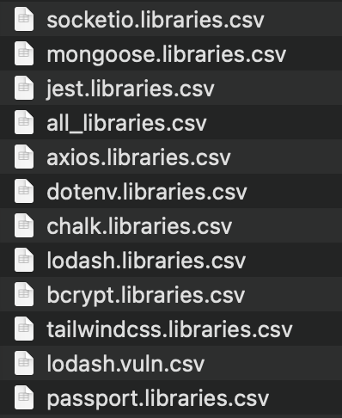
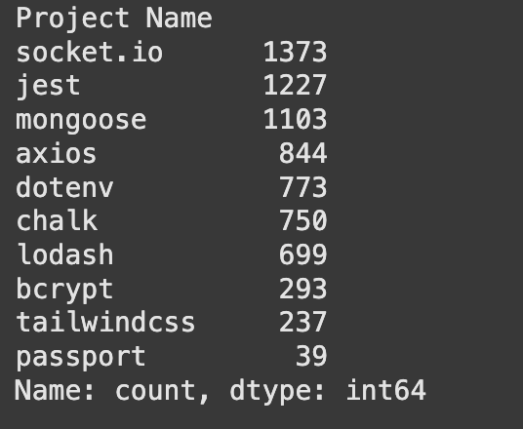
Open-Source Software (OSS) Projects
Notes:
These are the ten open-source Node.js projects we focused on for this analysis. They are very popular and get millions of downloads every day.
we created CSV files listing all the libraries each project depends on.

Slide 5
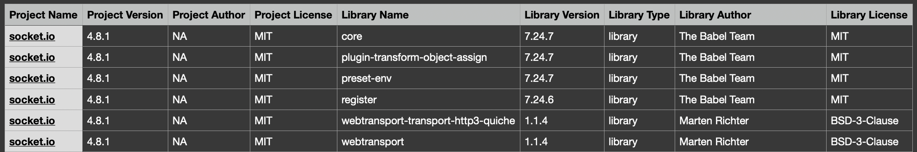
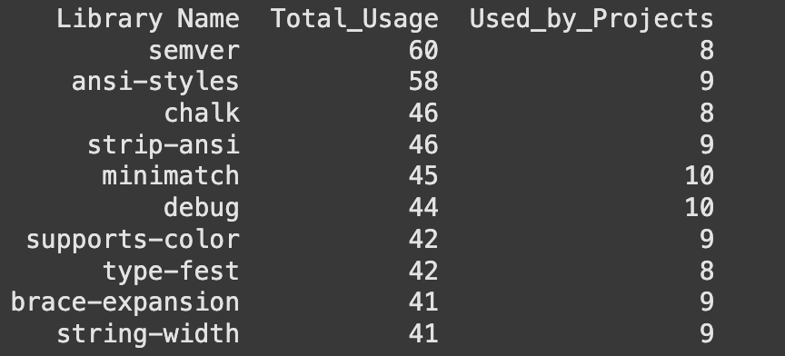
Libraries
Notes:
The CSV files contain details about the Open-Source Projects, including their version, the project author, and the license they use. For this analysis, we collected the library names along with their version, author, and license. While we could gather more information from the SBOM files, we focused on these fields for simplicity. By looking at this information, we can quickly identify which libraries are used across all ten selected open-source projects. From a security perspective, we can consider these libraries critical, since they are used in all of the projects we analyzed.

Slide 6
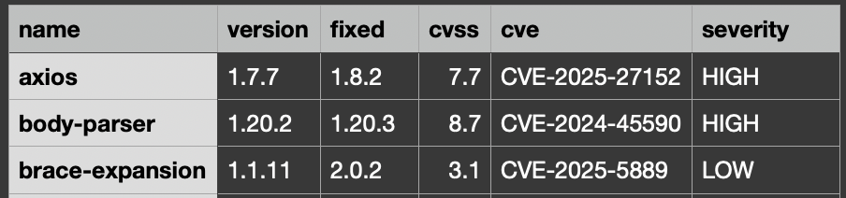
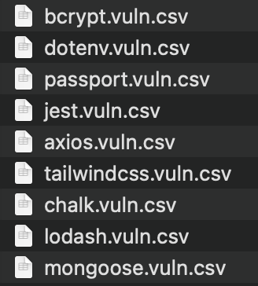
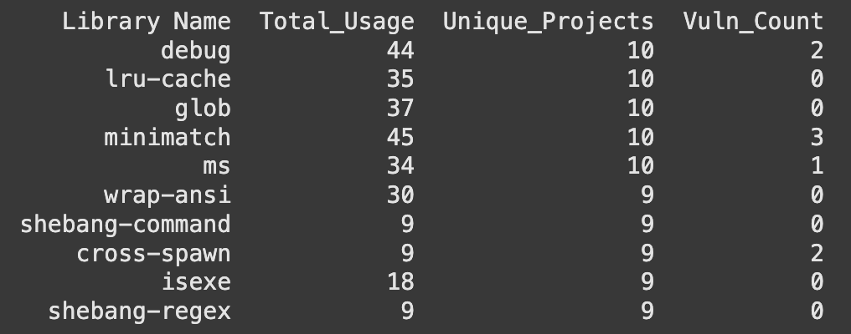
Vulnerabilities
Notes:
We use the OSV JSON reports to generate the CSV data for the vulnerability data. This data includes the file and library name, version, fixed version, CVSS score, and CVE identifier with severity.
CVSS (Common Vulnerability Scoring System) is a standardized scoring system that shows how severe a vulnerability is; higher numbers indicate more serious risks.
A CVE (Common Vulnerabilities and Exposures) identifier is a unique ID assigned to each known vulnerability so that it can be tracked consistently. This information helps us understand which libraries have security issues and how critical they are.

Slide 7
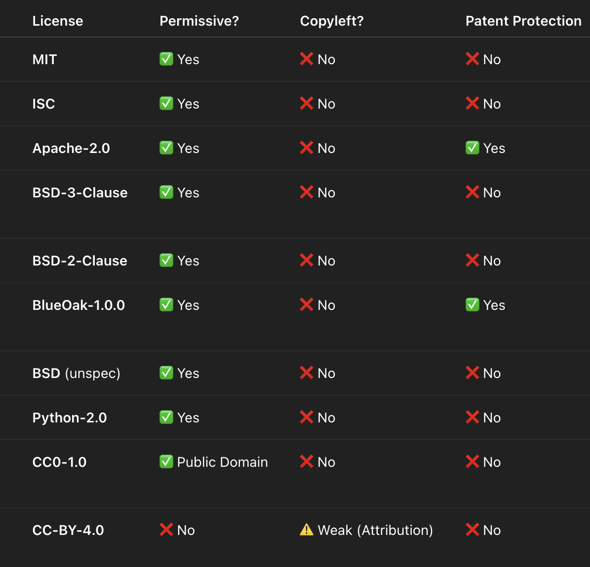
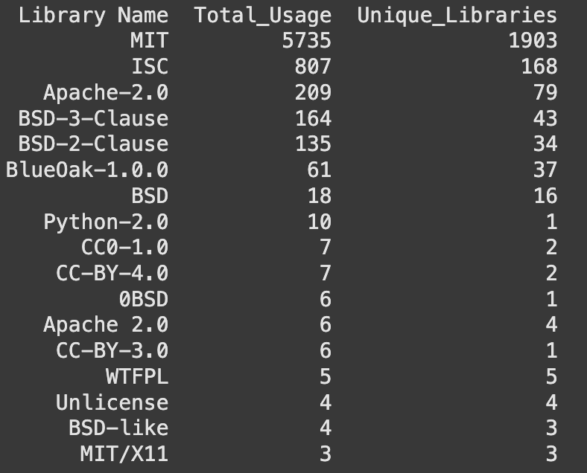
Licenses
Notes:
As mentioned before, the SBOM files allow us to see the licenses these libraries use, which is important because it helps us ensure compliance with legal requirements, understand any restrictions on how the software can be used, and assess potential risks when including these libraries in our projects.

Slide 8
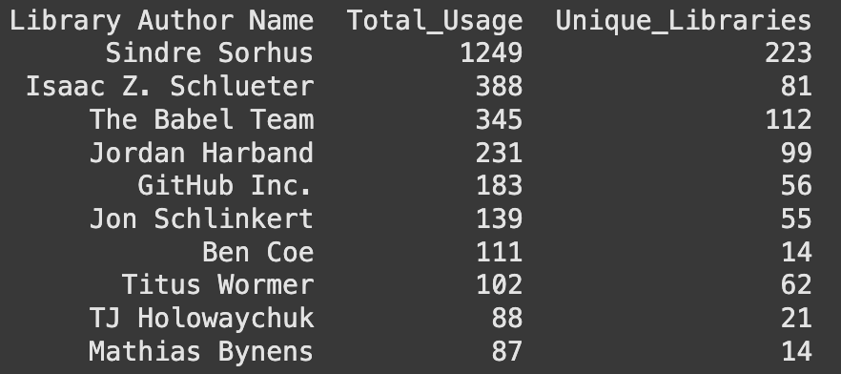
Authors
Notes:
Also, we can see who the authors of the libraries are. This is important because it tells us if the library comes from a trusted source or a well-known organization. It also shows if the main contributors are actively maintaining the library, which matters because if they stop, the library might not get updates or security fixes.

Slide 9
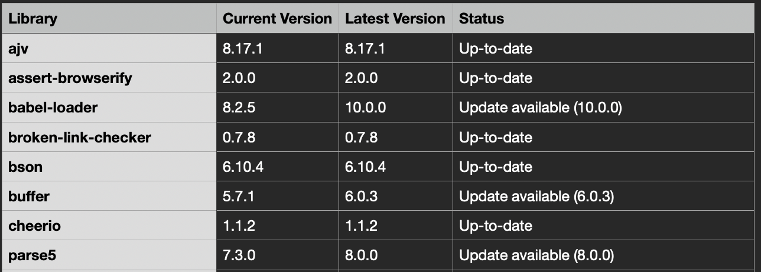

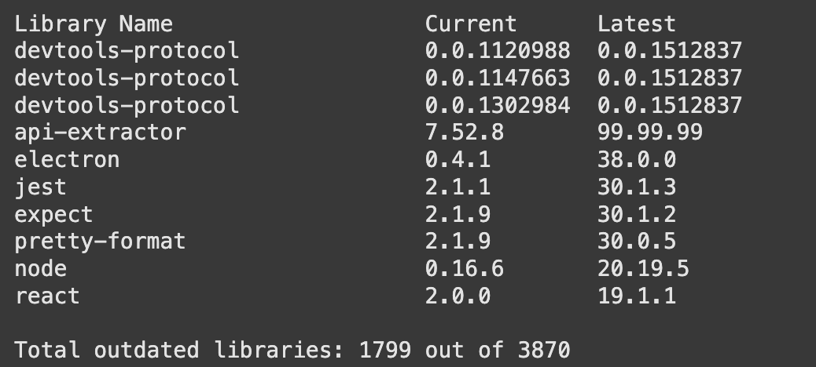
Outdated Libraries
Notes:
We use the npmjs registry to check the latest versions of the libraries used by the open-source projects. This helps us see how outdated each library is.
The file is generated using Python, and the CSV is simple—it includes the library name, the version currently used, and the latest available version.

Slide 10
RISK Assessment by OSS Project
Count of CVE (Critical, High, Moderate, Low)
Count of outdated libraries
Count of author missing
Vulnerability Score = (Critical × 20) + (High × 10) + (Moderate × 5) + (Low × 2)
Risk Score = Vulnerability Score + (Outdated Libraries × 3) + (Missing Authors × 1)
Notes:
To measure risk, I used a scoring system based on the information we collected: vulnerabilities, outdated libraries, and missing authors. As you may notice, license analysis is not included in this risk evaluation because it focuses on legal and compliance issues rather than immediate technical risk. First, we calculate a vulnerability score based on the severity of each vulnerability.
We assign 20 points for critical vulnerabilities, 10 for high, 5 for moderate, and 2 for low. Finally, the overall risk score is the sum of the vulnerability score, points for outdated libraries, and points for missing authors. Each category contributes to the total score, giving us a clear view of which projects may have the highest risk and need the most attention.

Slide 11
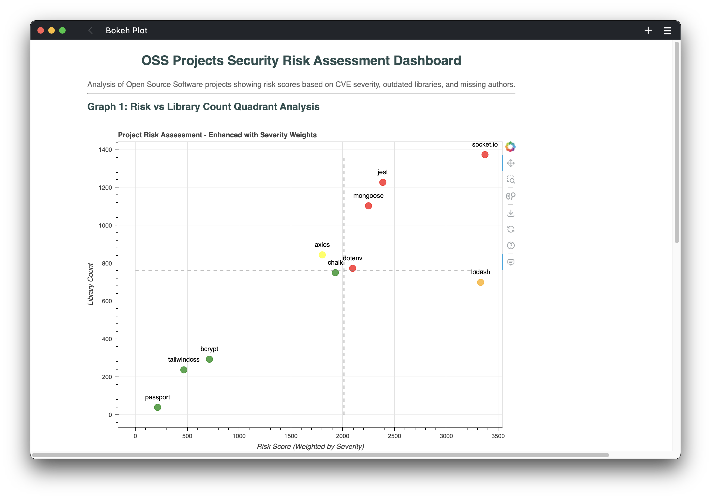

Demo
https://github.com/dan-breu/oss-nodejs-risk https://oss-nodejs-risk.netlify.app/
Notes:
Ok, let’s move on to the demo. All this information is available in the GitHub repository and also on our website hosted on Netlify. Show github
Show Colab
First, let’s look at the Google Colab notebook. Here, you can see how we import the files. I’m using a wildcard to import everything with names ending in libraries.csv and .vuln.csv.
Once the files are loaded, we can run queries to analyze the data and create visualizations, such as the most-used libraries or projects with vulnerabilities by severity.
Here is the code that checks the current and latest version of each library and creates a new CSV file.
Finally, I created two graphs and exported them to an HTML file to load on Netlify for better visualization.
Show netlify
In this graph, you can see the count of libraries versus the risk score. As expected, a project with more libraries usually has a higher risk. But it also helps us identify the riskiest projects. To dive a little deeper, we created a bar chart showing in detail the challenges each open-source project faces in terms of CVEs, outdated libraries, and missing authors.

Slide 12
Conclusion
One library can depend on many others, and this can quickly grow into hundreds of libraries in open-source projects. SBOM reports helps us react quickly to software supply chain attacks and give important about open-source software.
Open-source projects often share libraries, authors, and licenses, which can increase risk. Using multiple package managers makes it even harder to track and manage
these risks.
Socket.io and Lodash are open-source projects with higher risk scores. This is expected, as the risk grows with the number of libraries they use. Understanding the metrics that drive these risk scores is important so that proper measures can be taken to prevent potential security issues
Debug, minimatch, and ms are libraries with known vulnerabilities that are used by all of the selected open-source projects. Analyzing these patterns helps us make better decisions and respond proactively.

Slide 13

Thank You
danbreu.com

