Slide 1
Cancer Rates and Possible Correlations
Alfonso Moreno
Dan Brueckman
Deric Patton
Heather Solis

Slide 2
Outline
Analyzed cancer incidence and mortality rates for each state
All cancer types
Men and women combined
All races
Annual rates from 1999-2014
Looked for correlations
Health related qualify of life
Developed by the Center for Disease Control defined as a group’s perceived physical and mental health over time
Income per capita
with male vs female sub-analysis
Nutrition, exercise, and obesity

Slide 3
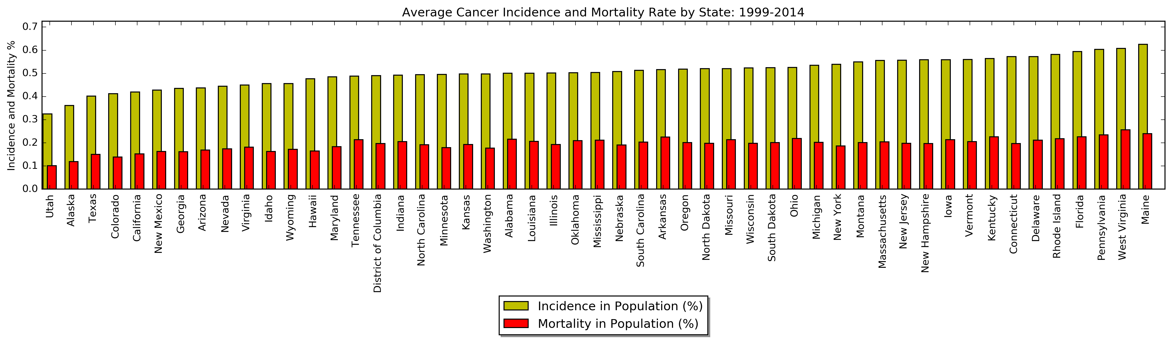
Average Cancer Incidence and Mortality Rates by State from 1999-2014

Slide 4
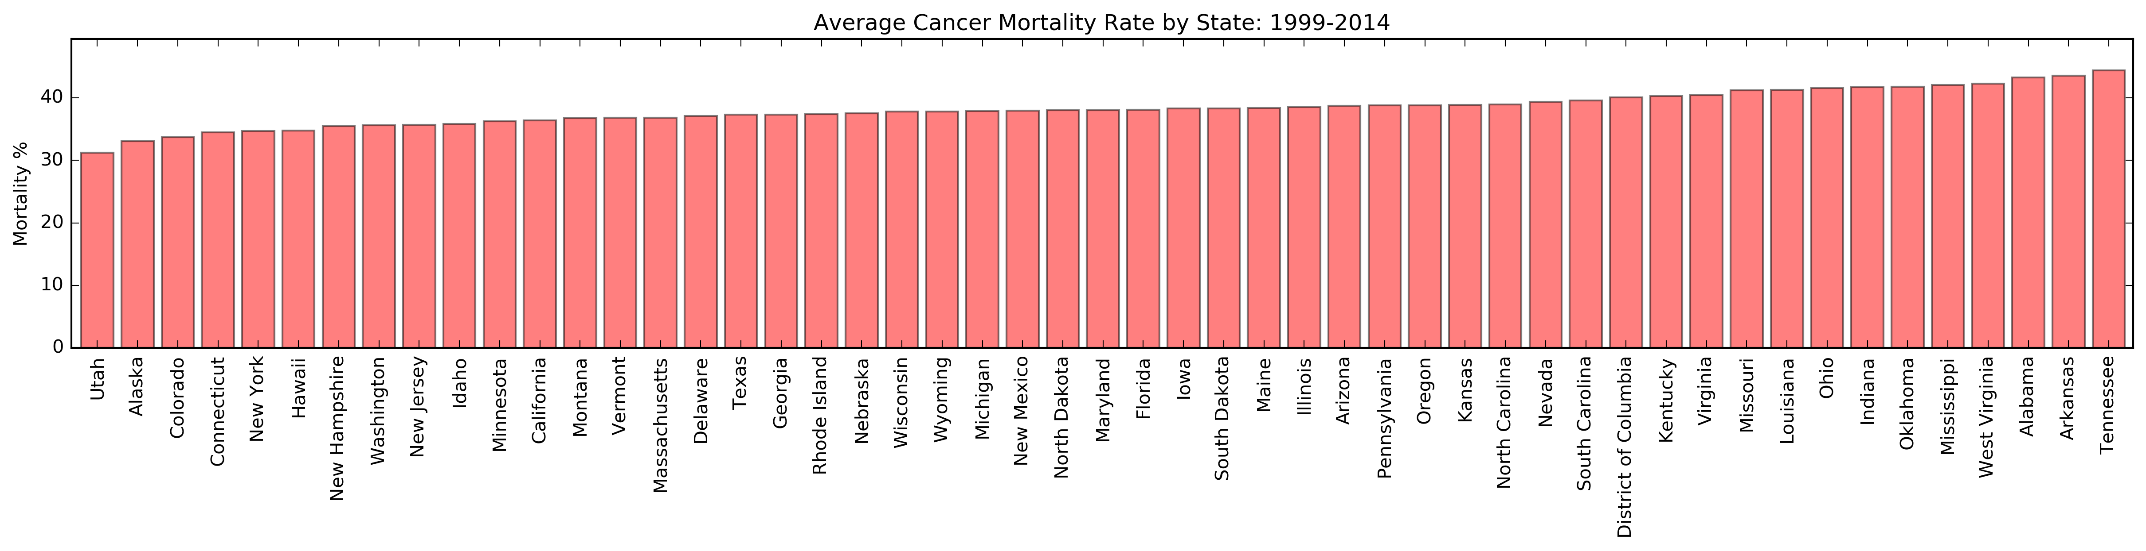
Average Cancer Mortality Rates by State from 1999-2014

Slide 5

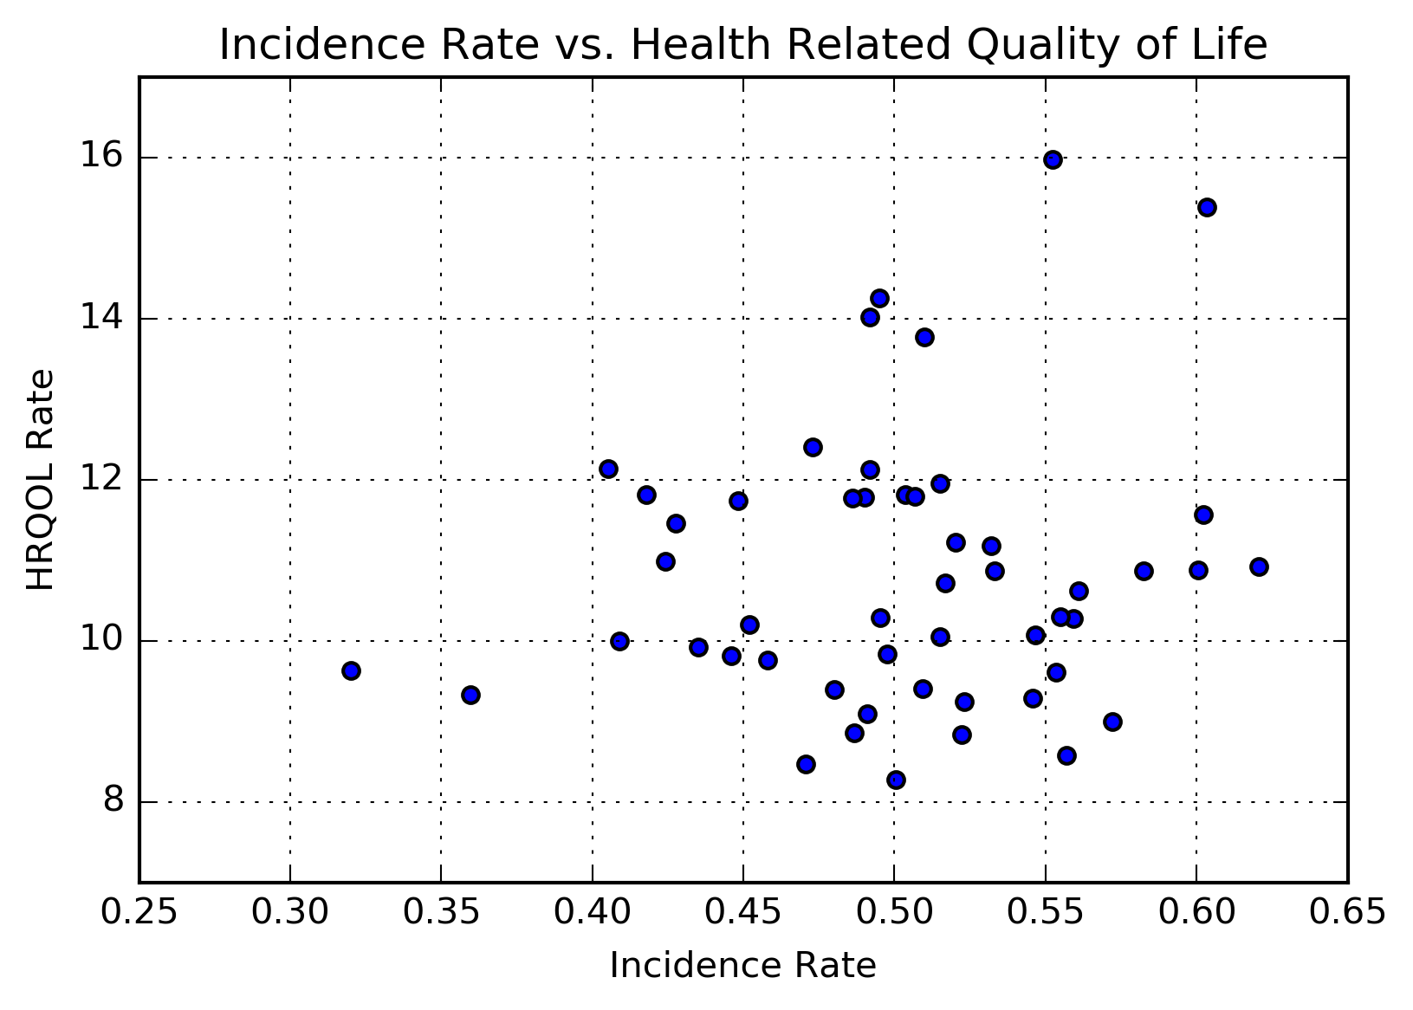
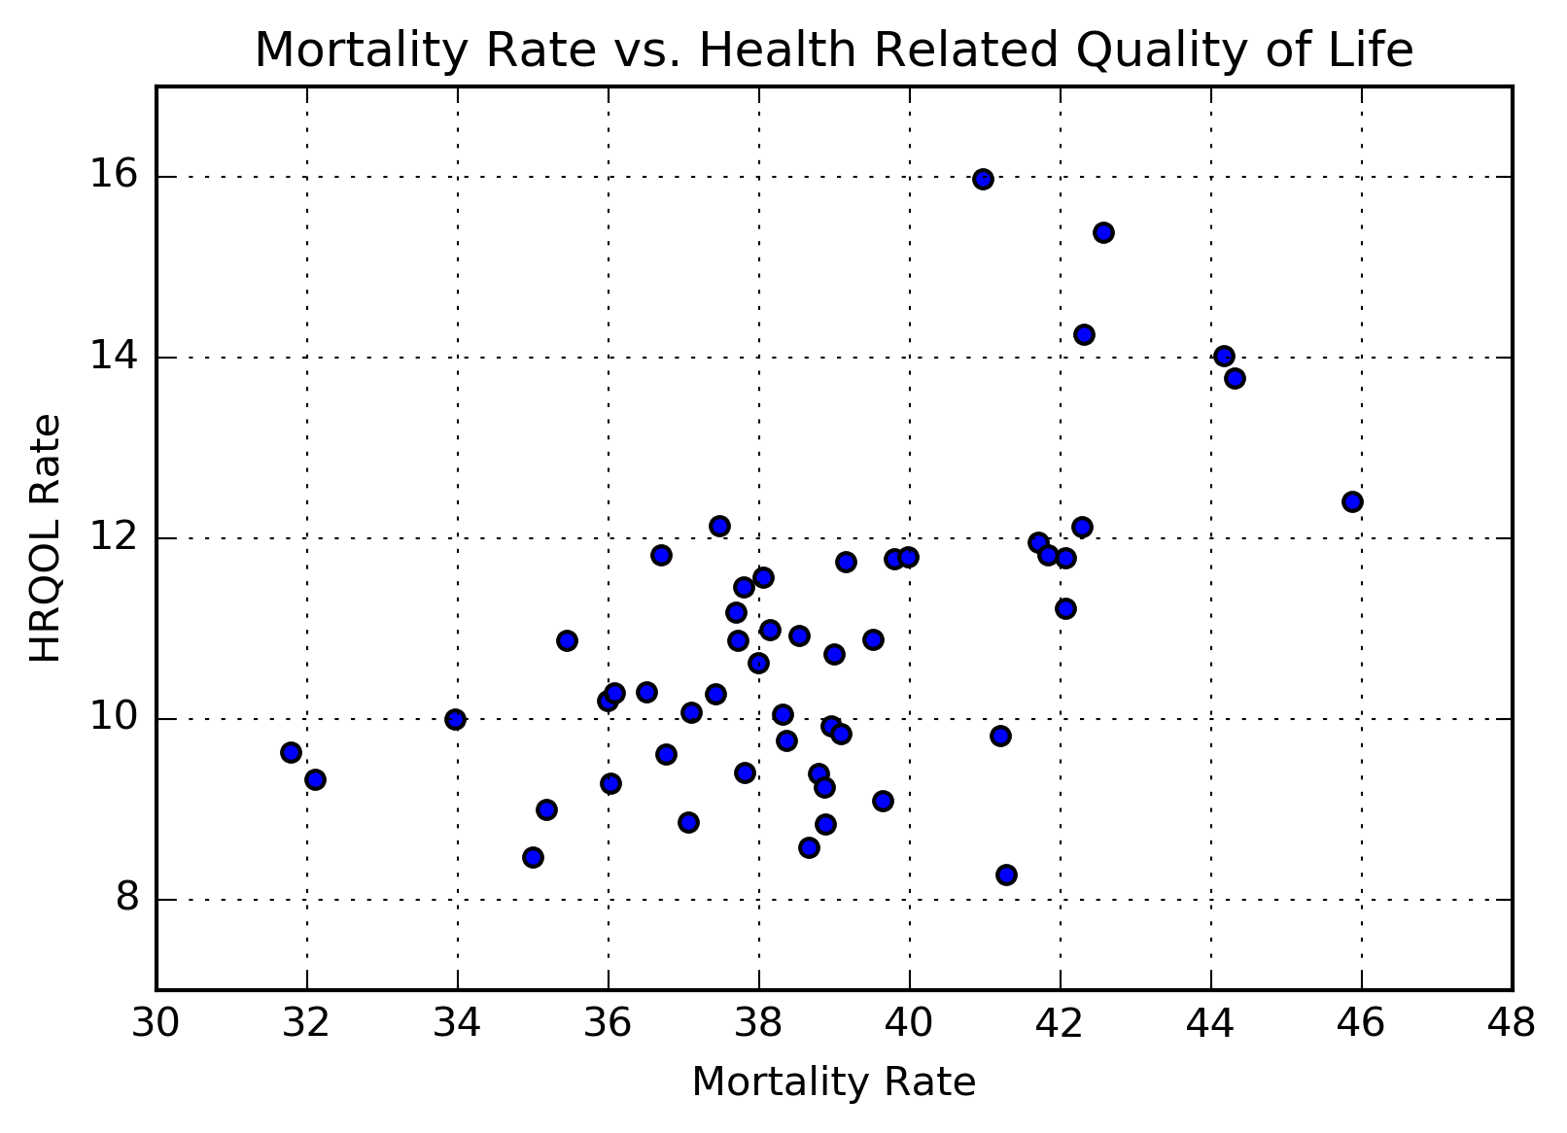
Cancer Rates vs. HRQOL Data from 1990-2010

Slide 6
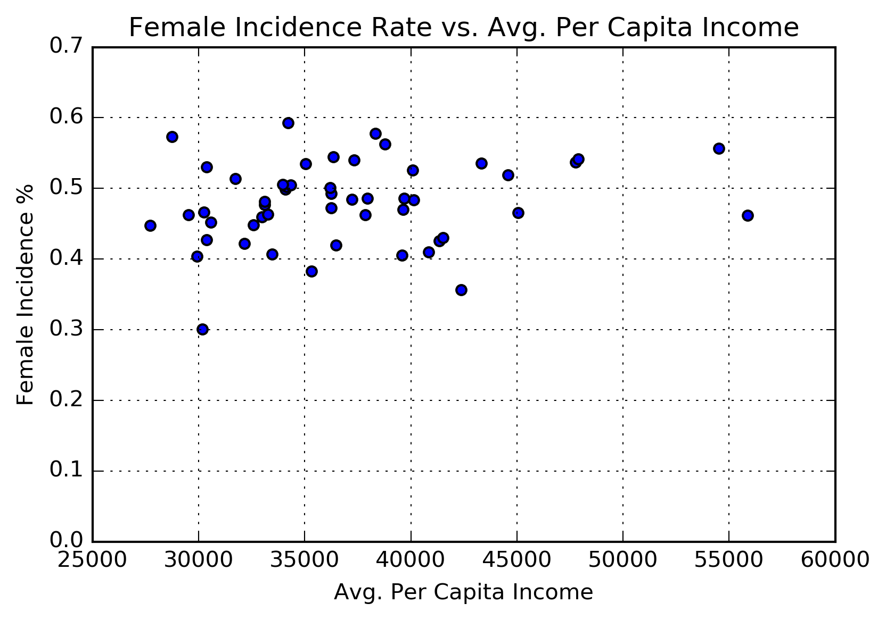
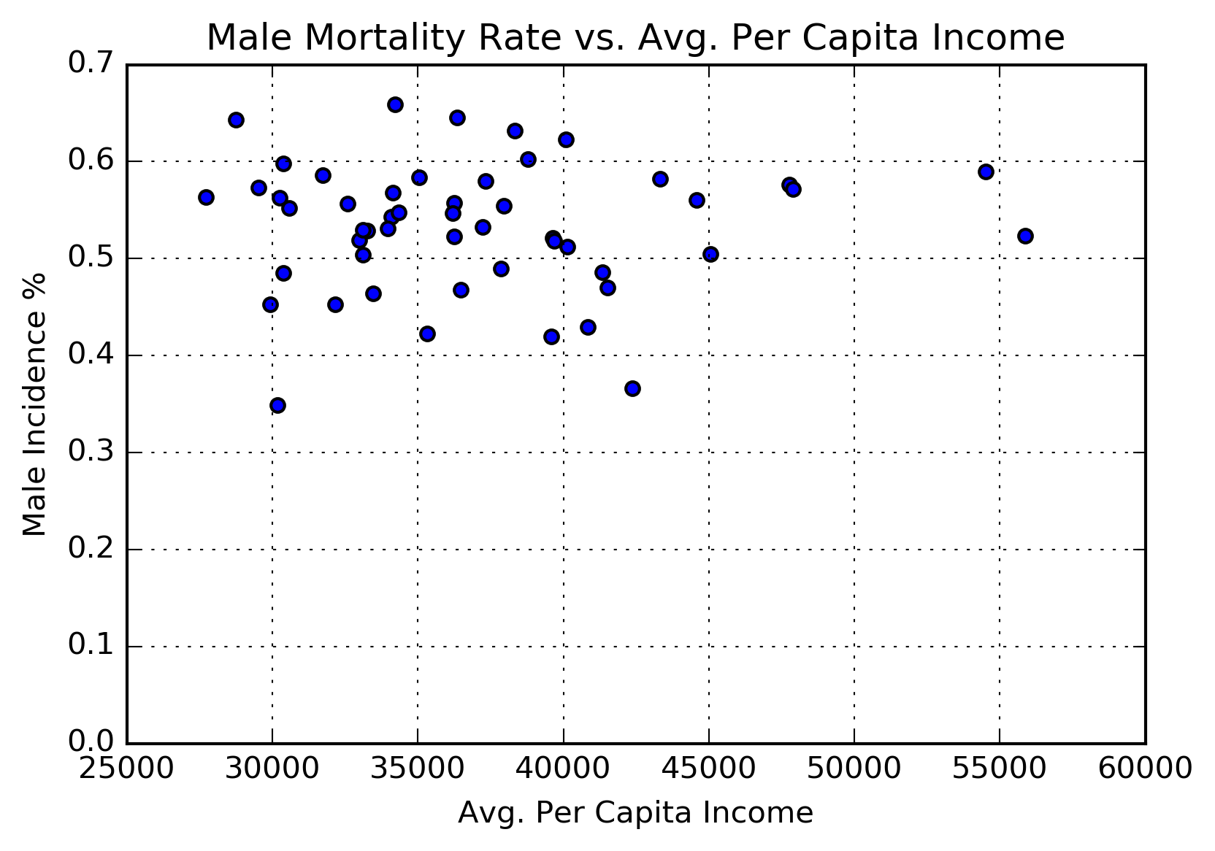
Cancer Incidence Rates vs. Per-capita income Income averaged over 1990-2016
Women
Men

Slide 7
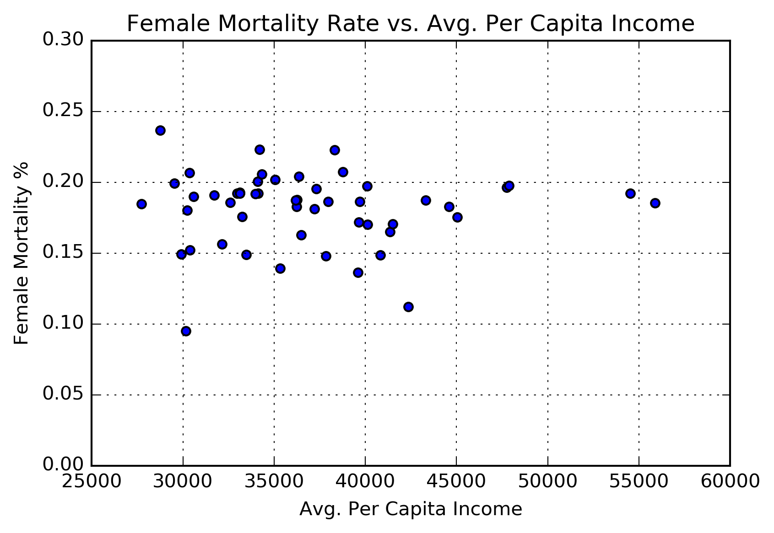
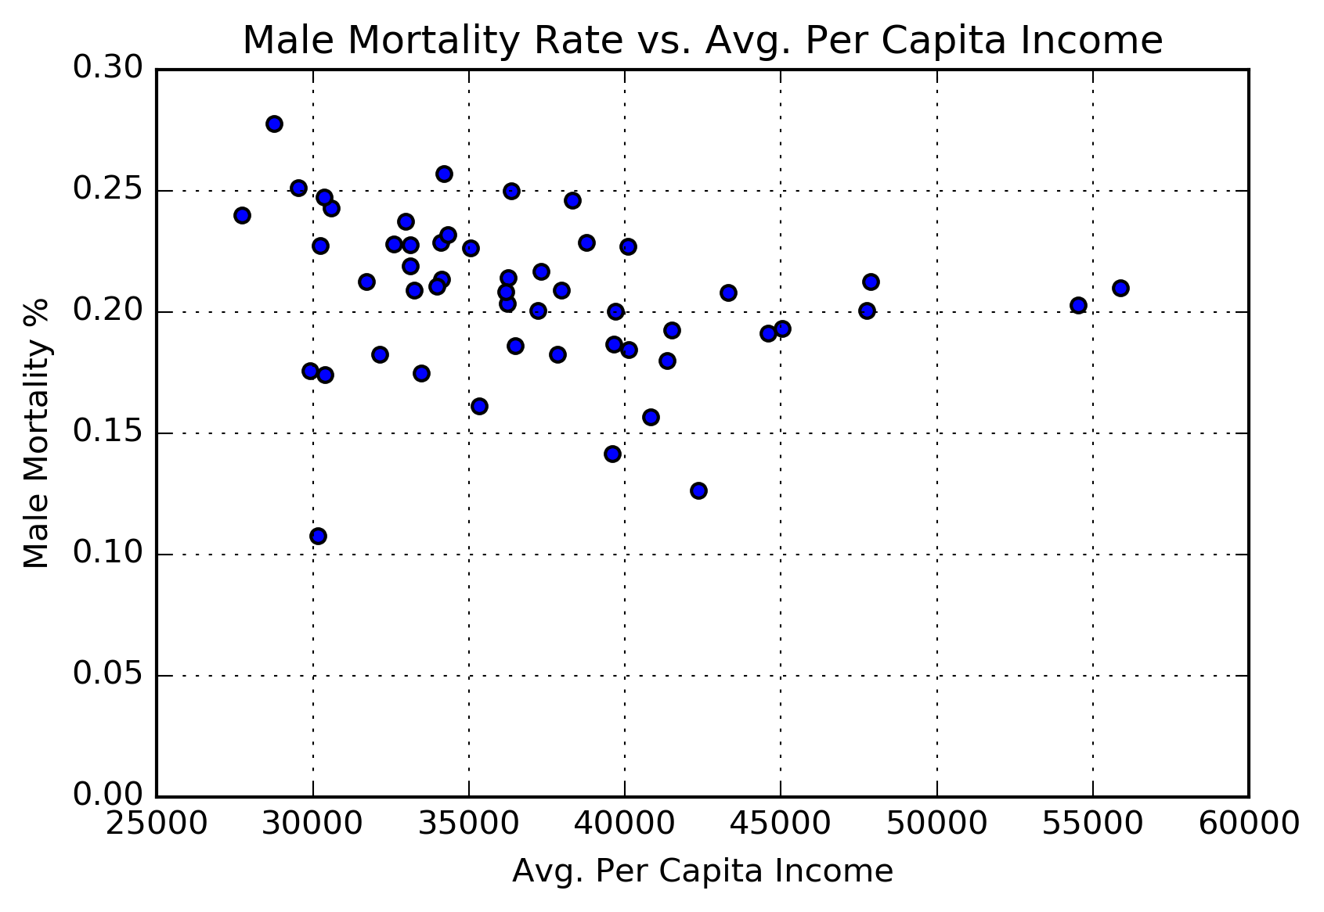
Cancer Mortality Rates vs. Per-capita income Income averaged over 1990-2016
Women
Men

