Slide 1
Cancer’s Contributors … Possibly
Alfonso Moreno • Dan Brueckman • Deric Patton • Heather Solis

Slide 2
The Question
Is there a difference in incidences of cancer and cancer mortality rates across the United States?
If so, what are some of the factors that contribute to this disparity?

Slide 3
Agenda
Total cancer incidence and mortality
Cancer and HQRL (Health Related Quality of Life)
Cancer and Income
Cancer and Health
Conclusions

Slide 4
Cancer Across America
Based on CDC data from 1999 to 2014
Focus on all cancers, all demographics
Data is averaged over the given time period
Incidences will be shown as a percentage of the population
Mortality will be shown as number of cancer deaths over number of incidences

Slide 5
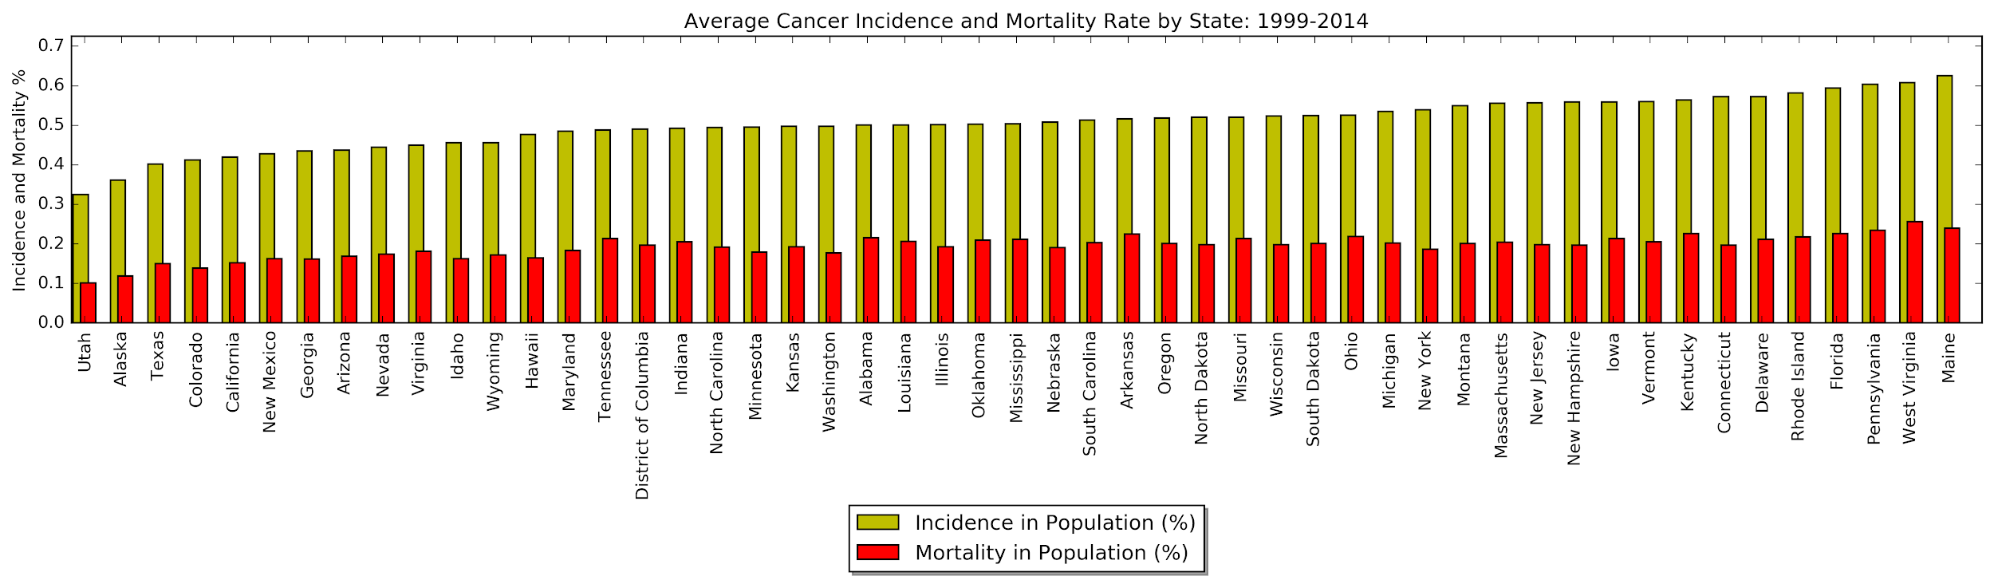
Incidence and Mortality

Slide 6
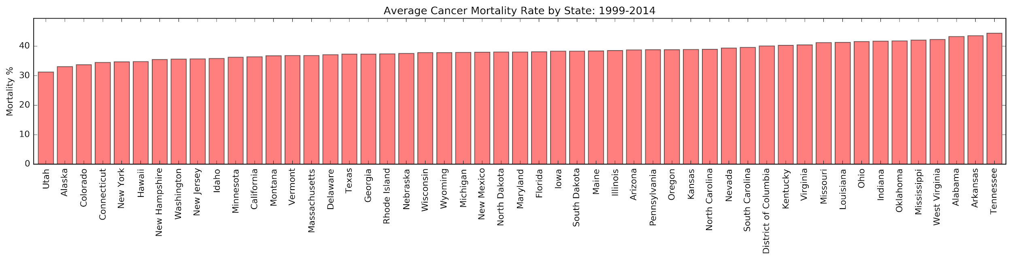
Mortality Rate

Slide 7
Does Per Capita-Income have an impact on cancer incidences or mortality rates?

Slide 8
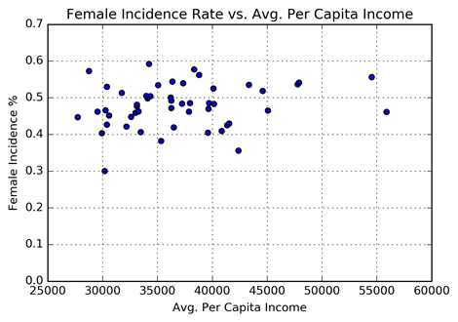
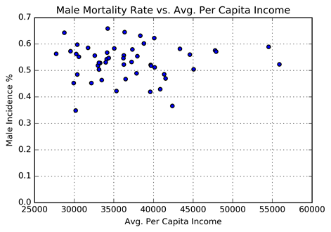
Cancer Incidence Rates vs. Per-capita Income Income averaged over 1990-2016
Women
Men

Slide 9
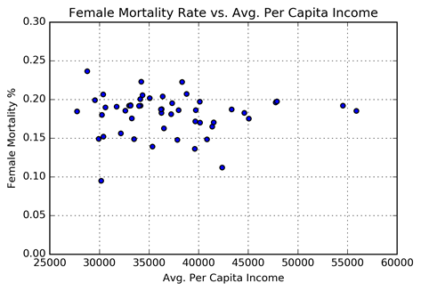
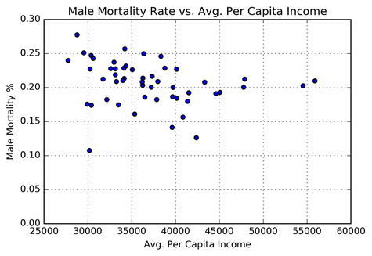
Cancer Mortality Rates vs. Per-capita Income Income averaged over 1990-2016
Women
Men

Slide 10
Does an individual’s Health Related Quality of Life have an impact on cancer incidences or mortality rates?

Slide 11
Health Related Quality of Life
“HRQOL” encompasses aspects of overall quality of life that can clearly show to affect health—either physical or mental.
Developed by the Center for Disease Control in order for states and communities to measure HRQOL.
Defined HRQOL as “an individual’s or group’s perceived physical and mental health over time.”

Slide 12
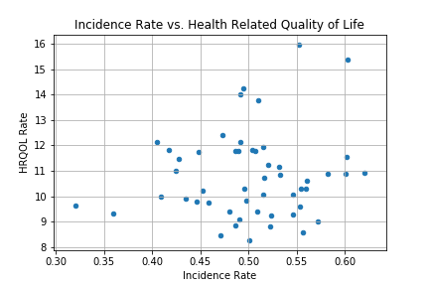
Incidence Rate vs. HRQOL
Data represents recorded cancer incidence rates and HRQOL from 1999 – 2010 for each state.
Points represent the interception of the average HRQOL rate and average incident rate of the population for each state.
There does not seem to be a correlation between HRQOL and cancer incidence rates.

Slide 13
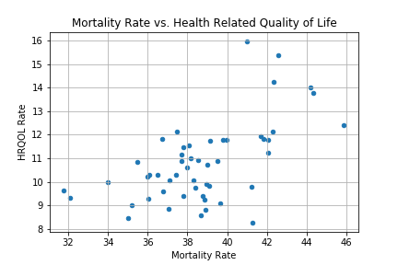
Mortality Rate vs. HRQOL
Data represents recorded cancer mortality rates and HRQOL from 1999 – 2010 for each state.
Points represent the interception of the average HRQOL rate and average mortality rate of the population for each state.
It appears that there is a slight correlation between HRQOL and cancer incidence rates.

Slide 14
Lifestyle Effects on Cancer
Centers for Disease Control and Prevention “Nutrition, Physical Activity, and Obesity - Behavioral Risk Factor Surveillance System”
This dataset includes data on:
Adult's diet
Physical activity
Weight status
Source: Behavioral Risk Factor Surveillance System. 2011-2014

Slide 15
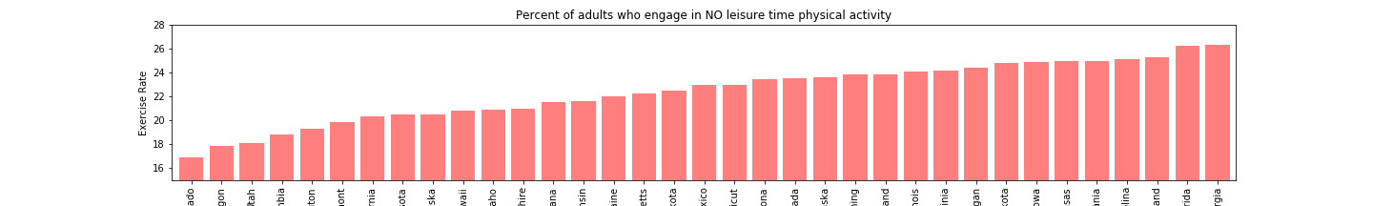
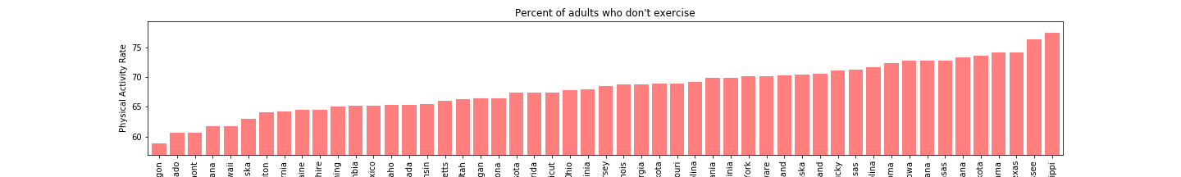
Lifestyle Effects on Cancer - Exercise
Most Active States: Oregon, Colorado, Utah
Least Active States: Mississippi, Tennessee, Alabama

Slide 16
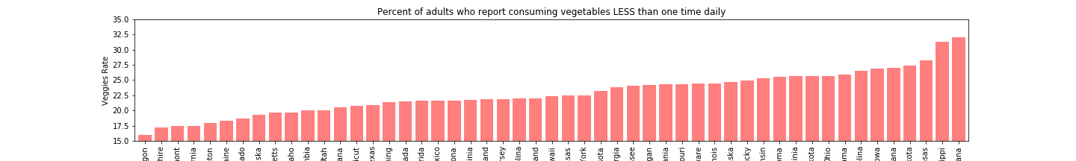
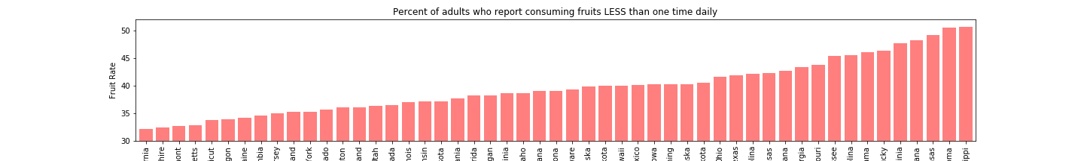
Lifestyle Effects on Cancer - Diet
Healthiest Diet: California, Oregon, New Hampshire, Vermont
Least Healthy Diet: Mississippi, Oklahoma, Louisiana

Slide 17
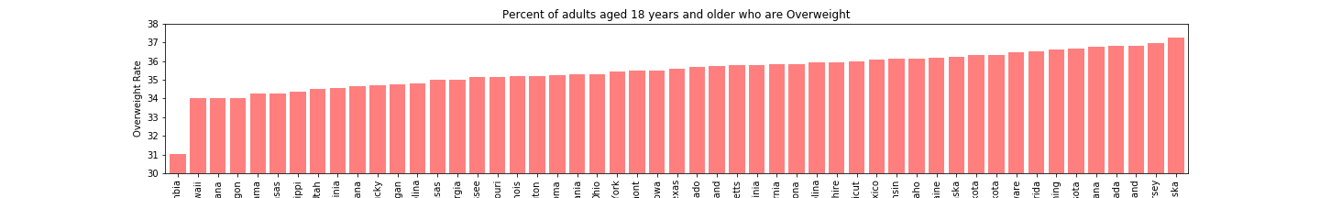
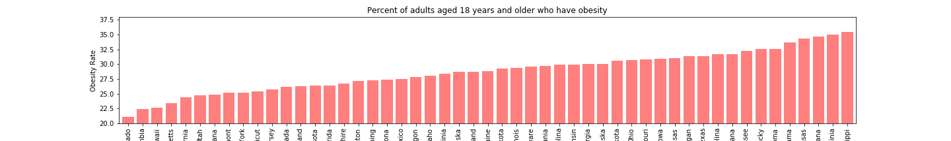
Lifestyle Effects on Cancer - Weight Status
Least Obese/Overweight: DC, Hawaii, Colorado
Most Obese/Overweight: Mississippi, West Virginia, Louisiana

Slide 18
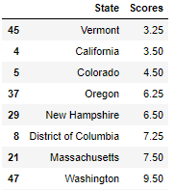
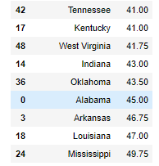
Health Index
Health Index would create a ranking of states according to all these lifestyle factors.
Top States Bottom States

Slide 19
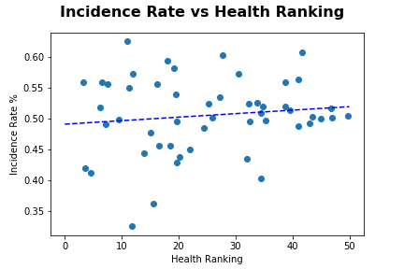
Health Index vs Cancer Incidence

Slide 20
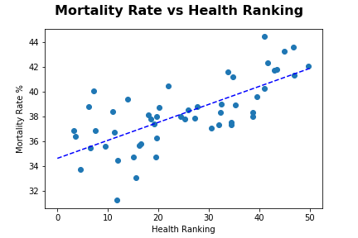
Health Index vs Cancer Mortality
Correlation is clearly shown between lifestyle and mortality rates

Slide 21
Conclusions
Cancer
HRQL
Income
Health
Final

