Slide 1

STAT 651 XC Rankings
Daniel Burkhalter

Slide 2

Goal: Rank South Dakota High School XC Runners based on Head-to-head comparisons
There were 112 XC Races in SD for the Fall of 2023
We obtained 46 Data Sources from Coaches from across the State
Data formats of .pdf, .xlsx, snail mail, & .txt

Slide 3
Three Key Datasets in Ranking Procedure
School | School ID
Alcester-Hudson | 1
Baltic | 2
Beresford | 3
Bon Homme | 4
Burke | 5
Canistota | 6
Canton | 7
Centerville | 8
Dakota Valley | 9
… | …
Name | ID | School ID
Owen Janiszeski | 1 | 17
Joe Cross | 2 | 9
Jack Brown | 3 | 9
Levi Vander Leest | 4 | 22
Alex Oberloh | 5 | 22
Ryan Fick | 6 | 22
Benjamin Strunk | 7 | 26
Tavin Schroeder | 8 | 14
Jonathon Roth | 9 | 26
Name | ID | School ID | Points
Owen Janiszeski | 1 | 17 | 1000
Joe Cross | 2 | 9 | 1000
Jack Brown | 3 | 9 | 1000
Levi Vander Leest | 4 | 22 | 1000
Alex Oberloh | 5 | 22 | 1000
Ryan Fick | 6 | 22 | 1000
Benjamin Strunk | 7 | 26 | 1000
Tavin Schroeder | 8 | 14 | 1000
Jonathon Roth | 9 | 26 | 1000
School Dataset
Name Dataset
Points Dataset

Slide 4
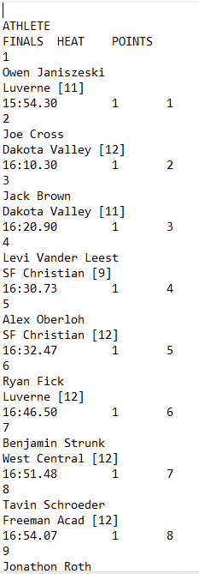

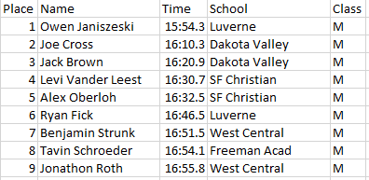
Data Formatting For Dakota Timing
txt_to_csv()

Slide 5
Are we ready for an Example?

Slide 6

Beresford XC Meet
Read in Results (see right table)
Schools that aren’t already in the School Database are assigned a School ID
Athletes that haven’t yet competed are assigned an ID (and a School ID) with 1000 points
$x=99$ Athletes competed
$n=\frac{\left(x−1\right)∗x}{2}=4851$ head-to-head comparisons
Each athlete places 5% of their points on the line for each comparison

Slide 7
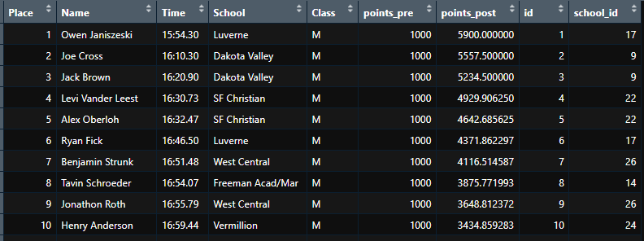
Ranking After Beresford XC Race

Slide 8
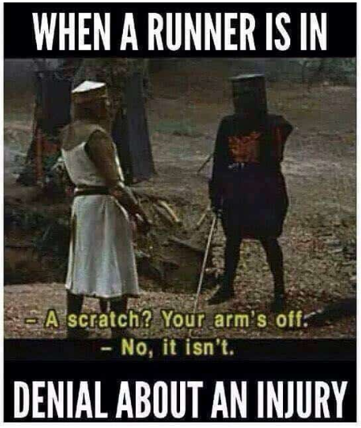
Everyone Trains for another week
MONTY PYTHON & THE HOLY GRAIL

Slide 9
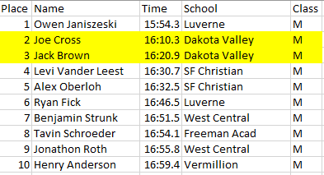
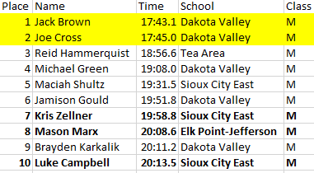
Why Times are Generally Considered a Poor Ranking Method
Beresford XC
Dakota Valley XC

Slide 10
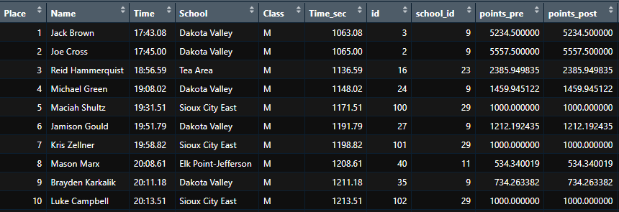
Dakota Valley XC
(before Ranking Algorithm)

Slide 11
Compiled Rankings after Week 2

Slide 12
Did It Work?

Slide 13
Scored 13 Meets Attended by Schools in Region 3A
Goal is to predict finish place at Region 3A XC Meet

Slide 14
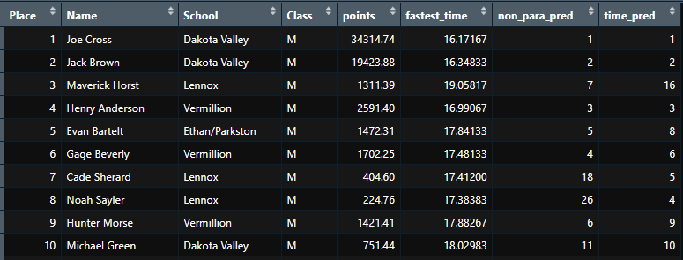
Region 3A Results
65 Runners for Region 3A
Points method predicts on average within 10 places of finishing
Time method predicts on average within 5 places of finishing
Times throughout the season appear to be a better predictor in race finishes than the Points Method

Slide 15
Potential Drawbacks of Points Method
More racing causes an above average individual to garner more points than an individual with fewer races
Schools that raced fewer times (within the 13 races) may be underrepresented in magnitude of points
The ratio of points sacrificed impacts the sensitivity of wins/losses
Although not perfect, time may be the best rank ordering method available
Could consider GPA as an example of non-perfect ranking method
A complete ranking system using all SD meets to predict finish at the State XC meet could yield different results due to equal representation from schools

Slide 16
Questions?

Slide 17
Next Steps
Rank Region 3A Runners Based on More XC Meets
Compare Time Ranking to ELO Ranking
Shiny App?

