Slide 1
Panel parter
R1 | Relay NC c5vdc→220vac (+manual)
R2 | Relay NC c5vdc→220vac (+manual)
R3 | Relay NC c220vav->220vac
C1 | Contactor 2P NO 16A 220vac
C2 | Contactor 2P NO 12A 220vac
C3 | Contactor 2P NO 9A 220vac
PWM | Variable current source
UPS | 12A input, 10A output
16A | fuse
L1 | L2 | L3 | N | G | grid
NC | R1
L1 | L2 | L3 | N | G | meter
L1 | N | C1
16A | dif
L1 | N | parter (high)
L1 | L2 | L3 | N | G | bucatarie
16A | dif
L2 | L3 | G | 3 phase beci
Panel beci
L1 | N
NC | R2
L1 | N | etaj
L123 | N | C4
L1 | N | pod
PWM
L1 | N | microgrid
L1 | N | microgrid
L1 | N | C2
L1 | N | lights parter
L1 | N | extra load
L1 | N | ups
L1 | N | parter(low)
10A | fuse
L1 | N | critical loads
Panel pod
Rack
 |  | CPU
10A | dif
L1 | N | microgrid
 |  | ECU
NC | R3
L1 | N | C3
L1 | N | solar
L1 | N | critical loads

Slide 2
Loads

Slide 3
Grid
Panels
L1 N
Large loads
L1
L2
L3
N
breaker relay
Critical loads
L1
L2
L3
N
Small loads
UPS
opener relay
extra load
breaker relay
ECU
CPU

Slide 4
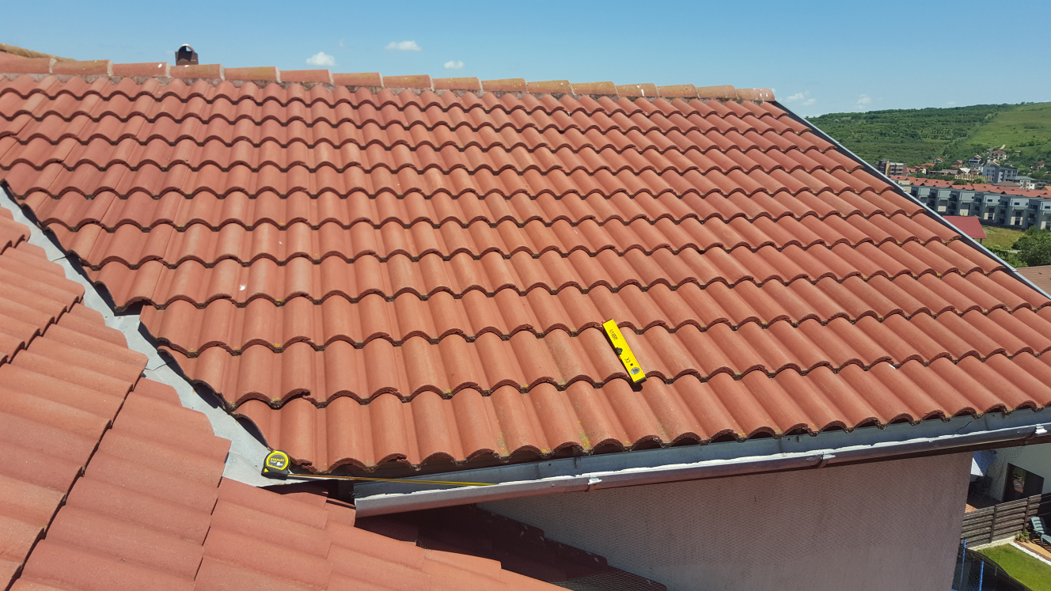
3.6m
3.7m

