Slide 1
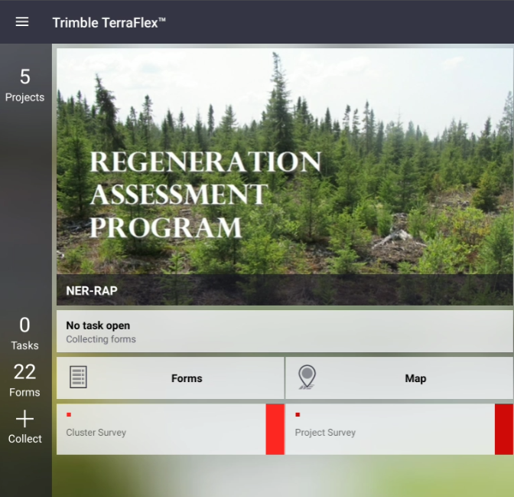
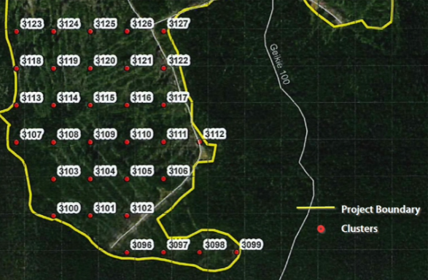
BEFORE GOING TO THE FIELD
Check the battery level of your Tablet
Make sure you can log in to Terraflex app
Make sure you can open RAP project
Prepare a map + GPS or a geoPDF map pin-pointing where each of the clusters are.
WHEN YOU ARE IN THE FIELD
Make sure the GPS is on
At the project location, open Terraflex – RAP project. Fill out the Project Survey form
Go to the cluster you need to survey
When you are at the plot 1 of the cluster, open Terraflex and fill out the Cluster Survey form. Use this form to survey plot 1 to 8.
Repeat 3 and 4
Make sure you can get to this screen before you head out !!!

Slide 2
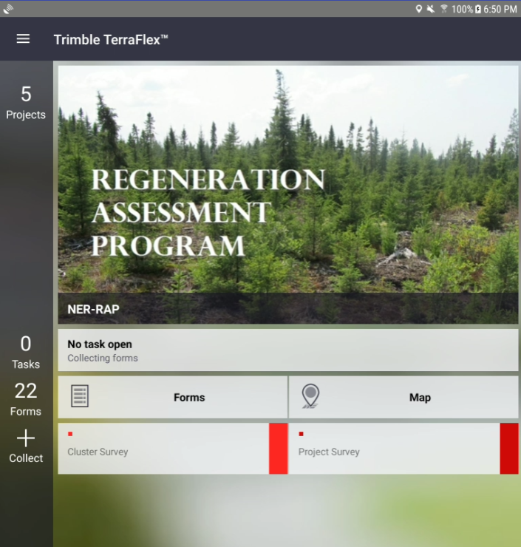
If your screen doesn’t look like this, you are probably in the wrong project. Tap “Projects” to switch to the RAP project.
Make sure your GPS signal is on!!
Tap Forms to view or edit previously collected forms
Tap Project Survey to open project survey form
Tap Cluster Survey to open cluster survey form
Terraflex’s Map is useless without wifi connection. One thing you could do is to look at your position relative to your previous survey points.

Slide 3
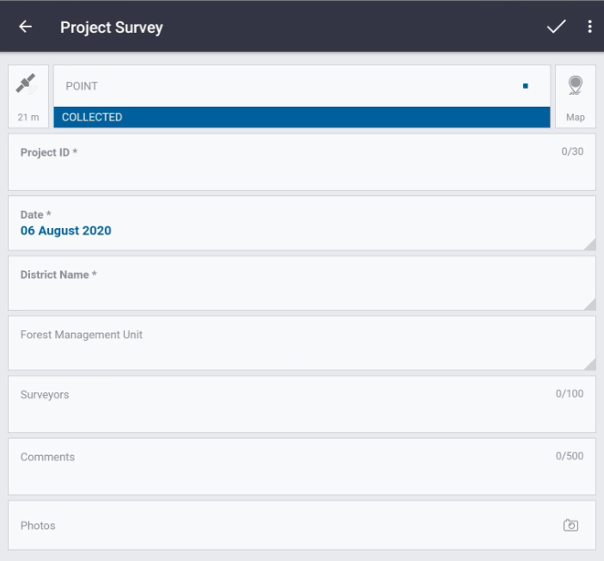

PROJECT SURVEY FORM
Project survey form should be filled out only once per project (not per trip)
When you are done, tap on the checkmark
Asterisk * indicates mandatory field
GPS point
Make sure it says “COLLECTED”
If not, turn on your GPS
Project ID
MUST match the Project ID of the project
Date
Auto-filled with today’s date
District Name
Name of your district
Forest Management Unit
Name of the forest management unit
Surveyors
Names of the field crew
Comments
Comments on the project location
Photos
Photos of the project location.

Slide 4
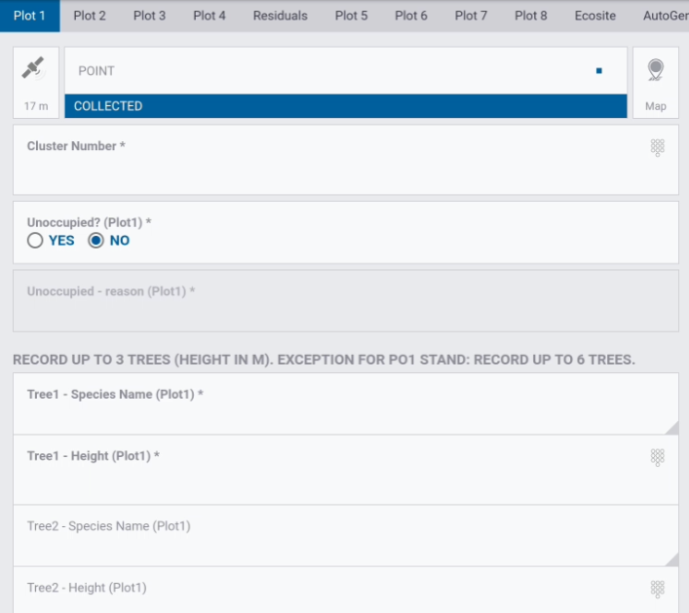

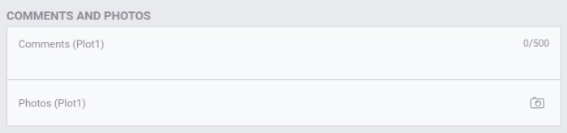
CLUSTER SURVEY FORM (1 of 2)
Consists of multiple pages.
Scroll left and right to move through pages. Currently we are on Plot #1
Asterisk * indicates mandatory field
GPS point
Make sure it says “COLLECTED”
If not, turn on your GPS
Cluster Number
MUST match the Cluster ID on your map.
Unoccupied
“No” if this plot has at least one regeneration tree. In this case you must record at least one tree and its height.
“Yes” if this plot has no regeneration tree. In this case you must specify why it’s unoccupied in the following field.
TreeX – Species Name/Height
Record the species name and the height on up to 3 trees (up to 6 trees on a poplar stand). For multiple trees of the same species, write them separately in tree1, tree2 etc.
Note that only the two tallest trees will be counted for the SPCOMP, but all trees will be counted for effective density.
Don’t survey trees that don’t meet the minimum height requirement.
If you made a mistake and need to delete a tree species, choose “Other” and leave the field empty.
When you are done,
swipe left to go to the next plot
Comments and Photos
An optional field to make note/photo of anything unusual.

Slide 5
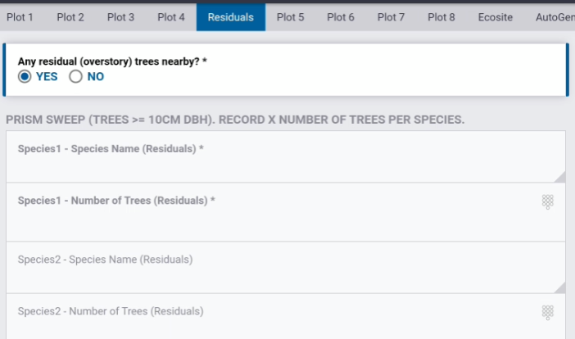

CLUSTER SURVEY FORM (2 of 2)
Any residual (overstory) trees nearby?
Right after you finish plot 4, do a prism sweep to see if there are any residual (>= 10cm DBH) trees nearby.
If “Yes”, fill out at least one residual tree.
If “No”, move on to next plot.
When you are done,
Tap here to go to the next plot (or swipe works just as well)
SpeciesX – Species Name and Number of Trees
On your prism sweep, if you found 3 Bw and 2 Bf, then fill out as follows:
Species1- Species Name: BW
Species1- Number of Trees: 3
Species2- Species Name: BF
Species2- Number of Trees: 2

Slide 6
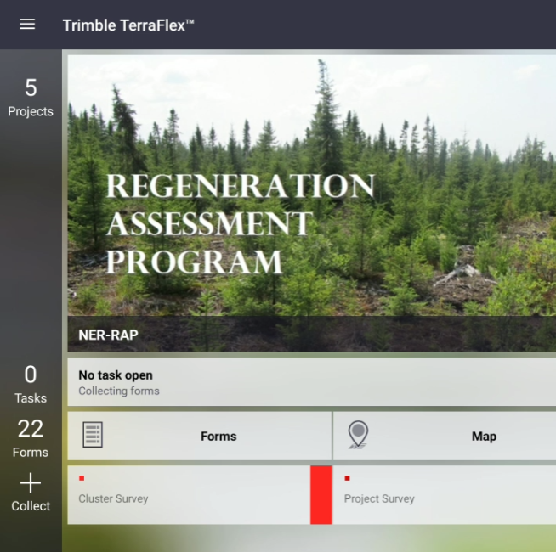
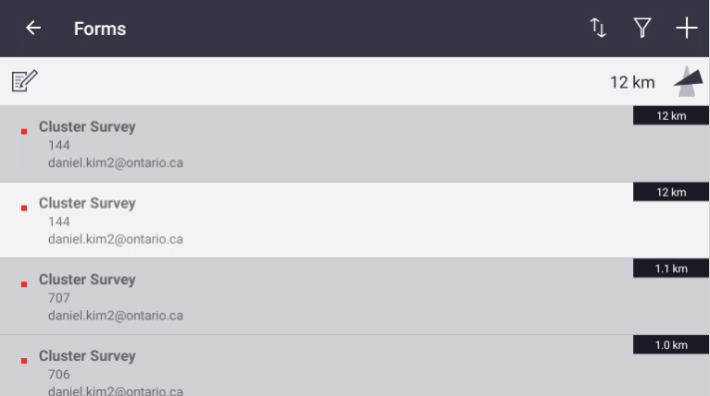
HOW TO GO BACK AND EDIT
3
2
1

Slide 7
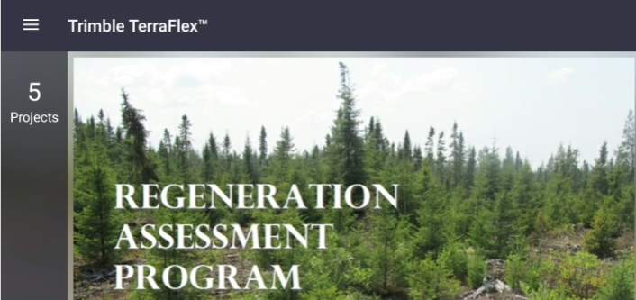

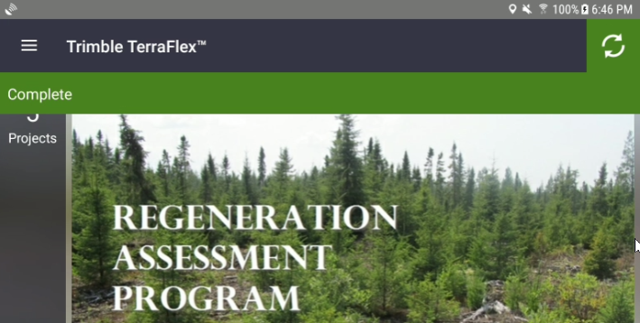
WHAT TO DO AFTER THE SURVEY
Go to a wifi zone and connect Try Googling anything to make sure you have the internet connection
Open Terraflex app and tap the menu icon on the top left
Tap on Sync
It worked if you see a green “Complete” stripe near the top
Now your survey data is safely backed up on the Terraflex server!

