Slide 1
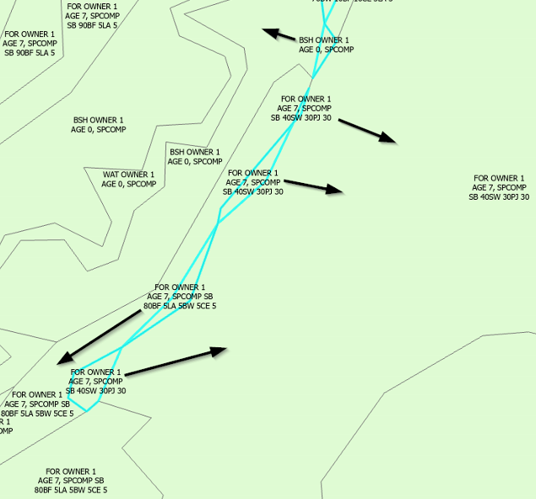
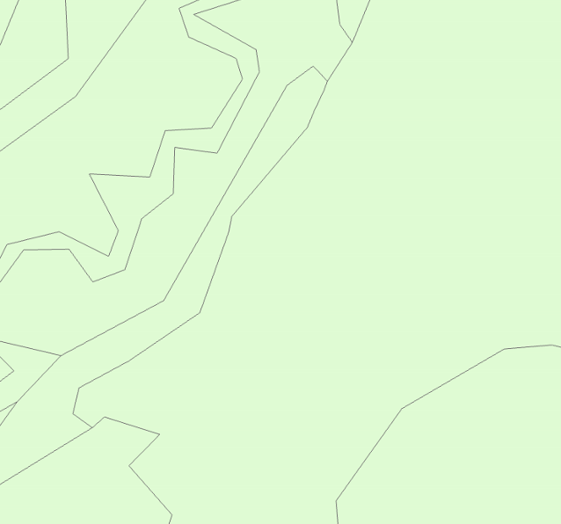
INPUT
OUTPUT
Notes:
selective sliver dissolve

Slide 2
B
A
S
C
D
Unique_ID | POLYTYPE | SPCOMP | AGE | SMZ | SHAPE_AREA
S | FOR | PJ 90PO 10 | 80 | DCHS 3 | 400
A | WAT | - | - | DCHS 3 | 50,000
B | FOR | PJ 90PO 10 | 80 | DCHS 1 | 40,000
C | FOR | SB 70BF 30 | 50 | DCHS 1 | 30,000
D | FOR | PJ 90PO 10 | 80 | DCHS 1 | 20,000

Slide 3
B
A
C
D
Unique_ID | POLYTYPE | SPCOMP | AGE | SMZ | SHAPE_AREA
A | WAT | - | - | DCHS 3 | 50,000
B | FOR | PJ 90PO 10 | 80 | DCHS 1 | 40,400
C | FOR | SB 70BF 30 | 50 | DCHS 1 | 30,000
D | FOR | PJ 90PO 10 | 80 | DCHS 1 | 20,000

