Slide 1
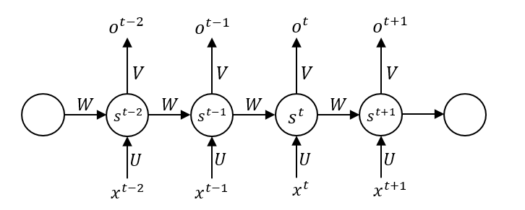
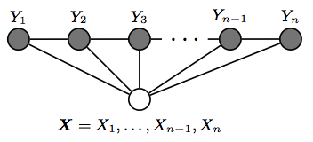
Recurrent Neural Networks (RNNs) and Conditonal Random Fields (CRFs)
A brief overview on theory and applications
(RNN)
(CRF)

Slide 2
Overview
Slide 1: RNN theoretical explanation
Slide 2: Applications of RNN: why and how to use them here?
Slide 3: CRF theoretical explanation (background)
Slide 4: CRF theoretical explanation (how they work)
Slide 5: Applications of CRF: why and how to use them here?
Slide 6: Further useful resources
Tried to summarize everything in short-enough space and time
Further reading and references can be found at end of presentation if needed or simply interested

Slide 3
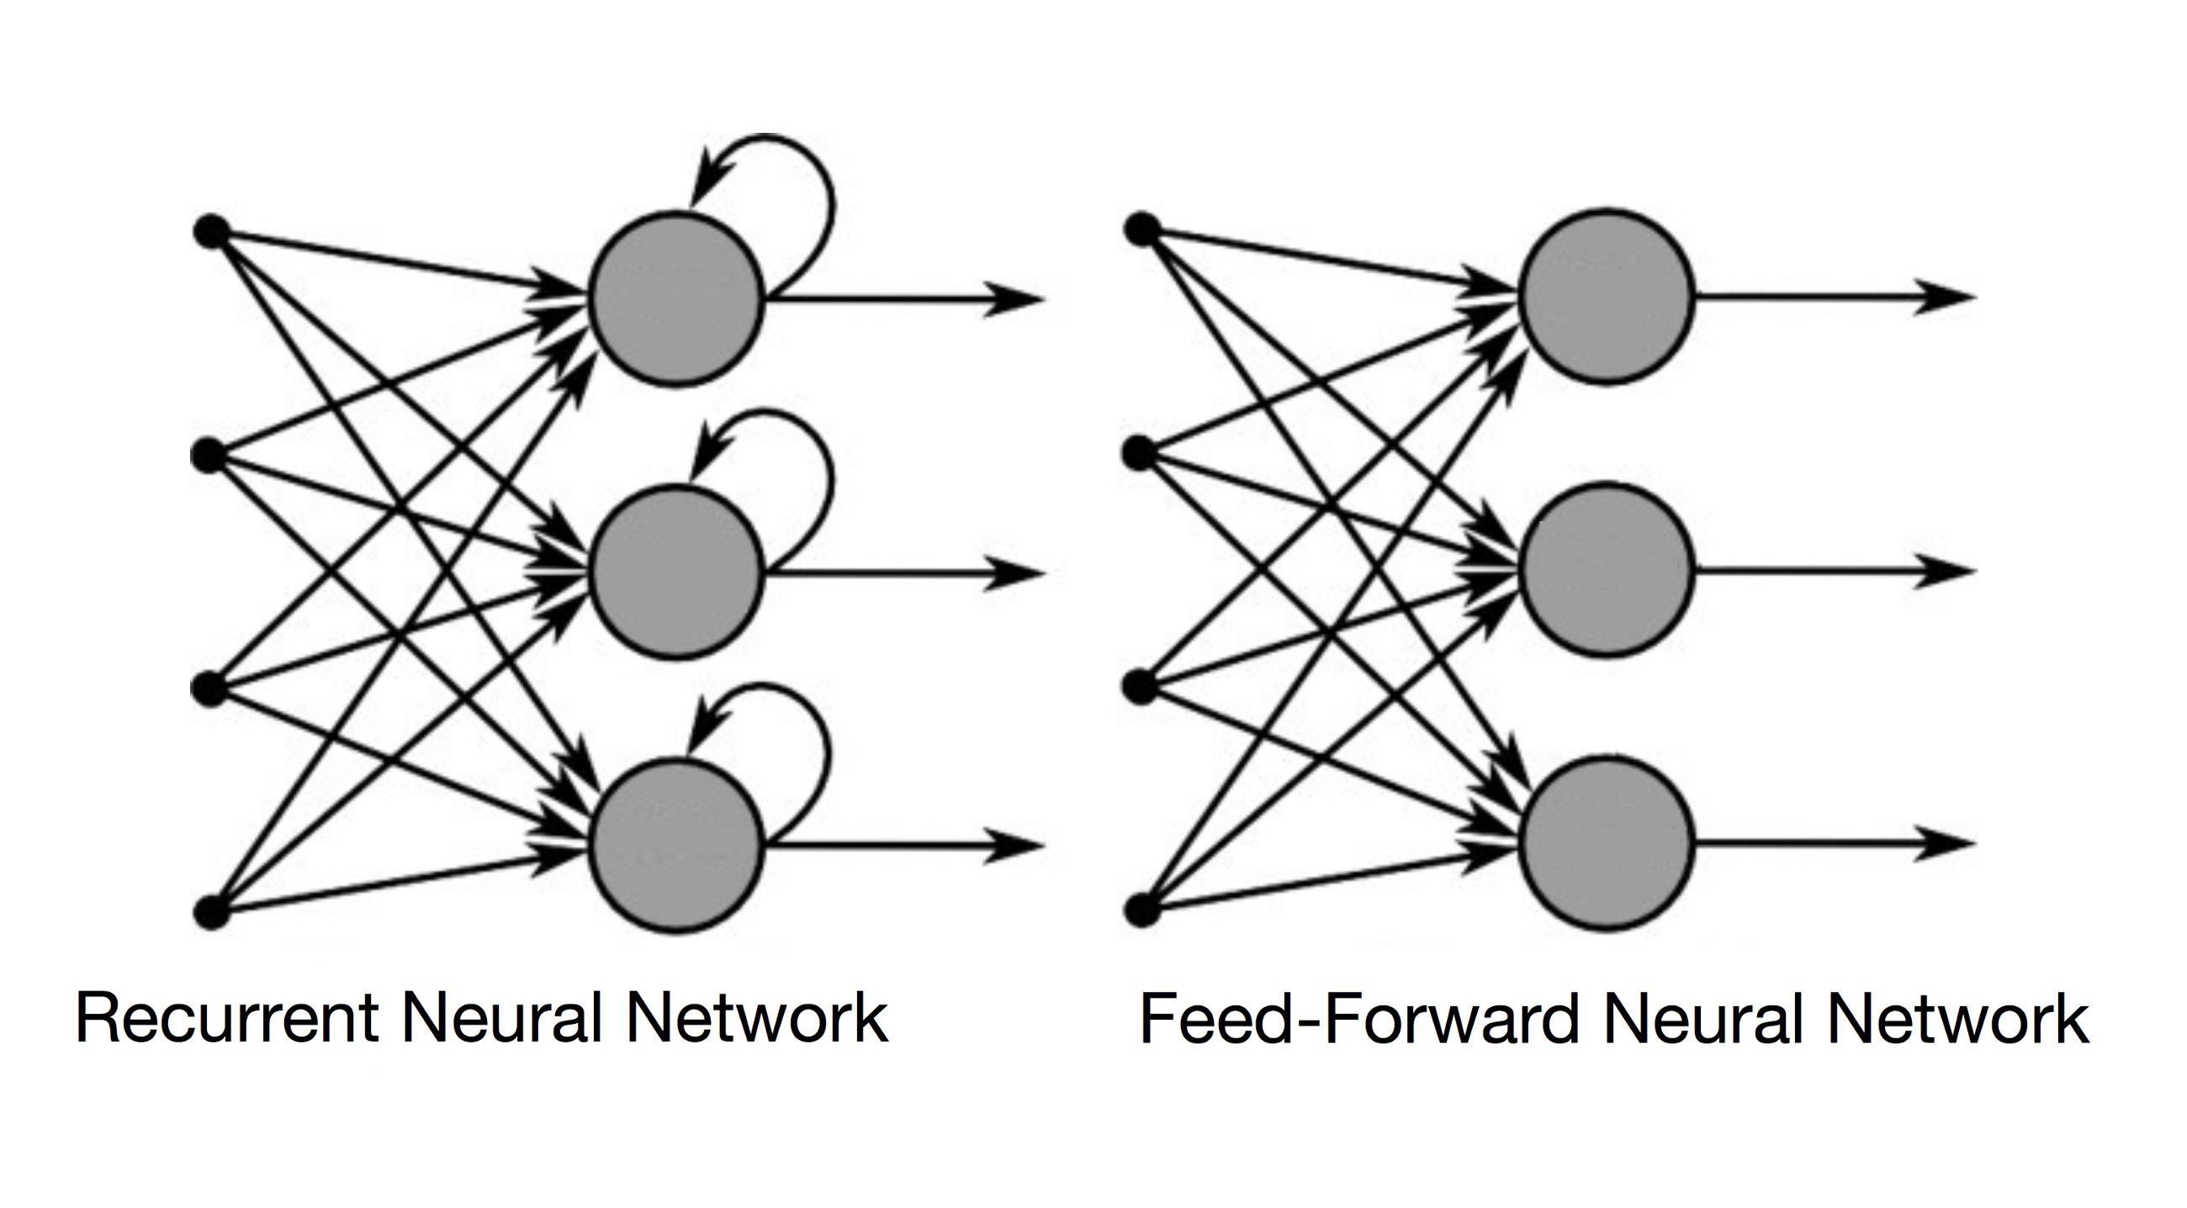
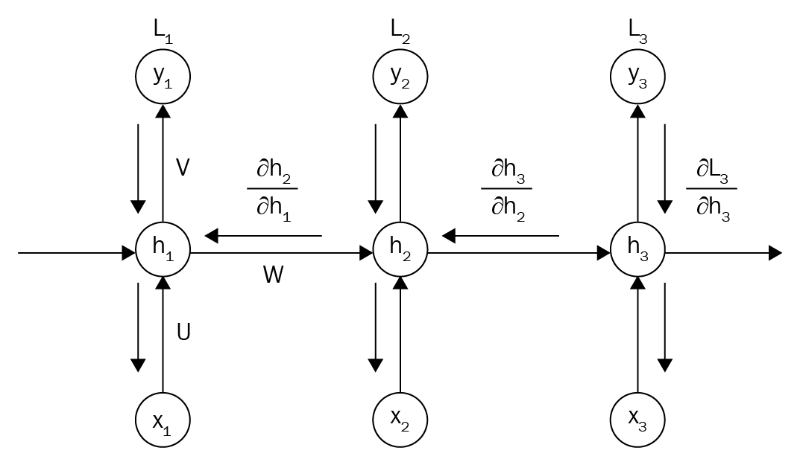
Recurrent Neural Networks (RNNs)
A problem of FFNNs is that they don’t handle order of sequences
No memory and forward/backward prop are independent of order of samples
RNNs have memory and capable of remembering past info + process accordingly
Applications of sequence modelling with RNNs include: language translation, image captioning, text generation, and activity recognition
For output of each hidden layer ‘h^{(t)}’, where ‘φ_{h}’ is the activation function:
h^{(t)} = φ_{h}(W_{xh}x^{(t)} + W_{hh}h^{(t-1)} + b_{h})
Backpropagation through time (BPTT) is adaptation of backprop to train RNNs
Idea is that overall loss ‘L’ is sum of all loss functions at times ‘t=1’ to ‘t=T’
Since loss at time ‘t’ is dependent on the hidden units at all previous time steps, the grad is:
$\frac{δL^{(t)}}{δW_{hh}}= \frac{δL^{(t)}}{δy^{(t)}}∗\frac{δy^{\left(t\right)}}{δh^{\left(t\right)}}∗\left(\sum_{k=1}^{t}{\frac{δh^{\left(t\right)}}{δh^{\left(k\right)}}}∗\frac{δh^{\left(k\right)}}{δW_{hh}}\right)$, where $\frac{δh^{(t)}}{δh^{(k)}}= \prod_{i=k+1}^{t}{\frac{δh^{(i)}}{δh^{(i−1)}}=\frac{δh^{(t)}}{{δh}^{(t−1)}}∗\frac{δh^{\left(t−1\right)}}{δh^{\left(t−2\right)}}∗…∗\frac{δh^{(k+1)}}{δh^{(k)}}}$
Prob comes from $\frac{δh^{(t)}}{δh^{(k)}}$ term having ‘t-k’ multiplications, therefore multiplying ‘W_{hh}’ weight as many times
If ‘|W_{hh}|’ < 1, this factor becomes very small: vanishing gradient (‘|W_{hh}|’ > 1 gets exploding gradient
Truncated BPTT or Long Short Term Memory (LSTM) units used as alternative to overcome gradient problem

Slide 4
Applications of RNNs
Generic RNN model corresponds to ‘many-to-one’ and ‘many-to-many’ sequence model
‘M-to-O’ likely to be most applicable to suit data, where we consider only final output of RNN to model north star score
Practical implementations of RNN often use LSTM cells in place of hidden layers to avoid vanish/explode gradient
Packages for implementing RNN models for a variety of uses include PyTorch, TensorFlow, and Keras (TF wrapper)
Some example uses of RNN models using TensorFlow:
Performing sentiment analysis of IMDb movie reviews (‘M-to-O’ classifier model that takes in text document and outputs ‘positive’ or ‘negative’ review prediction (https://github.com/dan-heaton/MSc_indiv_project/blob/master/background_research/PyML-ch-16-IMDB-sentiment.py)
Implementing RNN for character-level language modelling (‘M-to’M’ model that generates characters based on input and previous output (https://github.com/dan-heaton/MSc_indiv_project/blob/master/background_research/PyML-ch-16-IMDB-sentiment.py)
So how is this useful for us?
Data collected from watches + suits are time-series data
Readings collected at one timestep influenced by readings at previous time-steps
Correct regression of, e.g. suit data, should model this dependency to best predict north star score
Additionally, very-high-dimensionality data for suit data for few samples don’t easily lend to traditional ML models
Framework and language already exists to easily implement RNN models for the project
TensorFlow provides blueprints on building and fine-tuning the model, with supporting preprocessing packages (e.g. Pandas, NumPy) and general purpose ML toolkits (e.g. Sk-learn) exist to help in other stages

Slide 5
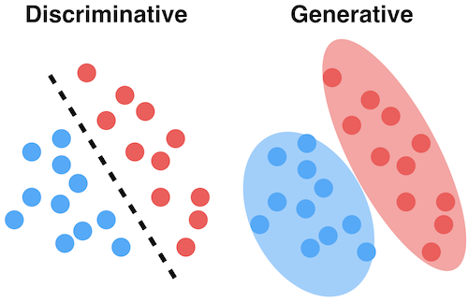
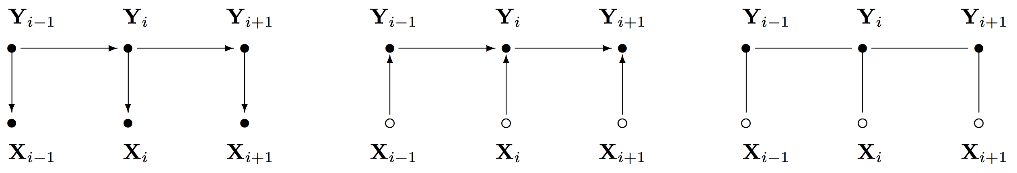
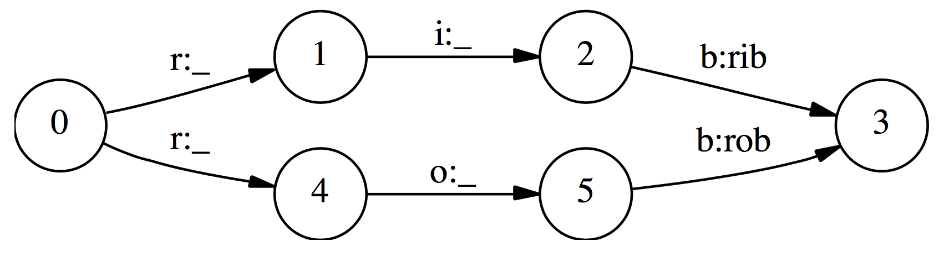
Conditional Random Fields (CRFs): Background
ML models have two common categorizations: generative and discriminative
Discriminative: models the decision boundary between different classes (e.g. CRFs, NNs, logistic regression)
Generative: models how the data was generated with can be used to make classifications (e.g. Naïve Bayes, HMMs)
HMM MEMM CRF
$$\hat{y}={argmax}_{y}P\left(y \right| x), \hat{y}={argmax}_{y}P\left(x \right| y)P(y)$$
CRFs are a discriminative model used for predicting sequences
Use contextual info from previous labels, thus increasing amount of info the model has to help predict
Log regression applied for sequence as CRFs in same way as Naïve Bayes is for HMMs
Improvement over Maximum Entropy Markov Models (MEMMs) in that MEMMs uses per-state exponential models for conditional probabilities of next states given current state
CRFs, meanwhile, use a single exponential model to determine the joint prob of the entire sequence of labels given the observation sequence
CRFs also don’t assume observations being independent of each other, like in HMMs (which do so to feasibly consider all observation sequences)
In CRF, the weights of different features in different states compete against each other
MEMMs have model to compute probability of next state given current state and observation; CRF computes all state transitions globally in single model
This helps to overcome the label bias problem in MEMMs which generates a bias towards states w/ few successor states
Given observation sequence ‘r i b’, if transitions out of state ‘0’ were preferred to go to state ‘1’ over ‘4’, then will always prefer that path
Single transitions from ‘1’ and ‘4’ mean obs sequence ‘r o b’ never predicted if ‘r i b’ more common in training set – problem!

Slide 6
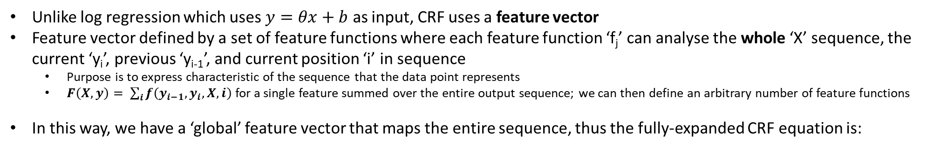
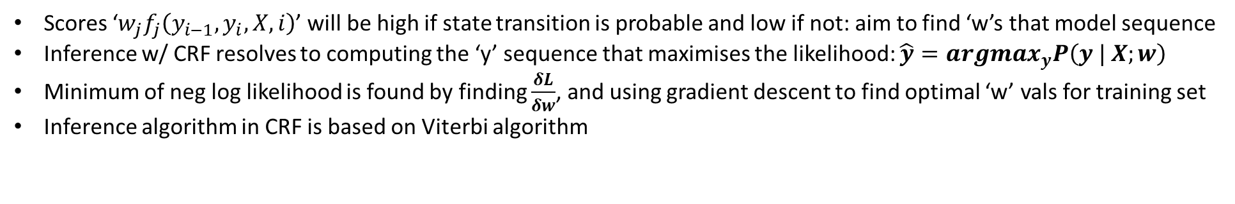
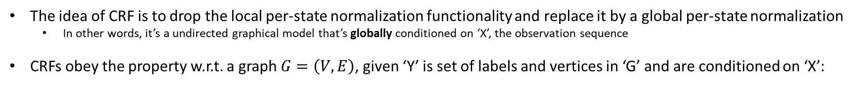
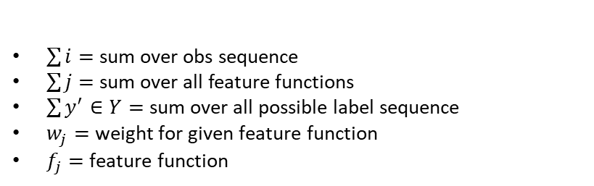

Conditional Random Fields (CRFs): How They Work
The idea of CRF is to drop the local per-state normalization functionality and replace it by a global per-state normalization
In other words, it’s a undirected graphical model that’s globally conditioned on ‘X’, the observation sequence
CRFs obey the property w.r.t. a graph $G=\left(V,E\right)$, given ‘Y’ is set of labels and vertices in ‘G’ and are conditioned on ‘X’:
$$P\left(Y_{v} | X, Y_{w}, w≠v\right)=P\left(Y_{v} | X, Y_{w}, w\sim v\right)$$
Unlike log regression which uses $y=θx+b$ as input, CRF uses a feature vector
Feature vector defined by a set of feature functions where each feature function ‘f_{j}’ can analyse the whole ‘X’ sequence, the current ‘y_{i}’, previous ‘y_{i-1}’, and current position ‘i’ in sequence
Purpose is to express characteristic of the sequence that the data point represents
$F\left(X, y\right)= \sum_{i}{f\left(y_{i−1}, y_{i}, X, i\right)}$ for a single feature summed over the entire output sequence; we can then define an arbitrary number of feature functions
In this way, we have a ‘global’ feature vector that maps the entire sequence, thus the fully-expanded CRF equation is:
$$P\left(y \right| X;w)=\frac{exp\left(\sum_{i}{\sum_{j}{w_{j}f_{j}\left(y_{i−1}, y_{i}, X, i\right)}}\right)}{\sum_{y^{′}∈Y}{exp\left(\sum_{i}{\sum_{j}{w_{j}f_{j}\left(y_{i−1}^{′}, y_{i}^{′}, X, i\right)}}\right)}}$$
$\sum{i}=$ sum over obs sequence
$\sum{j}=$ sum over all feature functions
$\sum{y^{′}∈Y}=$ sum over all possible label sequence
$w_{j}=$ weight for given feature function
$f_{j}=$ feature function
Scores ‘$w_{j}f_{j}\left(y_{i−1}, y_{i}, X, i\right)$’ will be high if state transition is probable and low if not: aim to find ‘w’s that model sequence
Inference w/ CRF resolves to computing the ‘y’ sequence that maximises the likelihood: $\hat{y}={argmax}_{y}P\left(y | X;w\right)$
Minimum of neg log likelihood is found by finding $\frac{δL}{δw}$, and using gradient descent to find optimal ‘w’ vals for training set
Inference algorithm in CRF is based on Viterbi algorithm

Slide 7
Applications of CRFs
Better adapted to sequence modelling than HMMs and MEMMs, given that CRFs are both a discriminative model and don’t suffer label bias problem
Allow us to define our own feature functions
E.g. if each observation is a word, the prefixes/suffixes of the word, whether it is capitalized or not, whether it contains a digit, etc.)
Feature functions also can inspect the entire input sequence ‘X’ at any point during inference
Equivalent to the constant transition probabilities of HMMs that instead vary across position in sequence of states, depending on obs sequence
The setup also allows us to implement decoding (determining the prob of given label sequence ‘Y’ given ‘X’ or inference (determining the most likely label sequence ‘Y’ given ‘X’)
An example of using CRFs via ‘Python-crfsuite’:
Performing sequence labelling using CRF in Python, to take in text documents and classify whether individual words are a part of a named entity or not (https://github.com/dan-heaton/MSc_indiv_project/blob/master/background_research/CRF_seq_labelling.py)
So how is this useful for us?
Much like RNNs, CRFs are a good model to model sequential data, as we will be analysing
Can be adapted for regression purposes to help predict north-star scores (Radosavljevic et al. (2010))
Can also be implemented within other neural networks (e.g. a CNN) to function as an RNN so as to enable a complete model that can be trained via backprop (Zheng et al. (2015))
Faster to train and make inference, though also requires manual feature extraction

Slide 8
Next Stages….
Analyse more papers regarding CRFs and RNNs w/ more specific applications for HAR
Can produce a roundup of these for a future meeting
Also analyse more papers pertaining to feature selection/extraction w.r.t HAR
Good feature selection required for CRFs especially
Find more examples of implementing these models in Python to analyse time-series HAR
Again, can produce more code examples for a future meeting
Start implementing these w/ some sample data from bodysuits
Ideally, will be a good jumping-off point w.r.t. potentially more advanced systems developed later on

Slide 9
Further Useful Resources
Machine Learning (Murphy, K.), chapter 10 – ‘Directed graphical models (Bayes nets)’ and Chapter 19 – ‘Undirected graphical models (Markov random fields)’
Good theoretical and thorough mathematical overview of HMMs, MEMMs, and CRFs
Python Machine Learning (Raschka et al.), chapter 16 – ‘Modelling Sequential Data Using Recurrent Neural Networks’
Briefly explains RNNs, how to implement the model using TensorFlow, and several examples of their use to real problems
Deep Learning (Goodfellow et al.), chapter 10 – ‘Sequence Modelling: Recurrent and Recursive Nets’
Deeper theoretical overview of the mathematics behind RNNs
‘Conditional Random Fields for Sequence Prediction’ (http://www.davidsbatista.net/blog/2017/11/13/Conditional_Random_Fields/)
Provides an excellent run-through of CRFs, how they’re trained, and how they differ from HMMs and MEMMs
‘Performing Sequence Labelling using CRF in Python’ (http://www.albertauyeung.com/post/python-sequence-labelling-with-crf/)
Shows how to preprocess text data, extract useful feature functions, and train/test a CRF model using ‘Python-crfsuite’

