Slide 1
Overview of Presentation
Background
Aims / Objectives of Project
Duchenne Muscular Dystrophy
The NSAA Assessment
RNNs: An Overview
Script Ecosystem Overview
Purpose and Overview of System
The Data Pipeline
Core RNN Engine
Supplementary Scripts
Experimentation
Overview of Experimentation
Experimentation Results
Evaluation and Conclusions
Significance of Results
Further Adaptations

Slide 2
Aims of Project
Determine whether recurrent neural networks are models capable of learning from suit data captured from subjects with DMD and, if so, build models that generalise towards accurate classifications of D/HC label and regression of NSAA scores for new data, given only ~50 complete ‘mat’ files from subjects
Use the models to gain insights into the most influential activities and measurements from the ‘.mat’ files on overall NSAA score and to identify activities that correlate highly with overall assessment. In doing so, it could possibly enable the reduction of 17 activities needed for accurate overall NSAA assessment to far fewer
Investigating the impact of training models on different types of source data directly (e.g. whether or not it’s possible to train models on natural movement data to the same standard as if we were using NSAA data)
Building models that are trained only on one ‘version’ of assessments of subjects and attempt to generalise to subsequent versions. This should provide an advisory tool for any specialists wishing to assess how a subject’s conditioned has progressed during the time between assessments.
Determine the most ideal model hyperparameters that learn from the suit data so as to give insights into the DMD condition itself
Package all the scripts and models necessary for a specialist or any other researcher wishing to use any of the built tools in a way that is easy to use and gives intuitive output

Slide 3
Duchenne Muscular Dystrophy
Duchenne muscular dystrophy (DMD) is a genetic disorder that is characterized by progressive muscle degeneration and weakness and is caused by the absence of dystrophic, a protein that helps keeps muscle cells intact which, being a progressive condition, leads to increasing levels of disability
It’s classified as a rare disease, with around 2,500 patients in the UK and an estimated 300,000 sufferers worldwide, and there are currently no known cures for any form of muscular dystrophy (MD), though there are treatments available to help manage the conditions.
DMD is one of the more severe forms of MD and generally affects boys in their early childhoods and many are confined to a wheelchair by 12 years of age, with those in their late teens generally losing the ability to move their arms and experiencing progressive problems with breathing.

Slide 4
The NSAA Assessment
The North Star Ambulatory Assessment (NSAA) is a 17-item rating scale that is used to measure functional motor abilities in subjects with DMD and is generally used to monitor the progression of the disease and the effects of treatments. The tests are to be completed without the use of any thoracic braces or any equipment assistance that may help the subject to complete the activities. To carry out the assessments, the assessor conducting the assessments needs a mat, a stopwatch, a box step, a size-appropriate chair, and at least 10-metres of pathway [8].

Slide 5
Purpose and Overview of System
System primarily used to extract and produce the data that is needed, to train models on this data, and assess a subject’s data on these models
Which data is used to train models and how subject is assessed is dependent on the type of experimentation being carried out
Functions as a complete solution to the fulfil the specified aims of the project
Encompasses 15 Python scripts divided into 3 parts: the data pipeline, the core RNN engine, and the supplementary scripts:
Also includes several batch scripts to automate the running of much of the setup and experimentation
Arguments to select the model training data and to set up system
Assessment of subject data via the TensorFlow models
TensorFlow models
Subject data to assess

Slide 6
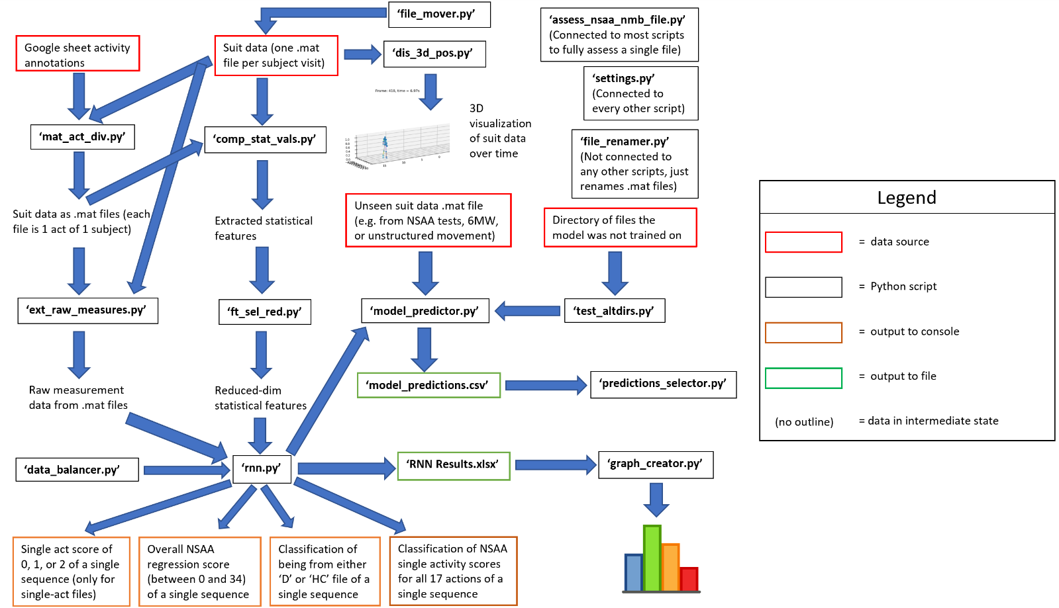
The Data Pipeline
Purpose of scripts is to ingest data in various forms and produce intermediate data
This can either be further processed by scripts or taken in as RNN data
Necessary as ‘rnn.py’ only has to deal with one format of data (as ‘.csv’), irrespective of whether it contains raw measurements, computed measurements, or data from single-act files
Generally, whole data pipeline is run only once by a batch file to get all data needed by ‘rnn.py’

Slide 7
Core RNN Engine
Creates models based on the arguments provided to ‘rnn.py’ and built on the data created from the data pipeline
Models are either assessed on the data left-out for the test set in ‘rnn.py’ or by complete files with ‘model_predictor.py’
Forms the basis of what is needed for experimentation
The ‘data_balancer.py’ and ‘test_altdirs.py’ scripts are ‘helper’ scripts that are used to directly help the ‘rnn.py’ and ‘model_predictor.py’ scripts, respectively

Slide 8
Supplementary Scripts
Several scripts are needed for other tasks that aren’t parts of the data pipeline or the core RNN engine
Includes functionality such as renaming files to a standard convention, selecting certain rows from a results file, creating graphs from results stored in results files, and storing system constants
Also includes ‘assess_nsaa_nmb_file.py’, which allows one to completely assess a subject based on the ‘final’ selected optimum models, as determined by experimentation

Slide 9
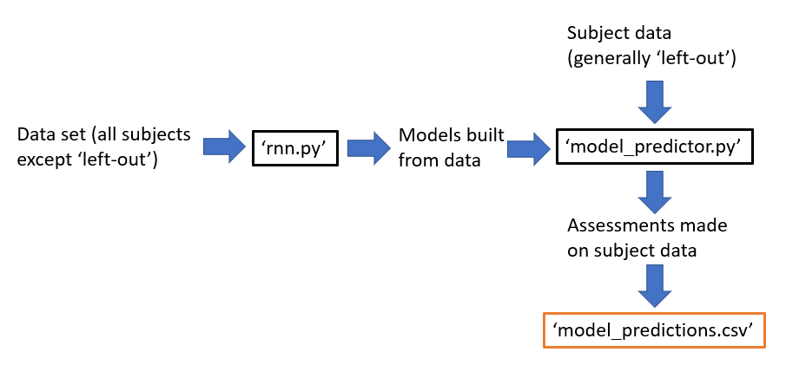
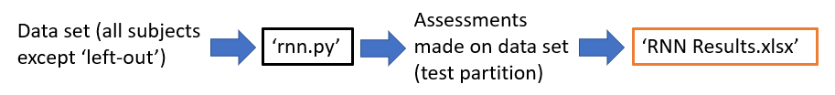
Overview of Experimentation
Broadly speaking, we are trying to accomplish several things with experimentation:
Determine the optimal settings of ‘rnn.py’ and thus optimal models to be used to assess complete data from complete subjects
Gain insights into the most useful forms of data to be used to train models (e.g. best raw measurements to use, ideal sequence lengths of inputs to RNN’s, most useful single NSAA activities, etc.)
Produce numerical representations for the generalisation performance over unseen subjects for various metrics to show expected performance on future assessments
Two types of experimentation that we undertake: ‘experiment sets’ and ‘model predictions sets’, which covered 33 total sets, involved the construction of >600 models, and spanned several months
Experiment sets are done to ascertain the optimal model setups to be used in later model predictions sets and are done using ‘rnn.py’, with results being obtained from the output of the testing portion of the input data
Model predictions sets make use of ‘model_predictor.py’ to make assessments on complete files and make use of pre-built models and covers the impact of various factors on the generalisation performance of models to unseen subjects or unseen files

Slide 10
Experimentation Results
Some of the most significant results we can conclude from experimentation are the following:
The ‘sensorMagneticField’ measurement, when considered on its own, was the best measurement to extracted and used to train models, in comparison with others like ‘position’ and ‘jointAngle’ either considered on their own or through results aggregation on different measurements’ models
With only using ‘sensorMagneticField’ data, the mean average error between the true and predicted overall NSAA score for a complete subject assessment on models unfamiliar with the subject, over many left-out subjects, was 2.4
I.e. These models were able to generalise towards ‘new’ subjects to within 2.4 of its true overall NSAA score
For the above scenario but with a new ‘version’ of a familiar subject, the predicted overall NSAA score was on average 4.89 lower
While we didn’t have the true values for the ‘V2’ files of the subjects, this was a result that made intuitive sense, as an average drop of ‘1’ for ~5 activities seems to correspond with a subject’s deteriorating performance over 5 months

Slide 11
Experimentation Results (continued)
Models were able to have been built on one type of data file (e.g. NSAA assessment data) and then used to assess other types of data file with ‘model_predictor.py’ (e.g. natural movement data), and vice versa
Models showed particularly good generalisation results, with a MAE between the true and predicted overall NSAA scores over all files in a data set (e.g. ‘NSAA’) tested on models built from another directory was ~2.5
Specific single-activity files, when assessed on models unfamiliar with the subject in question and when used to predict the overall NSAA score, corresponded much closer to the true overall NSAA score than others
In particular, activities using the subject’s left leg and involving the subject doing the activity from a standing position were shown to correspond more closely to the subject’s overall assessment
Optimal model performance was shown to be achieved with a sequence length of 600 for raw measurements and 10 for computed statistical values
In both cases, this corresponds to a 10 second time-context window, which was shown to be ideal to learn single-act scores, overall NSAA scores, and D/HC classifications
A high sequence overlap proportion of 0.9 and a discard proportion of 0.9 was needed to produce enough sequences to train with, while not using too many sequences in model training that would make training difficult
Certain raw measurements captured by the suit (‘position’, ‘sensorMagneticField’, ‘jointAngle’, and ‘jointAngleXZY’) were far more capable than others (e.g. ‘velocity’, ‘acceleration’) and being used to train models than actually learned from the data

Slide 12
Significance of Results
There are several significant takeaways from these results that potentially have wider implications
aa

