Slide 1
Recurrent Neural Networks Applied for Human Movement in Subjects with Duchenne Muscular Dystrophy
12/09/19
Daniel James Heaton, MSc Computing (Machine Learning), CID: 01524921

Slide 2
Overview of Presentation
Background
Aims of Project
Duchenne Muscular Dystrophy
The NSAA Assessment
Recurrent Neural Networks
Script Ecosystem Overview
Purpose and Overview of System
The Data Pipeline
Core RNN Engine
Supplementary Scripts
Experimentation
Overview of Experimentation
Experimentation Results
Evaluation and Conclusions
Significance of Results
Further Adaptations

Slide 3
Aims of Project
Determine whether recurrent neural networks are models capable of learning from suit data captured from subjects with DMD and, if so, build models that generalise towards accurate classifications of D/HC label and regression of NSAA scores for new data
Use the models to gain insights into the most influential activities, raw measurements, and model hyperparameter settings from the ‘.mat’ files on overall NSAA score and to identify activities that correlate highly with overall assessment. In doing so, it could enable the reduction from 17 activities needed for accurate NSAA assessment to far fewer, require fewer measurements from the suit, etc.
Investigate the impact of training models on different types of source data directly (e.g. whether or not it’s possible to train models on natural movement data to the same standard as if we were using NSAA data)
Build models that are trained only on one ‘version’ of assessments of subjects and attempt to generalise to subsequent versions, so as to provide an advisory tool for any specialists wishing to assess how a subject’s conditioned has progressed over time
Package all the scripts and models necessary for a specialist or any other researcher wishing to use any of the built tools in a way that is easy to use and gives intuitive output

Slide 4
Duchenne Muscular Dystrophy
Duchenne muscular dystrophy (DMD) is a genetic disorder that is characterized by progressive muscle degeneration and weakness and is caused by the absence of dystrophic, a protein that helps keeps muscle cells intact which, being a progressive condition, leads to increasing levels of disability
It’s classified as a rare disease, with around 2,500 patients in the UK and an estimated 300,000 sufferers worldwide and there are currently no known cures for any form of muscular dystrophy (MD), though there are treatments available to help manage the conditions
DMD is one of the more severe forms of MD and generally affects boys in their early childhoods and many are confined to a wheelchair by 12 years of age, with those in their late teens generally losing the ability to move their arms and experiencing progressive problems with breathing

Slide 5
The NSAA Assessment
The North Star Ambulatory Assessment (NSAA) is a 17-item rating scale that is used to measure functional motor abilities in subjects with DMD and is generally used to monitor the progression of the disease and the effects of treatments
The assessor gets the subject to carry out 17 sequential tasks, where each task is graded as follows: ‘2’ if there is no obvious modification of activity, ‘1’ if the subject uses a modified method but achieves the goal independent of physical assistance from another, and ‘0’ if the subject is unable to complete the activity independently, with the overall NSAA score being the sum of all 17 scores
The NSAA assessment has been shown to be a quick, reliable, and clinically relevant method to measure the functional motor ability of ambulant children with DMD, and is also considered to be suitable to be used in research

Slide 6
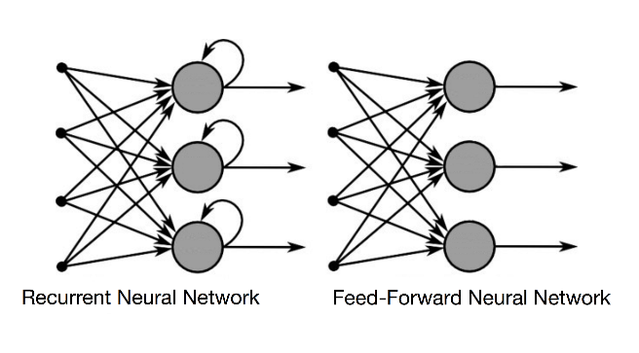
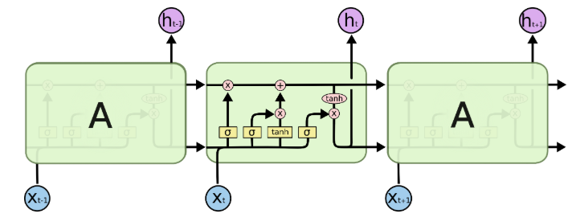
Recurrent Neural Networks
In this project, we deal with time-series data from the body suit, where each row (‘frame’) of joint angle values, position values, and so on that are contained in a ‘.mat’ file produced by the body suit is a single sample in time; we also know instinctively that these values in real-life are dependent on previous values, hence using them as inputs to a feedforward neural network is not ideal
With recurrent neural networks (RNNs), rather than the values of the hidden nodes of the FFNN being only affected by the values that feed into it, hidden layers in RNNs are also affected by their own previous values; in this sense, the RNN can be seen to contain a memory of sorts that enforces time-dependencies of data that is fed through it
Long short-term memory (LSTM) cells are also used as the hidden layers in the RNN to create paths through time that have derivatives that neither vanish nor explode and involve connection weights that may change at each time step, as they introduce loops within themselves to produce paths where the gradient can flow for long durations of time
This is all implemented within the ‘rnn.py’ script using TensorFlow to build the models, as it allows for a high amount of direct control over the models while showing better performance through threading and queues to speed up the training process

Slide 7
Purpose and Overview of System
System is primarily used to extract and produce the data that is needed, to train models on this data, and assess a subject’s data on these models
Which data is used to train models and how subject is assessed is dependent on the type of experimentation being carried out
Functions as a complete solution to the fulfil the specified aims of the project
Encompasses 15 Python scripts divided into 3 parts: the data pipeline, the core RNN engine, and the supplementary scripts
Also includes several batch scripts to automate the running of much of the setup and experimentation
System
Assessment of subject data via the TensorFlow models
Arguments to select the model training data and to set up system
TensorFlow models
Subject data to assess

Slide 8
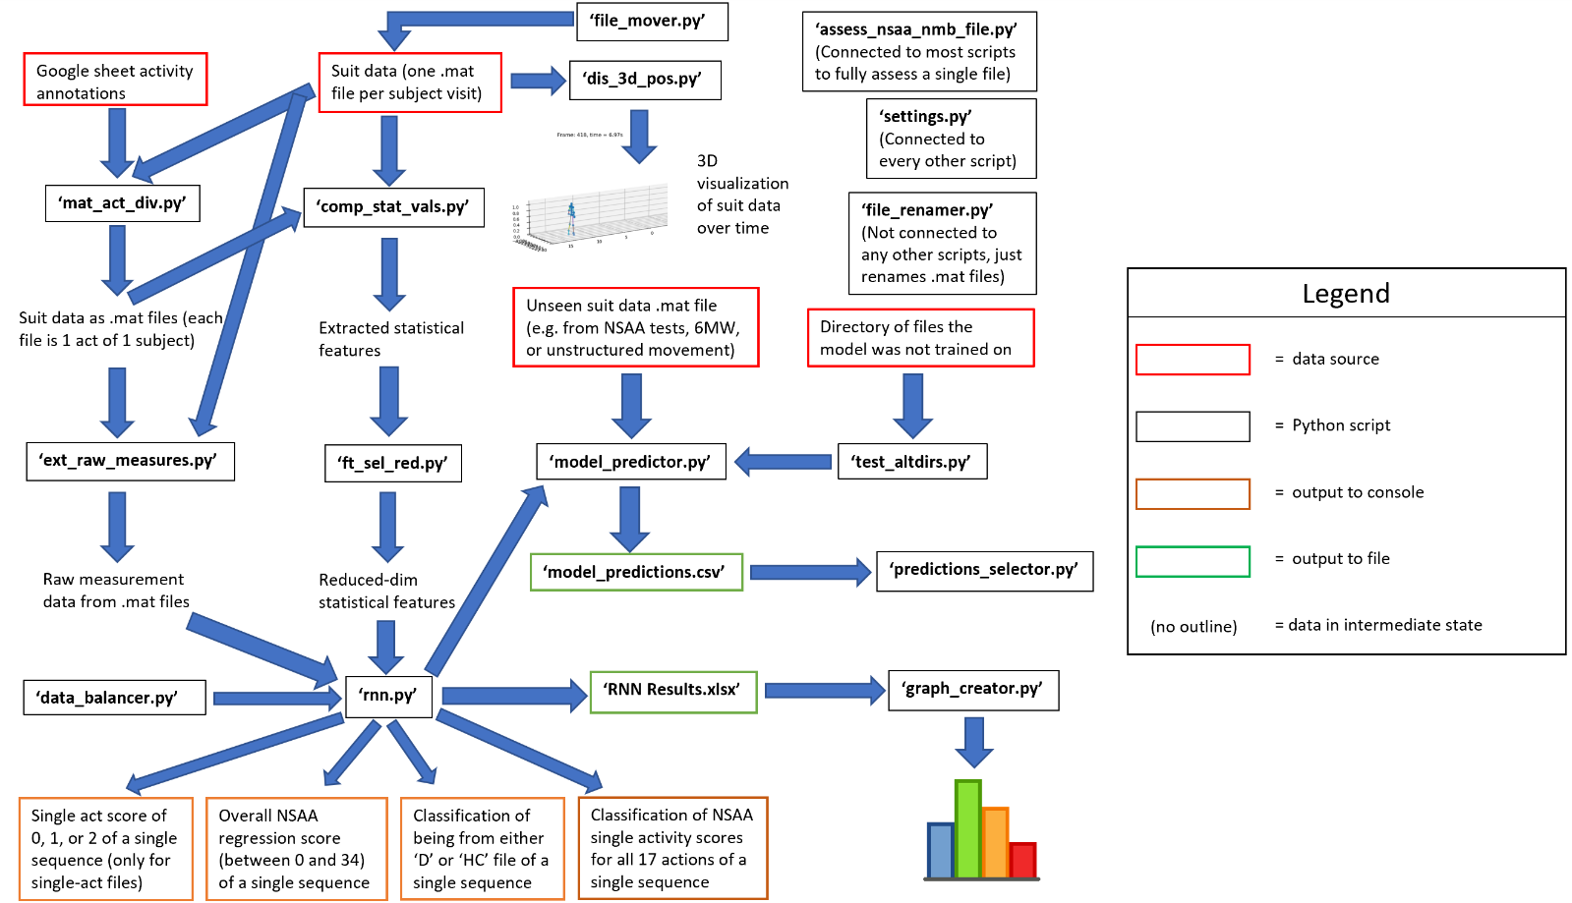
The Data Pipeline
Purpose of scripts is to ingest data in various forms and produce intermediate data
This can either be further processed by scripts or taken in as RNN data
Necessary as ‘rnn.py’ only has to deal with one format of data (as ‘.csv’), irrespective of whether it contains raw measurements, computed measurements, or data from single-act files
Prepares the data for whatever experimentation we are running

Slide 9
Core RNN Engine
Creates models based on the arguments provided to ‘rnn.py’ and that are built on the data created from the data pipeline
Models are either assessed on the data left-out for the test set in ‘rnn.py’ or by complete files with ‘model_predictor.py’
The ‘data_balancer.py’ and ‘test_altdirs.py’ scripts are ‘helper’ scripts that are used to directly run the ‘rnn.py’ and ‘model_predictor.py’ scripts, respectively, in a pre-set manner

Slide 10
Supplementary Scripts
Several scripts are needed for other tasks that aren’t parts of the data pipeline or the core RNN engine
Includes functionality such as renaming files to a standard convention, selecting certain rows from a results file, creating graphs from results stored in results files, and storing system constants
Also includes ‘assess_nsaa_nmb_file.py’, which allows one to completely assess a subject based on the ‘final’ selected optimum models, as determined by experimentation

Slide 11
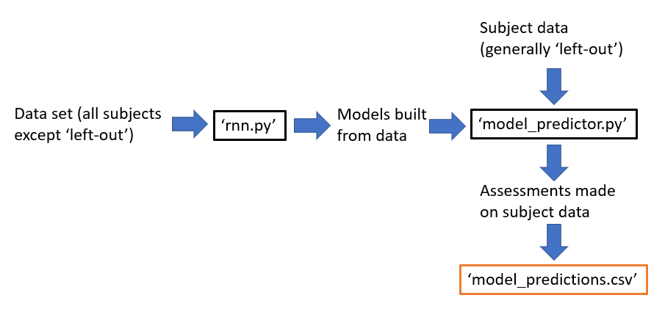
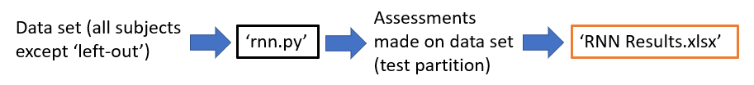
Overview of Experimentation
Two types of experimentation that we undertake: ‘experiment sets’ and ‘model predictions sets’, which covered 33 total sets, involved the construction of >600 models, and spanned several months
Experiment sets are done to ascertain the optimal model setups to be used in later model predictions sets and are done using ‘rnn.py’, with results being obtained from the predictions made on the testing portion of the input data
Model predictions sets use ‘model_predictor.py’ to make assessments on complete files and make use of pre-built models to cover the impact of various factors on the generalisation performance of models to unseen subjects or unseen files

Slide 12
Experimentation Results
Some of the most significant results we can conclude from experimentation are the following:
The ‘sensorMagneticField’ measurement, when considered on its own, was the best measurement to be extracted and used to train models, in comparison with others like ‘position’ and ‘jointAngle’ when either considered on their own or through results aggregation on different measurements’ models
With only using ‘sensorMagneticField’ data, the mean average error between the true and predicted overall NSAA score for a complete subject assessment on models unfamiliar with the subject, over many left-out subjects, was 2.4
I.e. These models were able to generalise towards ‘new’ subjects to within 2.4 of its true overall NSAA score
For the above scenario but with a new ‘version’ of a familiar subject, the predicted overall NSAA score was on average 4.89 lower for the ‘V2’ file compared with the ‘V1’ file from the same subject
While we didn’t have the true values for the ‘V2’ files of the subjects, this was a result that made intuitive sense, as an average drop of ‘1’ for ~5 activities seems to correspond with a subject’s deteriorating performance over 5 months

Slide 13
Experimentation Results (continued)
Models were able to have been built on one type of data file (e.g. NSAA assessment data) and then used to assess other types of data file with ‘model_predictor.py’ (e.g. natural movement data), and vice versa
Models showed particularly good generalisation results, with a MAE between the true and predicted overall NSAA scores over all files in a data set (e.g. ‘NSAA’) tested on models built from another directory was ~2.5
Specific single-activity files, when assessed on models unfamiliar with the subject in question and when used to predict the overall NSAA score, corresponded much closer to the true overall NSAA score than others
In particular, activities using the subject’s left leg and involving the subject doing the activity from a standing position were shown to correspond more closely to the subject’s overall assessment
Optimal model performance was shown to be achieved with a sequence length of 600 for raw measurements and 10 for computed statistical values
In both cases, this corresponds to a 10 second time-context window, which was shown to be ideal to learn single-act scores, overall NSAA scores, and D/HC classifications
A high sequence overlap proportion of 0.9 and a discard proportion of 0.9 was needed to produce enough sequences to train with, while not using so many sequences in model training as would make training difficult
Certain raw measurements captured by the suit (‘position’, ‘sensorMagneticField’, ‘jointAngle’, and ‘jointAngleXZY’) were far more capable than others (e.g. ‘velocity’, ‘acceleration’) at being used to train models than actually learned from the data

Slide 14
Significance of Results
With the use of the ‘assess_nsaa_nmb_file.py’ script, we have a wrapper script that should enable users to accurately assess either an NSAA or natural movement file accurately, which should help assessors with assessing new subjects
We’ve shown that the above script can also be used to help with ‘follow-up’ assessments with subjects as part of the initiative, which may prob useful in acting as a tool to monitor the progress of subjects’ DMD without the need for direct human assessment
The results we have found justify possibly undertaking new activities as part of the NSAA assessment, as the activities that predominantly involve the left leg and those from a standing position have been shown to be more ‘useful’ to us
Assessors could feasibly only need capture the natural movement behaviour of subjects and asses these with the above Python script to accurately assess the overall and single-act NSAA scores of either a new subject or a new version of an existing one, which would avoid the need to undertake the NSAA assessment at all

Slide 15
Further Adaptations
Explore alternatives in sequence modelling other than RNNs, including conditional random fields and hidden Markov models
Verification of source ‘.mat’ file data integrity through the use of data anomaly detection techniques and/or use of the ‘dis_3d_pos.py’ script
Given an annotation sheet of natural movement behaviour file names and what activity is contained within each, draw conclusions about the type of natural behaviour that is better able to predict a subject’s NSAA assessments
Validate the correctness of the original NSAA scores obtained in ‘nsaa_6mw_info.xlsx’ and the single-act start/end times within the Google annotations sheet
Extend the project to work with source ‘.mat’ files of subjects with different movement-impairing conditions other than DMD

