Slide 1
Recurrent Neural Networks Applied for Human Movement in Subjects with Duchenne Muscular Dystrophy
12/09/19
Daniel James Heaton, MSc Computing (Machine Learning), CID: 01524921

Slide 2
Overview of Presentation
Aims and Background
Script Ecosystem Overview
Experimentation, Evaluation, and Conclusions

Slide 3
1. Aims and Background

Slide 4
Aims of Project
Primary Aim: Build models to regress clinical NSAA scores and classify D/HC labels from both NSAA assessment data and natural movement data so as to uncover insights about the DMD condition, the NSAA assessment itself, and the data captured by the suit
Secondary Aim: Setup a framework that is easily usable for others to either carry out further experimentation and is extendable to further applications

Slide 5
DMD and the NSAA Assessment
Duchenne muscular dystrophy (DMD) is a genetic disorder that is characterized by progressive muscle degeneration and weakness
No known cures, though there are treatments available to help manage the conditions
DMD is one of the more severe forms of MD and generally affects boys in their early childhoods and many are confined to a wheelchair by 12 years of age
The North Star Ambulatory Assessment (NSAA) is a 17-item rating scale that is used to measure functional motor abilities in subjects with DMD and is generally used to monitor the progression of the disease and the effects of treatments
The assessor gets the subject to carry out 17 sequential tasks, each graded as either ‘2’ (successful activity), ‘1’ (successful but modified method), and ‘0’ (unable to complete activity), with the overall NSAA score being the sum of all 17 scores
Captured by the Xsens MVN motion capture suit

Slide 6
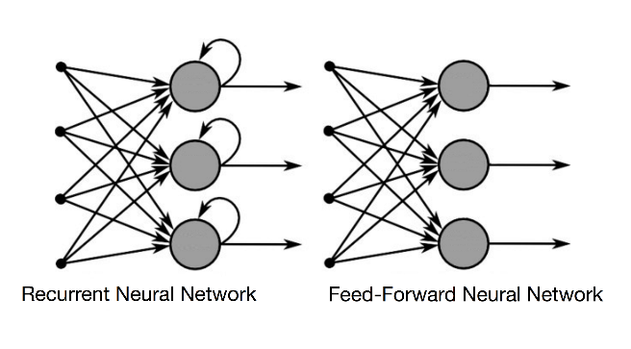
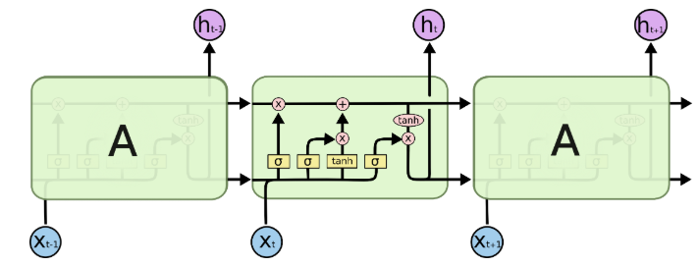
Recurrent Neural Networks
Data we deal with is ‘.mat’ file that captures frames of data sampled at regular time-intervals and are dependent on previous values
Using them as inputs to a feedforward neural network is not ideal
Using recurrent neural networks (RNNs) as opposed to FFNNs, hidden layers in RNNs are also affected by their own previous values
Hence, contains memory of sorts that enforces time-dependencies of data that is fed through it
Long short-term memory (LSTM) cells are also used here as the hidden layers in the RNN to create paths through time that have derivatives that neither vanish nor explode
Introduce loops within themselves to produce paths where the gradient can flow for long durations of time
Implemented using TensorFlow to build the models
Allows for a high amount of direct control over models and shows better performance through threading and queues

Slide 7
2. Script Ecosystem Overview

Slide 8
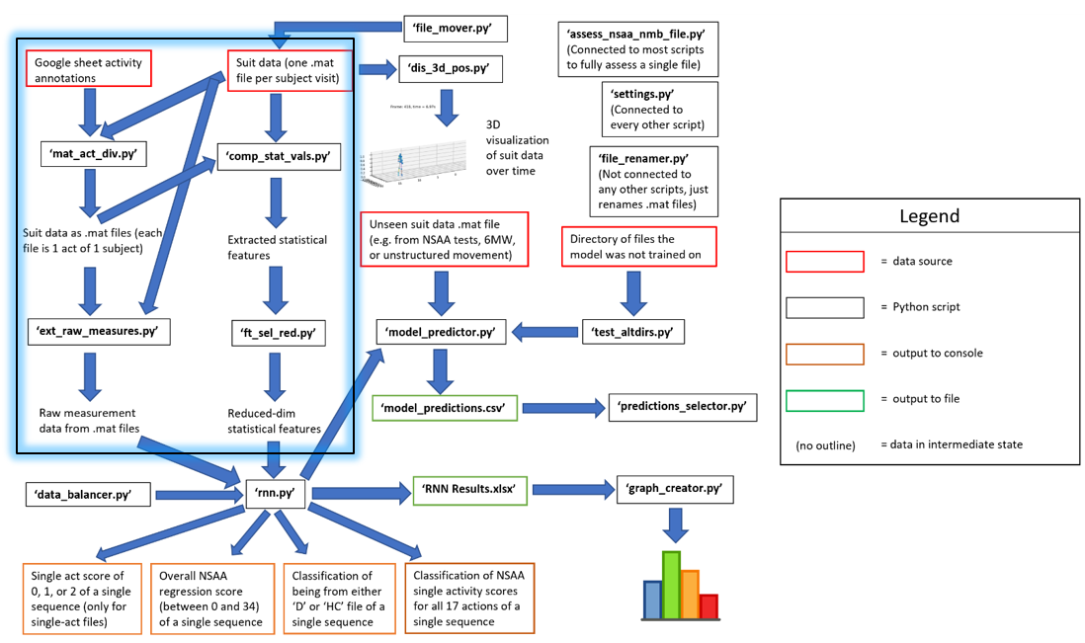
The Data Pipeline

Slide 9
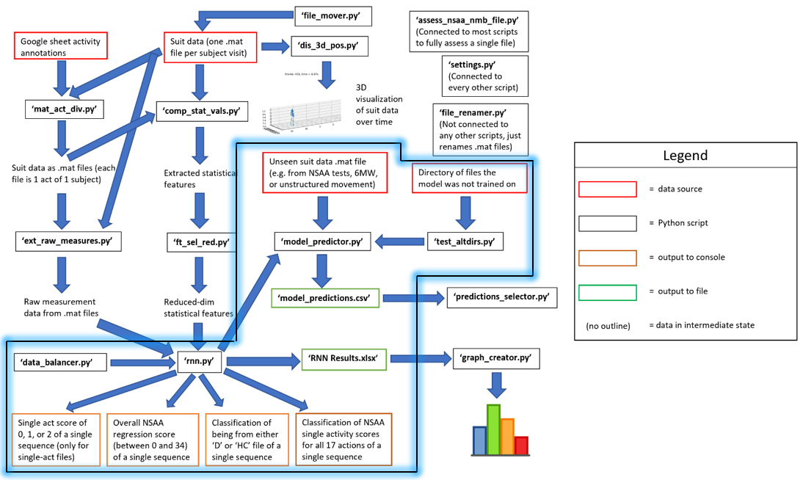
Core RNN Engine

Slide 10
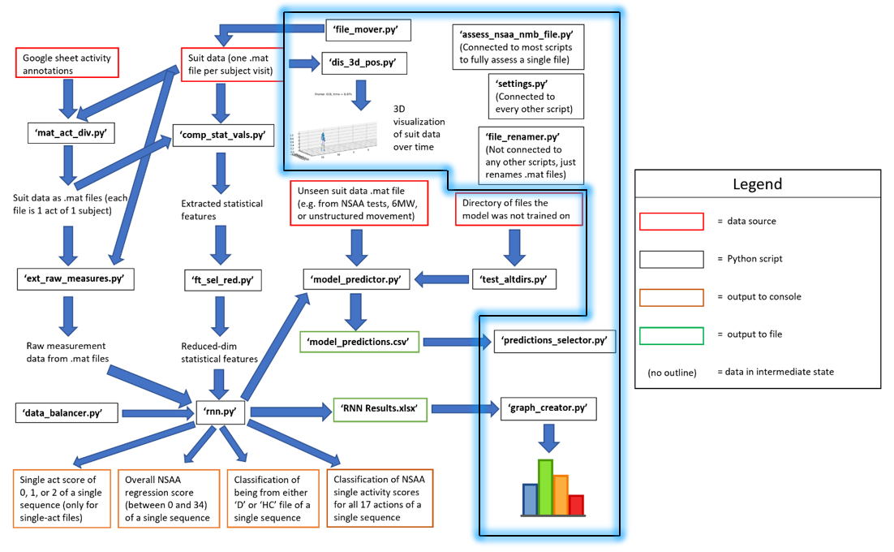
Supplementary Scripts

Slide 11
3. Experimentation, Evaluation, and Conclusions

Slide 12
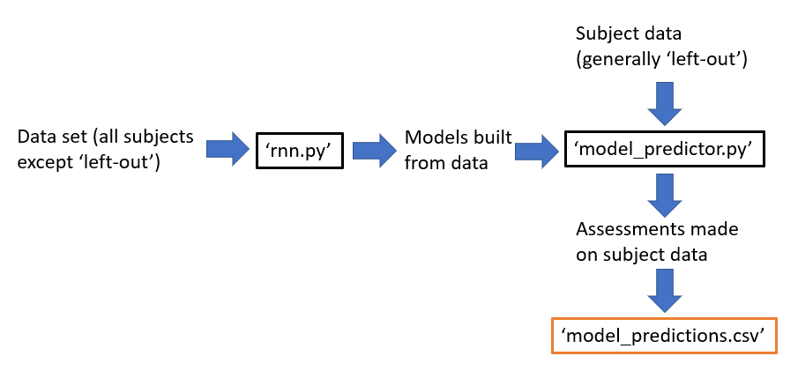
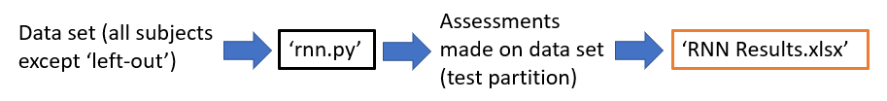
Overview of Experimentation
Two types of experimentation that we undertake: ‘experiment sets’ and ‘model predictions sets’
Covered 33 total sets, involved the construction of >600 models, and spanned several months
Consider only 6 of these in the following slides that show the most promising results
Experiment sets were initial experimentation to ascertain the optimal model setups (e.g. sequence length, sequence overlap)
Assessments made on the testing portion of the input data (models familiar w/ subject, not testing data)
Model predictions sets use ‘model_predictor.py’ to make assessments on complete files and make use of pre-built models
Assessments made on ‘left-out’ files from the data set (models NOT familiar w/ either subject, nor testing data)

Slide 13
Model Generalisation w/ 5 Left-Out Subjects
File Name | Measurements tested | Percent of acts corrected predicted | Predicted D/HC Label | Percent of correct predicted sequences | True Overall Score | Predicted Overall Score
D3 | [ALL MEASURES] | 41.18% | D | 100% | 19 | 27
D9 | [ALL MEASURES] | 52.94% | D | 100% | 22 | 25
D11 | [ALL MEASURES] | 70.59% | D | 100% | 27 | 28
D17 | [ALL MEASURES] | 94.12% | HC | 50% | 33 | 28
HC6 | [ALL MEASURES] | 100.0% | HC | 75% | 34 | 31
Subjects chosen for diverse range of overall NSAA scores (19, 22, 27, 33, 34)
Use 4 ‘chosen’ best raw measurements from earlier experimentation w/ computed stat values
Aggregates results from models build w/ separate measures
Shows results for the 3 ‘output types’ that models target: ‘overall’, ‘acts’, and ‘dhc’
Using results for ‘overall’ output type, can see generalisation ability but not to the degree for which we are aiming
Significance of Results: While models show some ability to learn from all measures and generalise towards new unseen subjects, we require further modifications to help them generalise better

Slide 14
Attempts at Improving Generalisation
Experimenting w/ different measurement combinations
Combining measures ‘horizontally’ to be used in same model
Excluding the ‘outlier’ subject (‘D10’, overall score of 3)
Replacing the complete-act source ‘.mat’ files w/ single-act-concat files
Rebalancing data set according to distribution of overall scores
Reducing dimensionality of raw measure data
Adding in 6-min walk supplementary data
Adding in small amount of noise to the data set
…among others

Slide 15
Model Generalisation w/ Added Natural Movement Behaviour
File Name | Measurements tested | Percent of acts corrected predicted | Predicted D/HC Label | Percent of correct predicted sequences | True Overall Score | Predicted Overall Score
D3 | ['jointAngle'] | 47.06% | D | 90.4% | 19 | 27
D3 (additional dir = allmatfiles) | ['jointAngle'] | 47.06% | HC | 48.44% | 19 | 27
D9 | ['jointAngle'] | 58.82% | D | 85.62% | 22 | 25
D9 (additional dir = allmatfiles) | ['jointAngle'] | 58.82% | HC | 34.38% | 22 | 24
D11 | ['jointAngle'] | 58.82% | D | 72.97% | 27 | 27
D11 (additional dir = allmatfiles) | ['jointAngle'] | 82.35% | D | 52.66% | 27 | 27
D17 | ['jointAngle'] | 76.47% | D | 89.84% | 33 | 27
D17 (additional dir = allmatfiles) | ['jointAngle'] | 82.35% | D | 67.19% | 33 | 27
HC6 | ['jointAngle'] | 100.0% | HC | 61.72% | 34 | 29
HC6 (additional dir = allmatfiles) | ['jointAngle'] | 100.0% | HC | 84.77% | 34 | 31
Shows the differing performance of models when trained exclusively on NSAA files vs when also ‘supplemented’ w/ portion of ‘allmatfiles’
Can see that the accumulation of the differences between true and predicted overall NSAA decreases from 22 to 19 when using additional data
Implies that using additional natural movement behaviour files along with NSAA scores helps w/ regressing towards the true NSAA scores
Significance of Results: Models show that additional natural movement data is useful for the models, suggesting more robust assessments can be done w/ activities mimicking natural movement closer

Slide 16
Model Generalisation w/ Different Measurements
File Name | Measurements tested | Percent of acts corrected predicted | Predicted D/HC Label | Percent of correct predicted sequences | True Overall Score | Predicted Overall Score | Aggregated Predicted Overall Score
D3 | ['position'] | 52.94% | D | 78.57% | 19 | 28 | 27
D3 | ['sensorMagnetic Field'] | 52.94% | D | 73.44% | 19 | 23 | 24
D3 | ['jointAngle'] | 47.06% | D | 94.87% | 19 | 28 | 27
D3 | ['AD’] | 58.82% | D | 68.75% | 19 | 28 | 26
D3 | [ALL MEASURES] | 52.94% | D | 78.57 | 19 | 27 | 26
D9 | ['position'] | 41.18% | HC | 0.94% | 22 | 27 | 32
D9 | ['sensorMagnetic Field'] | 52.94% | D | 99.69% | 22 | 25 | 26
D9 | ['jointAngle'] | 52.94% | D | 95.94% | 22 | 26 | 27
D9 | ['AD'] | 41.18% | D | 90.62% | 22 | 26 | 28
D9 | [ALL MEASURES] | 41.18 | D | 0.94% | 22 | 26 | 28
D11 | ['position'] | 47.06% | D | 64.53% | 27 | 25 | 25
D11 | ['sensorMagnetic Field'] | 70.59% | D | 99.69% | 27 | 25 | 25
D11 | ['jointAngle'] | 82.35% | D | 76.88% | 27 | 25 | 27
D11 | ['AD'] | 58.82% | D | 95.31% | 27 | 29 | 29
D11 | [ALL MEASURES] | 58.82% | D | 64.53 | 27 | 26 | 26
D17 | ['position'] | 88.24% | HC | 35.16% | 33 | 28 | 31
D17 | ['sensorMagnetic Field'] | 94.12% | HC | 7.03% | 33 | 33 | 34
D17 | ['jointAngle'] | 88.24% | D | 96.09% | 33 | 27 | 27
D17 | ['AD'] | 94.12% | D | 90.62% | 33 | 29 | 29
D17 | [ALL MEASURES] | 94.12% | HC | 35.16% | 33 | 29 | 32
HC6 | ['position'] | 100.0% | HC | 100.0% | 34 | 32 | 33
HC6 | ['sensorMagnetic Field'] | 100.0% | HC | 97.27% | 34 | 34 | 34
HC6 | ['jointAngle'] | 100.0% | HC | 52.34% | 34 | 30 | 32
HC6 | ['AD'] | 100.0% | D | 12.5% | 34 | 26 | 28
HC6 | [ALL MEASURES] | 100.0% | HC | 100.0% | 34 | 30 | 33
Each uses additional data from NMB and entirety of data set (excluding ‘left out’) for training)
Sum of abs diff between true and aggregated predicted overall score for each is:
position = 23
sensorMagneticField = 12
jointAngle = 21
AD = 25
ALL MEASURES = 16
On average, models built on and assessed w/ ‘sensorMagneticField’ data assesses subjects to within 2.4 of true overall NSAA score
Significance of Results: With the use of the ‘assess_nsaa_nmb_file.py’ script, we have a wrapper script that should enable users to accurately assess either an NSAA or natural movement file accurately, which should help assessors with assessing new subjects

Slide 17
Model Generalisation for ‘V2’ Files Left Out
Short file name | Measurements tested | Predict D/HC label (short file name) | True overall NSAA score (other version) | Predict overall NSAA Score (short file name) | True single act scores (other version) | Predict single acts scores (short file name)
D4V2-005 | ['sensorMagneticField'] | D | 20 | 23 | [1, 1, 1, 2, 2, 2, 2, 1, 1, 1, 0, 2, 0, 1, 1, 1, 1] | [2, 1, 1, 2, 2, 2, 2, 1, 1, 1, 0, 2, 0, 2, 1, 1, 1]
D4V2-010 | ['sensorMagneticField'] | D | 20 | 20 | [1, 1, 1, 2, 2, 2, 2, 1, 1, 1, 0, 2, 0, 1, 1, 1, 1] | [1, 1, 1, 2, 2, 1, 1, 1, 1, 1, 1, 1, 0, 1, 1, 1, 1]
D5V2-010 | ['sensorMagneticField'] | D | 34 | 27 | [2, 2, 2, 2, 2, 2, 2, 2, 2, 2, 2, 2, 2, 2, 2, 2, 2] | [2, 2, 2, 2, 2, 2, 2, 2, 2, 2, 1, 2, 2, 2, 1, 1, 1]
D5V2-011 | ['sensorMagneticField'] | D | 34 | 27 | [2, 2, 2, 2, 2, 2, 2, 2, 2, 2, 2, 2, 2, 2, 2, 2, 2] | [2, 2, 2, 2, 2, 2, 2, 2, 2, 2, 1, 0, 2, 2, 1, 1, 1]
D6V2-007 | ['sensorMagneticField'] | D | 30 | 23 | [2, 2, 2, 2, 2, 2, 2, 2, 2, 2, 1, 2, 1, 2, 2, 1, 1] | [2, 1, 1, 2, 2, 2, 2, 1, 1, 1, 0, 2, 0, 2, 1, 1, 1]
D6V2-008 | ['sensorMagneticField'] | D | 30 | 26 | [2, 2, 2, 2, 2, 2, 2, 2, 2, 2, 1, 2, 1, 2, 2, 1, 1] | [2, 2, 2, 2, 2, 2, 2, 2, 2, 2, 1, 2, 1, 2, 1, 1, 1]
D7V2-002 | ['sensorMagneticField'] | D | 26 | 23 | [2, 2, 2, 2, 2, 1, 1, 1, 1, 1, 1, 2, 2, 2, 1, 1, 2] | [2, 2, 1, 2, 2, 2, 2, 1, 1, 1, 1, 2, 0, 2, 1, 1, 1]
D7V2-004 | ['sensorMagneticField'] | D | 26 | 21 | [2, 2, 2, 2, 2, 1, 1, 1, 1, 1, 1, 2, 2, 2, 1, 1, 2] | [2, 1, 1, 2, 2, 2, 2, 1, 1, 1, 0, 2, 0, 2, 1, 1, 1]
D7V2-03 | ['sensorMagneticField'] | D | 26 | 12 | [2, 2, 2, 2, 2, 1, 1, 1, 1, 1, 1, 2, 2, 2, 1, 1, 2] | [1, 1, 0, 0, 2, 0, 0, 0, 0, 0, 0, 0, 0, 0, 0, 0, 1]
Models are trained w/ supplemented NMB data, but this time leaves out all the ‘V2’ files
On average, models that were trained on ‘V1’ using only ‘sensorMagneticField’ data would on average predict ‘V2’ file of same subject w/ 4.89 lower overall NSAA score than ‘V1’ file
By comparison, using ‘ALL MEASURES’ for each file (not shown in table) results in marginal increase on average overall score
‘sensorMagneticField’ also implies to be good for this source of generalisation
Significance of Results: Using the ‘assess_nsaa_nmb_file.py’ script and with above results, can use it on ‘follow-up’ assessments with subjects and act as a tool to monitor the progress of subjects’ DMD without human assessment

Slide 18
Use of ‘alt dirs’ for Model Creation
File assess dir | Model trained dir | Measurements tested | MAE between true and predicted NSAA scores over files (source dir) | Percentage of correct predicted file D/HC label (source dir) | MAE of percentage predicted wrong sequence D/HC classification over files (source dir) | Average percentage of single acts correctly predicted over files (source dir)
NMB | NSAA | ['sensorMagneticField'] | 3.05 | 90.67% | 12.69 | 87.14%
NMB | NSAA | ['position', 'sensorMagneticField', 'jointAngle', 'AD'] | 4.99 | 80.04% | 30.21 | 73.76%
NSAA | NMB | ['sensorMagneticField'] | 2.33 | 92.86% | 8.9 | 90.9%
NSAA | NMB | ['position', 'sensorMagneticField', 'jointAngle', 'AD'] | 4.79 | 80.95% | 24.78 | 77.45%
Here, looking at models which have been trained on ‘Model trained dir’ and assessed with all the files in ‘File assess dir’
Results show that, again, ‘sensorMagneticField’ on its own is superior to using an aggregation of measurements for this application
Using this measurement, models assess a subject on average ~2.7 away from true score
Assessing NSAA files using this measurement on models built from NMB data is comparable to assessing on NSAA models
Very possible, and potentially even ideal, to assess models with files from different data set than used to train models in case of NSAA/NMB directories
Significance of Results: Assessors could feasibly only need capture the natural movement behaviour of subjects and use ‘assess_nsaa_nmb_file.py’ to accurately assess the overall and single-act NSAA scores of a subject
- Would avoid the need to undertake the NSAA assessment at all

Slide 19
Assessing Subjects w/ Single-Act Files
Here we look at assessing single-act files on models built from complete-act NSAA and NMB files w/ ‘sensorMagneticField’
For each act, average the difference between true and predicted overall NSAA score over the 5 subjects
Climb/descend box on right (act 6 + 8) noticeably worse than using left (act 7 + 9); see similar w/ hop right (act 15) worse than left (act 16)
Acts using left leg generally correspond closer to true overall NSAA
Acts 13 to 17 on average more useful than others, which are acts performed stood up
Acts 8 to 11, meanwhile, have worse scores and are more performed from floor
Acts performed standing thus more indicative of accurate assessment than those from sitting
Significance of Results: The results we have found justify possibly undertaking new ‘left-leg and standing’ activities as part of the NSAA assessment

Slide 20
Further Adaptations
Explore alternatives in sequence modelling other than RNNs, including conditional random fields and hidden Markov models
Verification of source ‘.mat’ file data integrity through the use of data anomaly detection techniques and/or use of the ‘dis_3d_pos.py’ script
Given an annotation sheet of natural movement behaviour file names and what activity is contained within each, draw conclusions about the type of natural behaviour that is better able to predict a subject’s NSAA assessments
Validate the correctness of the original NSAA scores obtained in ‘nsaa_6mw_info.xlsx’ and the single-act start/end times within the Google annotations sheet
Extend the project to work with source ‘.mat’ files of subjects with different movement-impairing conditions other than DMD

Slide 21
GitHub: https://github.com/dan-heaton/MSc_indiv_project
GitLab: https://gitlab.doc.ic.ac.uk/djh18/MSc_indiv_project
Both contain the whole system, documentation, reports, and so on
Final report can also be found at: https://github.com/dan-heaton/MSc_indiv_project/blob/master/report_stuff/report_parts/msc-template/main.pdf
Can find much more detail on the system and all the experimentation undertaken

