Slide 1

SEED ROUND · S$1M – S$2M
Systematic equity intelligence
for serious portfolio managers.
We are pre-revenue. The platform is built and runs in simulation mode. We are raising S$1–2M to make it live. This is the honest case for why that is interesting.
contact@investpuppy.com · investpuppy.com
CONFIDENTIAL

Slide 2
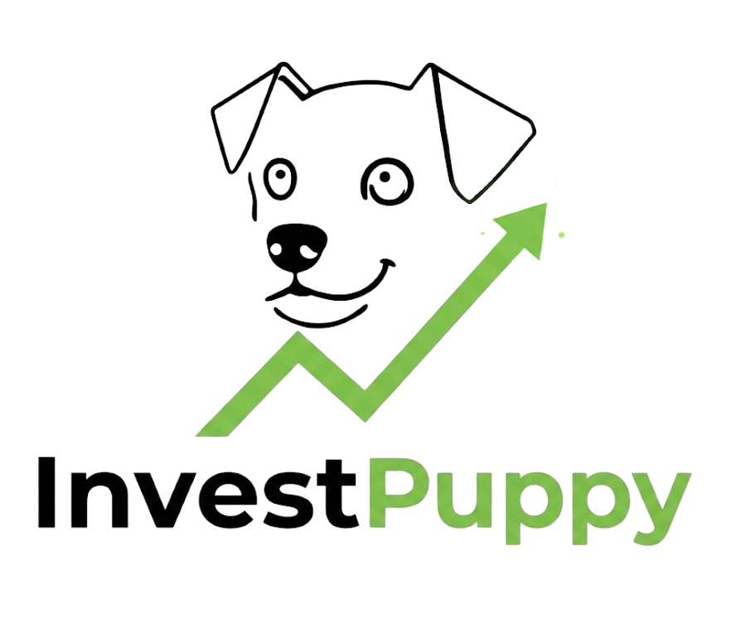
THE PROBLEM
Wealth managers are flying blind.
Boutique DPMs, independent RIAs, and family offices manage real money for real clients. They know systematic portfolio construction matters. But institutional-grade quant tools are built — and priced — for institutions. The middle market is ignored.
Priced for institutions
Bloomberg and FactSet charge tens of thousands per seat. Bespoke quant builds take years. Boutique managers face a bill designed for large buy-side desks.
~$32,000
Built for institutions
Existing platforms assume large quant teams and complex infrastructure. Boutique managers get the wrong product even when they can afford the price tag.
Bloomberg Terminal — per seat, per year (2026 verified).
Before Bloomberg PORT or any quant tooling is added.
No credible middle-market option
Enterprise platforms (Refinitiv, FactSet) run $24K–$50K+ per seat. The managers who need systematic tools most cannot access them.
Spreadsheets and gut feel fill the gap. Portfolio construction decisions lack rigour — not from lack of ambition, but lack of accessible tools.
InvestPuppy · investpuppy.com · contact@investpuppy.com · CONFIDENTIAL

Slide 3
WHY NOW
Three forces converging — right now.
01
02
03
Singapore's wealth
management moment
The cost of systematic
analysis has collapsed
Incumbents have no
incentive to move
MAS-regulated clarity, a dense independent advisor community, and record family office formation make Singapore the world's cleanest entry point. 2,000+ single family offices (MAS, 2024). 500+ independent wealth managers. The regulatory framework is settled. The clients are here. The timing is precise.
Running 10,000 portfolio configurations was computationally expensive a decade ago. Today it is not. The infrastructure exists to deliver institutional-grade systematic analysis at a fraction of historical cost. No one has productised this for the wealth management middle market.
Bloomberg and FactSet price for large institutions — their economics depend on it. The boutique wealth manager segment is too fragmented for them to serve directly. This gap is structural, not temporary. It will not be closed by the incumbents.
InvestPuppy · investpuppy.com · contact@investpuppy.com · CONFIDENTIAL

Slide 4

THE PLATFORM
Vektor.
Vektor is a systematic listed equity portfolio management platform built specifically for boutique wealth managers, family offices, and independent RIAs. It delivers institutional-grade rigour — without the institutional price tag, team size, or infrastructure requirement.
METHODOLOGY
10,000 portfolio configurations per strategy
The quantitative methodology behind Vektor is documented across 11 research papers — WP-00 through WP-10 — covering systematic construction, risk management, and portfolio analysis. Available on request.
Systematic construction at scale. Not guesswork. Not intuition.
Market-agnostic architecture
Any listed equity exchange, any currency. SGX is the primary use case.
THOUGHT LEADERSHIP
InvestPuppy: Unvarnished — 9 papers, 38 pages on financial software implementation failure. Panel-reviewed by 20 independent professionals. Already in circulation. Strapline: field notes from decades of bad projects.
Workflow-native integration
Sits alongside existing custody and reporting infrastructure.
Data-layer independent
Runs on IBKR market data as standard. Does not require Bloomberg feeds. Custom data connections available.
Audit-ready output
99.94% availability target. Every decision documented from day one.
VEKTOR BY INVESTPUPPY
InvestPuppy · investpuppy.com · contact@investpuppy.com · CONFIDENTIAL

Slide 5
POSITIONING
What Vektor is not.
Precision about what a product is not is rarer than precision about what it is. Both matter to a serious buyer — and a serious investor.
NOT
Not a data terminal
NOT
Not a replacement project
Vektor does not compete with Bloomberg or Refinitiv. It uses the data infrastructure the client already has and builds a systematic construction layer on top of it.
For most clients, nothing disappears — Vektor sits alongside existing custody, reporting, and CRM in days, not months. Exception: for Bloomberg PORT users, Vektor directly replaces the portfolio construction module. That is a replacement worth making.
NOT
Not algorithmic trading
NOT
Not priced for institutions
Vektor is systematic portfolio management — construction, analysis, documentation. It is not a prop desk tool, not high-frequency, not speculative. It is what regulated wealth managers need.
The middle market is the market. Boutique DPMs, independent RIAs, and family offices cannot justify enterprise pricing. Vektor is designed from the ground up for the segment every incumbent has ignored.
InvestPuppy · investpuppy.com · contact@investpuppy.com · CONFIDENTIAL

Slide 6
MARKET OPPORTUNITY
A clear market. A clear entry point.
Now
No PORT — capability provision
Singapore
Bloomberg Terminal without PORT. Add systematic construction for 56% of what one Terminal seat costs. Longer conversion path — value must be demonstrated, not compared.
2,000+ single family offices (MAS, 2024) — up from 400 in 2020. 500+ independent wealth managers. MAS regulatory clarity. Vektor is distribution-ready for this market today.
12–24 months
Bloomberg PORT users — replacement
Southeast Asia
PORT stays for risk reporting. Vektor replaces PORT's equity construction function. Total Bloomberg spend falls. Construction capability improves. Fastest to close.
Hong Kong, Malaysia, Thailand. Similar regulatory profiles. Existing InvestPuppy professional network extends here.
24–36 months
Data feed clients — development termination
Established markets
Running Bloomberg feeds for in-house quant work. Vektor ends the build. Note: sunk cost psychology requires quantifying continued build cost vs switching.
UK (FCA — regulatory content in development). Australia. Middle East. Platform requires no structural change to enter.
InvestPuppy · investpuppy.com · contact@investpuppy.com · CONFIDENTIAL

Slide 7
BUSINESS MODEL
AUM-tiered annual subscription.
Pricing is set. The model is AUM-tiered subscription — predictable SaaS revenue that grows as clients grow. Indicative pricing below, subject to Founding Mandate validation.
Tier
AUM
Annual price
Bloomberg context
THREE
ENTRY
MOTIONS
Entry
Up to S$75M AUM
S$24,000/yr
< 1 Bloomberg seat (S$43K+)
Growth
S$75M – S$250M AUM
S$48,000/yr
32–63% of 2–4 seat Bloomberg bill
Capability
No PORT. Terminal only. 56% of Terminal cost.
Institutional
S$250M – S$750M AUM
S$108,000/yr
40–57% of total Bloomberg spend incl. PORT (S$190K–S$270K typical)
Replacement
Enterprise
S$750M+
S$168,000+/yr
< 30% of typical Bloomberg + PORT infrastructure at scale
PORT users. Construction replaced. Risk stays.
Founding Mandate pricing: S$18,000/year for the first 12 months — 25% below the entry tier. From year two: permanently 1 tier below their AUM tier (floor: Entry at S$24,000). The permanent benefit scales with client growth — and generates NRR.
Termination
Data feed clients. Ends in-house build.
InvestPuppy · investpuppy.com · contact@investpuppy.com · CONFIDENTIAL

Slide 8
TRACTION
Where we are. Honestly.
The platform is built
The commercial machine is ready
Vektor runs in IBKR simulation mode. Full portfolio construction capability is live. It has not yet executed in a live account. That is what the seed round is for. The engineering gap is defined and costed.
25 client-facing documents. 5 presentation decks. A fully specified Founding Mandate Programme. A DD Navigation Guide. An NDA. A First 90 Days onboarding plan. Ready to deploy. Waiting for the first conversation to become a signed mandate.
The thought leadership is in circulation
The methodology is documented
InvestPuppy: Unvarnished — 9 papers, 38 pages on financial software implementation failure. Panel-reviewed by 20 independent professionals. Already reaching the professionals who will buy Vektor.
11 research papers (WP-00 – WP-10) document the quantitative approach behind Vektor. Available on request. This is not a black box. We can show our working.
InvestPuppy · investpuppy.com · contact@investpuppy.com · CONFIDENTIAL

Slide 9
THE TEAM
Two founders. One focus.
Senior leadership in fintech and financial software. Direct experience in this market. The problem Vektor solves is one we have encountered firsthand.
CEO
[FOUNDER A — NAME]
CTO
[FOUNDER B — NAME]
Senior leadership background in fintech and financial software. Extensive B2B sales experience selling into wealth managers, independent RIAs, and institutional clients. Deep familiarity with the operational context Vektor is built for.
[Biography to be completed. Fintech / financial software background. Experience directly relevant to platform architecture and quantitative systems development underpinning Vektor.]
Commercial leadership
Platform architecture
Client relationships
Quantitative systems
Market strategy
Engineering leadership
InvestPuppy · investpuppy.com · contact@investpuppy.com · CONFIDENTIAL

Slide 10
USE OF FUNDS
S$1M–S$2M — where it goes and what it delivers.
~45%
~30%
~25%
Engineering & product
Sales & BD headcount
Operational runway
Live-account validation and deployment. Platform hardening, security, performance. Capability build-out for launch.
First commercial hires to execute the Founding Mandate Programme and build the Singapore client base.
18–24 months of operational coverage. MAS regulatory engagement. FCA content pipeline. Legal and compliance.
MILESTONE TIMELINE — CLOSE TO FIRST REVENUE
M1–3
M4–6
M7–9
M9–13
Commercial hire. Engineering sprint. Founding Mandate conversations open.
Platform live-account validated. First Founding Mandate demos.
First client signed. WP-07 complete — UK distribution unlocked.
First revenue. Second and third clients. Series A preparation.
InvestPuppy · investpuppy.com · contact@investpuppy.com · CONFIDENTIAL

Slide 11
THE ASK
The ask is S$1–2M. Here is exactly what it funds.
S$1,000,000 – S$2,000,000
Seed round · Singapore-led close
What you get
Equity stake
Seed-round equity in InvestPuppy. Instrument and cap table discussed with interested investors — not before.
We have not fixed the valuation because we believe the right investor conversation determines the right number. We have a range in mind. If you are the right investor, we will share it.
Founding Mandate access
What we want in an investor partner:
12-month founding rate at S$18,000/year, then permanently 1 tier below their AUM tier. Investors with client relationships can facilitate introductions.
Domain experience in fintech, wealth management, or financial infrastructure
Transparent reporting
Network into Singapore's family office and independent RIA community
Quarterly updates. Honest assessment of progress and setbacks. Not a promise we make lightly. Consistent with our governing principle.
Patient capital — this is a relationship-driven B2B market
First-mover position
Alignment with the principle of building honestly
Entry before the category is competed. Singapore architecture ready now. Global architecture already in place.
InvestPuppy · investpuppy.com · contact@investpuppy.com · CONFIDENTIAL

Slide 12
Honest by design.
Serious when it matters.
We are building a platform that wealth managers can trust — in the rigour of its construction, the clarity of its output, and the honesty of the team behind it. We apply the same standard to this investor pack.
contact@investpuppy.com
investpuppy.com
CONFIDENTIAL · NOT AN OFFER OF SECURITIES

