Slide 1
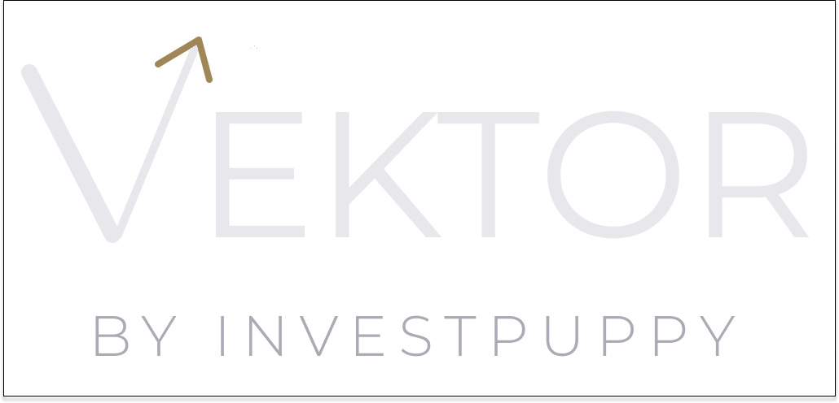
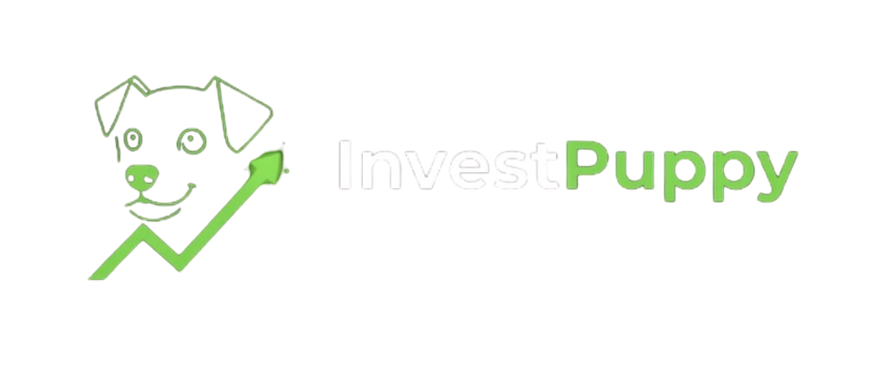
THE SIXTY-MINUTE MEETING
One Size Fits None.
Serious when it matters.
Giving wealth teams the quantitative infrastructure institutional asset managers take for granted.
investpuppy.com · contact@investpuppy.com · For professional and institutional investors only

Slide 2
THE PROBLEM
Manual process
The tools that generate genuine alpha have always required institutional infrastructure.
Excel-based allocation. No systematic signal selection.
Spreadsheets don't cut it. Institutional platforms are out of reach. Retail robo-tools were built for someone else entirely.
No audit trail
Decisions undocumented. Compliance exposure.
Scale ceiling
Adding mandates means adding headcount.
Vektor by InvestPuppy · The Sixty-Minute Meeting

Slide 3
THE PLATFORM
Systematic listed equity portfolio management.
Standalone or integrated. Complement, not replace.
Universe to portfolio
Per-instrument signal selection
Capital allocation precision
Screen 500+ instruments down to a target portfolio using liquidity, sector, and dividend criteria. 10,000 portfolio configurations map the efficient frontier; Modern Portfolio Theory identifies the max-Sharpe allocation.
Grid search across six technical indicators per holding. XGBoost validates every live signal before it reaches the portfolio manager's review screen.
Percentage weights become exact share quantities at live prices, with lot-size rounding and cash buffer management. 99.94%+ allocation efficiency.
Vektor by InvestPuppy · The Sixty-Minute Meeting

Slide 4
HOW IT WORKS
Eleven steps. From universe screening to funded positions.
01
02
03
04
05
06
Define universe
→
Screen
→
Optimise
→
Validate diversification
→
Select signals
→
PM review & approval
07
08
09
10
11
Onboard client
→
Run allocation
→
Fund mandate
→
Market orders
→
Monitor
Stock Analyst
Portfolio Manager
Operations
Vektor by InvestPuppy · The Sixty-Minute Meeting

Slide 5
WHY VEKTOR
Five reasons a DPM switches from spreadsheets to systematic.
01 Scalability without headcount
02 Audit trail by design
03 Signal quality, per instrument
Adding client mandates is a database operation. The platform scales; your team doesn't have to.
Every decision logged with user identity and timestamp. Compliance documentation is a by-product of normal operation.
Not one indicator for the whole portfolio. The optimal technical indicator, selected and validated, for every individual holding.
04 Capital precision
05 Any market, any currency
99.94%+ capital allocation efficiency. Percentage weights become exact quantities at live prices.
Exchange, benchmark, and currency are configuration parameters. SGX today. Any listed market tomorrow.
Vektor by InvestPuppy · The Sixty-Minute Meeting

Slide 6
THE NUMBERS
What the platform produces.
10,000
99.94%+
portfolio configurations — efficient frontier mapped, MPT selects max-Sharpe
Capital allocation efficiency
6
3 years
Technical indicators evaluated per instrument
Daily price history for signal optimisation
Vektor by InvestPuppy · The Sixty-Minute Meeting

Slide 7
THE HONEST ANSWER
What we are, and what we are not.
WE ARE
WE ARE NOT
— A systematic portfolio construction platform for listed equities
— A black box — every decision is visible, logged, and human-approved
— An eleven-step workflow from screening to funded positions
— A replacement for the portfolio manager's judgement
— A platform built for DPMs managing client capital, not retail investors
— A robo-advisor — institutional controls at every stage
— Market-agnostic — any exchange, any currency, any benchmark
— In production with live client capital yet — we are building that now
Vektor by InvestPuppy · The Sixty-Minute Meeting

Slide 8
SEE IT LIVE
We will run the platform on your market, your benchmark, your currency.
Pick any listed equity market, any currency, any benchmark. We will run the full Vektor workflow and show you the output live — the efficient frontier, the correlation matrix, the max-Sharpe allocation, and the per-instrument signal selection.
No slides. No promises. Just the platform, working on your data.
SGX is the demonstrated market. Any listed equity exchange with sufficient price history is supported — configure the exchange, lot sizes, and benchmark. The engine runs identically.
Vektor by InvestPuppy · The Sixty-Minute Meeting

Slide 9
WORKFLOW INTEGRATION
What changes. What stays exactly as it is.
DPM task
Vektor's role
What changes
Universe screening
Replaces
Systematic screening vs configured criteria. Replaces manual Bloomberg filters.
Portfolio optimisation
Replaces
10,000 portfolio configurations → efficient frontier → MPT max-Sharpe allocation. Replaces Excel model.
Indicator selection
Replaces
Grid search across 6 indicators per instrument. XGBoost validated.
Strategy approval
Unchanged
PM reviews complete strategy and approves. Structurally required. Better-informed.
Weight → share quantities
Replaces
Exact lot-rounded quantities at live prices. 99.94%+ allocation efficiency.
Client relationships
Unchanged
Suitability, reporting, communication — entirely with the portfolio manager.
Vektor by InvestPuppy · The Sixty-Minute Meeting

Slide 10
WHAT WE WANT YOU TO KNOW
Three things we will tell you before you ask.
01
02
03
No live track record yet.
Simulation is not live trading.
Backtest ≠ live performance.
The platform is operational in simulation mode. The complete workflow — research through order execution — is tested and running. A live track record begins with the first Founding Mandate client. We say this directly because it is a material fact.
The IBKR connection currently runs on a simulation account. Market impact, partial fills, and liquidity constraints are not yet modelled in live conditions. Live execution is activated before the first client onboards — that is a defined trigger, not a vague roadmap item.
Systematic strategies optimised on historical data will not perform identically in live markets. XGBoost validation reduces this gap. Walk-forward validation — the most rigorous proxy — is on the near-term roadmap. The PM approval gate is the final human check before any capital moves.
Full risk disclosure: WP-09 · Risk & Limitation Disclosure — available in the document suite.
Vektor by InvestPuppy · The Sixty-Minute Meeting

Slide 11
FOUNDING MANDATE PROGRAMME
This window is closing.
Three to five Founding Mandate positions. When the cohort is complete, these terms are gone permanently.
Commercial terms
Platform access
Founding Mandate pricing — locked permanently. Never increases.
Configured around your specific instruments, markets, and client profile.
Roadmap input
Recognition
Formal input into product development. Your workflow shapes the platform.
Acknowledged as a Founding Mandate partner in all communications.
Vektor by InvestPuppy · The Sixty-Minute Meeting

Slide 12
“
A NOTE FROM THE FOUNDER
Vektor was built because the tools that generate genuine alpha have always been out of reach for the firms that need them most.
Independent DPMs, boutique family offices, emerging market asset managers — these firms are doing real work with real clients, and they deserve institutional-grade tools.
Vektor is not a robo-advisor. It is not built for retail investors. It is built for professionals who manage capital seriously, who want systematic rigour without sacrificing their own judgement, and who believe that a well-constructed, well-governed quantitative process is better than an undocumented one.
The Founding Mandate programme is how we build this together. Not by selling a finished product — by partnering with the firms whose workflows shape what gets built.
BY INVESTPUPPY
Vektor by InvestPuppy · The Sixty-Minute Meeting

Slide 13
THE DOCUMENT SUITE
Everything you need for a complete due diligence process.
START HERE
COMMERCIAL
METHODOLOGY
At a Glance + Brochure
Why Vektor + Brand Story
WP-01 through WP-05
Platform overview and eleven-step workflow.
The market argument and the origin of the platform.
Portfolio construction, signal optimisation, allocation, multi-currency.
One page and four pages. First read.
For the PM and the principal.
For quant analysts and technical reviewers.
GOVERNANCE
TECHNICAL
NAVIGATION
WP-06, WP-08, WP-09
WP-07
DD Navigation Guide + FAQ
Audit trail, AI governance, risk disclosure.
AWS architecture, decision log, integration patterns.
Which document answers which question. Twelve plain-language answers.
For compliance officers and risk committees.
For CTOs and technical due diligence.
Start here if the suite feels large.
Vektor by InvestPuppy · The Sixty-Minute Meeting

Slide 14
BY INVESTPUPPY
Serious when it matters.
Enquire about Founding Mandate availability.
investpuppy.com
contact@investpuppy.com

