Slide 1
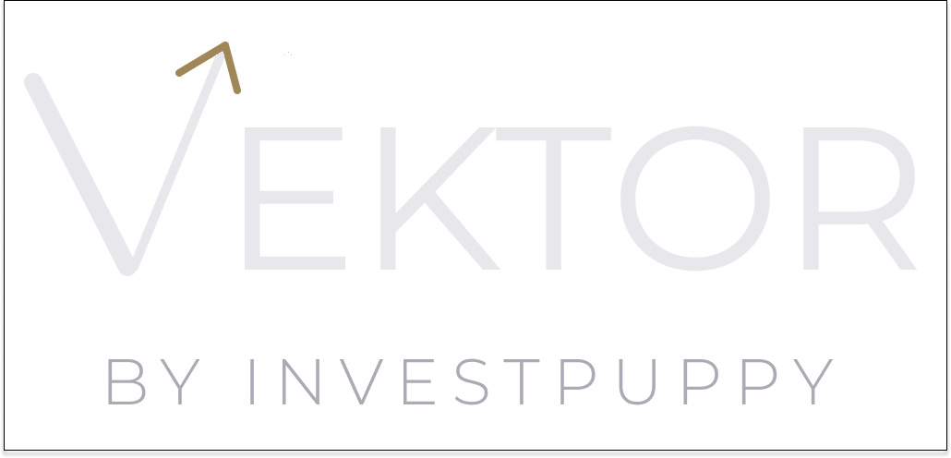

TECHNICAL DEEP DIVE
One Size Fits None.
Serious when it matters.
The methodology, the signal architecture, and the infrastructure — for quant analysts, CIOs, and technical due diligence teams.
investpuppy.com · contact@investpuppy.com · For professional and institutional investors only

Slide 2
AGENDA
Four areas. Ninety minutes.
01
Portfolio construction
Efficient frontier optimisation (10,000 portfolio configurations), correlation verification.
02
Signal architecture
Six indicators, grid search, XGBoost validation, per-instrument selection.
03
Capital allocation
Weight-to-position translation, lot rounding, 99.94%+ efficiency.
04
How to evaluate the outputs
Sharpe ratio, drawdown, benchmark comparison — reading Vektor's strategy results.
Vektor by InvestPuppy · Technical Deep Dive

Slide 3
UNIVERSE SCREENING
From 500+ instruments to the optimal portfolio.
Vektor applies three layers of systematic screening to any listed equity universe. Liquidity filter: minimum average daily volume threshold. Sector filter: configurable sector membership criteria. Dividend continuity: minimum years of consecutive dividend payment. The screened universe is the input to portfolio optimisation — not the final portfolio. Instrument selection remains a human decision.
Vektor by InvestPuppy · Technical Deep Dive

Slide 4
EFFICIENT FRONTIER OPTIMISATION
10,000 portfolio configurations. One MPT-optimised allocation.
10,000
portfolio configurations per strategy
For each strategy, Vektor generates 10,000 random portfolio weight combinations to map the feasible risk-return space. Each combination is evaluated on annualised return, volatility, and Sharpe ratio. The resulting scatter plots the empirical efficient frontier — the set of portfolios that maximise return for each level of risk. Modern Portfolio Theory then identifies the max-Sharpe portfolio: the allocation that produces the highest ratio of excess return to standard deviation. This is the target allocation.
Vektor by InvestPuppy · Technical Deep Dive

Slide 5
EFFICIENT FRONTIER
The geometry of optimal allocation.
The efficient frontier is generated by the portfolio configuration process. Every point on the frontier represents a portfolio that cannot be improved — no reallocation produces more return at the same risk level. The max-Sharpe point (marked in gold) is the portfolio where the ratio of excess return to volatility is maximised by Modern Portfolio Theory. This is Vektor’s target allocation before lot-size rounding. The frontier is visualised for every strategy build and presented to the Portfolio Manager at the approval stage.
Vektor by InvestPuppy · Technical Deep Dive

Slide 6
CORRELATION VERIFICATION
Diversification as a property, not a claim.
< 0.7
target pairwise correlation
After the max-Sharpe allocation is identified, Vektor computes the full pairwise correlation matrix for the selected instruments. High correlation between instruments means the portfolio is effectively less diversified than the instrument count suggests — a portfolio of ten instruments with average pairwise correlation of 0.85 is closer to a concentrated position than a diversified one. Correlation matrix verification is a required step before Portfolio Manager approval. Instruments with pairwise correlation above the configured threshold are flagged.
Vektor by InvestPuppy · Technical Deep Dive

Slide 7
SIGNAL ARCHITECTURE
Six indicators. One winner per instrument.
6
indicators evaluated per instrument
Vektor evaluates six technical indicators for every instrument in the portfolio: SMA (Simple Moving Average), EMA (Exponential Moving Average), MACD (Moving Average Convergence Divergence), Bollinger Bands, RSI (Relative Strength Index), and Stochastic Oscillator. For each indicator, a parameter grid is searched over the three-year historical window — optimising for Sharpe ratio. The highest-Sharpe configuration for each instrument is selected as the candidate signal.
Vektor by InvestPuppy · Technical Deep Dive

Slide 8
XGBOOST VALIDATION
Every live signal, validated against current conditions.
XGBoost
signal validation layer
Once the optimal indicator configuration is selected for each instrument, the live signal is validated by the XGBoost classification model before it reaches the Portfolio Manager's review screen. XGBoost evaluates whether the current signal — given current market conditions — is consistent with historical instances where the same indicator configuration produced a positive outcome. Signals below the confidence threshold are filtered. The confidence score and pass/fail status are stored in the strategy record and visible to the PM at approval.
Vektor by InvestPuppy · Technical Deep Dive

Slide 9
CAPITAL ALLOCATION
Weights become quantities. Quantities become positions.
Once a strategy is approved and capital is funded, Vektor runs the allocation calculation: fetch live prices from the database, multiply each instrument's portfolio weight by the total mandate capital to get target value, divide by the live price to get the raw quantity, round down to the nearest lot size. The residual — the capital that cannot be deployed due to lot-size rounding — is retained as a cash buffer. The full breakdown is displayed to the Portfolio Manager before confirmation.
Vektor by InvestPuppy · Technical Deep Dive

Slide 10
CAPITAL ALLOCATION EFFICIENCY
99.94%+ capital deployed.
99.94%+
allocation efficiency
The difference between the target capital and the actually deployed capital — after lot-size rounding — determines capital allocation efficiency. In simulation testing with a ten-instrument SGX portfolio at a typical mandate size, Vektor achieves 99.94%+ efficiency. The practical minimum recommended mandate size for a ten-instrument SGX portfolio is SGD 100,000 — below this threshold, lot-rounding effects become more pronounced. The efficiency figure is calculated and displayed at the allocation confirmation screen.
Vektor by InvestPuppy · Technical Deep Dive

Slide 11
AUDIT TRAIL
Every decision. Every user. Every timestamp.
Vektor produces a complete audit trail as a by-product of normal platform operation — not as a separate compliance layer. Every action across all eleven workflow steps is logged: the user who performed it, the timestamp, the action taken, and the state before and after. The three-role model (Analyst / Portfolio Manager / Operations) ensures structural separation — no user can perform actions outside their role. The complete chain from research to trade-ready position is retrievable at any point, for any strategy, without reconstruction.
Vektor by InvestPuppy · Technical Deep Dive

Slide 12
TECHNICAL ARCHITECTURE
AWS microservices. Region-agnostic by design.
Vektor runs on AWS (currently ap-southeast-1, Singapore) using a containerised microservices architecture on ECS Fargate. SageMaker serves two distinct roles: JupyterLab research environment for universe screening, and a managed XGBoost inference endpoint for signal validation. SQS decouples order generation from IBKR execution. EventBridge and Step Functions provide observable, retryable workflow orchestration. Cognito with Azure EntraID federation enables enterprise SSO. The two-account CI/CD strategy means deploying to any AWS region is a pipeline configuration, not an architecture change.
Vektor by InvestPuppy · Technical Deep Dive

Slide 13
EVALUATING THE OUTPUTS
How to read Vektor's strategy results.
Vektor uses Sharpe ratio as its optimisation objective — making it the directly applicable metric for evaluating every strategy output.
Sharpe ratio
Drawdown
Primary metric. Vektor's optimisation objective. A backtest Sharpe above 1.0 is a reasonable starting point. Above 2.0 warrants overfitting questions. Expect 50–70% of backtest Sharpe in live conditions.
Assess depth and duration together. A 20% drawdown recovering in 3 months is a different client experience from one taking 3 years. Check performance across sub-periods, not just the full backtest window.
Benchmark
Walk-forward validation
Use a sector-blended benchmark — not a single index. A concentrated ten-instrument portfolio will have different sector exposure from the STI or any single-country index.
The most honest test: optimise on in-sample data, test on out-of-sample period, advance window, repeat. On the Vektor near-term roadmap. Until then, XGBoost validation is the live signal quality check.
Full methodology: WP-10 · Evaluating Systematic Strategy Performance
Vektor by InvestPuppy · Technical Deep Dive

Slide 14
THE HONEST QUESTION
Isn't this just curve-fitting?
Yes. And here is what we do about it.
The risk
Structural mitigation 2
A grid search across three years of historical data will always find parameters that performed well in that period. The question is whether those parameters reflect genuine alpha or historical noise.
Three-year look-back window. Long enough to include multiple market regimes — trending and mean-reverting periods, high and low volatility. Parameters that work across regimes are more likely to be genuine.
Structural mitigation 1
Structural mitigation 3
Sharpe ratio as the objective function. Sharpe is more robust to outliers than raw return — it penalises volatility and rewards consistency, making it harder to overfit to a single strong period.
XGBoost validation. Live signals are validated against current market conditions before the PM sees them. A historically strong signal that looks anomalous now is filtered before it reaches approval.
What we do not yet have — Formal walk-forward validation — testing optimised parameters against genuinely out-of-sample data. This is on the near-term roadmap. Until then, the three mitigations above are the controls.
Vektor by InvestPuppy · Technical Deep Dive

Slide 15
BY INVESTPUPPY
Serious when it matters.
Request the full research series — ten white papers.
investpuppy.com
contact@investpuppy.com

