Slide 1
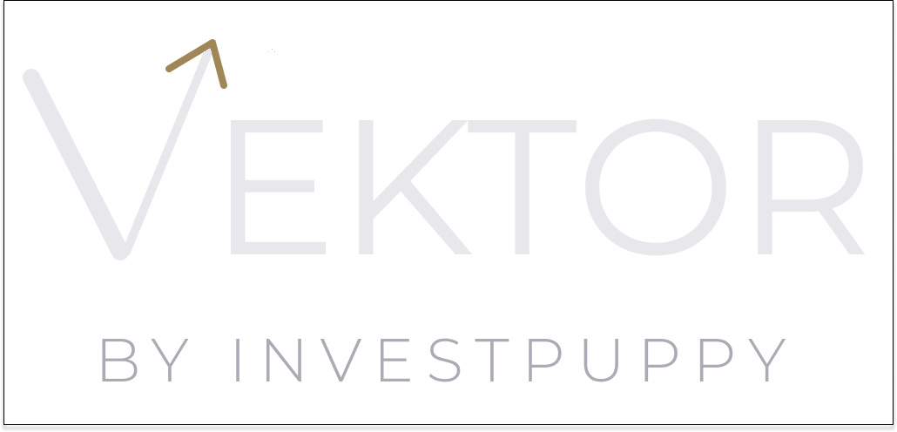
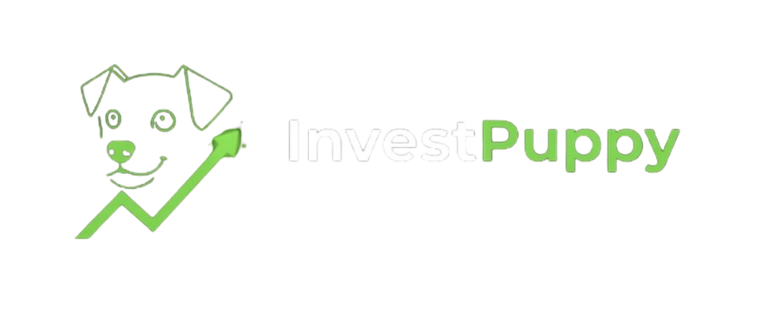
THE INSTITUTIONAL PARTNER
One Size Fits None.
Serious when it matters.
For established DPMs and family offices evaluating systematic infrastructure — a different kind of partnership.
investpuppy.com · contact@investpuppy.com · For professional and institutional investors only

Slide 2
WHERE YOU ARE
You have built something real.
An established DPM or family office has clients, AUM, and a process that works. The question is not whether to build systematic capability — it is whether to build it alone, buy an off-the-shelf platform that was not designed for your workflow, or partner with a platform that will configure itself around you.
Vektor is the third option. Not a product you adopt. A platform built with you.
Vektor by InvestPuppy · The Institutional Partner

Slide 3
THE INFRASTRUCTURE GAP
The tools you actually need have always been out of reach.
Institutional systematic platforms — the kind with full quantitative portfolio construction, per-instrument signal optimisation, XGBoost validation, and a complete three-role audit trail — have historically required a minimum AUM that most boutique firms never reach, or an in-house quant team that most boutique firms cannot afford.
Vektor is built to close this gap. Not by simplifying the methodology — by making institutional-grade methodology accessible without institutional-scale infrastructure costs.
Vektor by InvestPuppy · The Institutional Partner

Slide 4
THE VEKTOR ENGINE
The quantitative layer your team doesn't have to build.
Universe screening. Efficient frontier optimisation across 10,000 portfolio configurations with MPT max-Sharpe selection. Per-instrument signal selection across six technical indicators. XGBoost signal validation. Lot-size-precise capital allocation. A three-role audit trail that documents every decision from research to funded position.
All of this runs on AWS infrastructure that is region-agnostic, enterprise-SSO compatible, and designed to integrate with your existing PMS via REST API.
Vektor by InvestPuppy · The Institutional Partner

Slide 5
STANDALONE OR INTEGRATED
Complement, not replace.
Vektor produces a trade-ready allocation table via API — instruments, target quantities, target values — that feeds into your existing order management workflow. Your PMS, your custody interface, your client reporting: all unchanged. Vektor is the systematic construction layer that sits upstream of everything you already use.
A two-to-four week integration project connects Vektor's allocation endpoint to your existing PMS. Bloomberg continues to serve price discovery, news, and client reporting. Vektor handles the quantitative construction workflow.
Vektor by InvestPuppy · The Institutional Partner

Slide 6
THE THREE-ROLE MODEL
Institutional governance from the first mandate.
Stock Analyst. Portfolio Manager. Operations. Three structurally separated roles — each with distinct capabilities and explicit approval requirements. No user can perform actions outside their role. Every action across all eleven workflow steps is logged with user identity and timestamp.
The PM approval gate is the central control: no strategy reaches a client portfolio without an explicit PM approval action. No allocation executes without PM confirmation. No cash moves without Operations recording the wire. This is not a compliance feature — it is the architecture of the platform.
Vektor by InvestPuppy · The Institutional Partner

Slide 7
THE AUDIT TRAIL
Every decision, documented. Every action, attributed.
Vektor produces a complete audit trail as a by-product of normal platform operation. Strategy creation and approval. Client onboarding and risk profile assignment. Allocation calculation and confirmation. Cash funding with wire reference. Market order submission and execution. Every step logged, every user identified, every timestamp recorded.
A compliance officer reviewing any position can retrieve the complete chain — from the universe screening that produced the strategy, through the PM approval, to the market orders that funded the position — without reconstruction. The audit trail is not a separate system. It is the platform.
Vektor by InvestPuppy · The Institutional Partner

Slide 8
TECHNICAL ARCHITECTURE
Integration architecture.
USERS
Stock Analyst
Portfolio Manager
Operations
FRONTEND / API
React Admin Portal
AWS API Gateway
Cognito + Azure EntraID SSO
COMPUTE
ECS Microservices
SageMaker (Research + XGBoost endpoint)
EC2 IBKR Gateway
DATA / INFRA
RDS PostgreSQL
S3 + KMS
EventBridge + Step Functions + SQS
Region-agnostic. Current: ap-southeast-1 (Singapore). Any AWS region configurable via CI/CD pipeline.
Vektor by InvestPuppy · The Institutional Partner

Slide 9
THE PARTNERSHIP STRUCTURE
A different kind of founding mandate.
The Founding Mandate is not a discount on a standard product. It is a partnership in which your workflow shapes what gets built. Vektor is configured around your specific instruments, markets, and client profiles — not the other way around.
Founding Mandate partners receive preferential pricing locked for the duration of the relationship, formal input into the product roadmap, and direct access to the founding team. In exchange, they are building the platform alongside us — their operational experience during the early stage informs every subsequent development decision.
Risk disclosure: WP-09 · Risk & Limitation Disclosure — available in the document suite.
Vektor by InvestPuppy · The Institutional Partner

Slide 10
RISK & DUE DILIGENCE
Full disclosure available. We mean that.
The document suite includes WP-09: Risk & Limitation Disclosure — a structured, practitioner-level analysis of every significant risk category: model risk, execution risk, data risk, and operational risk. Each risk is assessed for likelihood and impact, with mitigations in place and those on the roadmap stated explicitly.
The suite also includes WP-06 (Audit Trail & Compliance), WP-07 (Technical Architecture with decision log), WP-08 (AI governance and MAS FEAT / SFC / FCA alignment), and WP-10 (how to evaluate systematic strategy performance). Full technical documentation — VPC architecture, RDS schema, IAM policies — available on request.
Vektor by InvestPuppy · The Institutional Partner

Slide 11
WHAT IS NOT YET LIVE
Three things we will tell you before you ask.
Live trade execution: the IBKR Gateway currently runs on a simulation account. The full order flow is tested and operational. Live execution is activated before the first Founding Mandate client onboards — a defined trigger condition.
Production environment: the current workload runs in the dev environment. Promotion to production occurs before the first client onboards.
Live track record: the platform has been validated in simulation. A live track record begins with the first Founding Mandate client. This is stated directly because it is a material fact for any institutional due diligence process.
Vektor by InvestPuppy · The Institutional Partner

Slide 12
THE ASK
Three to five positions. Currently open.
The Founding Mandate cohort is limited by design. Enough partners to build genuine operational breadth. Few enough that each one receives direct founding-team access and meaningful roadmap influence.
The programme closes when the cohort is complete. There are no extensions and no standard commercial alternative at these terms. Founding Mandate pricing is locked for the duration of the relationship — it never increases, regardless of how the platform develops or how AUM grows.
What happens next: a live demonstration on your data. Your market, your benchmark, your currency. No slides. Just the platform, working.
Vektor by InvestPuppy · The Institutional Partner

Slide 13
BY INVESTPUPPY
Serious when it matters.
Request Founding Mandate terms and the full document suite.
investpuppy.com
contact@investpuppy.com

