Slide 1
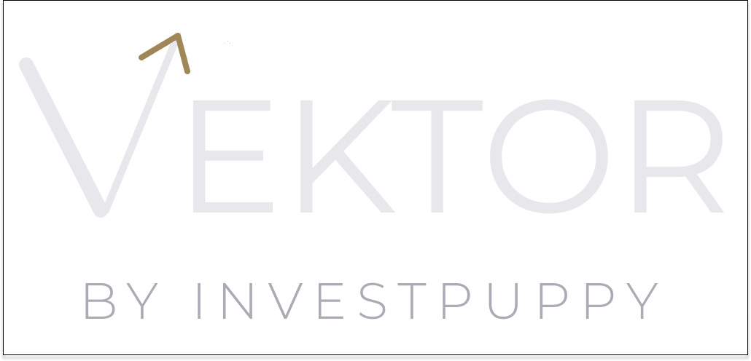
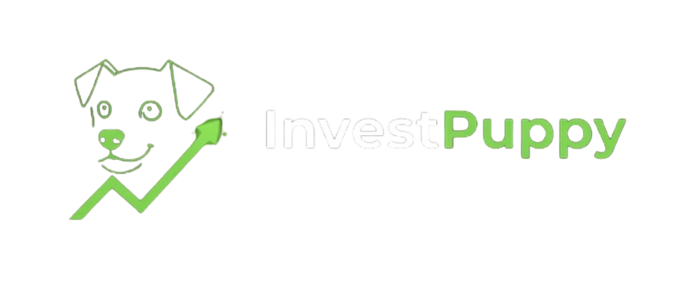
DUE DILIGENCE PRESENTATION
Governance, Risk &
Institutional Controls
This presentation answers the four questions a compliance officer, risk committee, or CTO will ask when evaluating Vektor for institutional adoption. Every claim is supported by a document in the due diligence suite.
For compliance officers, CTOs, and risk committees
Serious when it matters.
investpuppy.com · contact@investpuppy.com

Slide 2
AGENDA
Four questions. This presentation answers all four.
A compliance officer evaluating a systematic portfolio management platform needs answers to four questions. This presentation works through them in order.
01
Human oversight
At what specific points does a human act? Can the machine trade without approval?
02
AI governance
Where is machine learning used? What does it do — and what does it not do?
03
Audit trail
What is logged? Who has access? How is the compliance record produced?
04
Risk & infrastructure
What are the platform risks? How is it built and where does data reside?
Vektor by InvestPuppy · Due Diligence Presentation

Slide 3
QUESTION 01 · HUMAN OVERSIGHT
Five gates. Capital cannot move without human action at each one.
The human approval gates are structural — enforced by the platform workflow architecture, not configurable. The machine does not trade.
Strategy approval
PM reviews all instruments, weights, indicators, and XGBoost validation results. Explicit approval required. No strategy reaches a client without this record.
Portfolio Manager
Client assignment
PM creates client profile and assigns the approved strategy. Separate explicit action from strategy approval — cannot be combined.
Portfolio Manager
Allocation execution
PM reviews full position breakdown (symbols, quantities, prices, efficiency) and confirms. Cannot proceed without explicit PM confirmation.
Portfolio Manager
Cash funding
Operations records wire transfer with currency, amount, and reference. Operations cannot approve strategies or initiate allocations — structurally separated.
Operations
Market order submission
Orders submitted to IBKR Gateway only after all prior gates are complete. Executes only positions a human PM has already approved in full.
System — post-approval only
Reference: WP-06 Audit Trail & Compliance · WP-08 AI as Instrument

Slide 4
QUESTION 02 · AI GOVERNANCE
AI as instrument. Not as decision-maker.
WHERE ML IS USED
WHERE ML IS NOT USED
Universe screening
— Investment decisions — PM approves every strategy
Statistical analysis reduces 500+ instruments to target portfolio size. Every criterion is explicit and inspectable. Output reviewed by human analyst.
— Portfolio weight determination — efficient frontier optimisation (not ML); MPT identifies max-Sharpe
— Client suitability assessment — PM judgement only
— Compliance sign-off — human gates cannot be automated
XGBoost signal validation
Validates live signals before PM review. Produces a confidence score and pass/fail classification. Does not approve or act on signals — it is one input to the PM decision.
— Instrument selection — analyst selects from screened universe
The boundary is structural, not configurable. Reference: WP-08 AI as Instrument

Slide 5
QUESTION 03 · AUDIT TRAIL
Every action. Every actor. Every timestamp. Retrievable.
The audit trail is produced as a by-product of normal platform operation — no separate documentation process required.
Strategy created
Allocation calculated
Analyst identity · timestamp · instruments · weights · Sharpe ratio · XGBoost confidence scores
PM identity · timestamp · symbols · quantities · live prices · efficiency figure
PM approval
Cash funded
PM identity · timestamp · strategy ID · approval status — immutable record
Operations identity · timestamp · currency · amount · wire reference
Client onboarded
Orders submitted
PM identity · timestamp · client profile · strategy assigned · mandate capital
System · timestamp · instrument · quantity · order type · IBKR confirmation status
Reference: WP-06 Audit Trail & Compliance Architecture

Slide 6
ROLE SEPARATION
Three roles. Structurally separated.
An Analyst cannot approve strategies. Operations cannot initiate allocations. Role separation is enforced at the application layer today — infrastructure-level RBAC (AWS IAM) is on the next prototype roadmap.
STOCK ANALYST
PORTFOLIO MANAGER
OPERATIONS
— Universe screening
— Strategy approval
— Cash funding records
— Portfolio optimisation
— Client onboarding
— Wire reference logging
— Signal grid search
— Allocation execution
— Cash account activation
— XGBoost validation
— Strategy review & modification
— Reconciliation support
Research environment only. Cannot approve strategies, assign clients, or initiate allocations.
Investment decision authority. Every capital-affecting action requires explicit PM approval and generates an audit record.
Cash management only. Cannot approve strategies, assign clients, or initiate allocations.
Reference: WP-06 Audit Trail & Compliance · WP-08 AI as Instrument

Slide 7
QUESTION 04 · RISK DISCLOSURE
Fourteen risks. Assessed. Mitigated. Disclosed.
From WP-09: Risk & Limitation Disclosure — likelihood, impact, and mitigation for each risk category.
MODEL RISK
DATA RISK
— Backtest vs live gap — XGBoost validation + PM gate; walk-forward validation on roadmap
— Yahoo Finance dependency — quality checks on ingestion; institutional feed available
— Overfitting — 3-year look-back, 6-indicator grid, Sharpe as objective function
— Market data outage — 3-year RDS history unaffected; Slack alert on failure
— Signal decay — re-optimised per build; rebalancing trigger on roadmap
— FX accuracy — daily rates stored; position-level conversion per WP-05
— Concentration — correlation matrix verification required before PM approval
EXECUTION RISK
OPERATIONAL RISK
— Simulation vs live — live execution activated before first FM client onboards
— Human error — full breakdown visible at approval; audit trail supports investigation
— IBKR connectivity — SQS queue decouples orders; queue, not fail
— Platform availability — ECS auto-restarts; RDS backups; observability on roadmap
— Lot rounding — 99.94%+ efficiency; minimum mandate SGD 100,000+ recommended
— Regulatory — obligations remain with operating firm; Vektor provides audit trail
Full risk analysis: WP-09 Risk & Limitation Disclosure

Slide 8
INFRASTRUCTURE
AWS microservices. Region-agnostic. Decision log available.
COMPUTE
DATA
ECS Fargate (all microservices) · SageMaker (research + XGBoost endpoint) · EC2 IBKR Gateway · EC2 Bastion
RDS PostgreSQL (app + market data + FX rates) · S3 (model artefacts + backup) · 3 years daily equity prices
MESSAGING
AUTH & SECURITY
SQS (market order queue) · EventBridge (scheduled triggers) · Step Functions (workflow orchestration) · Slack (operational notifications)
Cognito + Azure EntraID (SSO federation) · KMS encryption at rest · HTTPS all connections · VPC network isolation
DEPLOYMENT
REGION
Two-account strategy: Shared CI/CD → Workload · Dev now, Prod before first FM client · AWS Amplify (React Admin Portal)
Current: ap-southeast-1 Singapore · Region-agnostic — any AWS region configurable without architecture change · Data residency follows region
Full decision log (9 decisions with alternatives and rationale): WP-07 Production Infrastructure & Technical Architecture

Slide 9
REGULATORY ALIGNMENT
Three jurisdictions. One convergent framework.
MAS (Singapore), SFC/HKMA (Hong Kong), and FCA/PRA (UK) have independently converged on the same four requirements for responsible AI in financial services. Vektor was designed against these shared first principles — not retrofitted for compliance.
Explainability
Accountability
XGBoost outputs a confidence score and pass/fail per signal — stored in the strategy record, visible to the PM and any compliance reviewer who queries the audit log.
Every AI output attributable to a specific model version, training dataset, and inference request. Every investment decision attributable to a specific human with timestamp.
Human oversight
Auditability
Human approval gates at every capital-at-risk stage. XGBoost output is an input to PM review, not a substitute for it. The PM makes the decision.
Every model call, validation result, strategy approval, and allocation logged with timestamp and identity. The complete chain from inference to trade is retrievable at any point.
Specific references: MAS FEAT/Veritas · HKMA TM-G-1 · SFC Circular March 2018 · PRA SS1/23 · FCA DP5/22 · Full detail: WP-08

Slide 10
CURRENT STATUS — WHAT IS NOT YET LIVE
We say this before you ask.
The following capabilities have defined trigger conditions — not open-ended aspirations. Each one is resolved before the first Founding Mandate client onboards, or is on the near-term roadmap with a stated condition.
Live trade execution
IBKR connection currently on simulation account. Full order flow tested. Live execution activated before first Founding Mandate client onboards.
Production environment
Workload runs in dev environment. Two-account CI/CD is in place. Promotion to production before first Founding Mandate client onboards.
Infrastructure-level RBAC
Role separation enforced at application layer today. AWS IAM-level RBAC on next prototype iteration roadmap.
Production observability
CloudWatch logging in place. Alerting dashboards on near-term roadmap. Slack notifications provide current operational visibility.
Live track record
Platform operational in simulation mode. Live track record begins with the first Founding Mandate client. This is a material fact stated directly.
Full risk analysis: WP-09 Risk & Limitation Disclosure

Slide 11
DUE DILIGENCE DOCUMENT SUITE
Every claim in this presentation has a supporting document.
WP-06
Audit Trail & Compliance
WP-07
Technical Architecture
Three-role model, complete action logging, compliance architecture. First document for any compliance officer.
AWS service inventory, architecture diagram, 9-decision log, data flows, integration patterns, region-agnostic deployment.
WP-08
AI as Instrument
WP-09
Risk & Limitation Disclosure
Governing principle, human approval gates, MAS FEAT / SFC / FCA alignment with specific regulatory document references.
14 identified risks across 4 categories. Likelihood, impact, mitigations in place and on roadmap with trigger conditions.
WP-10
Evaluating Performance
DD Guide
Due Diligence Navigation Guide
Sharpe ratio, drawdown, benchmark comparison, signal decay, walk-forward validation — how to evaluate Vektor strategy outputs.
15-document suite with question-based directory and 12-step recommended reading sequence for Founding Mandate partners.
All documents at investpuppy.com · Full technical documentation available on request to Founding Mandate partners

Slide 12
THE FOUNDING MANDATE — GOVERNANCE TERMS
What institutional adoption looks like at this stage.
The Founding Mandate programme is structured for institutional partners conducting full due diligence. Terms reflect the early stage — and the strategic advantage that comes with it.
Commercial terms
Platform configuration
Founding Mandate pricing locked permanently — never increases as the platform develops or additional clients join.
Configured around your specific instruments, markets, client profiles, and compliance workflow — not a generic deployment.
Data residency
Due diligence access
Deployed in your required AWS region. Data residency guarantees follow the region. Specific commitments agreed in mandate terms.
Full technical documentation — VPC architecture, RDS schema, IAM policies, SageMaker configuration — available on request.
Roadmap input
Risk transparency
Formal input into product development. Founding Mandate partner workflow shapes what gets built next and in what order.
WP-09 documents every known limitation with defined trigger conditions. No surprises after signing. Questions are welcome.
Vektor by InvestPuppy · Due Diligence Presentation

Slide 13
The questions this presentation has not answered
are the questions we want to hear.
Founding Mandate due diligence is a conversation, not a document review. Every question a compliance officer, CTO, or risk committee raises is a question the platform needs to answer — and the answer will be documented.
Serious when it matters.
contact@investpuppy.com
investpuppy.com
BY INVESTPUPPY
Due Diligence Presentation · For professional and institutional investors only

