Slide 1
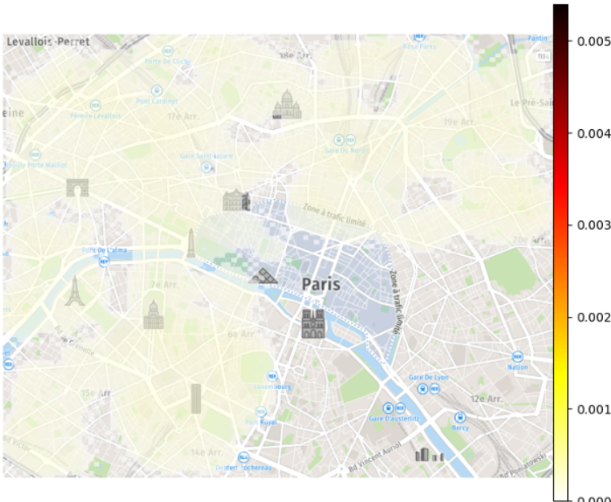
150%
120%
90%
60%
30%
0%

