Slide 1
Project PAM Ref: SP14-75-3DPR
Daniel Olsen (CE), Nicholas Lowman (CE)
Casey Spencer (EE), Chance Baker (EE)
Jeffrey Burdick (ME)- PM

Slide 2
Outline
Project Organization- JPB
Prerequisites and Definitions- NAL
Executive Summary- JPB
Market Gap, Criteria, and Specifications- CWB
Chassis Design and Standards- JPB
Functional Block Diagram- DMO, NAL
Printer Control Software- DMO
Timeline and Resources- CWS

Slide 3
Project Organization
Figure 1. Project Organization

Slide 4
Definitions and Prerequisites
Definitions
DLP- Digital Light Processing
FDM- Fused Deposition Manufacturing
PAM- Photoresin Additive Manufacturing
Prerequisites
Understanding of FDM process
Understanding of photoresins and curing process

Slide 5
Executive Summary
Problem Statement
Current hobbyist 3D printers are imprecise and fault-prone
High resolution additive manufacturing is currently not accessible for hobbyists (under $1,000)
Available PAM systems use proprietary hardware and software
Our Solution
A DLP PAM system can produce high quality and fast prints
Use off-the-shelf open-source hardware
Create a thoroughly documented reference design

Slide 6
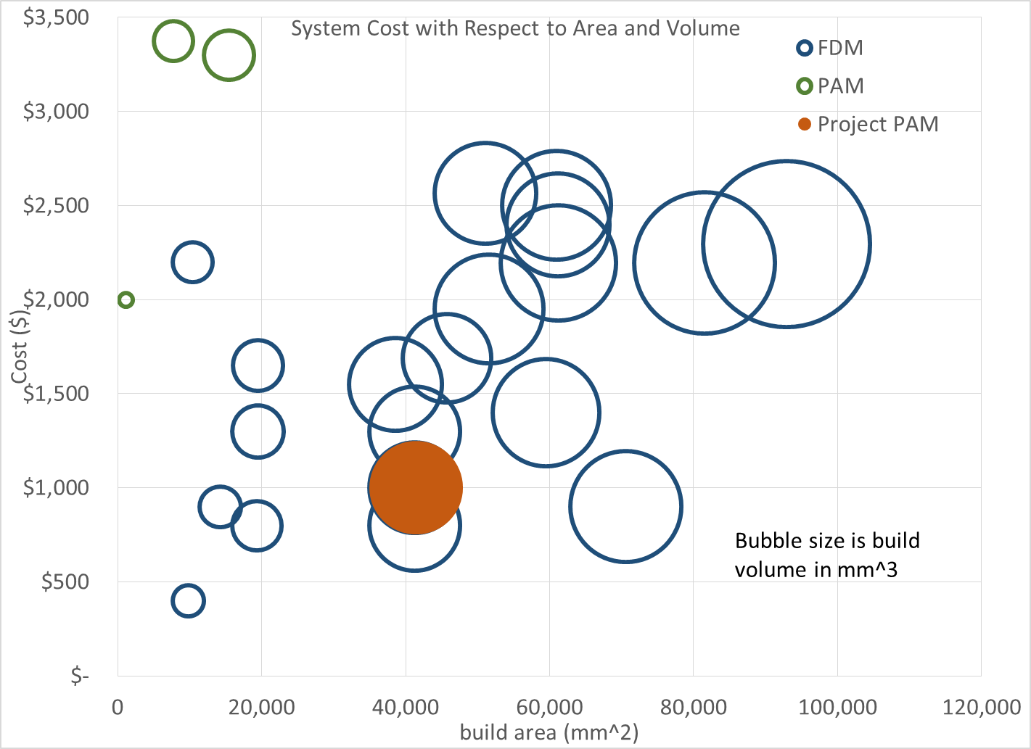
Market Gap
Figure 2. Market Gap

Slide 7
Criteria
Accessible to the hobbyist
Open Source and Free (as in speech)
Precise and repeatable
Flexible for the end user

Slide 8
Specifications
Table 1. Specifications
Geometry | Dimension/Tolerance
X and Y Axis Resolution | 0.100 mm
Z Axis Resolution | 0.100 ± 0.005 mm
Parallelism/Perpendicularity of a 20 mm cube | 0.050 mm
Dimensional Tolerance of a 20 mm cube | ± 0.050 mm

Slide 9
House of Quality
Figure 3. House of Quality

Slide 10
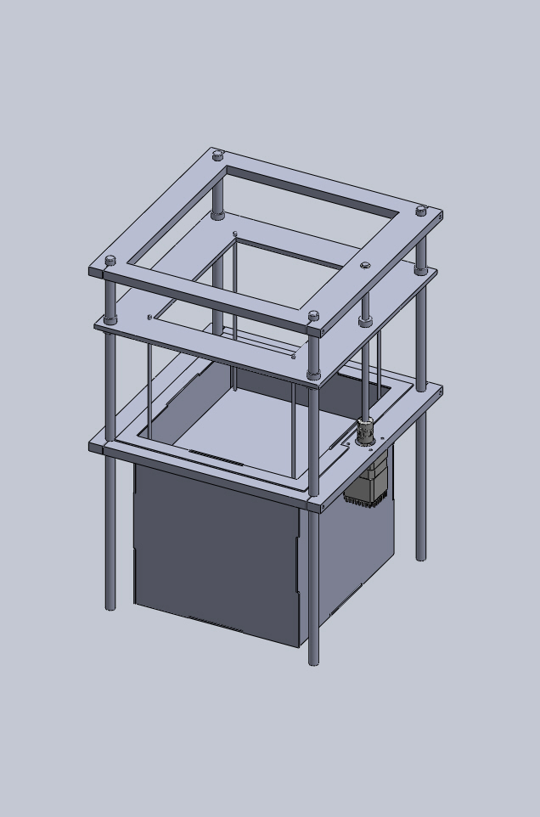
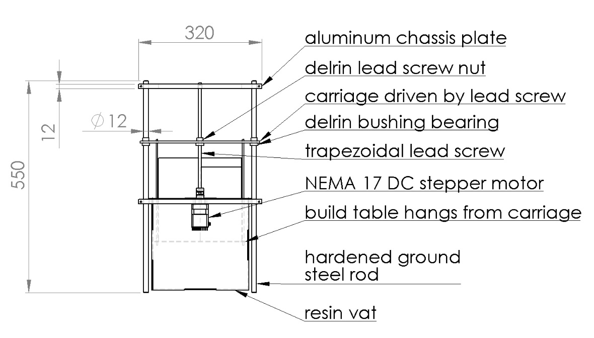
Chassis Design
Figure 4. Proposed chassis design
Figure 5. Isometric view
of proposed chassis

Slide 11
Standards
ISO 262 - Metric screw thread dimensions [2]
DIN 103 - Trapezoidal lead screw dimensions [3]
ANSI/NEMA MG 1-2011 - Stepper motor mounting dimensions [4]
ISO 6983 - G-Code [5]
ISO 10303-21 - STEP file [6]
STL file format ( ungoverned ) [7]
ISO/ASTM 52915:2013 - Additive manufacturing file format [8]
W3C XML 1.1 - Extensible Markup Language file format [9]
W3C SVG 1.1 - Scalable Vector Graphics file format [10]
ISO/IEC 14882:2011 / 2011 - C++ programming language [11]

Slide 12
Functional Block Diagram
Figure 6. Functional Block Diagram

Slide 13
Printer Control Software
Table 2. Comparison chart of three open-source printer
control software for DLP printer [11][12][13][14][15][16]
Solution | B9 Creator | MiiCraft | Creation Workshop | PAM
Language | C++ | Python | C# | C++
Cross-platform | ✓ | ✗ | ✓ | ✓
Slicing Software | Custom | Skeinforge | Slic3r | Slic3r
G-Code Support | ✗ | ✓ | ✓ | ✓
CAD File Input | STL | STL | STL, OBJ, 3DS | STL, OBJ, 3DS, STEP, AMF
Able to Add Supports | ✓ | ✗ | ✓ | ✓
Image Output | SLC | SVG | SVG | SVG

Slide 14
Timeline
Table 3. Proposed timeline
Phase | Start Date | End Date
Build | 2014-08-18 | 2014-09-26
Test | 2014-09-14 | 2014-11-07
Documentation and Presentation | 2014-11-14 | 2014-12-12

Slide 15
Resources
Table 4. Resources Needed
Item | Total Price | Department Acquisition (Y/N)
Arduino Uno | $38.00 | Y
Enclosure | $86.24 | N
Aluminum plate for chassis and build table | $148.00 | N
12mm ground linear bearing rod 1500mm | $93.70 | Y
Chassis hardware | $37.00 | Y
Photoresin vat | $47.00 | N
Makerjuice resins | $47.00 | N
Motion control system | $112.00 | Y
DLP projector | $344.00 | N
Computer | $0.00 | Y
TOTAL | $952.94

Slide 16
Conclusion
Problem Statement
Current hobbyist 3D printers are imprecise and fault-prone
High resolution additive manufacturing is currently not accessible for hobbyists (under $1,000)
Available PAM systems use proprietary hardware and software
Our Solution
A DLP PAM system can produce high quality and fast prints
Use off-the-shelf open-source hardware
Create a thoroughly documented reference design

Slide 17
References
Make: Ultimate Guide to 3D Printing
ISO 262:1998, ISO general purpose metric screw threads -- Selected sizes for screws, bolts and nuts.
DIN 103, ISO Metric Trapezoidal Screw Thread.
ANSI/NEMA MG 1-2011, Motors and Generators.
ISO 6983-1:2009, Automation systems and integration -- Numerical control of machines -- Program format and definitions of address words -- Part 1: Data format for positioning, line motion and contouring control systems.
ISO 10303-21:2002, Industrial automation systems and integration -- Product data representation and exchange -- Part 21: Implementation methods: Clear text encoding of the exchange structure.
ISO/ASTM 52915:2013, Standard specification for additive manufacturing file format (AMF) Version 1.1.
W3C, "XML 1.1 Extensible Markup Language (XML) 1.1 (Second Edition)," 16 August 2006. [Online]. Available: http://www.w3.org/TR/2006/REC-xml11-20060816/. [Accessed 16 April 2014].
W3C, "Scalable Vector Graphics (SVG) 1.1 (Second Edition)," 16 August 2011. [Online]. Available: http://www.w3.org/TR/SVG/. [Accessed 16 April 2014].
ISO/IEC 14882:2011, Information technology -- Programming languages -- C++.
E. Chu, "B9 Creator," Make: Ultimate Guide to 3D Printing, p. 93.
B9 Creations LLC, "B9 Creator GitHub," GitHub Inc., 2014. [Online]. Available: https://github.com/B9Creations/B9Creator. [Accessed 27 February 2014].
Rays Optics Inc., "MiiCraft User Guide," 2012. [Online]. Available: http://www.miicraft.com/web/assets/2012/11/MiiCraft-3D-printer-User-Guide.pdf. [Accessed 27 February 2014].
S. Hernandez, "Creation Workshop GitHub," GitHub Inc., 2014. [Online]. Available: https://github.com/Pacmanfan/UVDLPSlicerController. [Accessed 27 February 2014].
S. Hernandez, "Creation Workshop - SLA / FDM Slicer and Controller," Makerbot Industries LLC, 8 January 2013. [Online]. Available: https://www.thingiverse.com/thing:40778. [Accessed 27 February 2014].
Fabmetheus, "Skeinforge Vectorwrite," Demozendium, 17 July 2012. [Online]. Available: http://fabmetheus.crsndoo.com/wiki/index.php/Skeinforge_Vectorwrite. [Accessed 27 February 2014].

