Slide 1
Analysis of the Fuel Economy Benefit of Drivetrain Hybridization
Pages 6-13
Casey Spencer

Slide 2
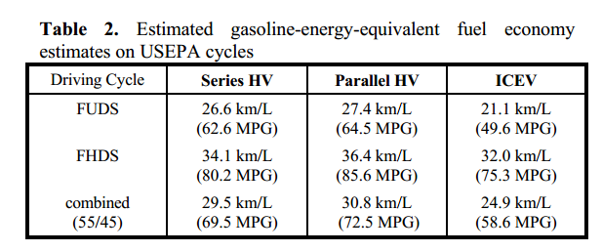
Fuel Economy Estimates

Slide 3
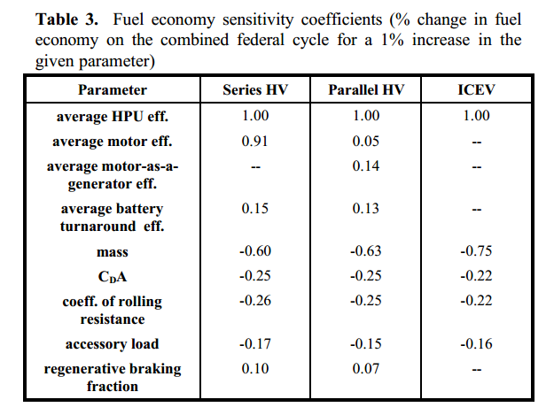
Sensitivity Coefficients

Slide 4

Estimating Fuel Economy

Slide 5
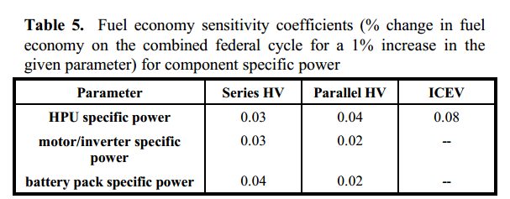
Sensitivity Coefficients

Slide 6
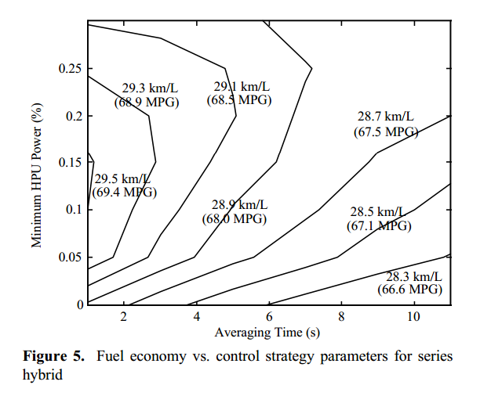
Fuel Econ vs. Control Parameters

Slide 7
Conclusions
“The parallel hybrid defined here achieves fuel economy that is 24% better than the ICEV while the series betters the ICEV by 18%.”
“The parallel hybrid is 4% more fuel-efficient than the series hybrid.”
“Lightweight midsized hybrid vehicles with low aerodynamic drag and rolling resistance using near- to mid-term technology can achieve 30km/L (70.6MPG) (gasoline-equivalent).”
“The series hybrid control strategy strongly influences its fuel economy and a ‘thermostat’ control strategy, neglecting thermal transient effects, is among the best of those examined here, considering fuel only.”

Slide 8
Conclusions cont.
“When a series hybrid uses on HPU capable of following motor power demands on a second-by-second basis, a control strategy can be used that reduces the sensitivity of fuel economy to battery efficiency to the same level as in a parallel hybrid.”
“The parallel and series hybrid fuel economies are not strongly dependent upon component specific power, but series hybrids are more sensitive to battery and motor specific power than are parallel.”
“The series hybrid’s fuel economy is less sensitive to regenerative braking effectiveness than to any other vehicle-level parameter, and the parallel hybrids fuel economy is less sensitive only to motor efficiency that to regenerative braking effectiveness. Doubling regenerative braking capture and parallel hybrid fuel economy by 7%.”

Slide 9
Conclusions cont.
“This parallel hybrid’s fuel economy is not significantly changed by connecting the motor directly to the differential rather than to the 5-speed transmission.”
“Control strategy development for a charge-sustaining parallel HV is challenging and warrants further investigation.”

