Slide 1
3D Printer Team 75
PowerPoint 1: Organize Team and Team Introduction

Slide 2
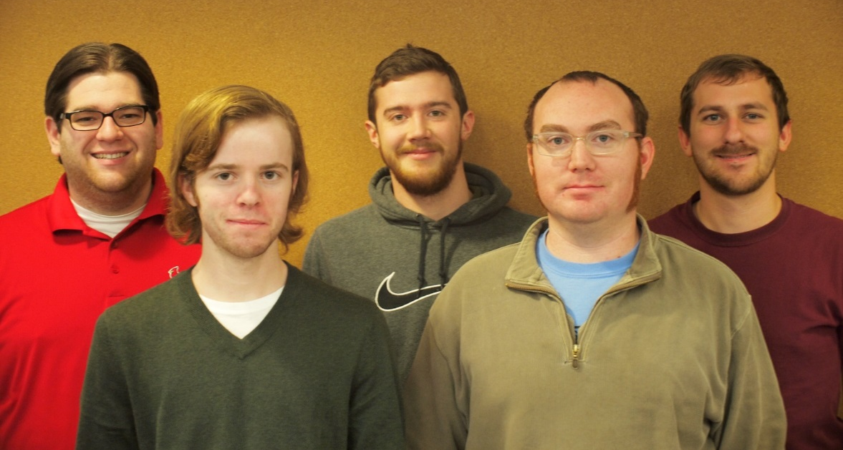
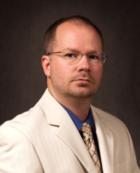
Team Info
Names listed left to right: Daniel Olsen (CE), Nicholas Lowman (CE), Casey Spencer (EE), Jeffrey Burdick (ME)- PM, Chance Baker (EE)
Faculty Technical Adviser
James Mabry: mabry@engr.siu.edu
Joe Lenox: lenox.joseph@gmail.com

Slide 3
Client: 3D Design and Replication Club
Steven Blair- President
sblair42@siu.edu

Slide 4
Problem Statements
High resolution prints are not currently accessible for hobbyists.
A DLP printer can produce higher quality and faster prints over current extruder based 3D printers.

Slide 5
Subsystems
Slicing Software/Image Processing- Daniel Olsen
Resin Management- Casey Spencer
Mechanical Motion System/Chassis- Jeff Burdick
Build Table and Resin Vat- Chance Baker
Control Software- Nick Lowman

Slide 6
Meeting Time
Tuesdays, 5:30 P.M.
7th Floor Library
Thursday, 12:15 P.M.
A 207

