Slide 1
3D Printer Team 75
PowerPoint 1: Organize Team and Team Introduction

Slide 2
Possible System Solutions
Use a single, high-resolution DLP projector
Use a laser with Cartesian motion
Use a pico projector with Cartesian motion

Slide 3
Trade-Offs: Single Projector
Pros
Cons
Motion only in one axis
More precise
Flexibility in projector choice
High upfront cost with projector purchase
Finite printing area
Bulky

Slide 4
Trade-Offs: Laser
Pros
Cons
Low cost
Flexible build area size
Motion in 3 axes
Less precise

Slide 5
Trade Offs: Pico Projector
Pros
Cons
Low cost
Flexible build area size
Motion in 3 axes
Less precise

Slide 6
Possible Subsystem Solutions: Resin Vat
Solution | Cost | Effectiveness | Advantage
Squeegee | Motor and Time | High | Level Layers
Sylgard 184 | $60 0.5 kg | High | Non Stick Surface
Teflon | $14 10 oz. | Med | Cheap and Easy to Use
Tilting | Motor and Time | Med | Peels
Gorilla Glass | $110 9"x9" | High | Peels w/o movement

Slide 7
Possible Subsystem Solutions: Build Table
Solution | Cost | Effectiveness | Advantage
Aluminum No Coating | No Extra Cost | Low | No Cost
Increase Cure Time | Increase Build Time | Medium | Free
Coating of FEP | $10.00 per 6 in² | High | Faster Build Times

Slide 8
Possible Subsystem Solutions: Printer Control Software
 | B9 Creator | MiiCraft | Creation Workshop
Language | C++ | Python | C#
Cross-platform | ✓ | ✗ | ✓
Slicing Software | Custom | Skeinforge | Slic3r
G-Code Support | ✗ | ✓ | ✓
CAD File Input | STL | STL | STL, OBJ, 3DS
Able to Add Supports | ✓ | ✗ | ✓
Image Output | SLC | SVG | SVG

Slide 9
Possible Subsystem Solutions: Computing Platform

Slide 10
Governing Science
Photocurable resins are hardened by exposure to light in a systematic manner to produce a desired shape
The build is progressed in layers in the Z axis which is controlled by a linear motion system

Slide 11
Standards
ISO 6983: G-Code
ATX 2.2 Motherboard Standard
Mini-ITX 2.0 Motherboard Standard
ATX Power Supply Standard

Slide 12
Limitations
Build size and build resolution are directly proportional
With a 1920 x 1080 pixel projector and 100μm build resolution the build area is 19.2mm x 10.8mm
Build area must be enclosed to prevent unwanted UV exposure

Slide 13
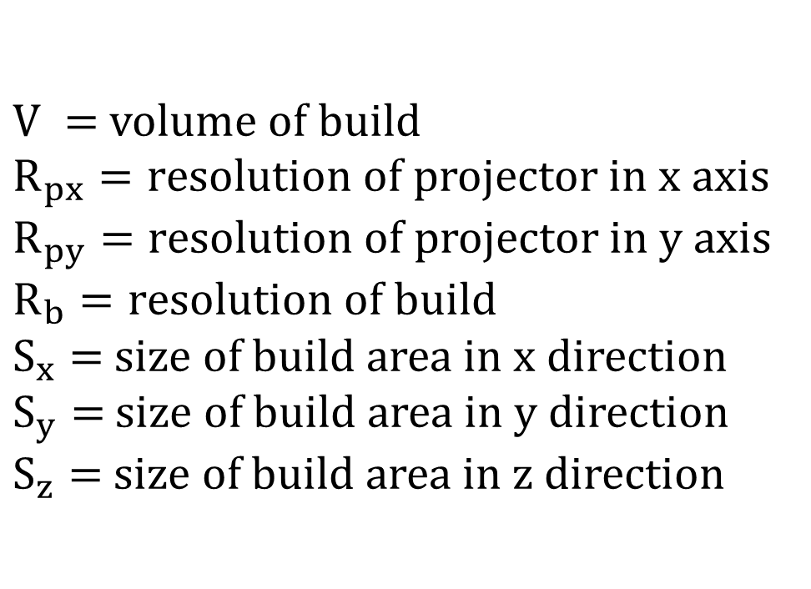
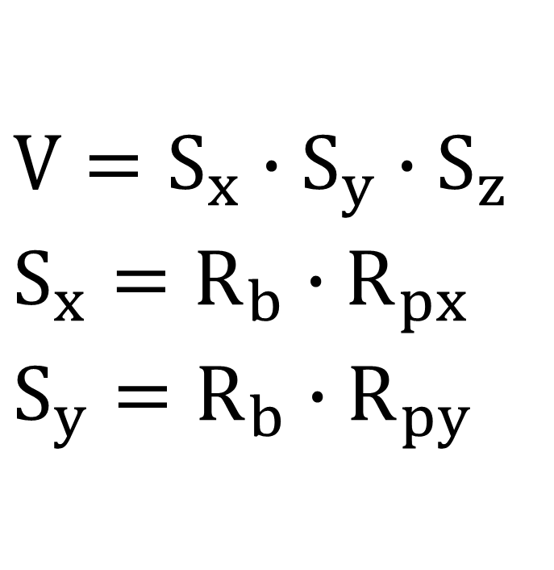
Equations
$$V=S_{x}∙S_{y}∙S_{z}$$
$$S_{x}={R_{b}∙R}_{px}$$
$$S_{y}={R_{b}∙R}_{py}$$
$V =$volume of build
$R_{px}=r$esolution of projector in x axis
$R_{py}=r$esolution of projector in y axis
$R_{b}=r$esolution of build
$S_{x}=$ size of build area in x direction
$S_{y}=$ size of build area in y direction
$S_{z}=$ size of build area in z direction

