Slide 1
Team 75-Project PAM
Daniel Olsen (CE), Nicholas Lowman (CE)
Casey Spencer (EE), Chance Baker (EE)
Jeffrey Burdick (ME)- PM

Slide 2
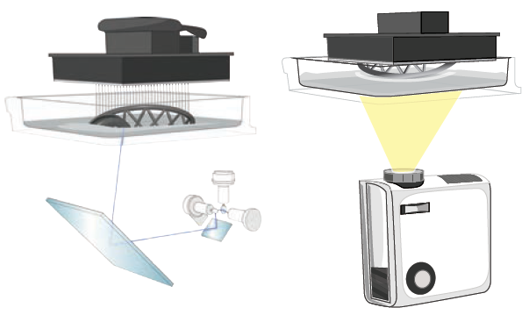
Project PAM
TEAM 75; Saluki Engineering
Overall Purpose:
High resolution prints are not currently accessible for hobbyists. A DLP printer can produce higher quality and faster prints over current extruder based 3D printers.
What are you doing:
Use off-the-shelf open-source hardware to create an open-source SLA printer that is accessible to the hobbyist.
Why are you doing it:
Current SLA printers are not within the price range of the average hobbyist. Current hobbyist printers produce subpar quality prints
What are the recent findings
Pigment can be added to resins to change the color
The market is lacking the open-source software that perfectly fits the needs of the project
What is next
Budget and timeline
Acquire a projector
Test subsystem candidates

Slide 3
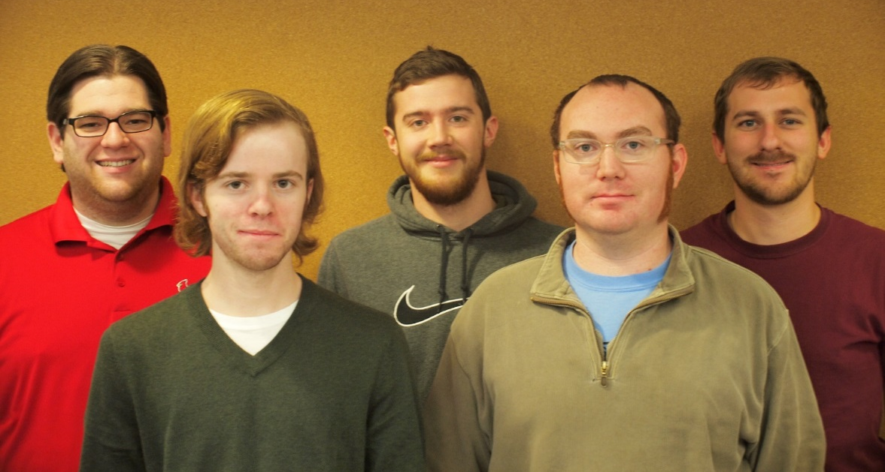

Team Info
Names listed left to right: Daniel Olsen (CE), Nicholas Lowman (CE), Casey Spencer (EE), Jeffrey Burdick (ME)- PM, Chance Baker (EE)
Faculty Technical Adviser
James Mabry: mabry@engr.siu.edu
Joe Lenox: lenox.joseph@gmail.com

Slide 4
Client: 3D Design and Replication Club
Steven Blair- President
sblair42@siu.edu

Slide 5
Meeting Time
Tuesdays, 5:30 P.M.
7th Floor Library
Thursday, 12:15 P.M.
A 207

Slide 6
Problem Statements
High resolution additive manufacturing is currently not accessible for hobbyists
A DLP PAM system can produce higher quality and faster prints over current extruder based 3D printers

Slide 7
Motivation / Market Gap
Current PAM systems are not within the price range of the average hobbyist
Current hobbyist additive manufacturing systems produce subpar quality prints

Slide 8
Our Solution
Use off-the-shelf open-source hardware to create an open-source DLP PAM system that is accessible to the hobbyist.

Slide 9
Subsystems
Slicing Software/Image Processing- Daniel Olsen
Motors/Motor Control- Casey Spencer
Mechanical Motion System/Chassis- Jeff Burdick
Build Table and Resin Vat- Chance Baker
Control Software- Nick Lowman

Slide 10
Criteria
Accessible to the hobbyist
Open Source and Free ( as in speech )
Precise and repeatable
Able to enlarge print area or have larger print area from beginning

Slide 11
Constraints
Build size
Physical size
Hardware cost
Manufacturability
Software availability

Slide 12
House of Quality

Slide 13
Functional Block Diagram

Slide 14
Governing Science
Photocurable resins are hardened by exposure to light in a systematic manner to produce desired geometry
The build is progressed in layers in the Z axis which is controlled by a linear motion system

Slide 15
Standards
ISO 6983 - G-Code
ISO 10303-21 - STEP file
ISO/ASTM 52915:2013 - Additive manufacturing file format
STL file format ( ungoverned )
ANSI/NEMA MG 1-2011 - Stepper motor mounting dimensions
W3C XML 1.1 - Configuration file format
ISO/IEC 14882:2011 / 2011 - C++ programming language
DIN 103 - Trapezoidal lead screws

Slide 16
Limitations
Build area size and build resolution are directly proportional
With a 1920 x 1080 pixel projector and 100μm build resolution the build area size is 19.2mm x 10.8mm
Build volume must be enclosed to prevent unwanted UV exposure
Maintaining precision as z-axis travel increases becomes prohibitively expensive

Slide 17
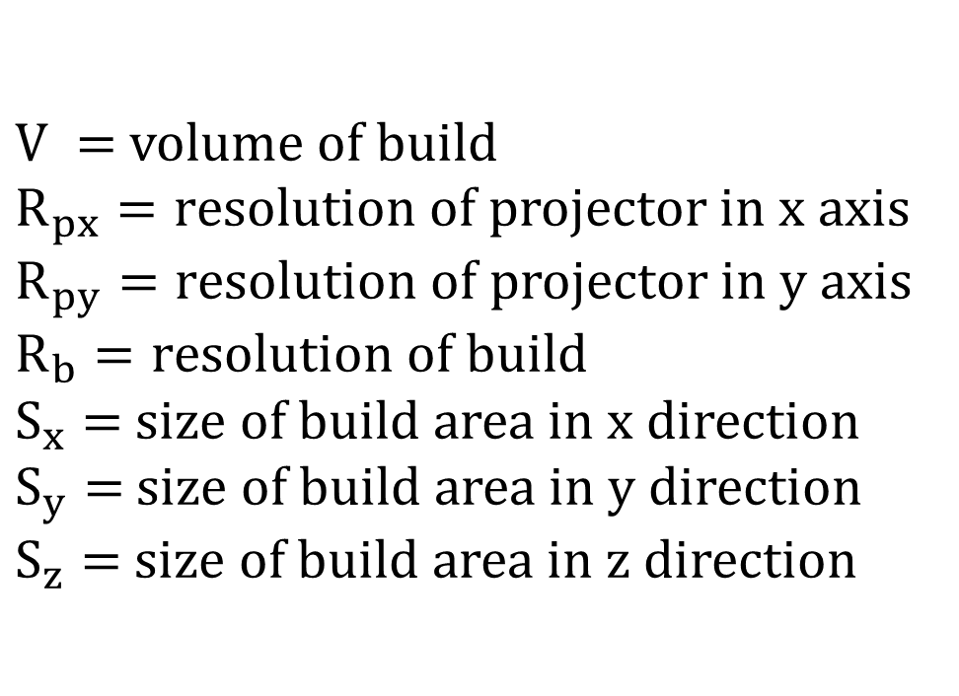
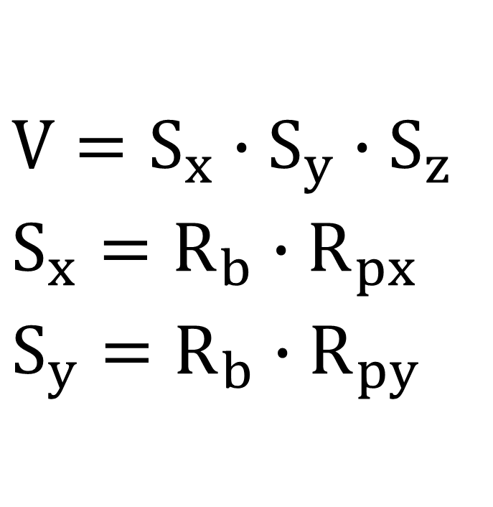
Equations
$$V=S_{x}∙S_{y}∙S_{z}$$
$$S_{x}={R_{b}∙R}_{px}$$
$$S_{y}={R_{b}∙R}_{py}$$
$V =$volume of build
$R_{px}=r$esolution of projector in x axis
$R_{py}=r$esolution of projector in y axis
$R_{b}=r$esolution of build
$S_{x}=$ size of build area in x direction
$S_{y}=$ size of build area in y direction
$S_{z}=$ size of build area in z direction

Slide 18
Possible System Solutions
Use a single, high-resolution DLP projector
Use a laser with Cartesian motion
Use a pico projector with Cartesian motion

Slide 19
Possible Subsystem Solutions: Light Source
Solution | Advantages | Disadvantages
Large fixed-position projector | Motion only in one axis reduces complexity More precise High flexibility in projector choice | High initial cost Finite build area size Bulky
Pico projector with Cartesian motion | Low initial cost Flexible build area size | Required motion adds complexity Less precise Low luminosity increases build time
Laser with Cartesian motion | Low cost Flexible build area size High luminosity lasers can cure resin faster | Required motion adds complexity Less precise

Slide 20
Possible Subsystem Solutions: Resin Vat
Solution | Advantage | Disadvantage | Effectiveness
Squeegee | Level Layers | Motor and Time | High
Sylgard 184 | Non Stick Surface | Expensive ($60 0.5 kg) | High
Teflon | Cheap($14 10 oz.) and Easy to Use | Short Service Life | Med
Tilting | Peels | Motor and Time | Med
Gorilla Glass | Peels w/o movement | Expensive ($110 9"x9“) | High

Slide 21
Possible Subsystem Solutions: Build Table
Solution | Advantage | Disadvantages | Effectiveness
Aluminum No Coating | No Cost | No Extra Cost | Low
Increase Cure Time | Free | Increase Build Time | Medium
Coating of FEP | Faster Build Times | Expensive ($10.00 per 6 in²) | High

Slide 22
Possible Subsystem Solutions: Printer Control Software
Solution | B9 Creator | MiiCraft | Creation Workshop
Language | C++ | Python | C#
Cross-platform | ✓ | ✗ | ✓
Slicing Software | Custom | Skeinforge | Slic3r
G-Code Support | ✗ | ✓ | ✓
CAD File Input | STL | STL | STL, OBJ, 3DS
Able to Add Supports | ✓ | ✗ | ✓
Image Output | SLC | SVG | SVG

Slide 23
Possible Subsystem Solutions: Stepper Motor
Solution | Advantage | Disadvantage | Effectiveness
Unipolar | Easier to Control | Low Torque to Power Ratio | High
Bipolar | Higher Torque to Power Ratio | Harder to Control | High

Slide 24
Possible Subsystem Solutions: Framing
Solution | Advantages | Disadvantages
Sheet | Less expensive more accessible to hobbyist incorporates enclosure | Less precise
Extrusion | More precise can incorporate linear motion | More expensive less accessible to hobbyist

Slide 25
Possible Subsystem Solutions: Enclosure
Solution | Advantages | Disadvantages
CNC cut hard sheet | Inexpensive Accessible to hobbyist | None
Plastic wrap | Inexpensive Accessible to hobbyist | Maintenance would be involved

Slide 26
Possible Subsystem Solutions: Linear Motion Bearings
Method | Advantages | Disadvantages
Round bearings | Can work with any framing | Requires separate hardware from framing
V-Slot extrusions | Can also be framing | More expensive
OpenRails | Can work with sheet framing or extrusions

Slide 27
Possible Subsystem Solutions: Linear Motion Drive
Method | Advantages | Disadvantages
Lead screws | Precision Can handle load
Timing belt | Less expensive than lead screws | May be less precise than lead screws
Timing cable | Less expensive than lead screws | May be less precise than lead screws

Slide 28
Subsystem Testing
Slicing Software/Image Processing
Slice accuracy
Motors/ Motor Control
Torque capability
Step accuracy
Mechanical Motion System/Chassis
Linear motion drive precision
Linear motion bearing accuracy
Build Table and Resin Vat
Adhesion and service life

Slide 29
Subsystem Testing: Slicing Software/Image Processing
Slice Accuracy
A 3d model can be sliced and the resultant slices can be compared to the geometry of the original model
Discrepancies in volume can be determined to quantify slice accuracy

Slide 30
Subsystem Testing: Motors/ Motor Control
Torque capability
The motor can be commanded to step while monitoring electrical draw and torque
This experiment should be repeated for half stepping and microstepping
Step Accuracy
The motor can be commanded to step while monitoring the output shaft angle
The repeatability of stepping can then be determined

Slide 31
Subsystem Testing: Mechanical Motion System/Chassis
Linear motion drive precision
A drive system can be driven at a constant speed while monitoring driven position
The driven velocity and acceleration would quantify precision of the system
Linear motion bearing precision
Cantilevered load can be applied to a drive system and the resultant change in velocity and acceleration would quantify the precision of the system

Slide 32
Subsystem Testing: Build Table and Resin Vat
Vat and build table adhesion and service life
Adhesion can be tested for adhesive force by bonding a hook to the test surface with the test resin and applying tension while monitoring tension necessary to separate the hook from the test surface
Service life can be tested by monitoring changes in adhesion force over adhesion test cycles

Slide 33
System Testing
Functions Test
Test the images are outputted correctly
Test that the motion systems move together correctly
Test Print Objects
Print standard test objects and compare quality to images of the print objects from other DLP printers on the market

