Slide 1
Team 75-3D Printer Power Point 7
Daniel Olsen (CE), Nicholas Lowman (CE)
Casey Spencer (EE), Chance Baker (EE)
Jeffrey Burdick (ME)- PM

Slide 2
Chassis sketch

Slide 3
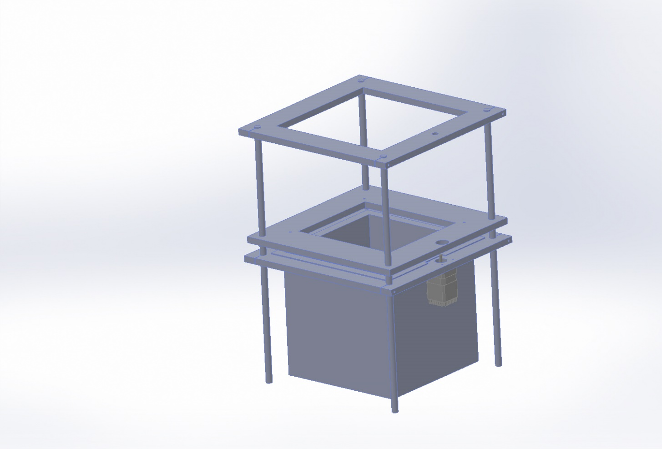
CAD Drawing

Slide 4
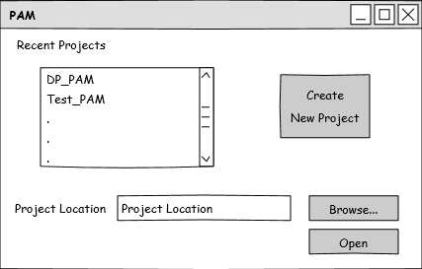
User Interface: Startup Page

Slide 5
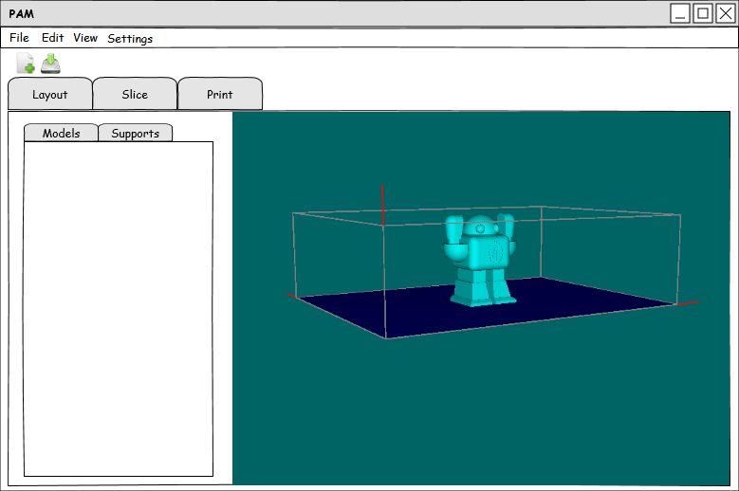
User Interface: Layout Page

Slide 6
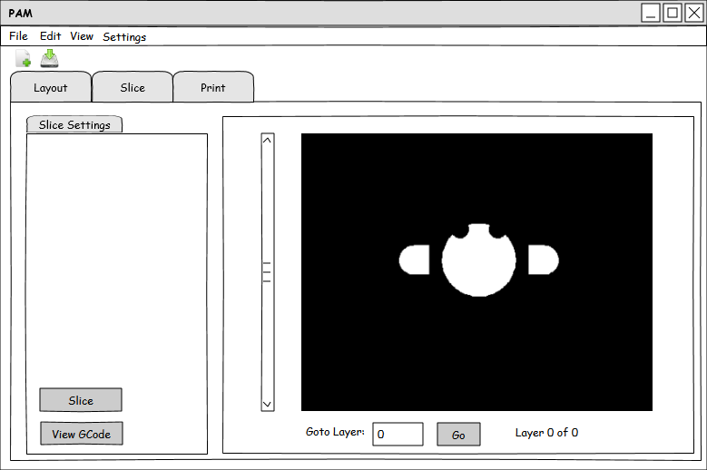
User Interface: Slice Page

Slide 7
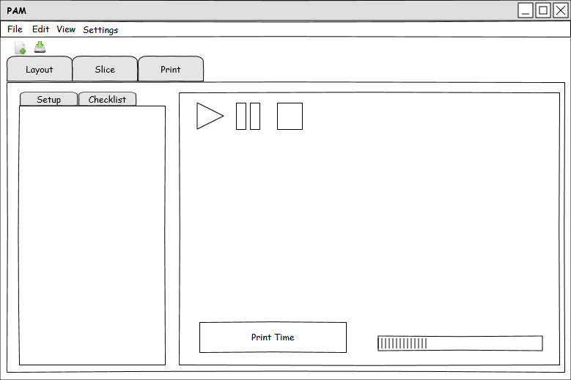
User Interface: Print Page

Slide 8
Schematic

Slide 9
Schematic contd.

