Slide 1
Project PAM Ref: SP14-75-3DPR
Daniel Olsen (CE), Nicholas Lowman (CE)
Casey Spencer (EE), Chance Baker (EE)
Jeffrey Burdick (ME)- PM

Slide 2
Team 75 Organization
Figure 1. Project Organization

Slide 3
Outline
Project Organization- JPB
Prerequisites and Definitions- NAL
Executive Summary- JPB
Market Gap, Criteria, and Specifications- CWB
Chassis Design and Standards- JPB
Functional Block Diagram- DMO, NAL
Printer Control Software- DMO
Timeline and Resources- CWS

Slide 4
Executive Summary
Problem
High resolution additive manufacturing is not accessible for hobbyists (under $1,000)
Current hobbyist 3D printers are imprecise, fault-prone, and poorly documented
Available PAM systems are inflexible, use proprietary hardware and software
Solution
Libre
Accessible to the hobbyist
Precise and repeatable
Flexible for the end user
Off-the-shelf open-source hardware
A thoroughly documented reference design

Slide 5
Market Gap
Figure 2. Market Gap

Slide 6
Top Down vs. Bottom Up

Slide 7
System Block Diagram
Figure 6. Functional Block Diagram

Slide 8
Specifications
Table 1. Specifications
Geometry | Dimension/Tolerance
Build Volume Size | 192 mm x 216 mm x 216 mm
X and Y Axis Resolution | 0.100 mm
Minimum Layer Height | 0.015 ± 0.002 mm
Parallelism/Perpendicularity of a 20 mm cube | 0.050 mm
Dimensional Tolerance of a 20 mm cube | ± 0.050 mm

Slide 9
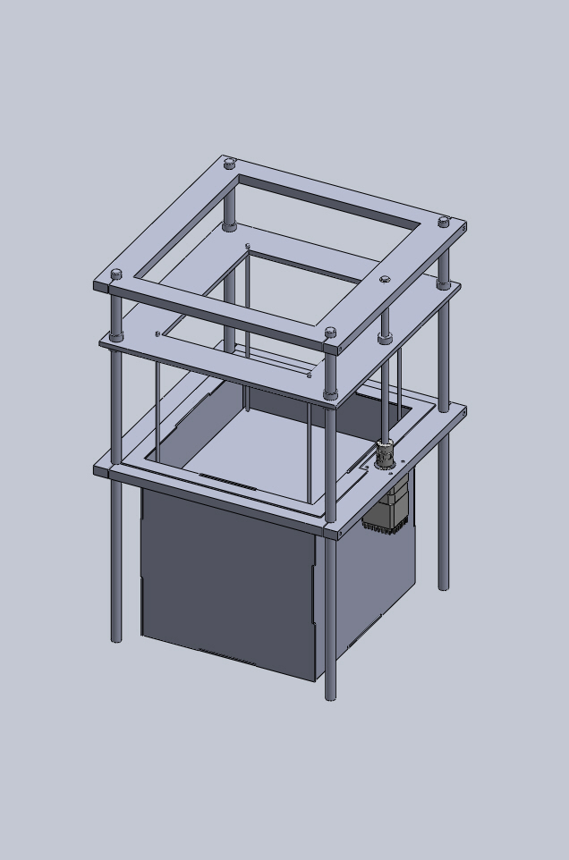
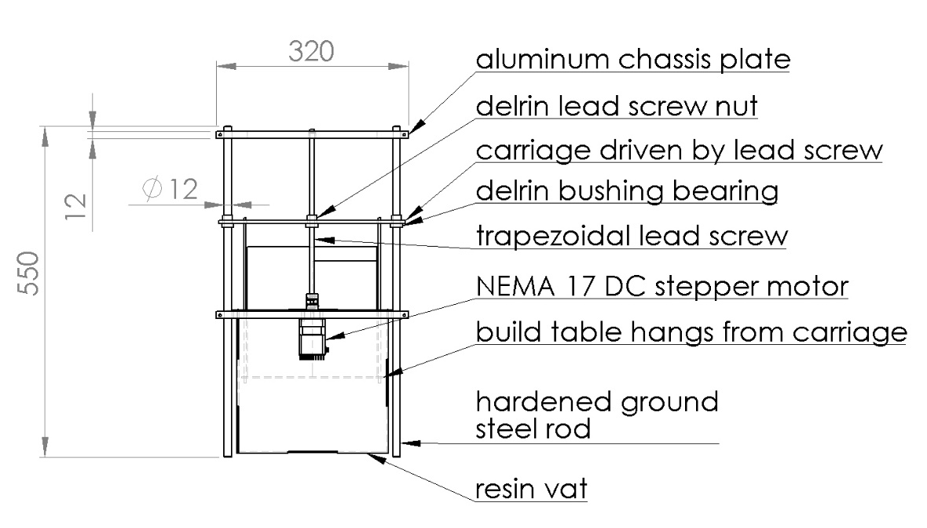
Previous Chassis Proposal
Figure 4. Proposed chassis design
Figure 5. Isometric view
of proposed chassis

Slide 10
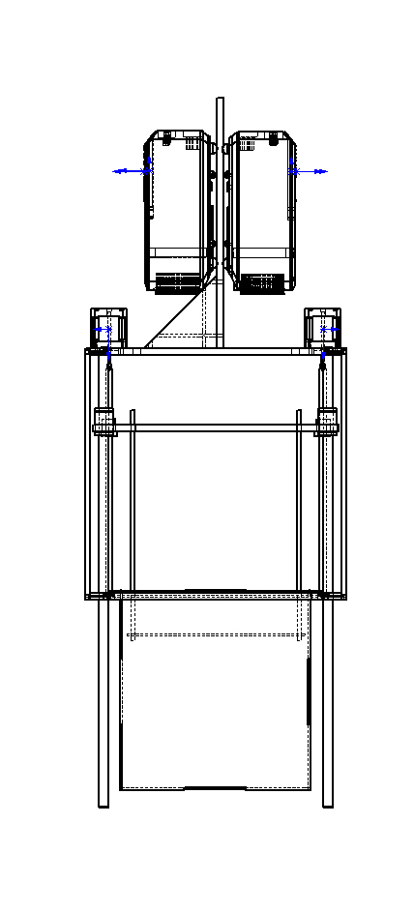
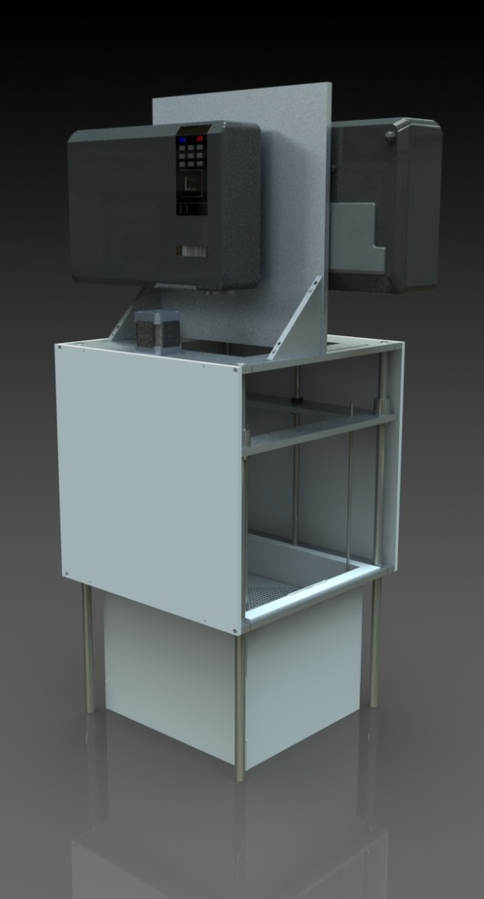
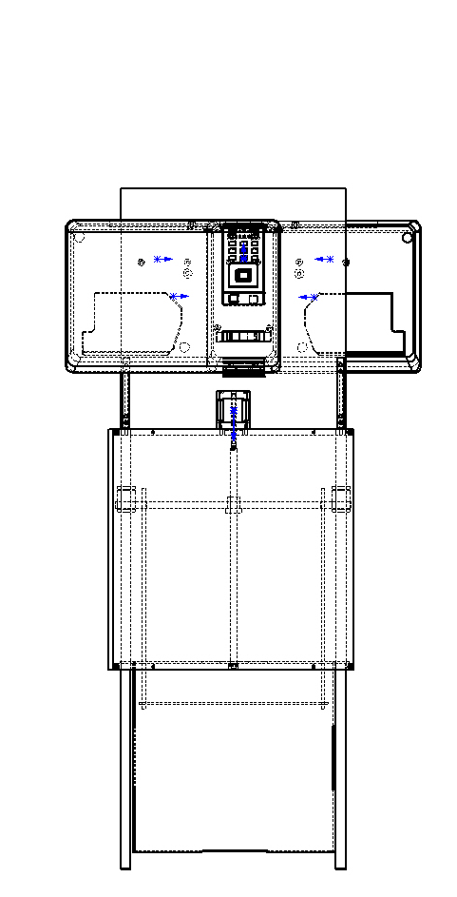
Current Prototype

Slide 11
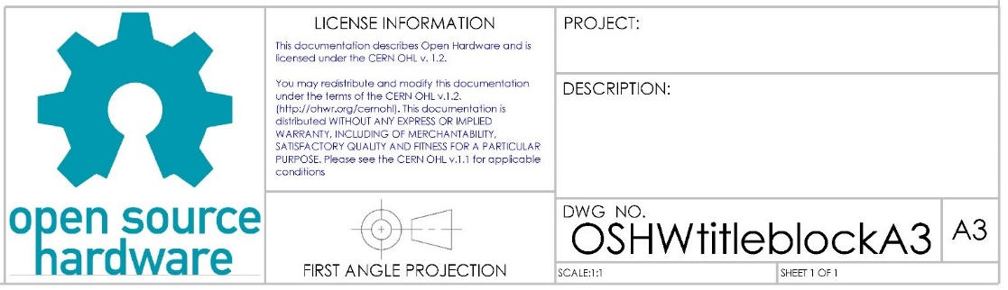
Technical Drawings/Title Block
The Coupler was GD&T according to ISO standards.
A Title Block was created for the Open Source Hardware Community
Notes:
GD&T (Geometric Dimensioning &Tolerance)
Datum's are necessary when properly GD&Ting high quality parts
The following are important details to
Geometric Characteristic Symbols Tolerance, Characteristic, Symbol
Material Conditions Terms & Symbols: MMC→(M), LMC→(L), RFS→(none)
Additional Symbols
We noticed that ISO s to use and acknowledge revisions made to a specific part. Community projects are so poorly documented that not even a basic title block exists within the Open Source Hardware Community.

Slide 12
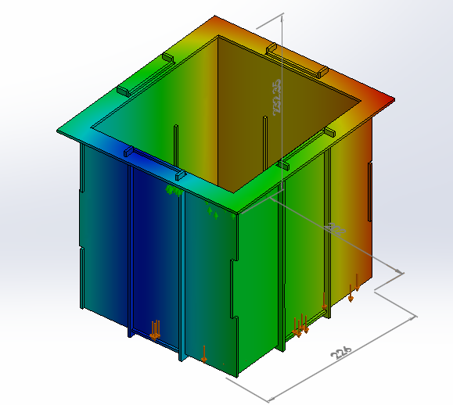

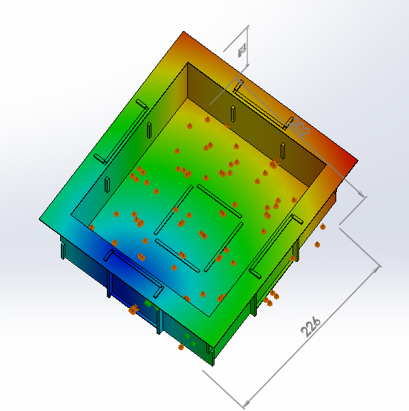
Vat Simulation
FEA Simulation (fixtures, bonds, forces) – experienced bonding issues
Notes:
$\left(d_{isplacement Values}≤0mm\right)$ indicates the ribbed vat will not sway.
$\left(d_{isplacement Values}≥0mm\right)$ indicates the ribbed vat will sway. ← (result of bonding issues)

Slide 13
Wire Diagram

Slide 14
Hardware Software Interface

Slide 15
Hardware Software Interface contd.

Slide 16
Projector and Resin
Projector Qualities
High Resolution DLP
UV Filter Removal
Throw Distance
Resin
Test for Layer Thickness
Test for Exposure Time

Slide 17
Software Problems

Slide 18
New Design

Slide 19
Timeline

Slide 20
Timeline & Budget
Table 3. Proposed timeline
Phase | Start Date | End Date
Build | 2014-08-18 | 2014-09-26
Test | 2014-09-14 | 2014-11-07
Documentation and Presentation | 2014-11-14 | 2014-12-12

Slide 21
Summary
Problem Statement
Current hobbyist 3D printers are imprecise and fault-prone
High resolution additive manufacturing is currently not accessible for hobbyists (under $1,000)
Available PAM systems use proprietary hardware and software
Our Solution
A DLP PAM system can produce high quality and fast prints
Use off-the-shelf open-source hardware
Create a thoroughly documented reference design

Slide 22
Acknowledgements
Dr. Spyros Tragoudas | Dr. Tod Policandriotes | Lakendria Kenner
Dr. Rasit Koc | Dr. Vidya Singh-Gupta | Scott J. Grunewald
Dr. Lizette Chevalier | Dr. Frances Harackiewicz | Eddie Krassenstein
Dr. James Mathias | Dr. Alan J. Weston | Austin Miller
Dr. James Mabry | Kay Purcell | Indiegogo Funders
Tim Attig | Joe Lennox

Slide 23
References
Make: Ultimate Guide to 3D Printing
ISO 262:1998, ISO general purpose metric screw threads -- Selected sizes for screws, bolts and nuts.
DIN 103, ISO Metric Trapezoidal Screw Thread.
ANSI/NEMA MG 1-2011, Motors and Generators.
ISO 6983-1:2009, Automation systems and integration -- Numerical control of machines -- Program format and definitions of address words -- Part 1: Data format for positioning, line motion and contouring control systems.
ISO 10303-21:2002, Industrial automation systems and integration -- Product data representation and exchange -- Part 21: Implementation methods: Clear text encoding of the exchange structure.
ISO/ASTM 52915:2013, Standard specification for additive manufacturing file format (AMF) Version 1.1.
W3C, "XML 1.1 Extensible Markup Language (XML) 1.1 (Second Edition)," 16 August 2006. [Online]. Available: http://www.w3.org/TR/2006/REC-xml11-20060816/. [Accessed 16 April 2014].
W3C, "Scalable Vector Graphics (SVG) 1.1 (Second Edition)," 16 August 2011. [Online]. Available: http://www.w3.org/TR/SVG/. [Accessed 16 April 2014].
ISO/IEC 14882:2011, Information technology -- Programming languages -- C++.
E. Chu, "B9 Creator," Make: Ultimate Guide to 3D Printing, p. 93.
B9 Creations LLC, "B9 Creator GitHub," GitHub Inc., 2014. [Online]. Available: https://github.com/B9Creations/B9Creator. [Accessed 27 February 2014].
Rays Optics Inc., "MiiCraft User Guide," 2012. [Online]. Available: http://www.miicraft.com/web/assets/2012/11/MiiCraft-3D-printer-User-Guide.pdf. [Accessed 27 February 2014].
S. Hernandez, "Creation Workshop GitHub," GitHub Inc., 2014. [Online]. Available: https://github.com/Pacmanfan/UVDLPSlicerController. [Accessed 27 February 2014].
S. Hernandez, "Creation Workshop - SLA / FDM Slicer and Controller," Makerbot Industries LLC, 8 January 2013. [Online]. Available: https://www.thingiverse.com/thing:40778. [Accessed 27 February 2014].
Fabmetheus, "Skeinforge Vectorwrite," Demozendium, 17 July 2012. [Online]. Available: http://fabmetheus.crsndoo.com/wiki/index.php/Skeinforge_Vectorwrite. [Accessed 27 February 2014].

