Slide 1
Project PAM Ref: SP14-75-3DPR
Daniel Olsen (CE), Nicholas Lowman (CE)
Casey Spencer (EE), Chance Baker (EE)
Nathaniel Tyler (ME), Jeffrey Burdick (ME)- PM

Slide 2
Outline
Project Organization- JPB
Executive Summary, Market Gap,
Specifications, and Chassis Design- JPB
Documentation, Vat Simulation- NBT
Wiring Diagram- CWS
Hardware/Software Interface - NAT
Projector and Resin- CWB
Functional Block Diagram- DMO
Printer Control Software- DMO
Budget- DMO
Summary and Acknowledgements- CWS

Slide 3
Team 75 Organization
Figure 1. Project Organization

Slide 4
Executive Summary
Problem
High resolution additive manufacturing is not accessible for hobbyists (under $1,000)
Current hobbyist 3D printers are imprecise, fault-prone, and poorly documented
Available PAM systems are inflexible, use proprietary hardware and software
Solution
Libre
Accessible to the hobbyist
Precise and repeatable
Flexible for the end user
Off-the-shelf open-source hardware
A thoroughly documented reference design

Slide 5
Market Gap
Figure 2. Market Gap

Slide 6
Specifications
Table 1. Specifications
Geometry | Dimension/Tolerance
Build Volume Size | 192 mm x 216 mm x 216 mm
X and Y Axis Resolution | 0.100 mm
Minimum Layer Height | 0.015 ± 0.002 mm
Parallelism/Perpendicularity of a 20 mm cube | 0.050 mm
Dimensional Tolerance of a 20 mm cube | ± 0.050 mm

Slide 7
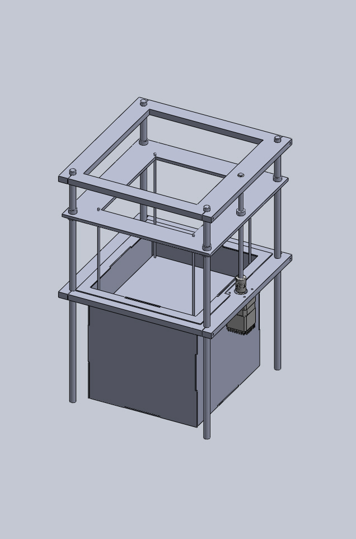
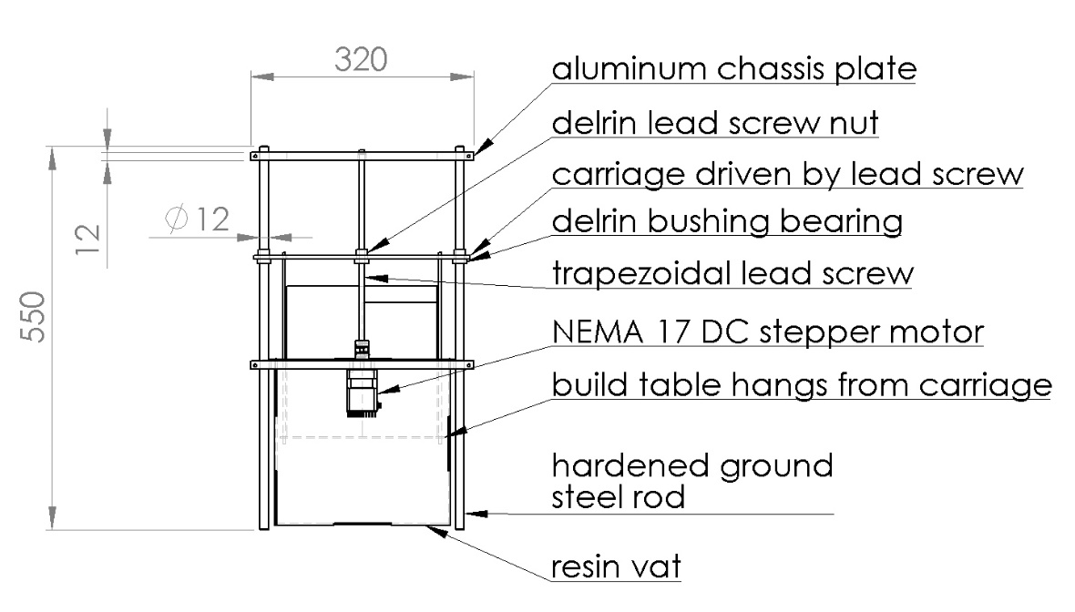
Previous Chassis Proposal
Figure 3. Proposed chassis design
Figure 4. Isometric view
of proposed chassis

Slide 8
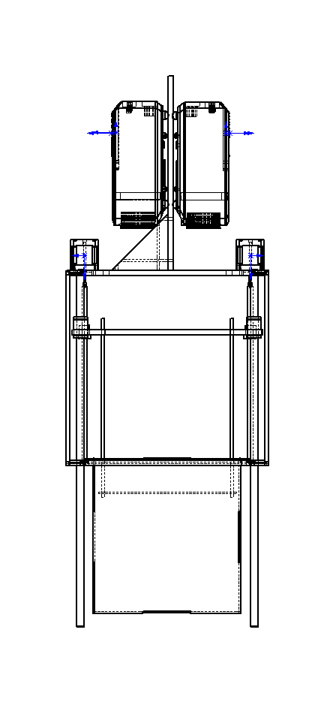
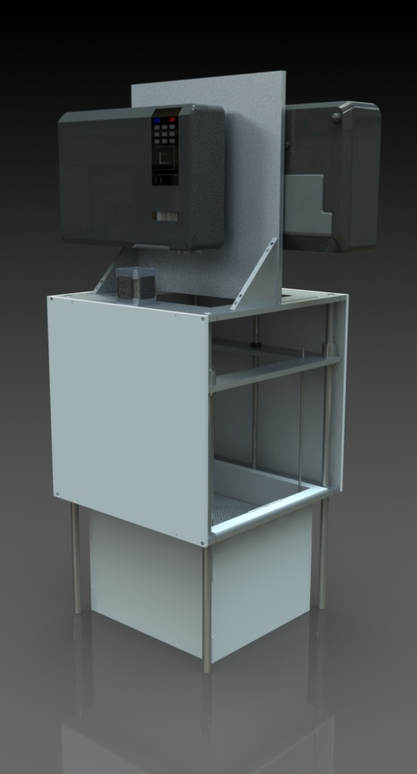
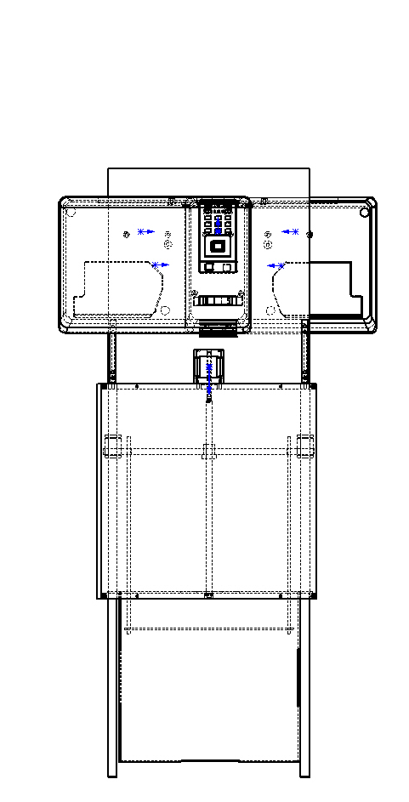
Current Prototype
Figure 5. Current Rendering

Slide 9
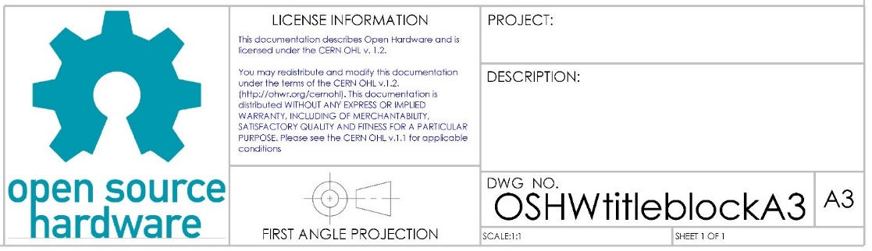
Technical Drawings/Title Block
The Coupler was GD&T according to ISO standards.
A Title Block was created for the Open Source Hardware Community
Figure 6. OSHW Title Block
Notes:
GD&T (Geometric Dimensioning &Tolerance)
Datum's are necessary when properly GD&Ting high quality parts
The following are important details to
Geometric Characteristic Symbols Tolerance, Characteristic, Symbol
Material Conditions Terms & Symbols: MMC→(M), LMC→(L), RFS→(none)
Additional Symbols
We noticed that ISO s to use and acknowledge revisions made to a specific part. Community projects are so poorly documented that not even a basic title block exists within the Open Source Hardware Community.

Slide 10
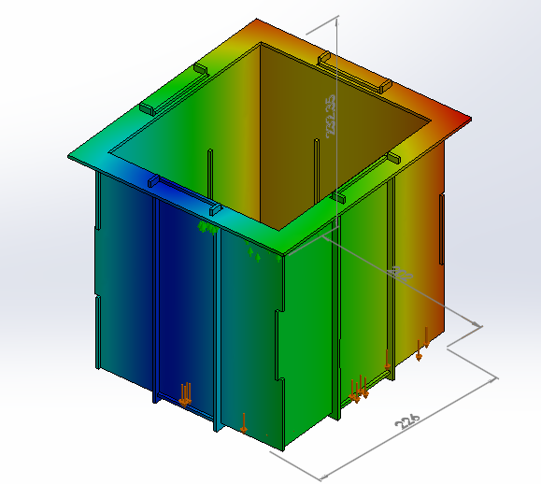

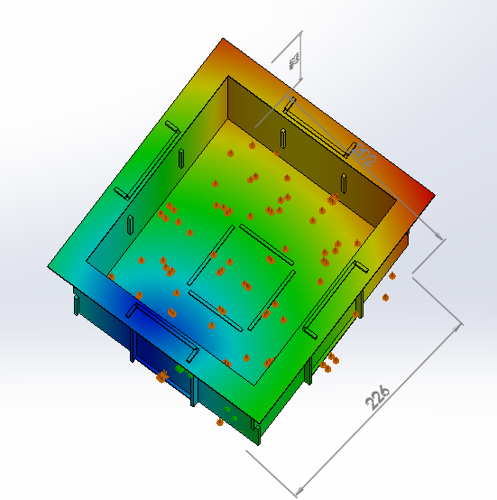
Vat Simulation
FEA Simulation (fixtures, bonds, forces) – experienced bonding issues
Figure 7. Simulation Results
Notes:
$\left(d_{isplacement Values}≤0mm\right)$ indicates the ribbed vat will not sway.
$\left(d_{isplacement Values}≥0mm\right)$ indicates the ribbed vat will sway. ← (result of bonding issues)

Slide 11
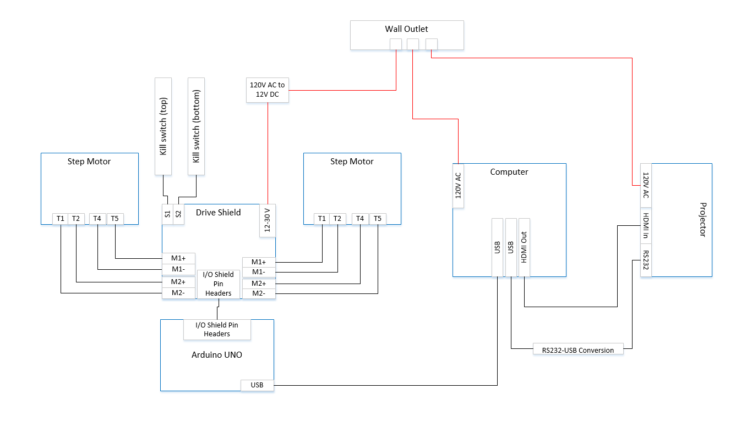
Wire Diagram
Figure 8. High Level Wire Diagram

Slide 12
Hardware Software Interface
GRBL - Lightweight Arduino firmware used to interface the software and the motors/hardware
CNC Motor Shield: 4 Pololu DRV8825 drivers
4 dual H-bridge drivers with current control logic, allowing for more precise stepping and power management
Adafruit Motor Shield (AFMS): Uses an H-bridge motor driver
4 H-bridge drivers capable of running 2 stepper motors, however lacks some of the logic for more precise control

Slide 13
Projector and Resin
Projector Qualities
High Resolution DLP
UV Filter Removal
Throw Distance
Resin
Test for Layer Thickness
Test for Exposure Time

Slide 14
Functional Block Diagram
Figure 9. Functional Block Diagram

Slide 15
Problems with 3D Printing Software
Set out to create the de facto DLP 3D printer control software
Harder said then done
STL file format
No common platforms
Batch Slicing vs. Slicing On Demand

Slide 16
LibreCAM
Open Source and Libre
Very few dependencies for core application
Qt 5, Open Cascade Community Edition
Modular
Develop plugins for CNC machines, 3D printers, mills, etc …
Tool path creation/debugging

Slide 17
Budget
Table 2. Subsystem Cost
Item | Price
Motion control | $113.61
Chassis | $315.99
Hardware software interface | $25.97
Motors/motor control | $82.83
Maker Juice resins | $45.00
Total | $602.17

Slide 18
Next Steps
Finish Prototype
Finalize LibreCAM
Complete User Documentation
Package Initial Release
Compete in Cornell Cup

Slide 19
Summary
Problem Statement
Current hobbyist 3D printers are imprecise and fault-prone
High resolution additive manufacturing is currently not accessible for hobbyists (under $1,000)
Available PAM systems use proprietary hardware and software
Our Solution
A DLP PAM system can produce high quality and fast prints
Use off-the-shelf open-source hardware
Create a thoroughly documented reference design

Slide 20
Acknowledgements
Dr. Spyros Tragoudas | Dr. Tod Policandriotes | Lakendria Kenner
Dr. Rasit Koc | Dr. Vidya Singh-Gupta | Scott J. Grunewald
Dr. Lizette Chevalier | Dr. Frances Harackiewicz | Eddie Krassenstein
Dr. James Mathias | Dr. Alan J. Weston | Austin Miller
Dr. James Mabry | Kay Purcell | Indiegogo Funders
Tim Attig | Joe Lennox

