Slide 1
Project PAM
The world’s first open source dlp
3d printer

Slide 4


Slide 5
Problem
High resolution additive manufacturing is not accessible for hobbyists (under $1,000)
Current hobbyist 3D printers are imprecise, fault-prone, and poorly documented
Available PAM systems are inflexible, use proprietary hardware and software

Slide 6
Solution
Libre
Accessible to the hobbyist
Precise and repeatable
Flexible for the end user
Off-the-shelf open-source hardware
A thoroughly documented reference design

Slide 7
Market Gap

Slide 8
Specifications
Geometry | Dimension/Tolerance
Build Volume Size | 192 mm x 216 mm x 216 mm
X and Y Axis Resolution | 0.100 mm
Minimum Layer Height | 0.015 ± 0.002 mm
Parallelism/Perpendicularity of a 20 mm cube | 0.050 mm
Dimensional Tolerance of a 20 mm cube | ± 0.050 mm

Slide 9
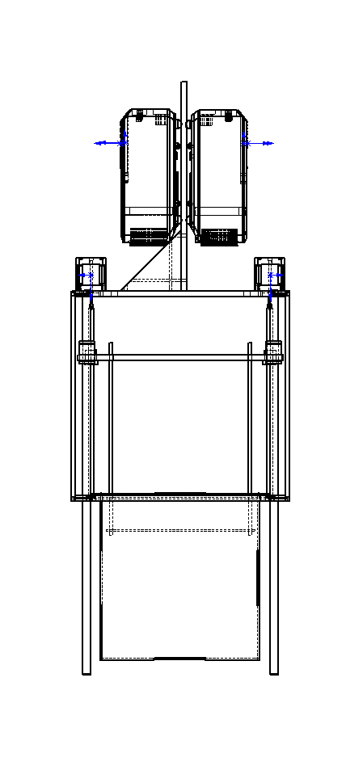
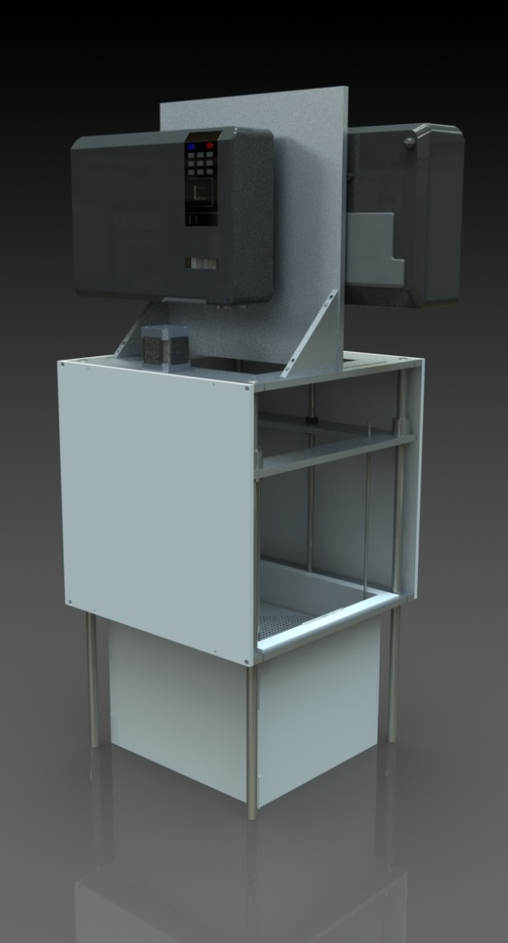
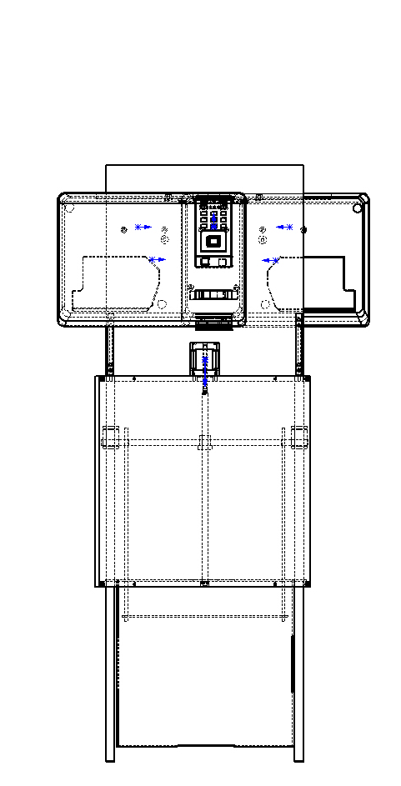
Current Prototype

Slide 11
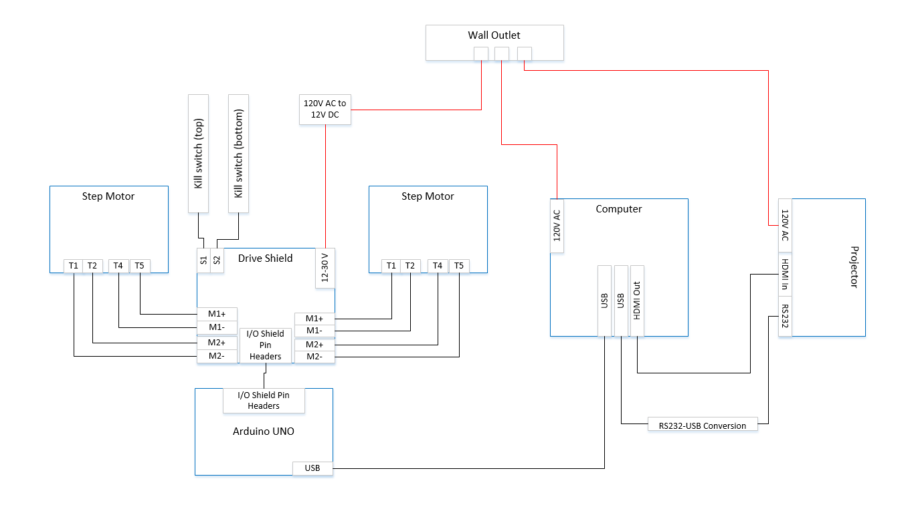
Wire Diagram

Slide 12
Functional Block Diagram

Slide 13
Cost
Item | Price
Motion control | $113.61
Chassis | $315.99
Hardware software interface | $25.97
Motors/motor control | $82.83
Maker Juice resins | $45.00
Total | $602.17

Slide 14
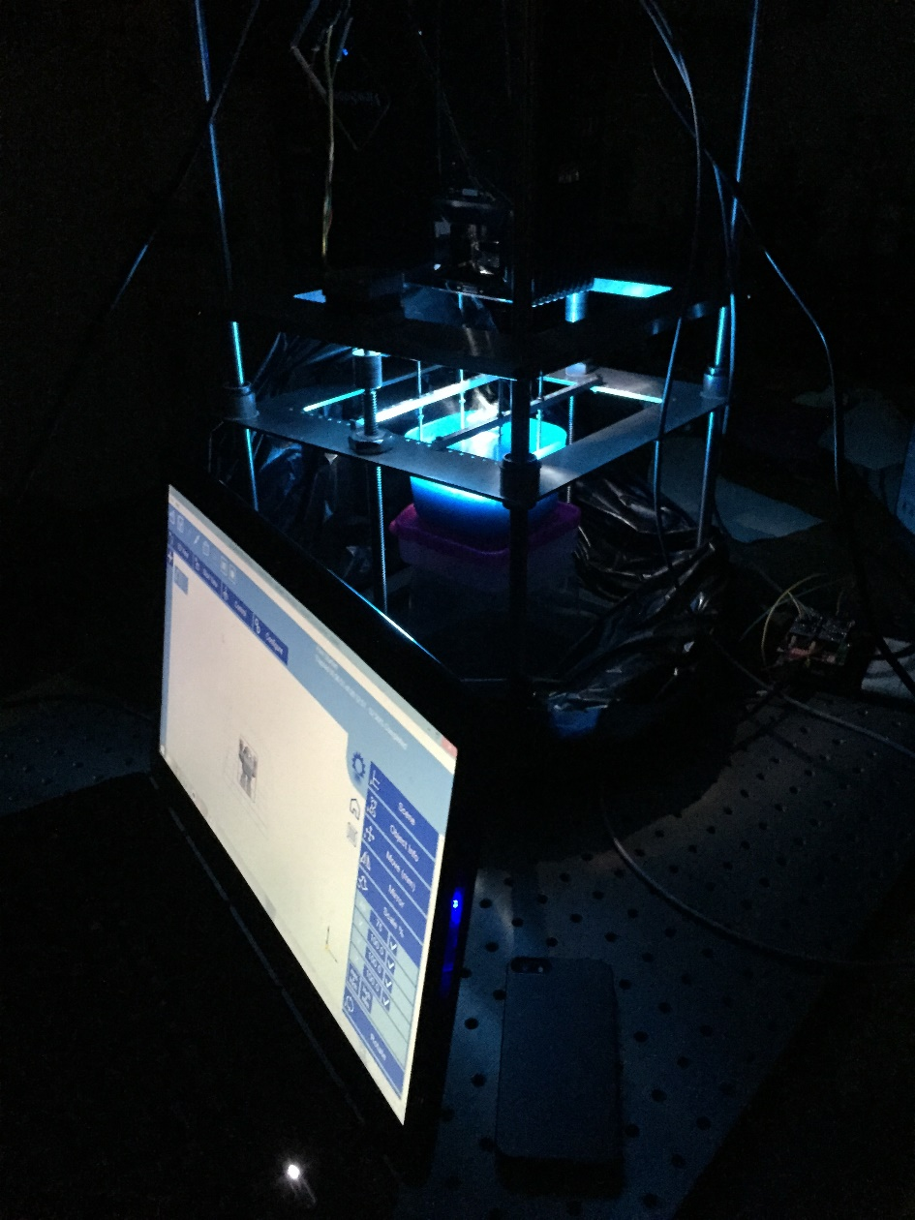
Full System Run

Slide 15
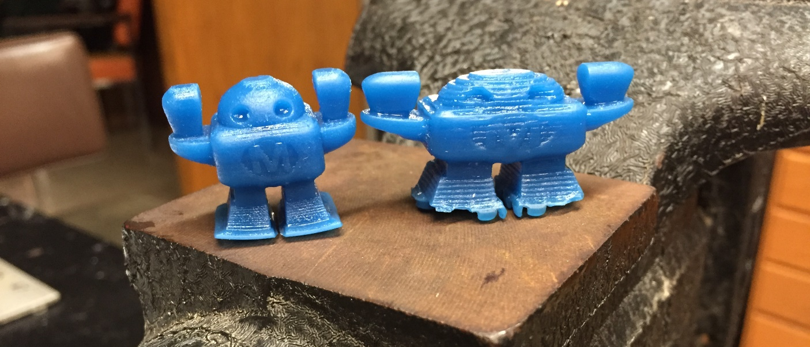
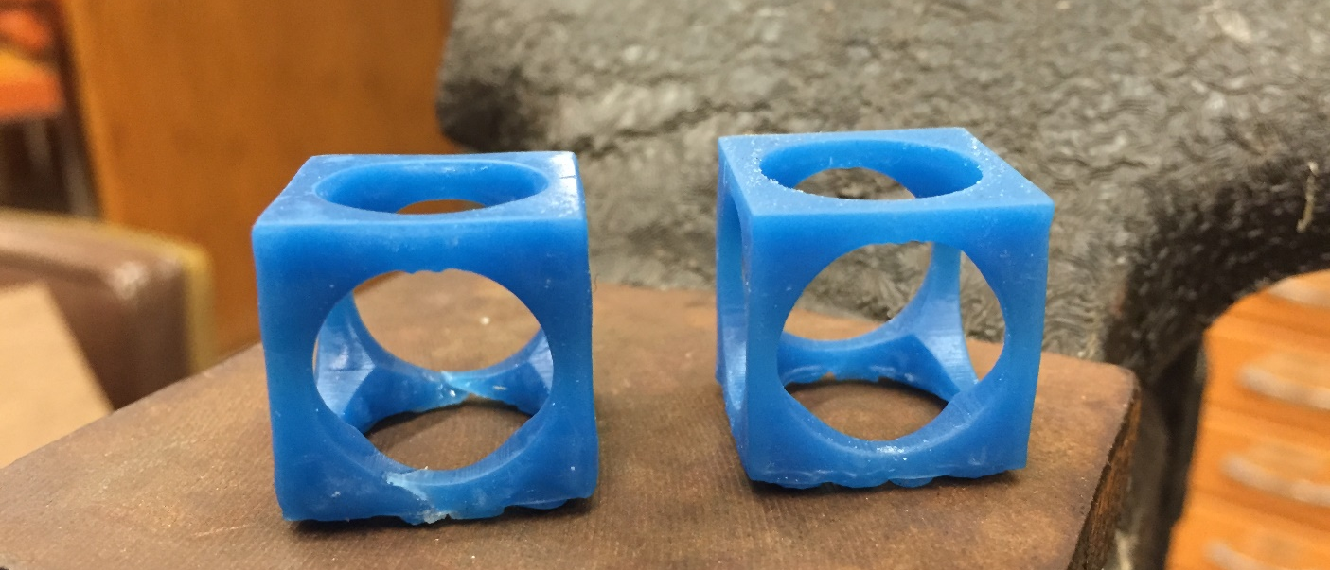
Test Prints

Slide 16
