Slide 1
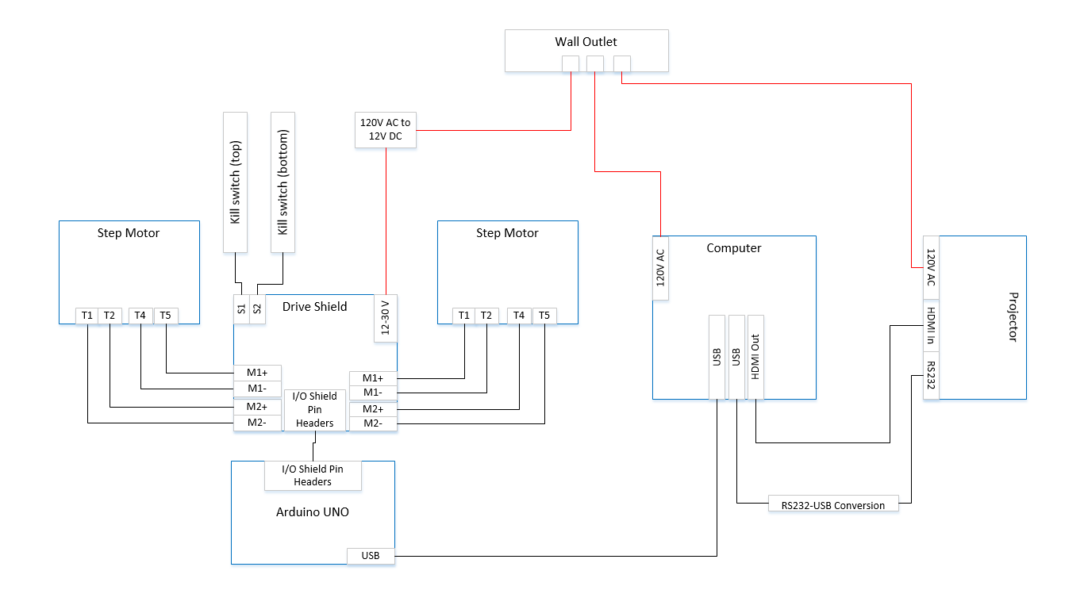
Schematic
Wiring Diagram

