Slide 1
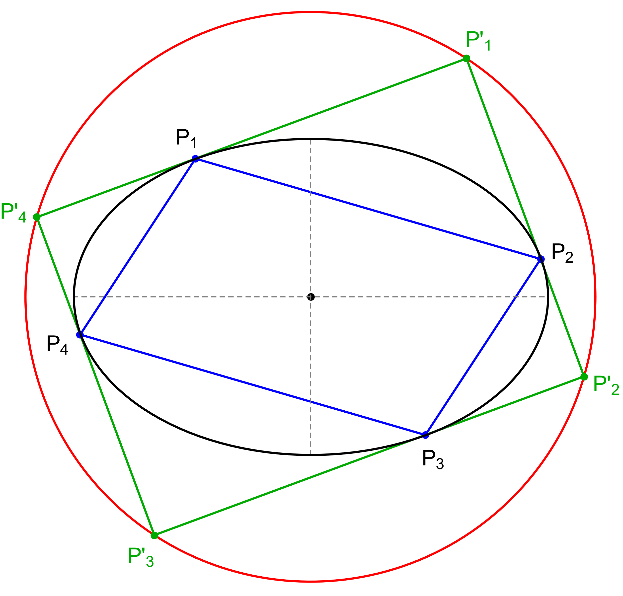
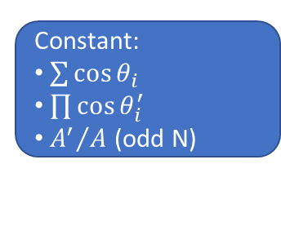
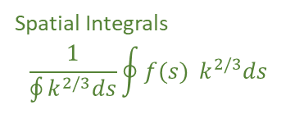
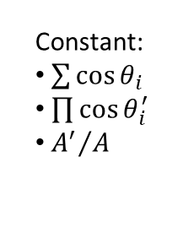

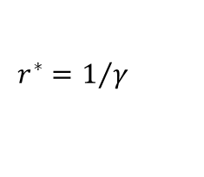
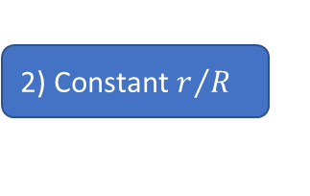
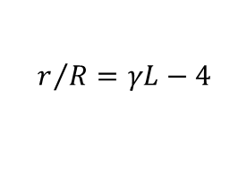




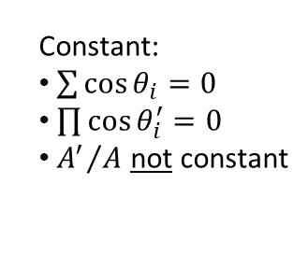

$$N=3$$
$$N=4$$
$$∀N$$
1) Loci
3) Mittenpunkt $X_{9}=0$
Generalized Mittenpunkt
Elliptic
Non-Elliptic
Quasi-Elliptic
Point
Circle
Circumbilliard
Monge’s orhtoptic
0) Integrability
constants
4) Stationary Cosine Circle
Generalized Stationary Circle
$$r^{∗}=\frac{L}{r/R+4}$$
$$r^{∗}=1/γ$$
Perimeter L
Angular Mom$. γ$
2) Constant $r/R$
$$r/R=γL−4$$
Constant:
$\sum{\cos{θ_{i}}}$
$\prod{\cos{θ_{i}^{′}}}$
${A^{′}}/A$
Constant:
$\sum{\cos{θ_{i}=0}}$
$\prod{\cos{θ_{i}^{′}=0}}$
${A^{′}}/A$ not constant
Constant:
$\sum{\cos{θ_{i}}}$
$\prod{\cos{θ_{i}^{′}}}$
${A^{′}}/A$ (odd N)
Spatial Integrals
$$\frac{1}{\oint{k^{2/3}ds}}\oint{f(s){ k^{2/3}ds}}$$

