Slide 1
Landsat ground Recognition
Daniele Trappolini
Emanuele Fratocchi
Luca Avitabile
Edoardo Ulrich Proverbio
Michele Luca Puzzo

Slide 2
Modelling Part
Logistic Regression
OvR
Multiclass
Naive Bayes
CatBoost

Slide 3
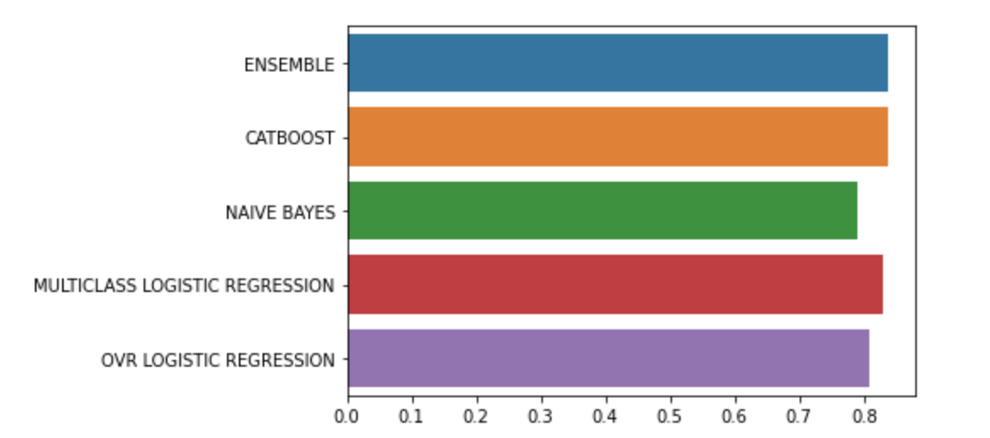
Ensemble
Naive Bayes+ Logistic Regression+ Catboost
In this Ensemble we just computed the mode of the predictions of the best three previous models.
When we have 3 different value, mode has no sense, so we pick the catboost prediction, that is our best classifier.

Slide 4
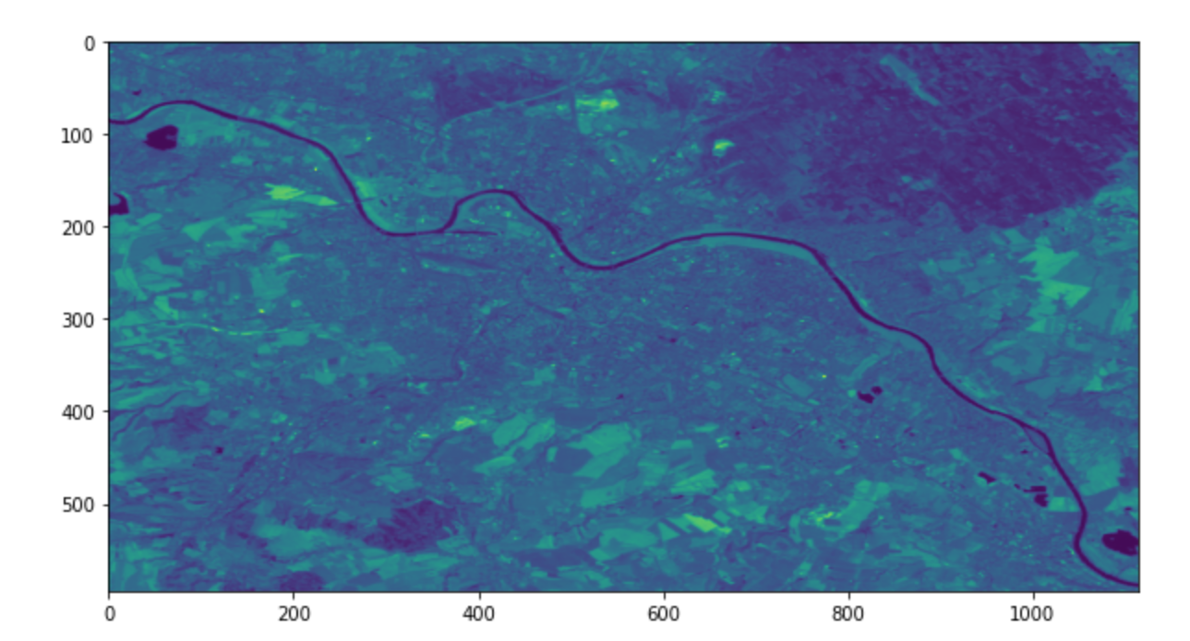
Real Case Study Application
In this part we used Earth Engine API’s to scrape and collect a new dataset:
We access to a collection of images taken from Dresden Area

Slide 5
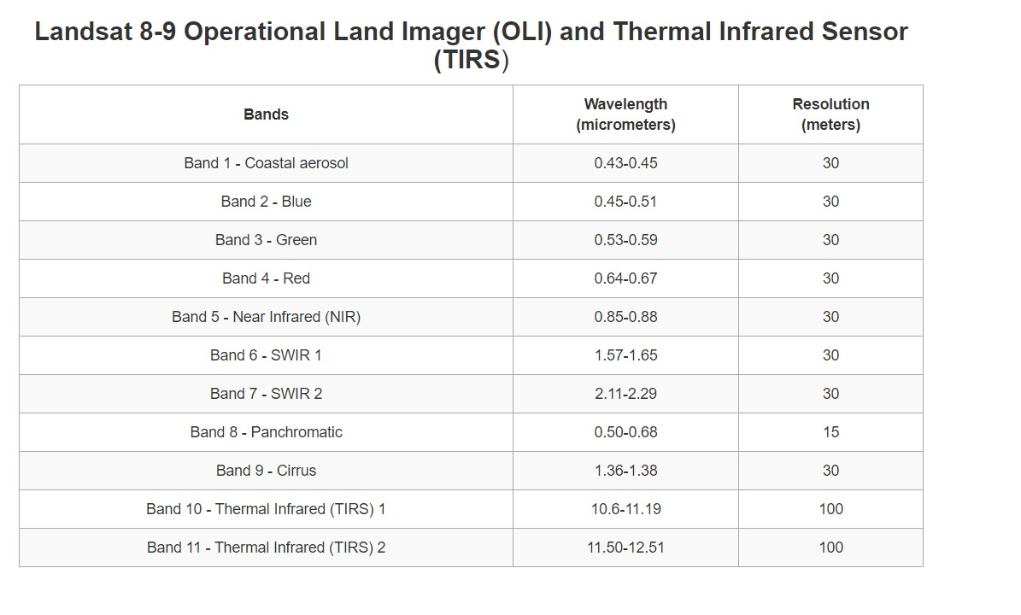
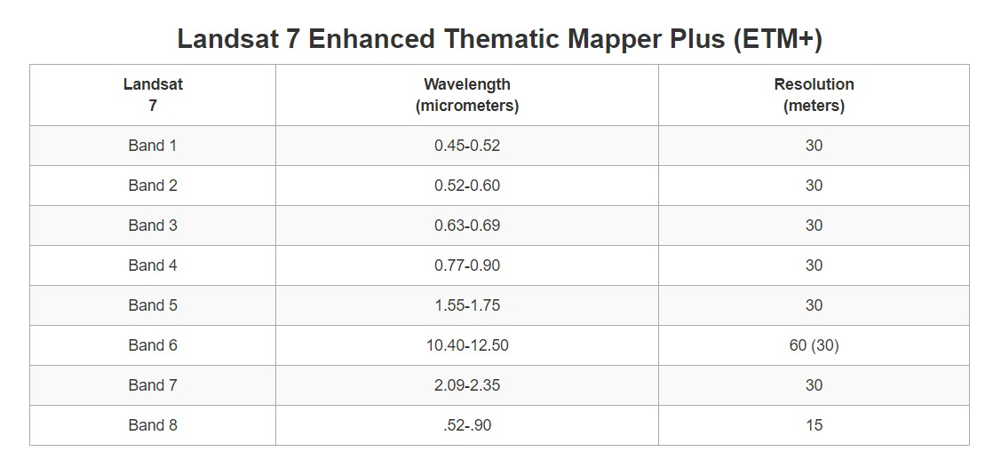
Open the image as an array
https://www.usgs.gov/faqs/what-are-band-designations-landsat-satellites?qt-news_science_products=0#

Slide 6
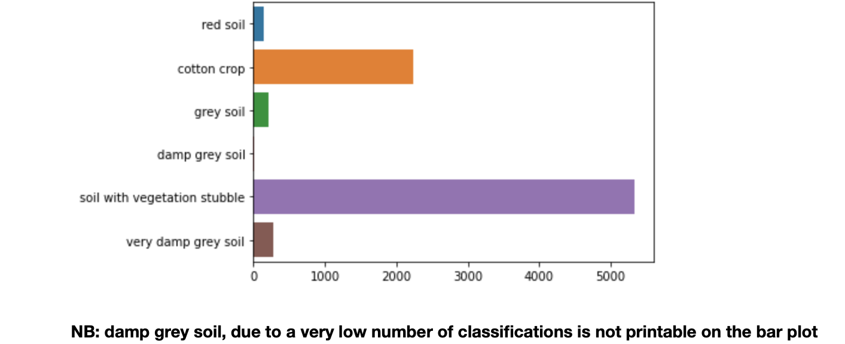
Classification on our image, from Landsat-8 mission
So this are the results of the application of our trained model to our real case:

Slide 7
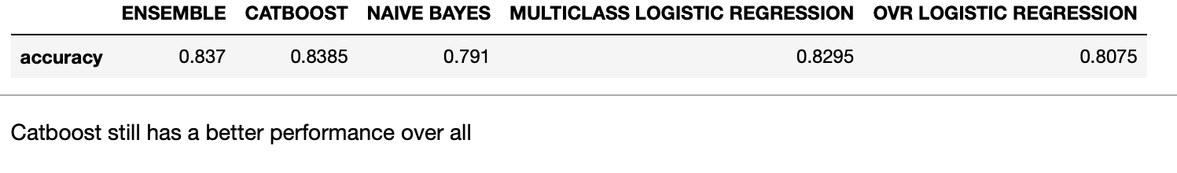
Conclusion
We were achieved to improve the performances through the ensemble method on the same dataset because the two high performance method are two ensemble. The catboost is an ensemble methods and the ensemble is made by us.

