Slide 1
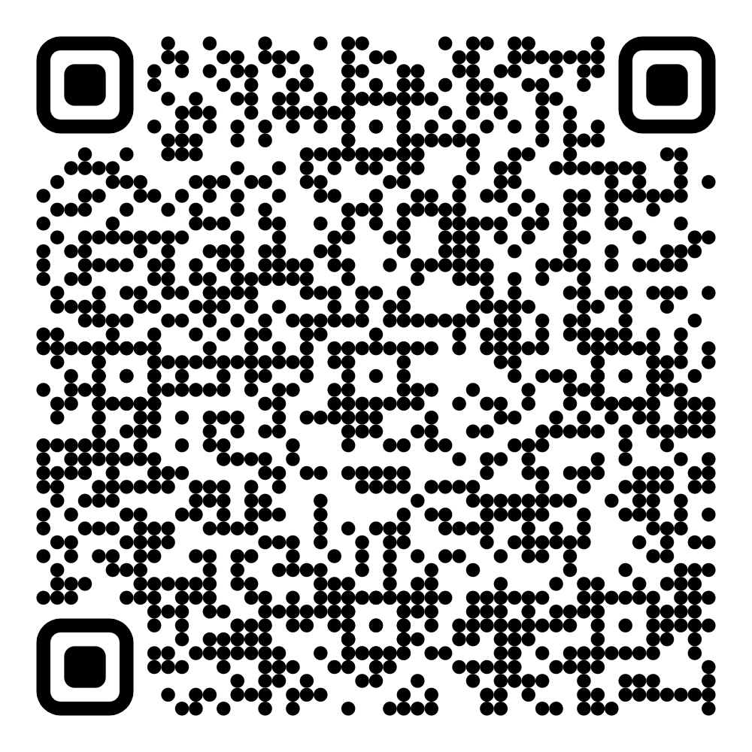
Common Mistakes in Web Accessibility
Presenter: Dan Tripp
Slides: https://hello.siteimprove.com/csun-2025-common-web-accessibility-mistakes

Slide 2
QR code for these slides

Slide 3
Introduction
Study of 31,881 pieces of advice. Consultants to customers.
Audience: web content authors, web developers, all web, no apps.
Automated, not manual (mostly).

Slide 4
Introduction (slide 2)
Parts of this talk:
The dataset
The top 5 mistakes, and how to fix them
Affects: screen reader users, users with low vision, voice access AT users.
User impact: high.
Fixes: easy. One line.
Conclusion: one meta-strategy.

Slide 5
Introduction (slide 3)
Knowledge level: Technical, intermediate. HTML, CSS, WCAG, “accessible name”.
Questions throughout.

Slide 6
Blank slide

Slide 7

Joke Sloth image slide
“These slides are waaaaaay too text-heavy.”
“It’s gonna be what? 10 AM?”
“They’ll be thinking: I got out of bed for this?”
“Add some color.”
“… or bold.”
“… or ANYTHING!”
“Add a sloth.”

Slide 8
The Dataset
Dashboard of automated accessibility checks
→ Customer disagrees with automated check (element-specific)
→ Support ticket → Consultant decides: is automated check correct?
If yes: → Consultant chooses 1 of 451 advice templates, or writes their own → Sends advice to customer

Slide 9
The Dataset
Repeat 31,881 times across 2659 customer websites = “the dataset”
From March 2023 to December 2024.
✨AI✨
→ Top 30 → Hand-picked → Top 5
High user impact, all WCAG, under-documented.

Slide 10
The Dataset (slide 3)
“Common mistakes” as documented elsewhere:
WebAIM Million: 1 million pages. Web Almanac: 34 million pages.
Many blog posts.

Slide 11
The Dataset (slide 3)
Why this talk?
Siteimprove’s slightly different rule set.
Our customers: more “honest mistakes”, not neglect.
Our consultants’ human judgement on
the root of the problem, and
the appropriate fix.
→ No longer about “fully-automated” accessibility testing.
4. Under-documented mistakes.

Slide 12
Blank slide

Slide 13
Blank slide

Slide 14
Mistake 1 of 5: Empty Link
Automated check said: "Link missing a text alternative“
Customer wrote: “This link says “Kelly Griffith” and it’s fine.”

Slide 15
Mistake 1 of 5: Empty Link (slide 2)
Consultant wrote: “There is an empty and invisible <a> element here, right next to the visible link “Kelly Griffith”. That's what the Siteimprove rule is failing on - the empty and invisible <a> element (not the visible <a> element). Sometimes empty <a> elements like this are caused by your CMS (Content Management System) when you type some text then erase it. That is: the text will be erased, but not the <a> tags that surrounded the text. To fix this: in your CMS, switch to its HTML view (if available), and remove the empty <a> element (and leave the visible <a> element as it is.)”

Slide 16
Empty Link - Customer Scenario
100% WYSIWYG.

Slide 17
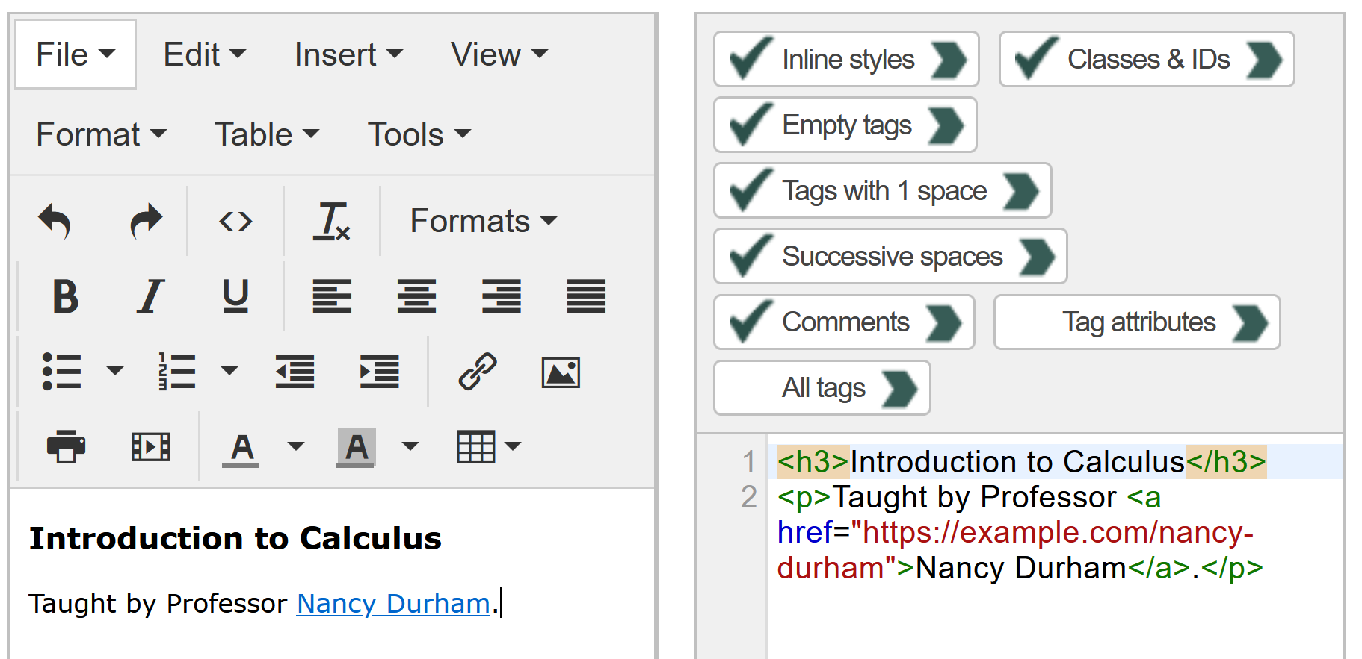
Empty Link - Customer Scenario (slide 2)

Slide 18
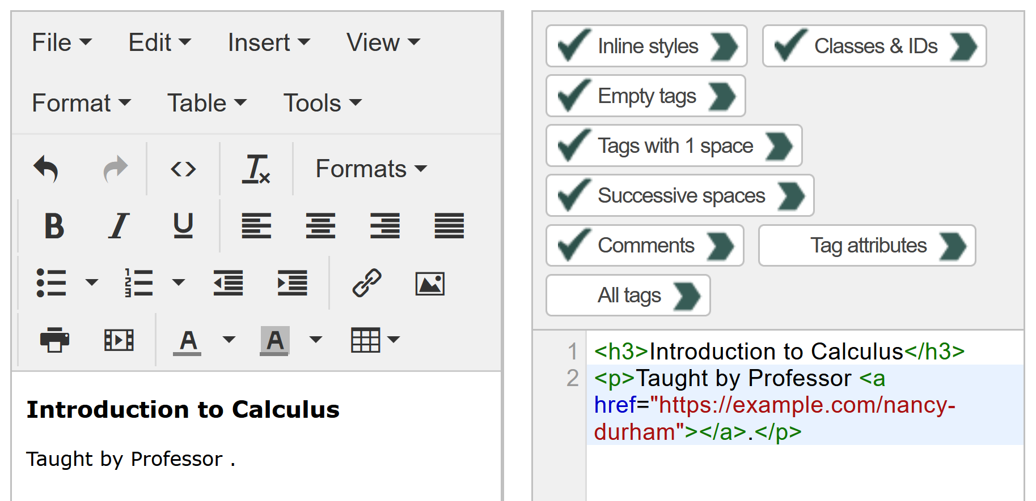
Empty Link - Customer Scenario (slide 3)

Slide 19
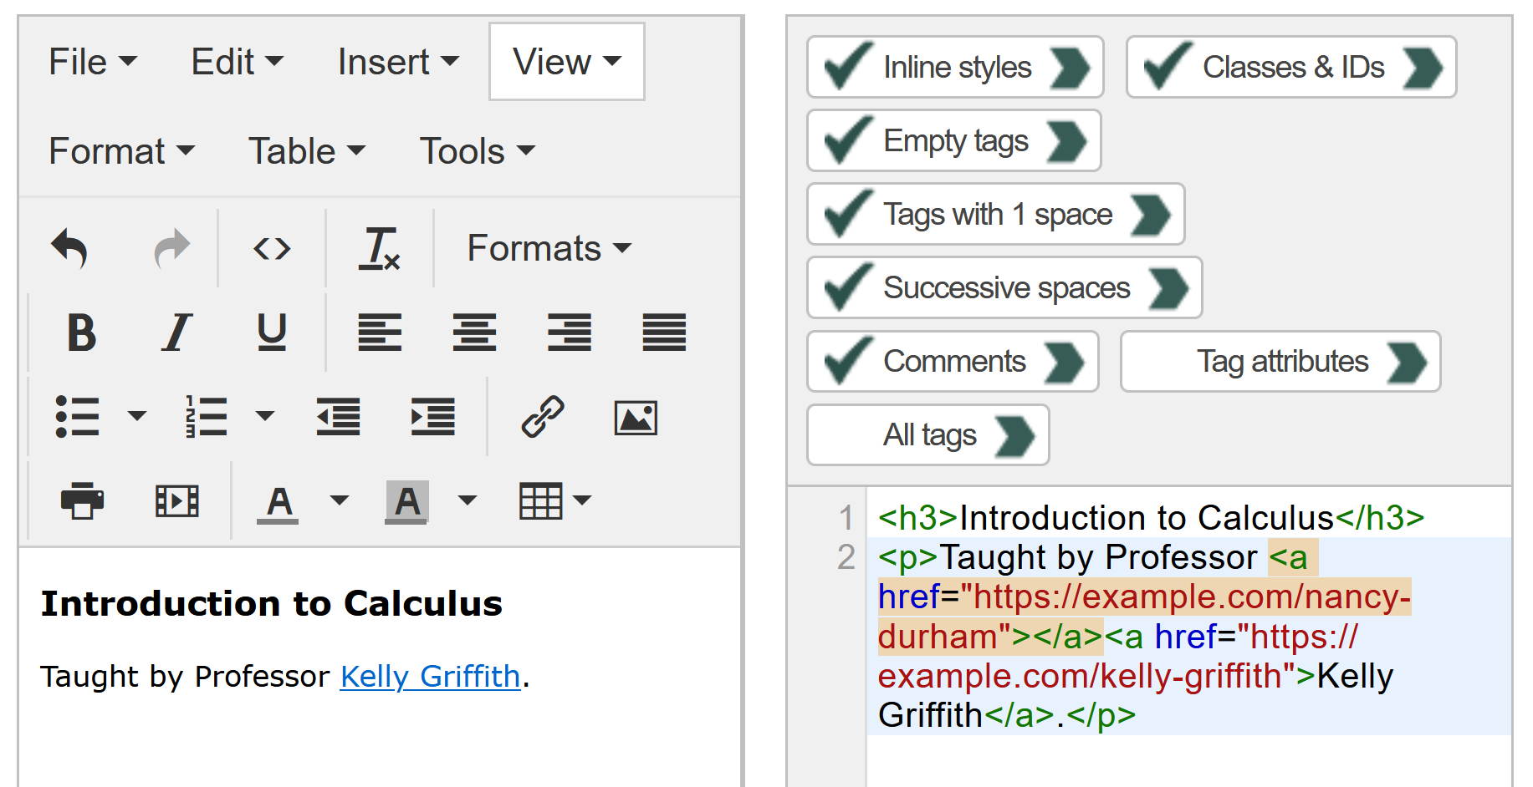
Empty Link - Customer Scenario (slide 4)

Slide 20
Empty Link – User Impact
Mostly screen reader users.
Redundant at best, misleading junk at worst.

Slide 21
Empty Link – How To Fix
Delete them all.
Spread the word.
Many tools flag it (including Siteimprove), only WAVE calls it “Empty Link”.
“Empty Link” = alarm bells.

Slide 22
Empty Link – Documentation Elsewhere
WebAIM Million: Specific. 44.6% of pages have 1+ empty links.
Web Almanac: Only generally.
Online commentary:
On the WYSIWYG cause: some commentary.
On the “out-of-date” nature of many empty links: none.
Our dataset:
I checked 50.
12/50 were either 1) broken links, or 2) clearly wrong, given the context.
→ 24% misleading junk
Colleague….

Slide 23
Blank slide

Slide 24
Blank slide

Slide 25
Mistake 2 of 5: Heading Used For Emphasis
Automated check said: “Content missing after heading”
Consultant wrote: “There is no text content between this heading ("$2.99 / lb") and the heading after it (“Bananas"), and they both have the same heading level.”
(continues…)

Slide 26
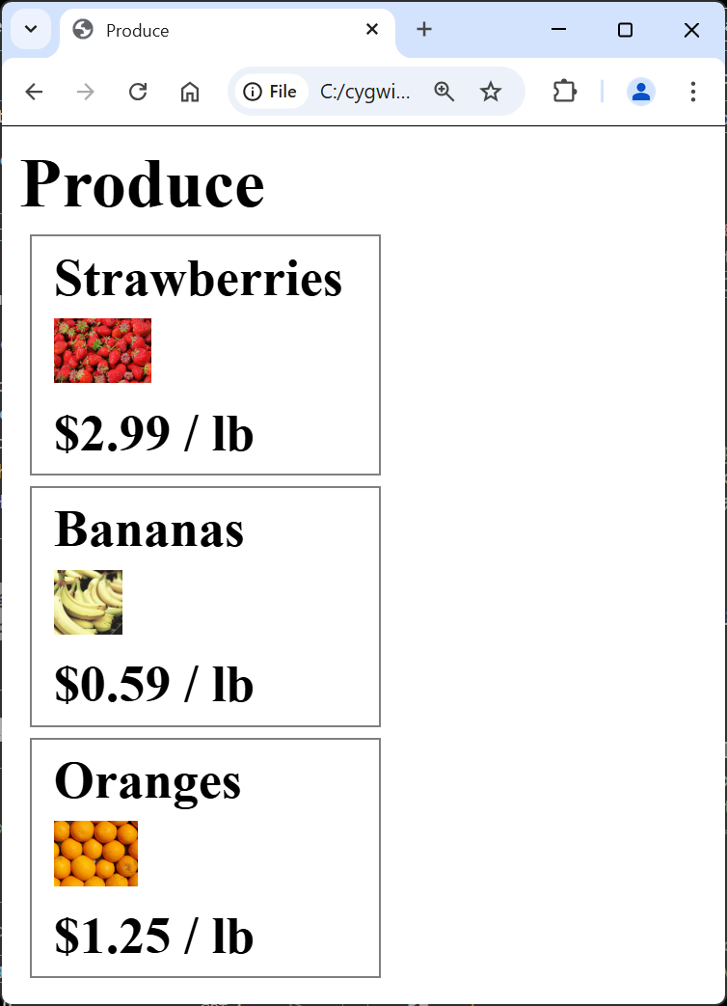
Heading Used For Emphasis
(slide 2)
→ → → → → → → → → → → → → → → → → →

Slide 27
Mistake 2 of 5: Heading Used For Emphasis (3)
Consultant wrote (continued):
“This rule is failing because the author of this page used heading tags to achieve visual emphasis on the first heading. That is contrary to how headings are meant to be used in HTML. Headings in HTML are meant to be used the same way they're used in a table of contents or a print newspaper: to give a title to the section of content which follows the heading. That proper use of headings enables a popular feature of screen readers: "jump to next heading", which the screen reader user can use to both move around the page and get an overview of the page.” (continues…)

Slide 28
Heading Used For Emphasis (slide 2)
Consultant wrote (continued):
“Both of those techniques will be rendered ineffective if the web author improperly uses a heading for visual emphasis, and that is the case here.
To fix this: remove the heading tags so that the prices (“$2.99 / lb”, “$0.59 / lb”, etc.) aren’t headings any more. Then (optionally) adjust the font size and boldness via CSS to make this text look like it does now.”

Slide 29
Heading Used For Emphasis > Customer Scenario
Wanted to emphasize some text, and used a heading to do it.
“Emphasize” = “make big and bold”.

Slide 30
Heading Used For Emphasis > User Impact
The screen reader user might wonder things such as:
Is “$2.99 / lb" supposed to be a section of the page where everything is “$2.99 / lb“? (No.)
Is “$2.99 / lb" the price of strawberries or bananas? (Strawberries.)

Slide 31
Heading Used For Emphasis – HTML Before Fix
<div>
<h2>Strawberries</h2>
<img src="strawberries.jpeg" alt="Strawberries">
<h2>$2.99 / lb</h2>
</div>
<div>
<h2>Bananas</h2>
<img src="bananas.jpeg" alt="Bananas">
<h2>$0.59 / lb</h2>
…

Slide 32
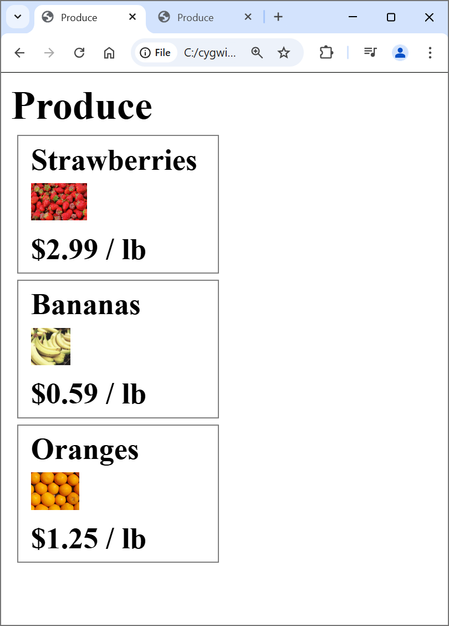
Heading Used For Emphasis – HTML After Fix
<div>
<h2>Strawberries</h2>
<img alt="Strawberries" src="strawberries.jpeg">
<span class="price">$2.99 / lb</span> /*changed*/
</div>
<div>
<h2>Bananas</h2>
<img alt="Bananas" src="bananas.jpeg">
<span class="price">$0.59 / lb</span> /*changed*/
…

Slide 33
Heading Used For Emphasis – Documentation Elsewhere
WebAIM, Web Almanac: no, because:
Fully-automated only.
“Skipped heading level” check only.
Siteimprove’s automated check didn’t catch this. Its consultants did.
Only incidentally caught by the automated checks. → Many not caught.

Slide 34
Blank slide

Slide 35
Blank slide

Slide 36
Mistake 3 of 5: Font Size “px / pt” Mix-Up
Automated check said: “Color contrast does not meet minimum requirement”
Customer wrote: “WCAG says that large text only needs 3:1 contrast (not 4.5:1), and this text is large enough (it’s 18 px) and it has 3.2:1 contrast, so it should pass WCAG. Why is the automated check saying that it fails?”

Slide 37
Font Size “px / pt” Mix-Up (slide 2)
Consultant wrote: “Unfortunately this text does not meet WCAG's definition of "large". The definition uses "pt" units (also known as "point" units) - not "px" units - but you've interpreted it as though it uses "px" units. Large text begins at "18 point or 14 point bold". 18 point equals 24px. As you stated, the size of this text is 18px. That equals 13.5pt, which is less than the 18pt required by the WCAG definition of "large" (for non-bold text). So this text needs to have at least 4.5:1 contrast (not 3:1), and it doesn't, so it fails this WCAG success criterion.”

Slide 38
Font Size “px / pt” Mix-Up – Customer Scenario
WCAG SC uses: pt.
Most real-world CSS uses: px.
Browser devtools “computed properties” uses: px.
Meters vs. feet.

Slide 39
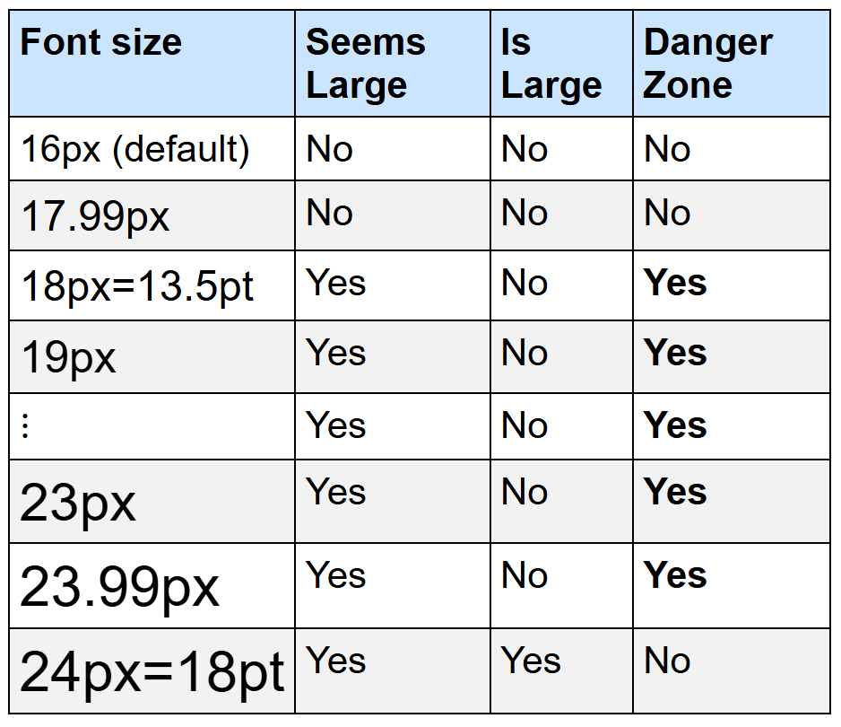
Font Size “px / pt” Mix-Up – Danger Zone
}

Slide 40
Font Size “px / pt” Mix-Up – User Impact
The well-known impact of insufficient contrast, from WCAG: "People with low vision often have difficulty reading text that does not contrast with its background."

Slide 41

Font Size “px / pt” Mix-Up – CSS Before Fix
.cta-button {
color: rgb(60, 55, 255);
background-color: black;
font-size: 18px; /* This is "large" by WCAG */
}

Slide 42


Font Size “px / pt” Mix-Up – CSS After Fix Option A (Increase Font Size)
.cta-button {
color: rgb(60, 55, 255);
background-color: black;
font-size: 24px; /* equals 18pt = WCAG "large" */
}

Slide 43

Font Size “px / pt” Mix-Up – CSS After Fix Option B (Increase Contrast)
.cta-button {
color: rgb(95, 95, 255); /* gives 4.5:1 contrast */
background-color: black;
font-size: 18px;
}

Slide 44
Font Size “px / pt” Mix-Up – Documentation Elsewhere
WebAIM Million, Web Almanac:
Not the “px / pt” mix-up exactly.
WCAG, WebAIM contrast page:
Mention the different px / pt units, but do NOT mention the bad thing that happens if you mix them up.

Slide 45
Blank slide

Slide 46
Blank slide

Slide 47
Mistake 4 of 5: “Label in Name” Failure
Automated check said: “Visible label and accessible name do not match”

Slide 48
“Label in Name” Failure (slide 2)
Consultant wrote:
The accessibility guidelines are quite strict on this and require that the visible label, in its entirety, and with the words in the same order, is included in the accessible name. (Not the other way around.)
The visible label is "Read more" and the accessible name is coming from the aria-label, which is "Read full article: payment methods".
To fix this is: change the aria-label so that all of the words in the visible label appear at the start of the aria-label.

Slide 49
“Label in Name” Failure (slide 3)
Consultant wrote (continued):
For example, since the visible label is “Read more”, change this:
aria-label="Read full article: payment methods"
to this:
aria-label="Read more about payment methods"

Slide 50
“Label in Name” Failure – Customer Scenario
Heard that "read more" is bad for screen reader users. So they added an aria-label, but something went badly.

Slide 51
“Label in Name” Failure – User Impact
One of:
“Voice access AT” AKA “Speech recognition” AKA …
Voice Control user (iPhone) ← needs “front-loading”
Voice Access user (Android)
More?
Screen reader users
Sighted screen reader user
Blind screen reader user with sighted tech support

Slide 52
“Label in Name” Failure – Before & After Fix
→
Before:
<a href="https://example.com/payment-methods"
aria-label="Read full article: payment methods">
Read more
</a>
After:
<a href="https://example.com/payment-methods"
aria-label="Read more about payment methods">
Read more
</a>

Slide 53
“Label in Name” Failure – How To Fix
Ask: does this really need an aria-label?
If so: copy the visible text, paste it at the start of the aria-label, then add any other words after.

Slide 54
“Label in Name” Failure – Examples
Good or Bad | aria-label | Visible label
Good | Read more about payment methods | Read more
Bad | Payment methods, read more | Read more
Bad | Full article | Read more
Bad | Download the PDF about payment methods | Download PDF
Bad | 3 2 3 5 5 5 1 2 3 4 | 323-555-1234

Slide 55
“Label in Name” Failure – Documentation Elsewhere
WebAIM Million, Web Almanac: none. (WAVE / Lighthouse.)
WCAG:
“Front-load”: prominently a “best practice”, but doesn’t say why.
Sighted screen reader user: Yes.
Does any tool flag “failure to front-load”? A: No.

Slide 56
Blank slide

Slide 57
Blank slide

Slide 58
Mistake 5 of 5: Bad <label> Element
Automated check said: “Form field missing a label”
Consultant wrote: I can see that you added a <label> element, but there are two problems with it:
1) It's been made invisible by the CSS property "display: none". In addition to making the label invisible, this "display: none" also makes the label not take effect for accessibility purposes.
2) The <label> has for="search" and the <input> has name="search”. This isn't working because <label for="..."> is meant to refer to an id="..." attribute, not a name="..." attribute. (continues…)

Slide 59
Bad <label> Element (slide 2)
Consultant wrote (continued):
To fix this:
Remove "display: none" from the <label>,
and
2) Change <label for="search"> to <label for="site-search"> (because the ID of the <input> is "site-search").

Slide 60
Bad <label> Element – Customer Scenario
Added a <label>, but one or more things went badly.
Out of approx. seven.

Slide 61
Bad <label> Element – User Impact
Screen reader will announce "edit blank" rather than “search entire site edit blank”.
Voice access AT users: need use “show numbers”.
Mouse users: smaller clickable area.

Slide 62
Bad <label> Element – HTML Before & After Fix
→
Before:
<label style="display: none" for="search">
Search entire site
</label>
<input name="search" id="site-search">
After:
<label for="site-search">
Search entire site <!– also makes the -->
</label> <!-- label visible. -->
<input name="search" id="site-search">

Slide 63
Bad <label> Element – Fix Checklist
0. Make peace with the idea of having a visible <label> for every field.
<input> has an id="..." attribute.
<input>'s id="..." attribute is unique (no excuses)
Has a <label> element.
<label> has a for="..." attribute
<label>'s for="..." matches <input>'s id="..." (not name="…")
<label> does not have "display: none" nor "visibility: hidden” (in the CSS) nor aria-hidden=“true” (in the HTML).
<label> has text content (and it doesn’t have "display: none" nor "visibility: hidden” in the CSS nor aria-hidden=“true” in the HTML)

Slide 64
Bad <label> Element – Scope
Not just <input>. Also <select>, <textarea>, …
Other ways to fix eg. aria-label not <label>.

Slide 65
Bad <label> Element – Documentation Elsewhere
WebAIM Million: "35.5% of form inputs identified were not properly labeled"
Web Almanac: similar.
Generally: yes. Checklist: no.

Slide 66
Blank slide

Slide 67
Blank slide

Slide 68
Meta-Strategy
“Get a second opinion”
This dataset started with a disagreement.
Other tools cover 3/5 mistakes, well.
Good: Empty Link, px / pt mix-up, bad label
Dodgy: Heading for emphasis, Label in name
All free: Siteimprove, axe (Deque), ARC (TPGi), IBM, WAVE (WebAIM), ANDI, browser devtools accessibility tree, and yes, ChatGPT etc.
Multi-tool anecdotes from customers.

Slide 69
Thank you
dtr@siteimprove.com
https://linkedin.com/in/dan-tripp

