Slide 1
Common Mistakes in Web Accessibility
Presenter: Dan Tripp

Slide 2
Introduction
Study of approx. 48,000 pieces of advice. Consultants to customers.
Audience: web content authors, web developers, all web, no apps.
Automated checks, not manual (mostly).
Automated checks don’t find everything.

Slide 3
Introduction (slide 2)
Parts of this talk:
  The dataset
  The top 5 mistakes, and how to fix them
    Affects: screen reader users, users with low vision, voice access AT users.
    User impact: high.
    Fixes: easy. One line.
  Conclusion: one meta-strategy.
  Questions: any time.

Slide 4
Introduction (slide 3)
Knowledge level: Not quite beginner: HTML, CSS, WCAG, “accessible name”.

Slide 5
Blank slide

Slide 6

Joke Sloth
“These slides are waaaaaay too text-heavy.”
“Add some color.”
“… or bold.”
“… or ANYTHING!”
“Add a sloth.”

Slide 7
The Dataset > The Workflow
Dashboard of automated accessibility checks
  → Customer disagrees with automated check (element-specific)
  → Support ticket → Consultant decides: is automated check correct?
  If yes: → Consultant chooses 1 of 600 response templates, or writes their own
  Sends advice to customer

Slide 8
The Dataset > Scale
Repeat 48,159 times = “the dataset”
… across 4,094 customer websites
… from March 2023 to August 2026.
Granular. Sub-SC.
Finding “top 5” tricky. Edit, fill in the blanks.

Slide 9
The Dataset > Analyzing It
✨AI✨
  AI “clustering”, not LLMs.
  → A rough top 30 → Hand-picked → My top 5
  High user impact, all WCAG, under-documented.

Slide 10
“Common Mistakes” As Documented Elsewhere
WebAIM Million: 1 million pages. Web Almanac: 34 million pages.
Many blog posts.
Notes:
* WebAIM million is 2026
* Web Almanac is 2025

Slide 11
Why This Talk?
  Siteimprove’s slightly different rule set.
  More “honest mistakes” than pure neglect.
  Our consultants’ human judgement on
      the root of the problem, and
      the appropriate fix.
  → No longer about “fully-automated” accessibility testing.
  4. Under-documented mistakes.

Slide 12
Blank slide 1

Slide 13
Mistake 1 of 5: Leftover Link

Slide 14
Leftover Link > In The Dataset
Automated check said:
“Link missing a text alternative”
Customer wrote:
“What do you mean this link is missing a text alternative? This link HAS a text alternative – it’s obviously “Janelle Fong”. Your automated checker is wrong.”

Slide 15
sloth

Slide 16
Leftover Link > What The Consultant Wrote
Consultant wrote: “There is an empty and invisible <a> element here, right next to the visible link “Janelle Fong”. That's what this Siteimprove rule is failing on - the empty and invisible <a> element (not the visible <a> element). Sometimes empty <a> elements like this are caused by your CMS (Content Management System) when you type some text then erase it. That is: the text will be erased, but not the <a> tags that surrounded the text. To fix this: in your CMS, switch to its HTML view (if available), and remove the empty <a> element (and leave the visible <a> element as it is.)”

Slide 17
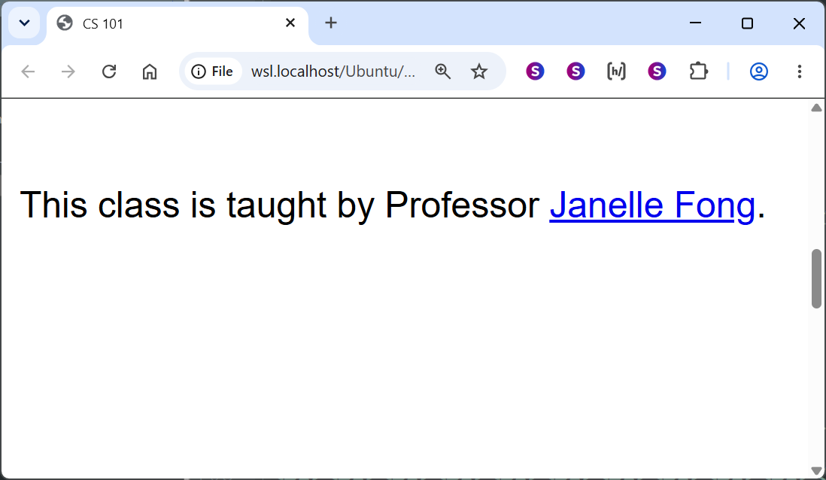
Leftover Link > Example Page
This class is taught by Professor
<a href="/janelle-fong">Janelle Fong</a>
<a href="/linda-hughes"></a>
← Flagged

Slide 18
Leftover Link > The Cause
100% WYSIWYG

Slide 19
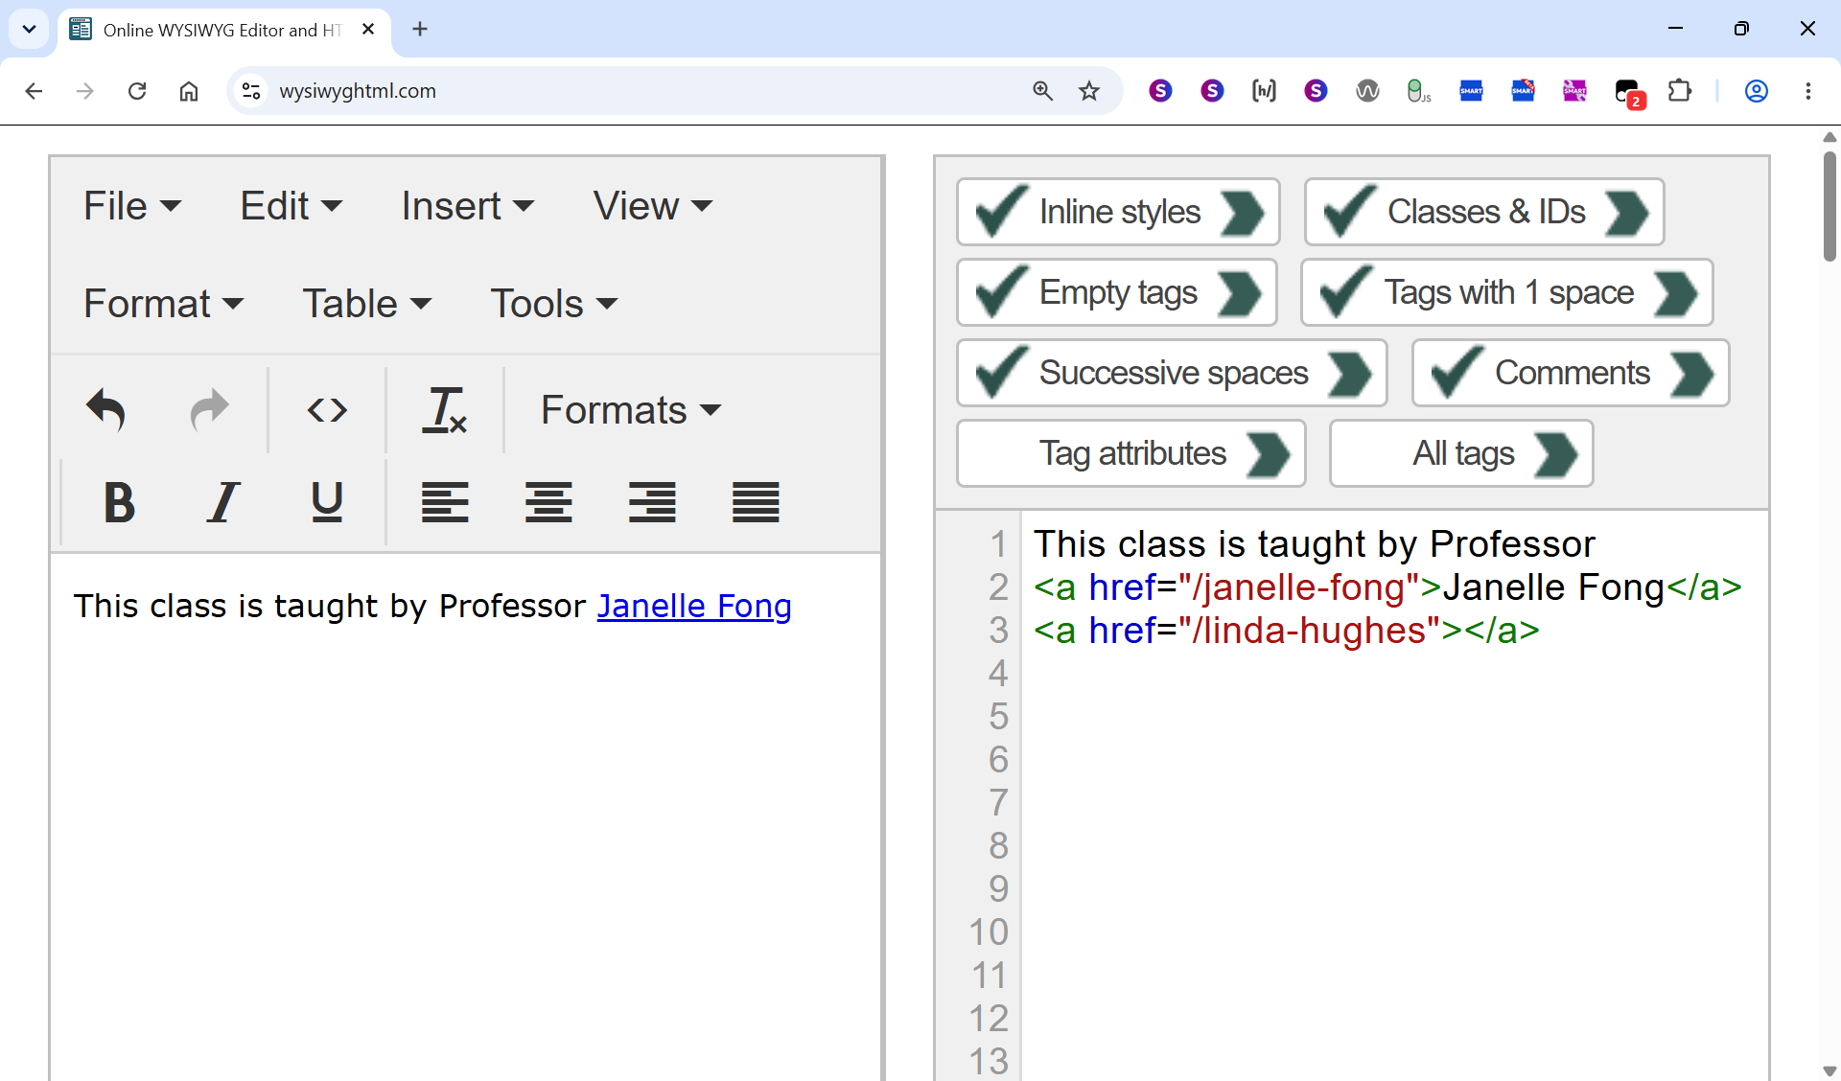
Leftover Link > Page Author Side
> Current HTML

Slide 20
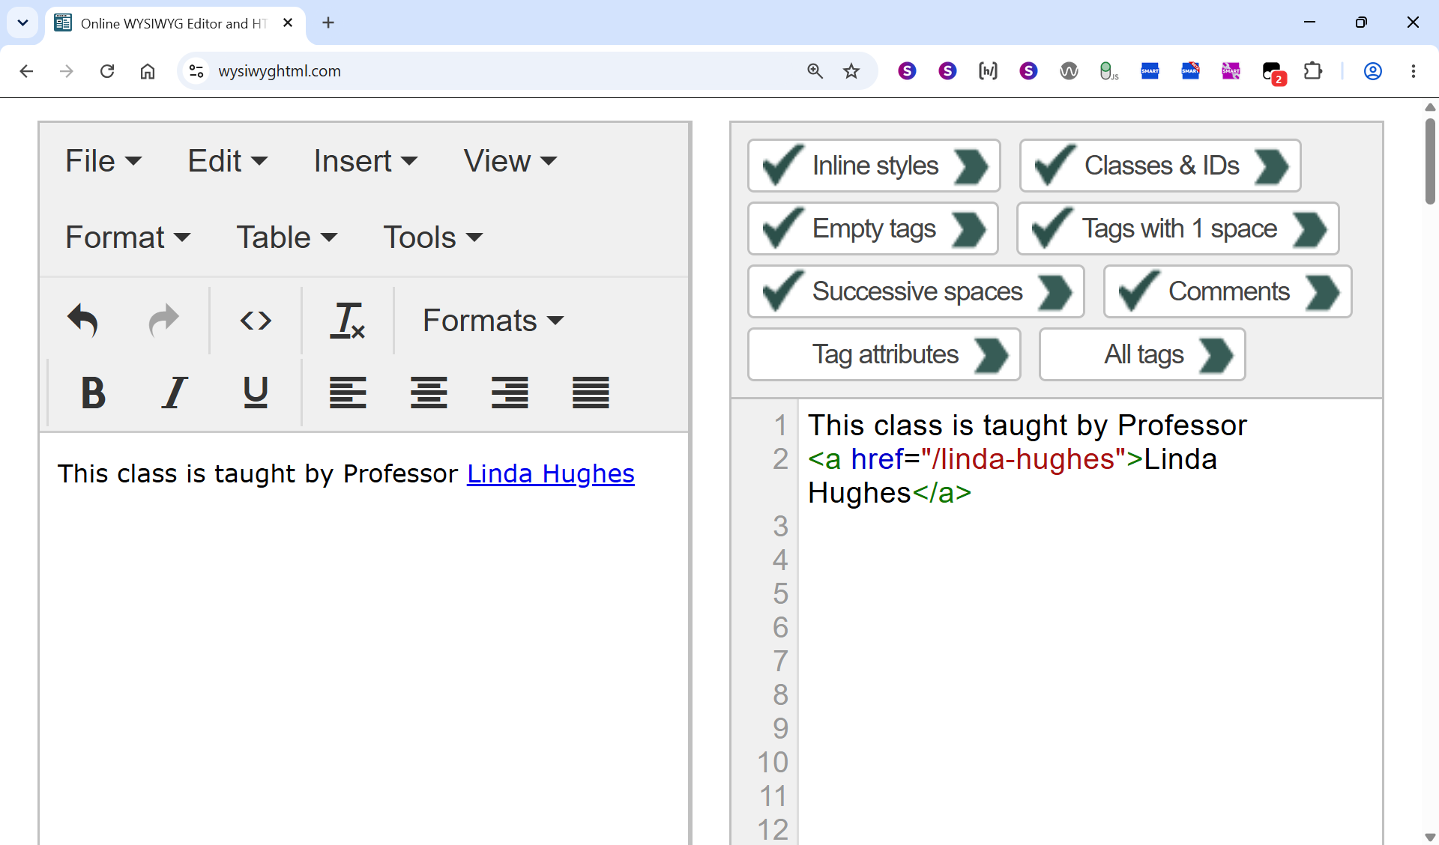
Leftover Link > Page Author Side
> Back in Time, Version 1

Slide 21
Backspacing over “Linda Hughes”, animated screenshot 1/9

Slide 22
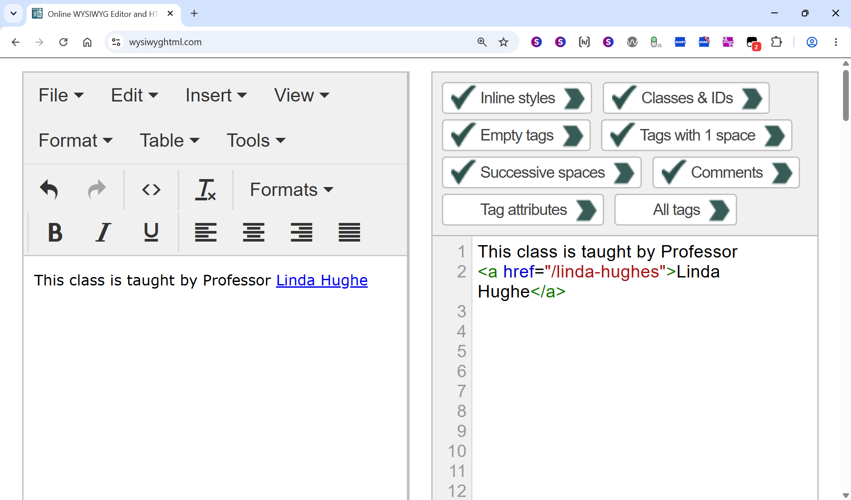
Backspacing over “Linda Hughes”, animated screenshot 2/9

Slide 23
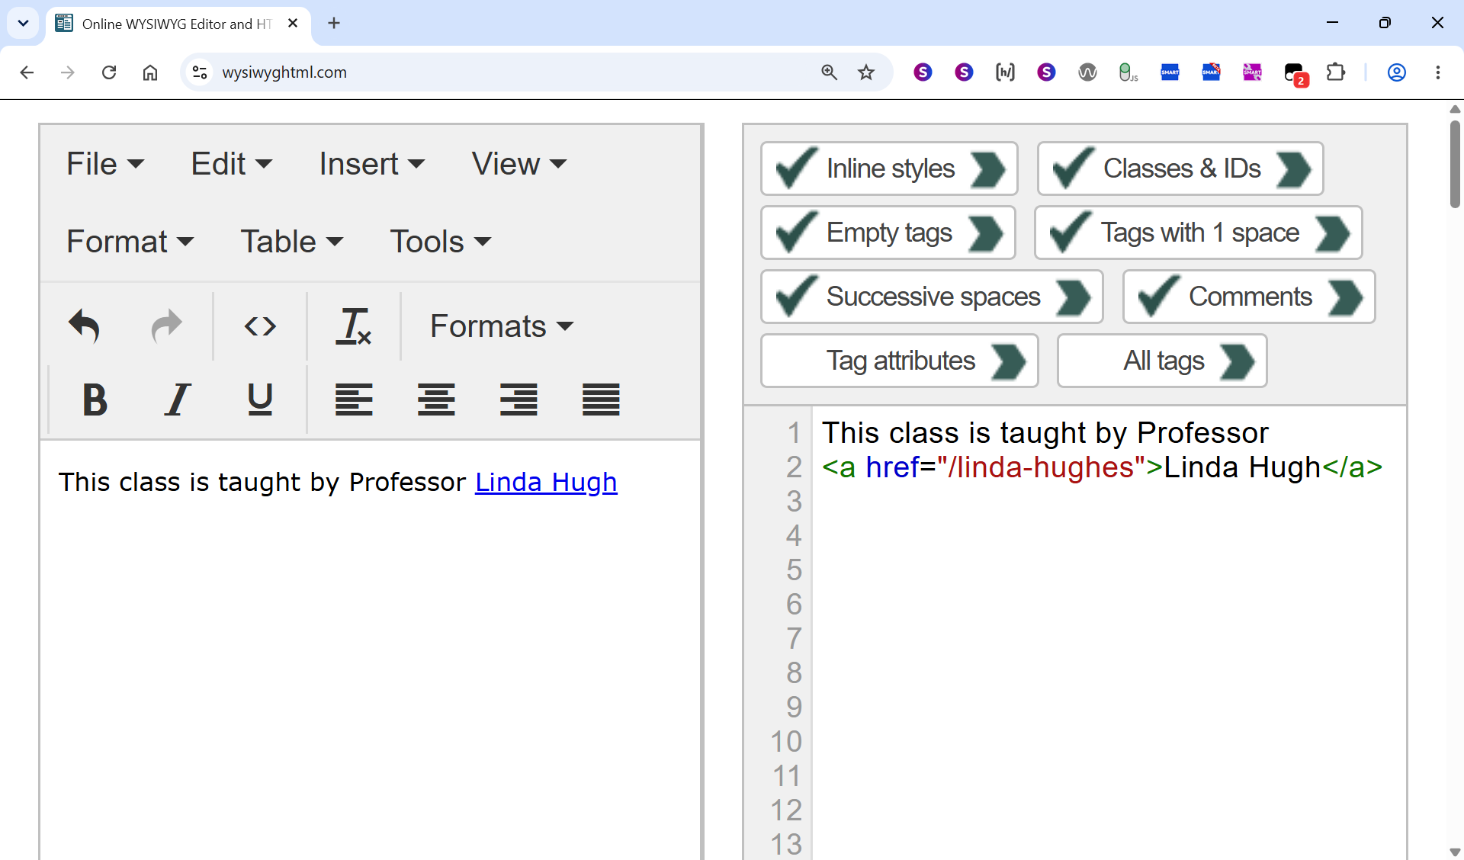
Backspacing over “Linda Hughes”, animated screenshot 3/9

Slide 24
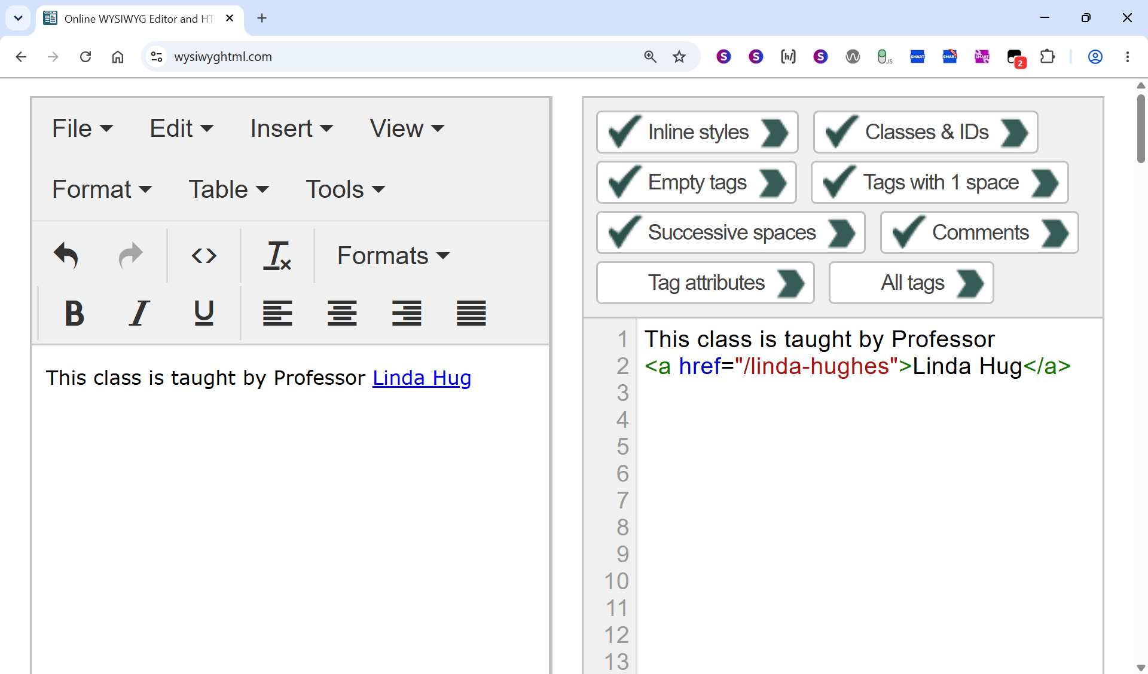
Backspacing over “Linda Hughes”, animated screenshot 4/9

Slide 25
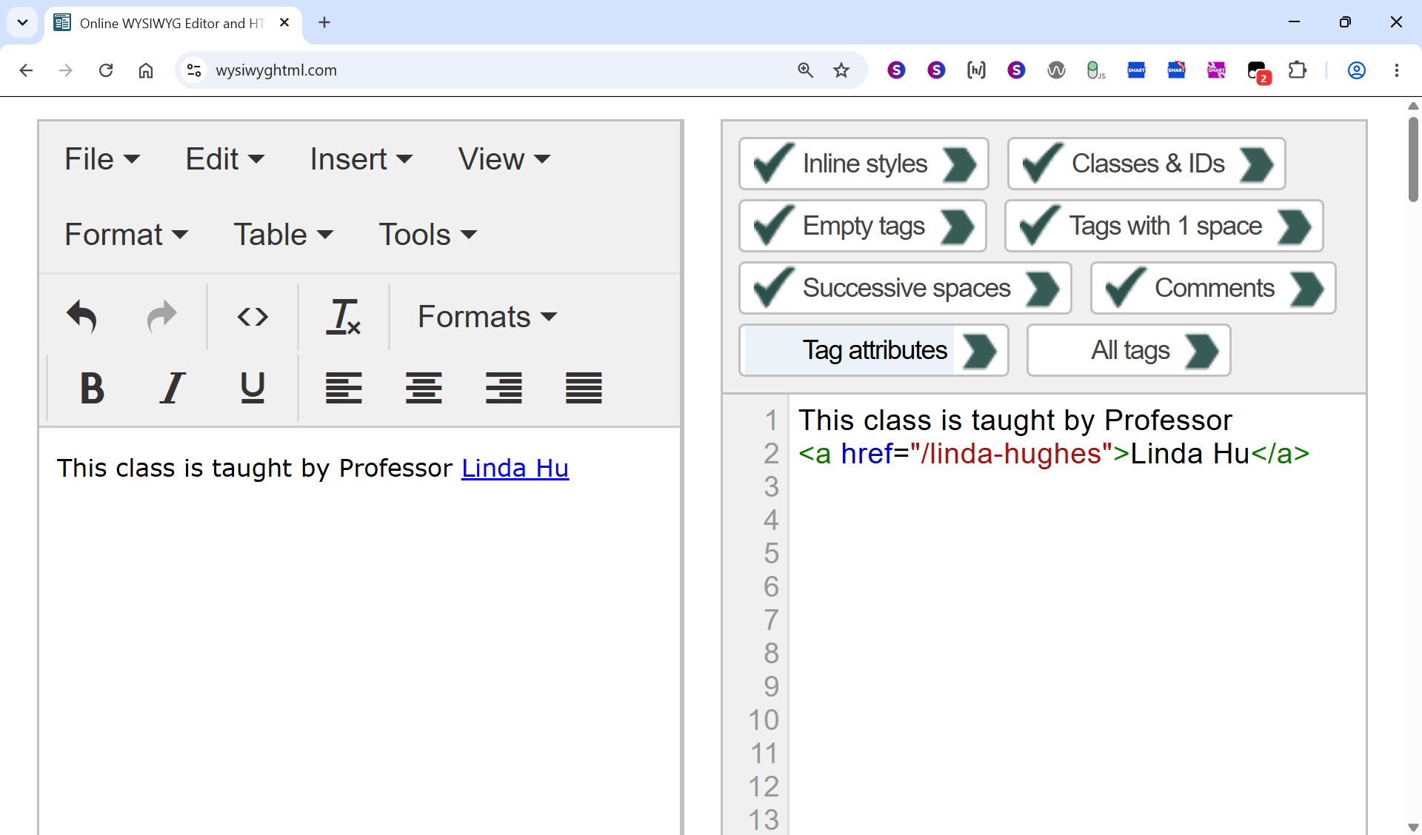
Backspacing over “Linda Hughes”, animated screenshot 5/9

Slide 26
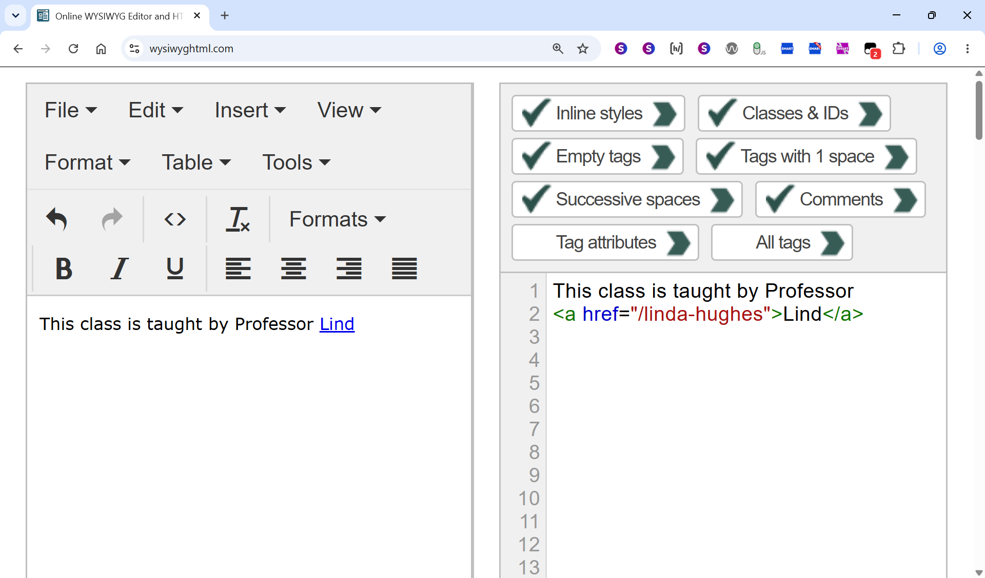
Backspacing over “Linda Hughes”, animated screenshot 6/9

Slide 27

Backspacing over “Linda Hughes”, animated screenshot 7/9

Slide 28
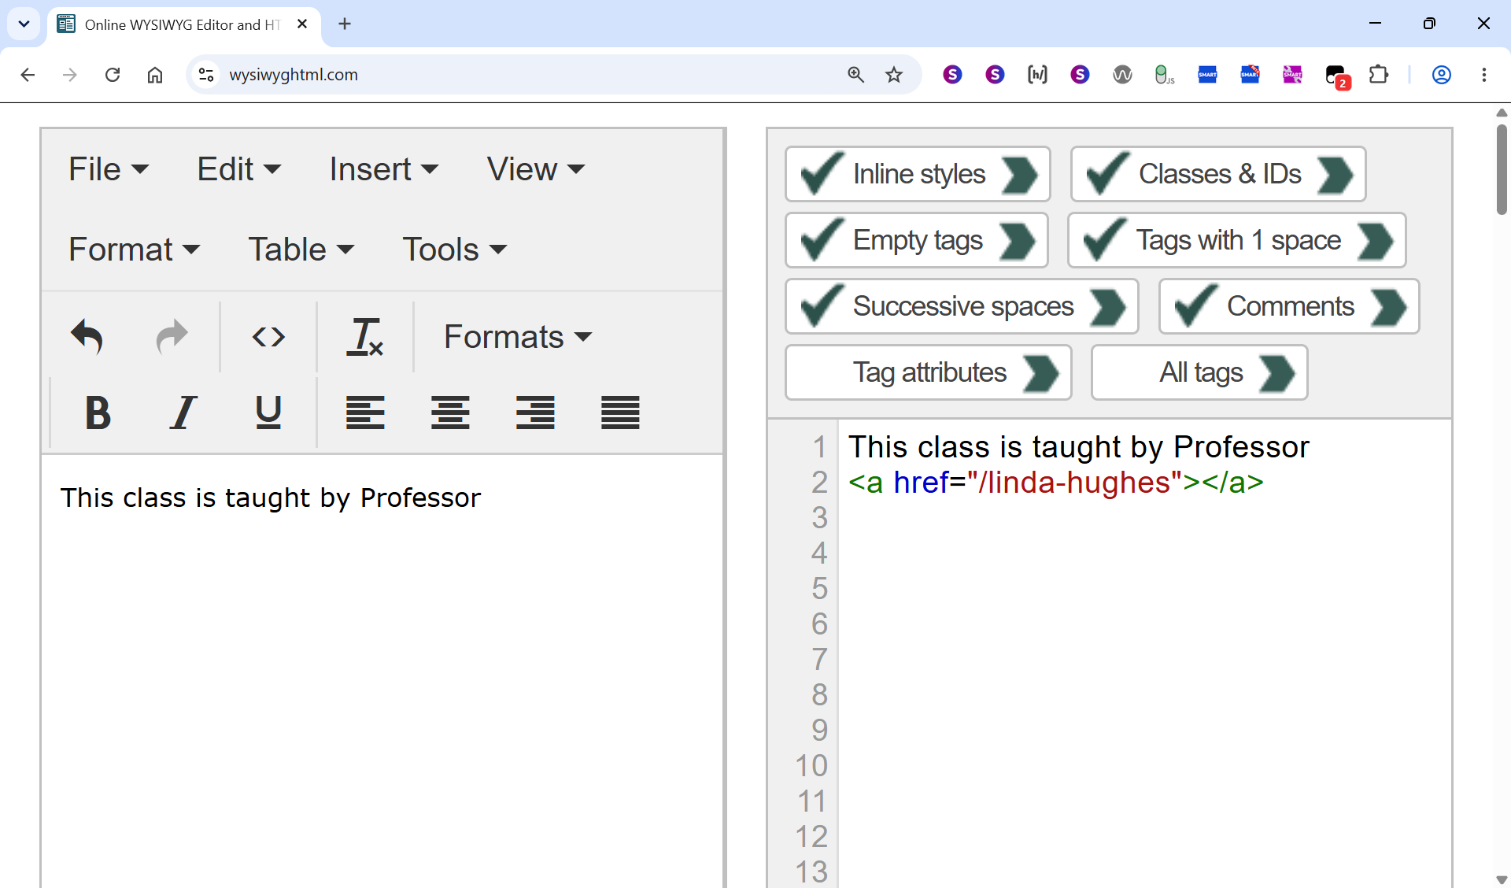
Backspacing over “Linda Hughes”, animated screenshot 8/9

Slide 29
Backspacing over “Linda Hughes”, animated screenshot 9/9

Slide 30
Leftover Link > User Impact
Mostly screen reader users.
Two types of Leftover Link:
  “Misleading junk” leftover link (our example)
  “Redundant” leftover link

Slide 31
Leftover Link > How To Fix
Delete them all.
Spread the word.
Many tools flag generic “link has no accessible name”
Only WAVE calls out “Empty Links” (mostly of which are “Leftover Links” AFAICS)
WAVE “Empty Link” = alarm bells.

Slide 32
Leftover Link > Documentation Elsewhere
WebAIM Million: specific “Empty Link”
  46.3% of pages have 1+ empty links.
Web Almanac: the more generic “link has no accessible name”
  (axe rule ID = “link-name”)
Other online commentary:
  On the WYSIWYG cause, advice to delete: I found some.
  On the “out-of-date” aspect (= misleading junk, unique user harm): I found none.

Slide 33
Leftover Link > My Manual Check
I checked 50.
12/50 were the “misleading junk” type (= either broken links, or clearly outdated and incorrect)
12/50 = 24%
WebAIM Million’s 46.3%, combined with my dataset’s 24%
  → “a lot”
  … of pages contain 1+ of the “misleading junk” type of leftover links.

Slide 34
Leftover Link > Colleague Anecdote
Colleague didn’t notice any difference (leftover vs. non-leftover)

Slide 35
Blank slide 2

Slide 36
Mistake 2 of 5: Heading Used Only For Visual Effect

Slide 37
Sloth 1

Slide 38
Heading Used Only For Visual Effect
> In The Dataset
Automated check said: “Content missing after heading”
Consultant wrote: “This check is flagging the fact that there is no text between the “$10” heading and the “Drill“ heading, and they both have the same heading level (h2).”
(continues…)

Slide 39
Heading Used Only For Visual Effect
> Consultant Wrote (Continued)
“This rule is failing because the author of this page used heading tags to achieve visual emphasis on the first heading. That is contrary to how headings are meant to be used in HTML. Headings in HTML are meant to be used the same way they're used in a table of contents or a print newspaper: to give a title to the section of content which follows the heading. That proper use of headings enables a popular feature of screen readers: "jump to next heading", which the screen reader user can use to both move around the page and get an overview of the page.” (continues…)

Slide 40
Heading Used Only For Visual Effect
> Consultant Wrote (Continued More)
“Both of those techniques will be rendered ineffective if the web author improperly uses a heading for visual emphasis, and that is the case here.
To fix this: remove the heading tags so that the prices (“$10”, “$100”, etc.) aren’t headings any more. Then (optionally) adjust the font size and boldness via CSS to make this text look like it does now.”

Slide 41
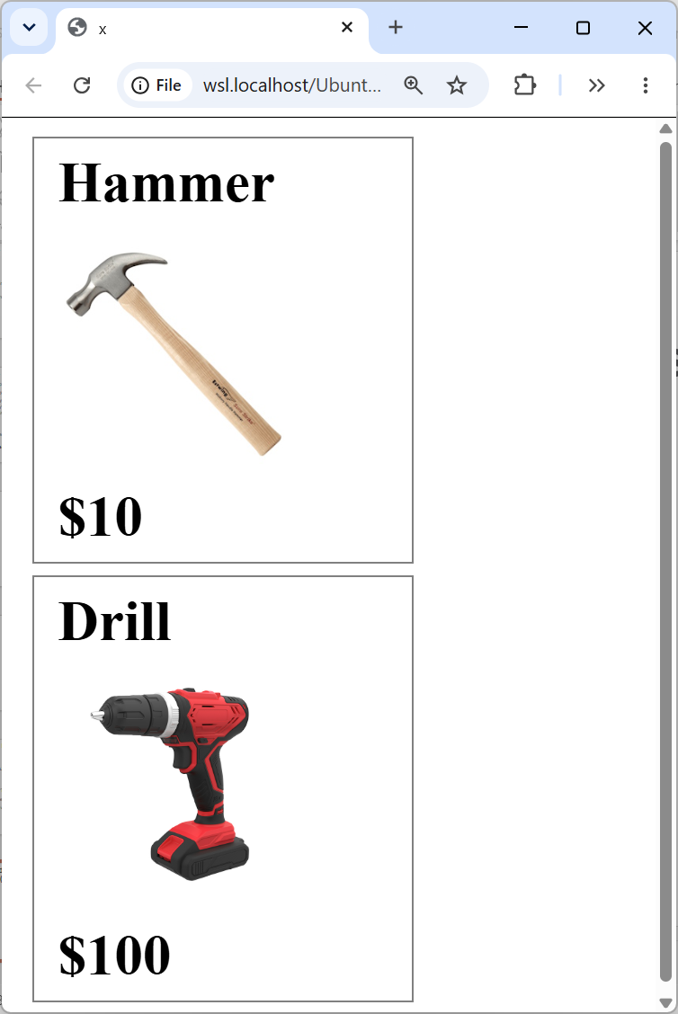
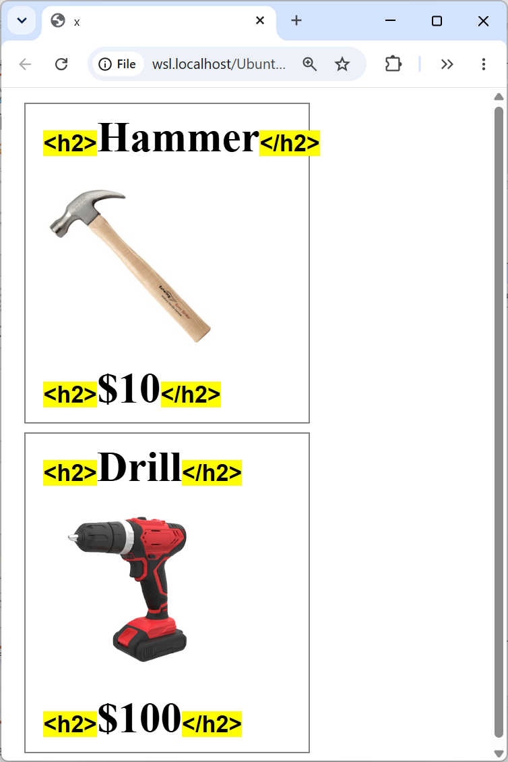
Heading Used Only For Visual Effect > Example Page

Slide 42
Heading Used Only For Visual Effect > Page Author Side
Wanted to make some text big and bold (fine), and used a heading to do it (bad).
Broke the rule: “Each heading should describe the section of content it precedes.”
  https://webaim.org/techniques/headings/
Problem flagged vs. real problem.
Flagged

Slide 43
Heading Used Only For Visual Effect
> User Impact
Screen reader users.
“Because headings are the primary mechanism used by screen reader users to navigate content, their proper implementation is important.” – WebAIM Million.
  “Jump by heading” = h key

Slide 44
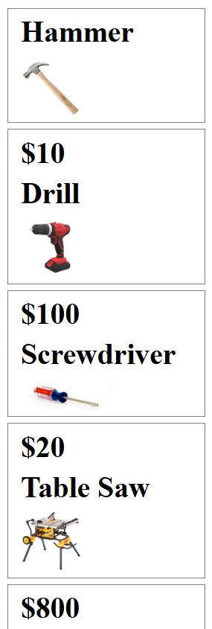
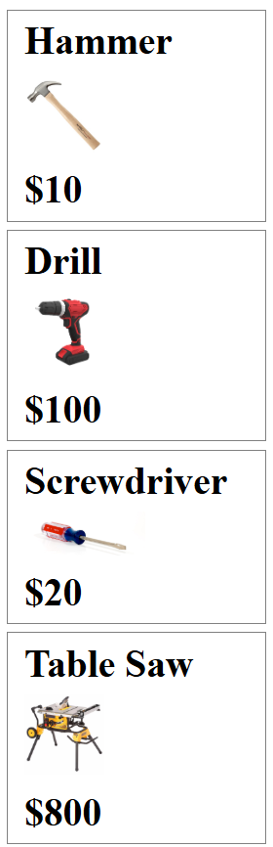
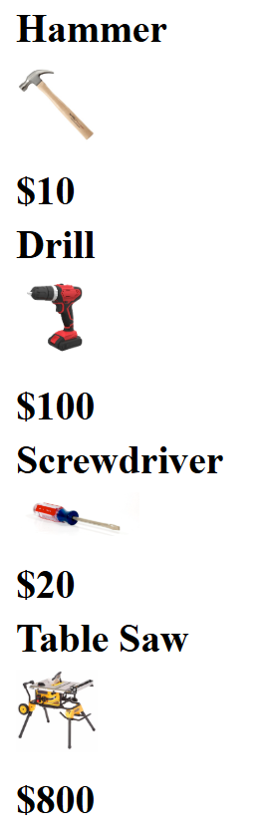
Heading Used Only For Visual Effect > example page screenshots

Slide 45
Heading Used Only For Visual Effect > HTML Before Fix
<h2>Hammer</h2>
<img src="hammer.png" alt="hammer">
<h2>$10</h2>
<h2>Drill</h2>
<img src="drill.png" alt="drill">
<h2>$100</h2>

Slide 46
Heading Used Only For Visual Effect > HTML After Fix
<h2>Hammer</h2>
<img src="hammer.png" alt="hammer">
<span class="price">$10</span> /* fixed */
<h2>Drill</h2>
<img src="drill.png" alt="drill">
<span class="price">$100</span> /* fixed */
Or <strong> tag etc.
Visuals: unchanged.

Slide 47
Heading Used Only For Visual Effect
> Documentation Elsewhere
WCAG Failure Technique F43, Example 1: “A heading used only for visual effect”. (SC 1.3.1 Info and Relationships.)
WebAIM Million, Web Almanac: no, because:
  Fully-automated only (eg. “skipped heading level”).
Siteimprove’s automated check didn’t catch this. Its consultants did.
  Only incidentally caught by the automated checks.
  → Many not caught.

Slide 48
Blank slide 3

Slide 49
Mistake 3 of 5: Font Size “px / pt” Mix-Up

Slide 50
Font Size “px / pt” Mix-Up > In The Dataset
Automated check said: “Color contrast does not meet minimum requirement”
Customer wrote: “WCAG says that large text only needs 3:1 contrast (not 4.5:1), and this text is large enough (it’s 18 px) and it has 3.3:1 contrast, so it should pass WCAG. Your automated checker says that it fails. So your automated checker is wrong.”

Slide 51
Sloth 2

Slide 52
Font Size “px / pt” Mix-Up > Consultant Wrote
“Unfortunately this text does not meet WCAG's definition of "large". The definition uses "pt" units (also known as "point" units) - not "px" units - but you've interpreted it as though it uses "px" units. Large text begins at "18 point or 14 point bold". 18 point equals 24px. As you stated, the size of this text is 18px. That equals 13.5pt, which is less than the 18pt required by the WCAG definition of "large" (for non-bold text). So this text needs to have at least 4.5:1 contrast (not 3:1), and it doesn't, so it fails this WCAG success criterion.”

Slide 53

Font Size “px / pt” Mix-Up > Example Page
← 3.3:1 contrast
<button class="cta-button">Create an Account</button>
…
.cta-button {
background-color: rgb(91, 91, 91);
color: rgb(181, 181, 181);
font-size: 18px;
}

Slide 54
Font Size “px / pt” Mix-Up
> Page Author Side
WCAG: “large” text doesn’t need as much contrast.
WCAG uses: pt.
Most real-world CSS uses: px.
Browser devtools (“computed properties”) uses: px.
Yards vs. feet.
  House setback: 8 yards.
  8 feet < 8 yards.

Slide 55
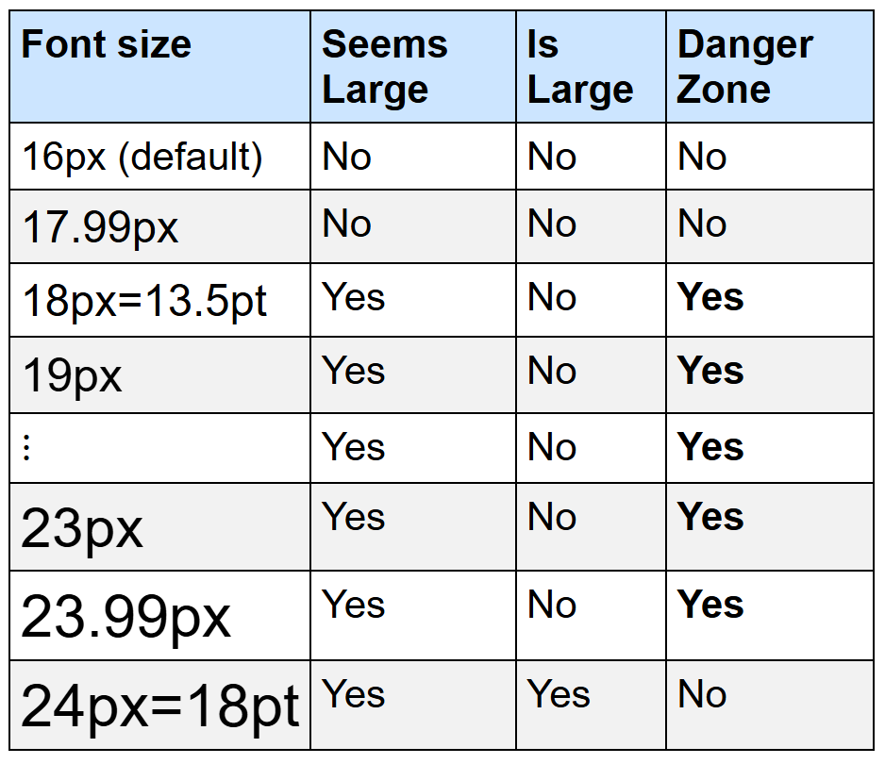
Font Size “px / pt” Mix-Up – Danger Zone

Slide 56
Font Size “px / pt” Mix-Up
> User Impact
The well-known impact of insufficient contrast, from WCAG: "People with low vision often have difficulty reading text that does not contrast with its background."

Slide 57


Font Size “px / pt” Mix-Up
> CSS After Fix Option A (Increase Contrast)
.cta-button {
background-color: rgb(91, 91, 91);
color: rgb(211, 211, 211); /* gives 4.5:1 contrast */
font-size: 18px;
}
← Before. 3.3:1 contrast.
← After. 4.5:1 contrast.

Slide 58

Font Size “px / pt” Mix-Up
> CSS After Fix Option B (Increase Font Size)
.cta-button {
background-color: rgb(91, 91, 91);
color: rgb(181, 181, 181);
font-size: 24px; /* equals 18pt = WCAG's "large" */
}
← Before. 3.3:1 contrast.
← After. Still 3.3:1 contrast.

Slide 59
Font Size “px / pt” Mix-Up
> Documentation Elsewhere
WebAIM Million, Web Almanac:
  Not the “px / pt” mix-up exactly.
WCAG, misc. blog posts:
  Mentions the different px / pt units, but do not mention the bad thing that happens if you mix them up, or how easy it is to mix them up.

Slide 60
Blank slide 4

Slide 61
Mistake 4 of 5: “Label in Name” Failure
WCAG SC 2.5.3 (all of it).

Slide 62
Sloth 3

Slide 63
“Label in Name” Failure > In The Dataset
Automated check said: “Visible label and accessible name do not match”

Slide 64
“Label in Name” Failure > Consultant Wrote
The accessibility guidelines are quite strict on this and require that the visible label, in its entirety, and with the words in the same order, is included in the accessible name. (Not the other way around.)
The visible label is "Read more" and the accessible name is coming from the aria-label, which is “Full article: payment methods".
To fix this is: change the aria-label so that all of the words in the visible label appear at the start of the aria-label.

Slide 65
“Label in Name” Failure
> Consultant Wrote (continued)
For example, since the visible label is “Read more”, change this:
aria-label="Full article: payment methods"
to this:
aria-label="Read more about payment methods"

Slide 66
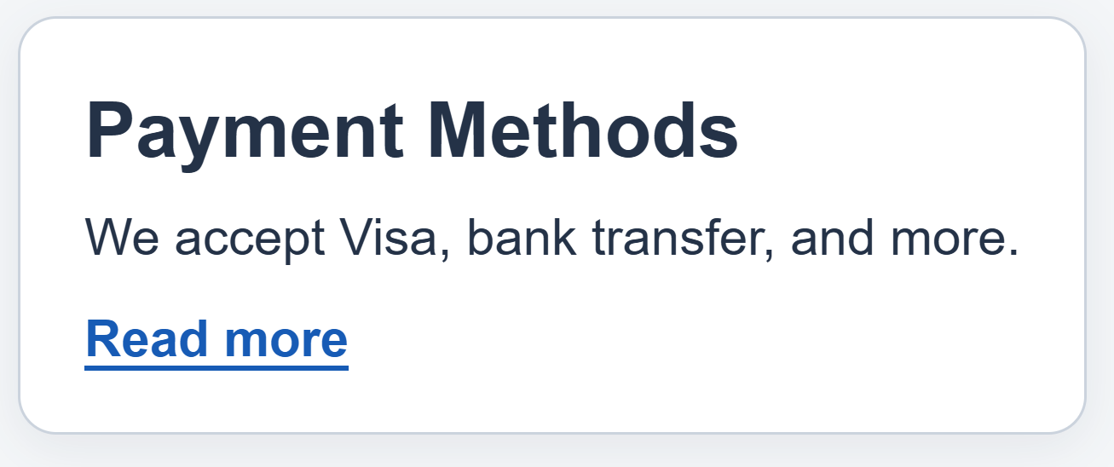
“Label in Name” > Example Page
<a href="/payment-methods"
aria-label="Full article: payment methods">
Read more
</a>

Slide 67
“Label in Name” > Example Page Again
<a href="/payment-methods"
aria-label="Full article: payment methods">
Read more
</a>
WCAG says …

Slide 68
“Label in Name” Failure
> Page Author Side
Page author heard that many links named "read more" is bad for screen reader users.
So they added an aria-label.
… and it’s bad.
Notes:
– Leonie quote is from F-Word podcast with Bruce Lawson, https://f-word.dev/episodes/19/ , 29:58

Slide 69
“Label in Name” Failure
> Page Author Side (continued)
Bigger category: “ARIA gone wrong”.
Leonie Watson: “I’ve probably seen more websites brought down by using ARIA than I have made better for it.”
Notes:
– Leonie quote is from F-Word podcast with Bruce Lawson, https://f-word.dev/episodes/19/ , 29:58

Slide 70
“Label in Name” Failure > User Impact
“Voice access AT” users AKA “Speech recognition” AKA …
  Voice Control (iPhone) ← needs “front-loading” (roughly)
  Voice Access (Android)
Screen reader users
  Sighted screen reader user
  Blind screen reader user with sighted tech support
And more…

Slide 71
“Label in Name” Failure > Vocabulary
Two meanings of “label”.
In “Label in Name” …
  “Label” means “visible label”
  “Name” means “accessible name” (= usually aria-label)
    Live in a11y tree.
aria-label ≠ visible label
“aria-label should be called aria-name”.

Slide 72
“Label in Name” Failure > Before & After Fix
→
Before:
<a href="/payment-methods"
aria-label="Full article: payment methods">
Read more
</a>
After:
<a href="/payment-methods"
aria-label="Read more about payment methods">
Read more
</a>

Slide 73
“Label in Name” Failure > How To Fix
Ask: does this really need an aria-label?
If so: copy the visible text, paste it at the start of the aria-label, then add any other words after.

Slide 74
“Label in Name” Failure > Examples
Visible label | aria-label (= accessible name) | Good or Bad
Read more | Read more about payment methods | Good
Read more | Full article | Bad
Download PDF | Download the PDF | Bad
323-555-1234 | 3 2 3 5 5 5 1 2 3 4 | Bad
Read more | Payment methods, read more | Bad (due to lack of front-loading)

Slide 75
“Label in Name” Failure
> Documentation Elsewhere
WebAIM Million, Web Almanac: none. (WAVE / Lighthouse.)
WCAG:
  “Front-load”: prominently a “best practice”, but doesn’t say why.
  Sighted screen reader user: Yes.
Does any web checker flag “failure to front-load”? A: No.
  Native mobile: axe devtools android “label at front” rule.
Notes:
- https://docs.deque.com/devtools-mobile/2024.9.18/en/android-label-at-front

Slide 76
Blank slide 5

Slide 77
Mistake 5 of 5: Bad <label> Element

Slide 78
Sloth 5

Slide 79
Bad <label> Element, In The Dataset
Automated check said: “Form field missing a label”
Consultant wrote: I can see that you added a <label> element, but there are two problems with it:
1) It's been made invisible by the CSS property "display: none". In addition to making the label invisible, this "display: none" also makes the label not take effect for accessibility purposes.
2) The <label> has for=“address1" and the <input> has name=“address1”. This isn't working because <label for="..."> is meant to refer to an id="..." attribute, not a name="..." attribute. (continues…)

Slide 80
Bad <label> Element,
Consultant Wrote (continued)
To fix this:
Remove "display: none" from the <label>,
and
2) Change <label for=“address1"> to <label for=“addressLine1"> (because the ID of the <input> is “addressLine1").

Slide 81
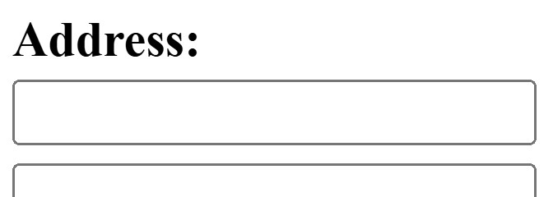
Bad <label> Element, Example Page
Has a form field e.g. <input> element.
Added a <label> element.
… and it’s bad.
… has two problems (out of seven).
<label style="display: none" for="address1">
Address Line 1
</label>
<input name="address1" id="addressLine1">

Slide 82
Bad <label> Element, User Impact
Screen reader will announce "edit blank" rather than “address line 1 edit blank”.
Voice access AT users: need use “show numbers”.
Mouse users: smaller clickable area.

Slide 83
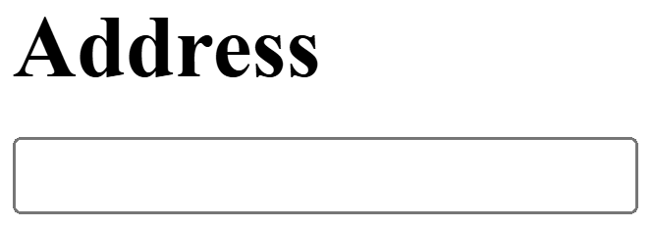
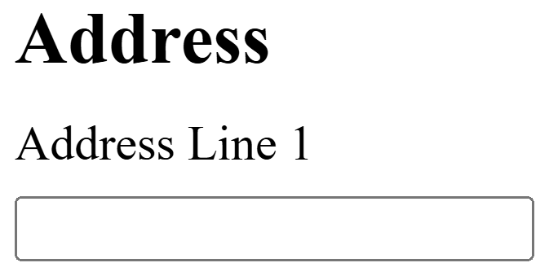
Bad <label> Element, HTML Before & After Fix
Before:
<label style="display: none" for="address1">
Address Line 1
</label>
<input name="address1" id="addressLine1">
After:
<label for="addressLine1">
Address Line 1
</label>
<input name="address1" id="addressLine1">

Slide 84
Bad <label> Element, Fix Checklist (The 7)
0. Make peace with the idea of having a visible label for every form field.
<input> has an id="..." attribute.
<input>'s id="..." attribute is unique (no excuses)
Has a <label> element.
<label> has a for="..." attribute
<label>'s for="..." matches <input>'s id="..." (not name="…")
<label> does not have "display: none" nor "visibility: hidden” (in the CSS) nor aria-hidden=“true” (in the HTML).
<label> has text content (and it doesn’t have "display: none" nor "visibility: hidden” in the CSS nor aria-hidden=“true” in the HTML)

Slide 85
Bad <label> Element, Scope
Not just <input>. Also <select>, <textarea>, …
Other ways to fix eg. aria-label not <label>.

Slide 86
Bad <label> Element, Documentation Elsewhere
WebAIM Million: "33.1% of form inputs identified were not properly labeled"
Web Almanac: similar.
Generally: yes. Checklist: no.
  Especially not “display: none”.

Slide 87
Blank slide 6

Slide 88
Sloth 6

Slide 89
Conclusion > Some Bad News
Stepping back…
There’s a lot of common mistakes.
Top 5 covers “most”? No.
Top 5 → 8% (very roughly)
600 response templates.

Slide 90
Conclusion > Good News: Meta-Strategy
“Get a second opinion”
= another tool.
This dataset started with a disagreement.
Other tools cover 3/5 mistakes well.
  Good: Leftover Link, px / pt mix-up, bad label
  Spotty: Heading used only for visual effect, Label in name

Slide 91
Conclusion > Meta-Strategy (continued)
All free: Siteimprove, axe (Deque), WAVE (WebAIM), ARC (TPGi), IBM, browser devtools accessibility tree, and yes, ChatGPT etc.
Multi-tool anecdotes from customers.

Slide 92
Thank You
dtr@siteimprove.com
https://linkedin.com/in/dan-tripp

