Slide 1
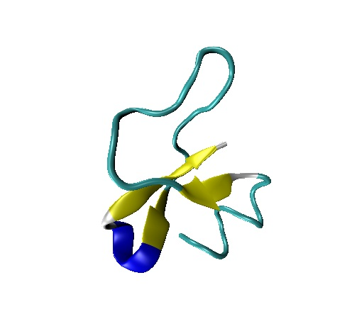
Quick Overview of Antimicrobial Peptides (AMP) Data Set Features
Daniel Veltri, Ph.D.
March 5th, 2020

Slide 2
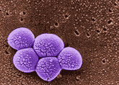
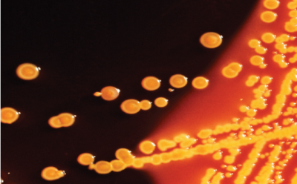

Motivation: Antimicrobial Resistance
Reports of antibiotic resistance have increased despite a slowdown in new antibiotics coming to market in recent decades.
The U.S. Center for Disease Control reports over 2 million infections and 23,000 deaths due to antibiotic-resistant bacteria and fungi each year in the U.S.
Both the White House and the World Health Organization have recently put out urgent calls for new drug development efforts.
Methicillin-resistant Staphylococcus aureus (left) and Carbapenem-resistant Enterobacteriaceae (right).

Slide 3

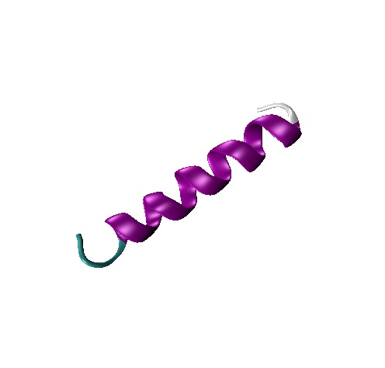
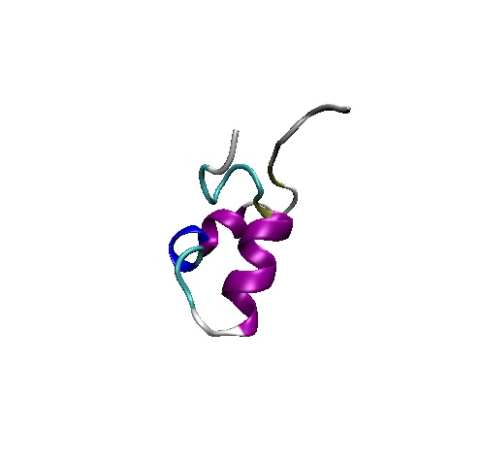
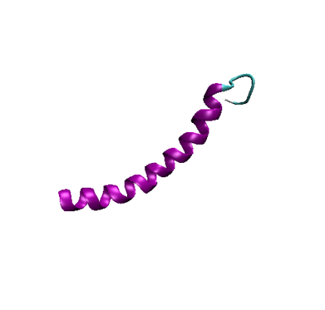
AMPs: One of Nature’s Solutions
Beta Defensin 1
Homo sapiens
PDB: 1IJV
Magainin 2
Xenopus laevis
PDB: 2MAG
Aurelin
Aurelia aurita
PDB: 2LG4
Cathelicidin LL-37
Homo sapiens
PDB: 2K6O
One promising area for new antibiotic research has been natural antimicrobial peptides (AMPs). These short peptides with innate antibacterial activity are found across all phyla of life.
To date, efforts in designing or modifying AMPs have had limited success in delivering new drugs to market.

Slide 4
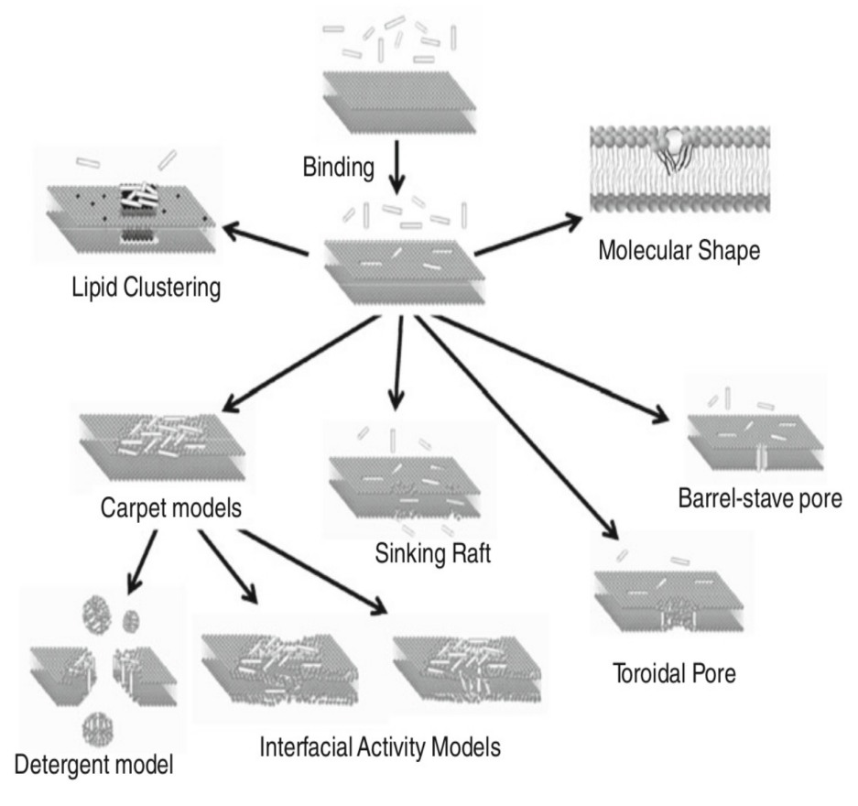
AMPs are Complicated!
Amino acid (AA) physicochemical properties are important for AMP activity (charge, hydrophobicity, etc.).
AMPs are highly diverse, both in sequence and killing mechanism.
We still do not know exactly how physicochemical properties relate to AMP activity- knowledge needed to guide AMP design.
Some proposed AMP attack mechanisms
Figure Source: Wimley (2011) J. of Mem. Bio. 239(1):27-34.

Slide 5

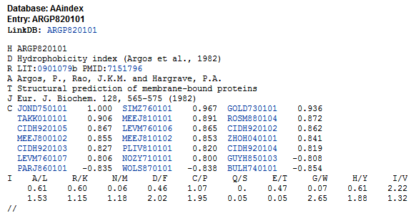
Features from the AAIndex
Most features are from the AAIndex, an extensive collection of quantified AA physicochemical features.
Amino Acid Index
(www.genome.jp/aaindex)
A sample AAIndex entry
Notes:
We keep growing our feature set

Slide 6
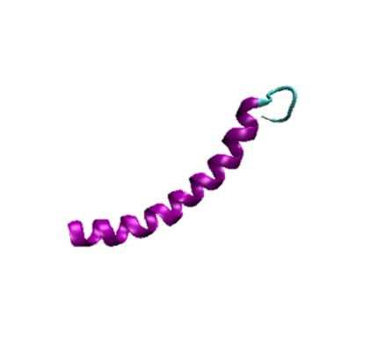
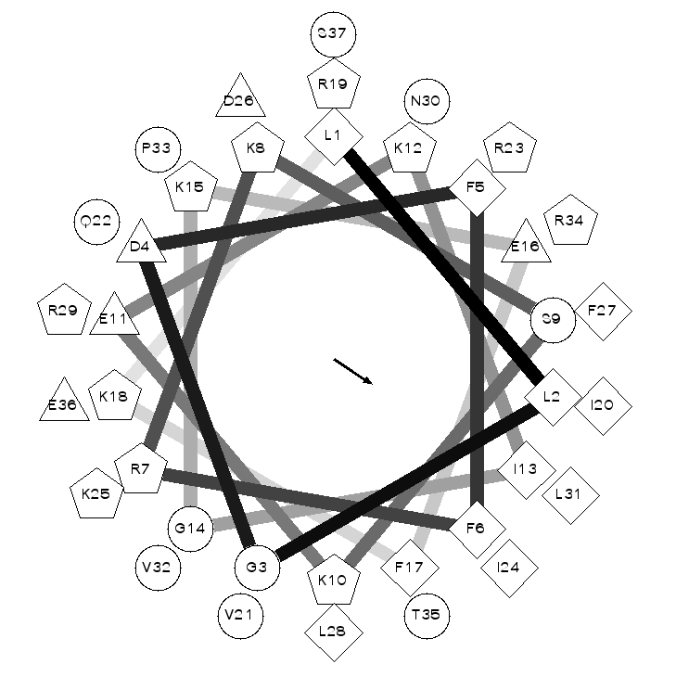
Regional Features
N-terminus
First 10AA
C-terminus
Last 10AA
Most Amphipathic Window
18AA in Length
$$<Feature1 ,…,Feature11,ClassLabel>$$
~
Physicochemical Features Include:
AAIndex Features
Features from the EMBOSS package (emboss.sourceforge.net)
1 Engineered Featured from Feature from TCBB 14(2) pp300-313
Mean Amphipathic Moment
More details on all of these features (and many more) in my Dissertation: http://mars.gmu.edu/handle/1920/10178
Notes:
Helical Wheel: 100deg for alpha, 160deg for beta-sheet
Mean amp. Moment is measure of how amphipathic a helix is perpendicular to its axis

Slide 7
Feature Description Table
Feature_Name | Part_of_Peptide_Considered | Description | Reference
FULL_Charge | Average over full peptide | amino acid charge | http://emboss.sourceforge.net/apps/cvs/emboss/apps/pepstats.html
FULL_AcidicMolPerc | Average over full peptide | Mole% of Acidic amino acids | http://emboss.sourceforge.net/apps/cvs/emboss/apps/pepstats.html
FULL_AURR980107 | Average over full peptide | Frequency of helix amino acids | https://www.genome.jp/dbget-bin/www_bget?aaindex:AURR980107
FULL_DAYM780201 | Average over full peptide | Relative mutability of amino acids | https://www.genome.jp/dbget-bin/www_bget?aaindex:DAYM780201
FULL_GEOR030101 | Average over full peptide | Amino acid linker propensity (helicity) | https://www.genome.jp/dbget-bin/www_bget?aaindex:GEOR030101
FULL_OOBM850104 | Average over full peptide | Amino acid non-bonded energy per atom | https://www.genome.jp/dbget-bin/www_bget?aaindex:OOBM850104
NT_EFC195 | Present in first 10 N-terminal amino acids | Engineered feature using evolutionary algorithm looking for ‘GCCA’ pattern | https://www.dveltri.com/documents/veltri_kamath_shehu_TCBBv1.1.pdf
AS_MeanAmphiMoment | Present in window of amino acids with highest amphipathicity | Mean amphipathic moment | https://www.nature.com/articles/nsb1096-842.pdf?origin=ppub
AS_DAYM780201 | Present in window of amino acids with highest amphipathicity | Relative mutability of amino acids | https://www.genome.jp/dbget-bin/www_bget?aaindex:DAYM780201
AS_FUKS010112 | Present in window of amino acids with highest amphipathicity | Amino acid composition in helical chains | https://www.genome.jp/dbget-bin/www_bget?aaindex:FUKS010112
CT_RACS820104 | Present in last 10 C-terminal amino acids | amino acid geometry | https://www.genome.jp/dbget-bin/www_bget?aaindex:RACS820104

