Slide 1
MT-output comparator
simple tool (written in Perl) for visualisation of differences
  between two MT-systems
  between two versions of one MT-system
input:
  source sentences,
  reference translations,
  two MT-outputs we want to compare
output:
  HTML file with highlighted matching sequences
  sentences are sorted according to the difference in number of n-grams matching the reference
available at:
  http://code.google.com/p/failfinder: trunk/scripts/MToutput_comparator

Slide 2
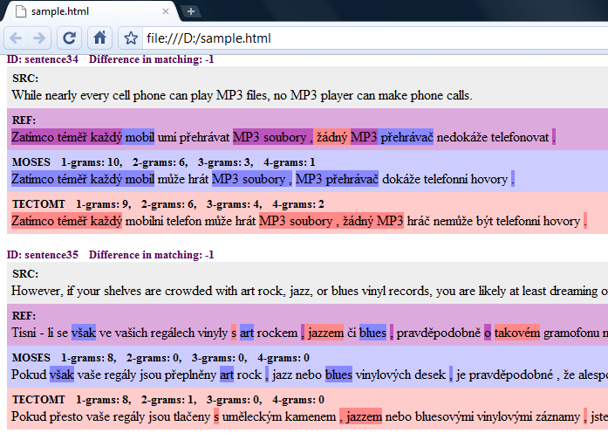
Screenshot

