Slide 1
Aligned Corpus Viewer
See words in context
  Training data
  Test data
    Reference
    System output
See alignments
  Even in test data (re-run Giza on train + test)
Dynamic HTML
  Underlying word index prepared in advance

Slide 2
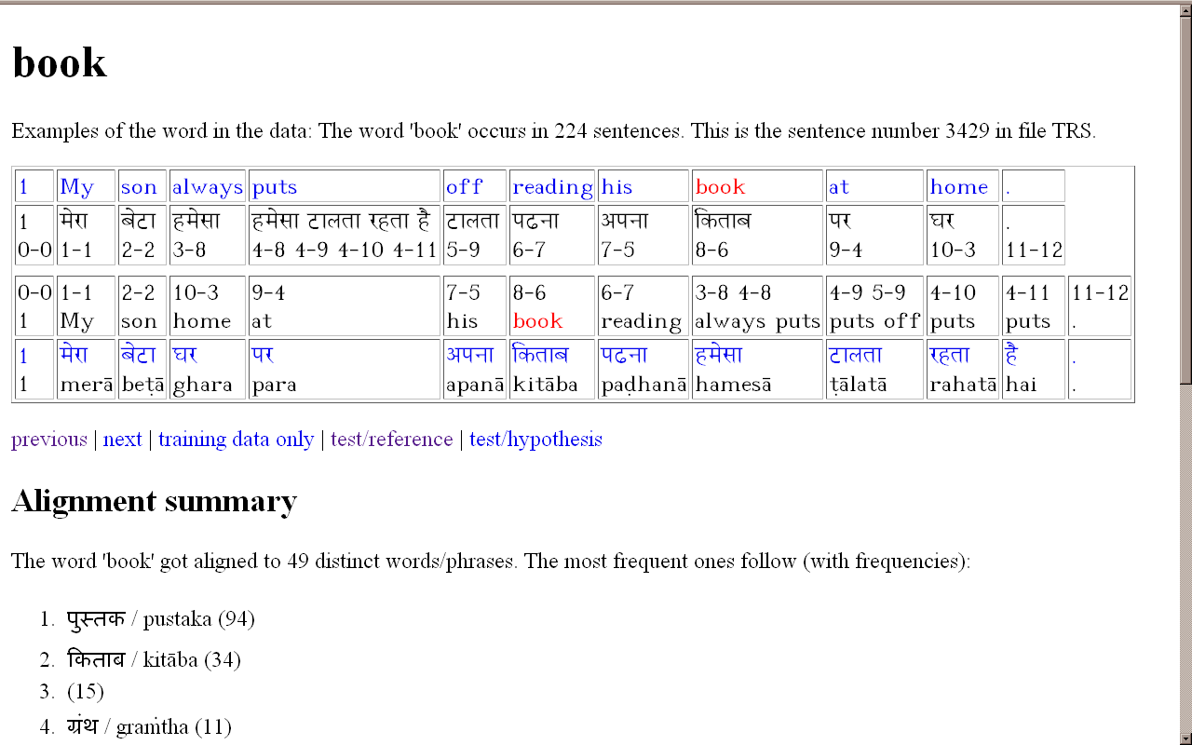
Aligned Corpus Viewer

Slide 3
Aligned Corpus Viewer
All words are clickable
(go to their example sentences)
Alignment indices and counterparts
(arrows are difficult)
Other sentences with this word
Transliteration
How frequently was it aligned to what?

Slide 4
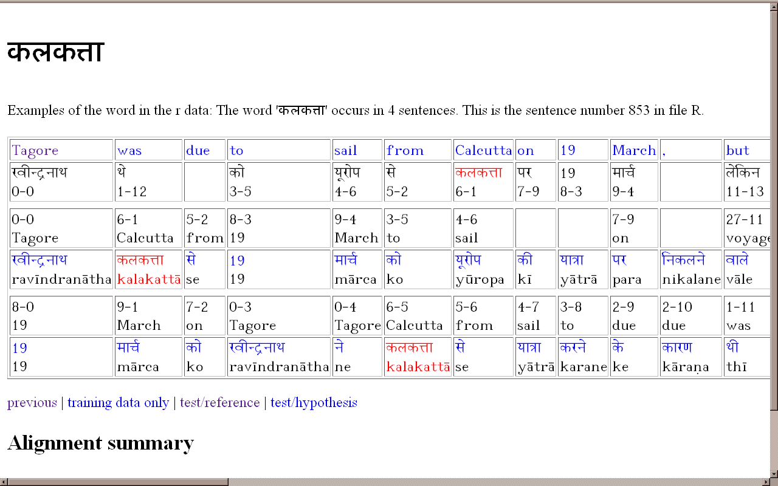
Triple alignment
SOURCE
REFERENCE
SYSTEM

Slide 5
To do
Sort words w.r.t. alignment
  entropy of translations
  filter examples for given aligned counterpart
Shift from words to phrases
  use suffix arrays
Look up phrase tables / Joshua grammars

