Slide 1

AUTOMATION
Nguyen Ngoc Duy

Slide 2




















I. Overview about framework

Slide 3
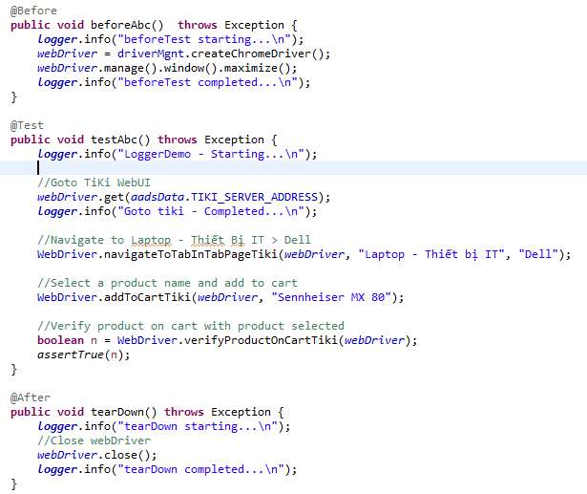
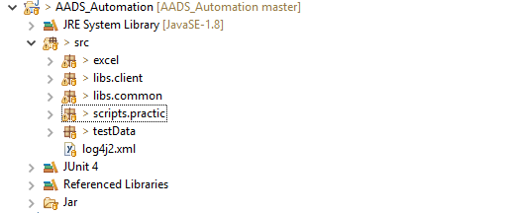
I. Overview about framework

Slide 4
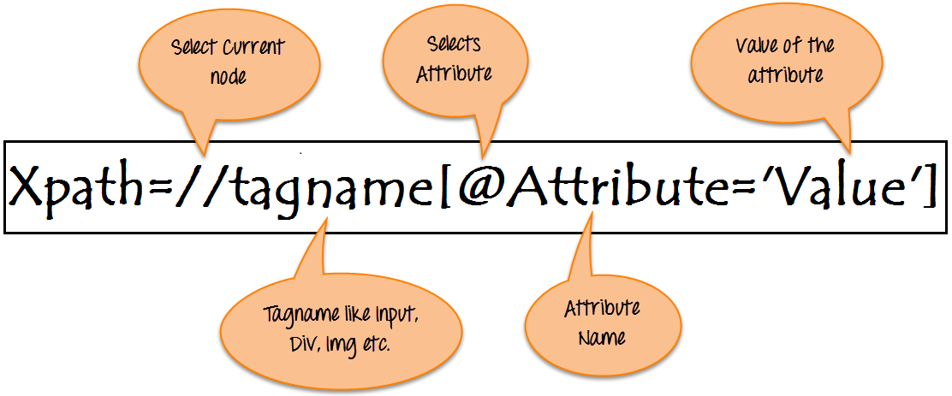
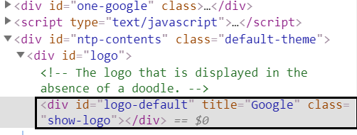
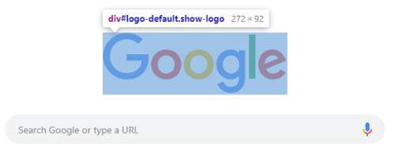
II. XPath and CSS
1. Xpath
// : Select current node.
Tagname: Tagname of the particular node.
@: Select attribute.
Attribute: Attribute name of the node.
Value: Value of the attribute.
//div[@id=‘logo-default’]

Slide 5
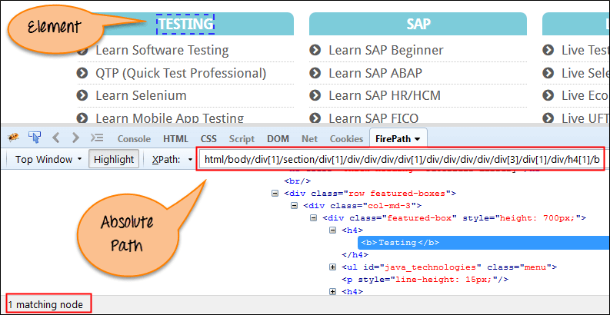
1. Xpath
Absolute xpath
html/body/div[1]/section/div[1]/div/div/div/div[1]/div/div/div/div/div[3]/div[1]/div/h4[1]/b

Slide 6
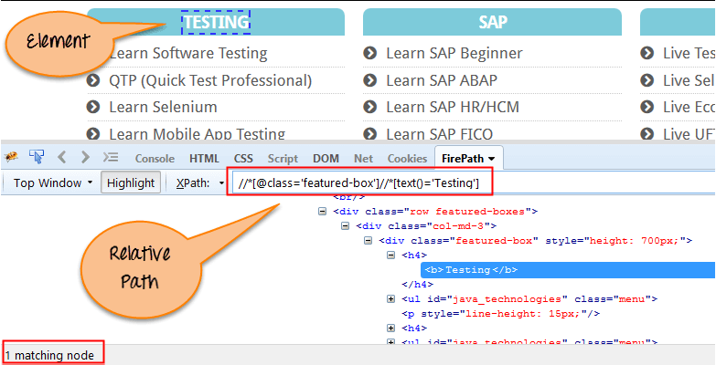
1. Xpath
Relative xpath
Relative xpath: //*[@class='featured-box']//*[text()='Testing']

Slide 7
1. Xpath
a. Start-With, Contains, Text
b. Or, And
c. XPath axes methods
+ Following/ Preceding/Following-sibling/Preceding-sibling
+ Child/Parent/Ancestor/ Descendant

Slide 8
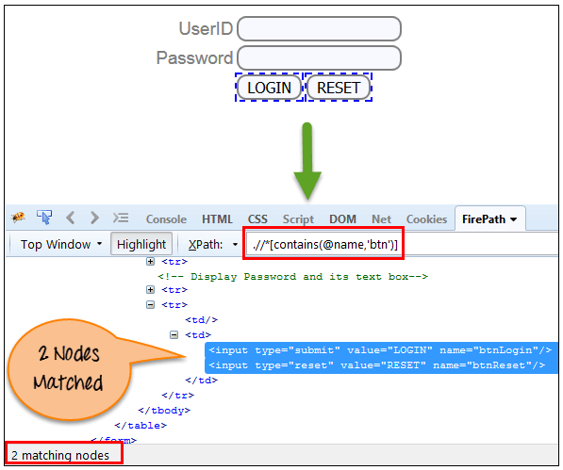
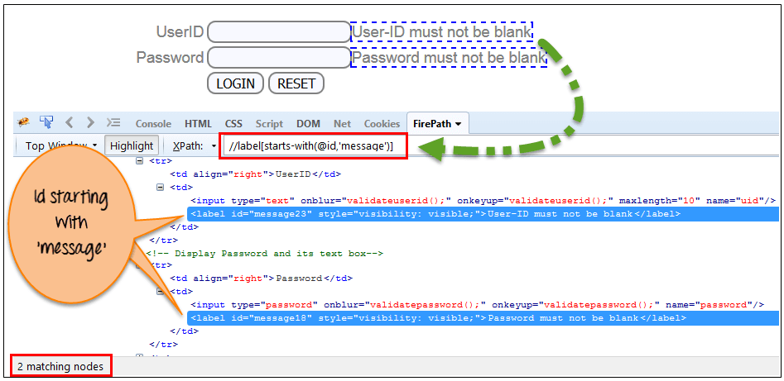
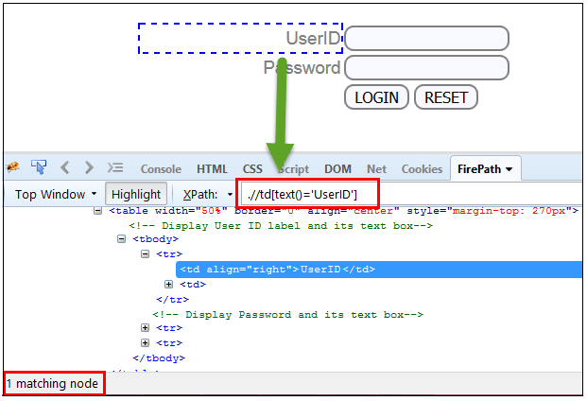
Contains
Start-with/end-with
Xpath=//*[contains(@name,'btn')]
Xpath=//label[starts-with(@id,'message')]
Text
Xpath=//td[text()='UserID']
Xpath=//td[contains(text(),’User’)]

Slide 9
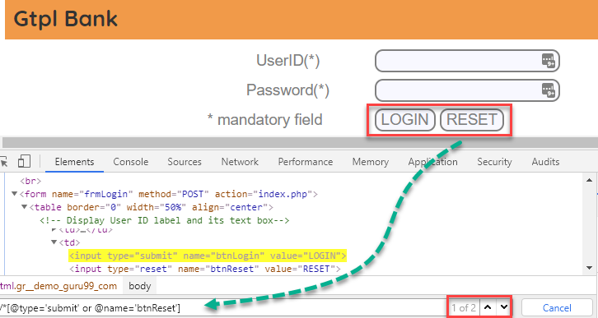
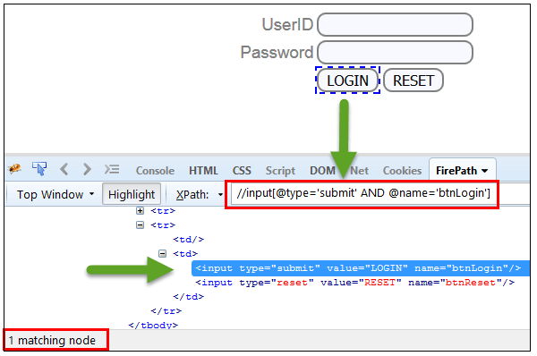
Using OR & AND
Xpath=//*[@type='submit' or @name='btnReset']
Xpath=//input[@type='submit' and @name='btnLogin']

Slide 10
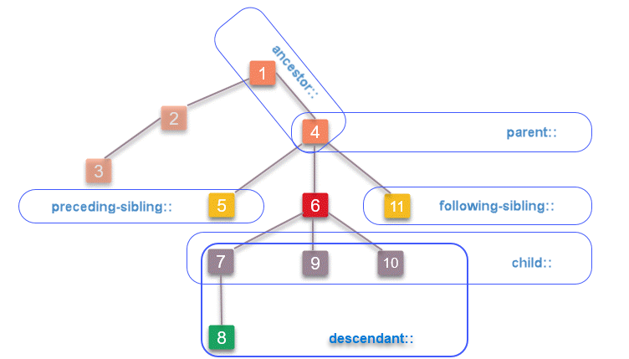
XPath axes methods

Slide 11
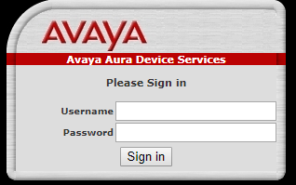
XPath axes methods
+Following/preceding/Following-sibling/Preceding-sibling
<td class=‘login’>
<span id=‘username’></span> (1)
<span id =‘password’></span> (2)
<span id =‘sign-in’></span> (3)
</td>
<td class=‘add’>
<span id = ‘12345’> (4)
(1)
(2)
(3)
Xpath(2)= //span[@id=‘password’]
//span[@id=‘password’]//following-sibling::span (3)
//span[@id=‘password’]//preceding-sibling::span (1)
//span[@id=‘password’]//following::span (3), (4)
//span[@id=‘password’]//preceding::span (1)
(4)

Slide 12
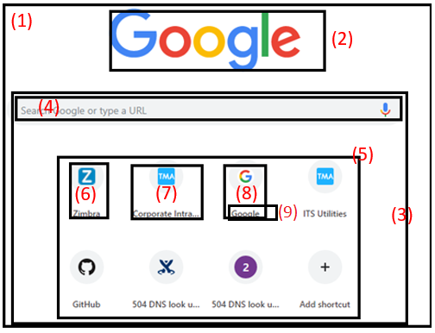
XPath axes methods
+ Child/Parent/Ancestor/ Descendant
<div class=‘win’ style=‘--tile-title-color:rgba(50,50,50,1);’</> (1)
<div class=‘logo’ title=‘Google’ ></td> (2)
<div class=‘utility’> (3)
<span id=‘search’>Search Google or type a URL</span> (4)
<span id =‘highlight’></span> (5)
<a label =‘Zimbra’ href="https://webmail.tma.com.vn/"></a> (6)
<a label=‘Coporate-Intranet’ href="https://intranet.tma.com.vn/"</a> (7)
<a label=‘Google’ href=‘https://google.com.vn’</a> (8)
<a name =‘Google’</a> (9)
Xpath(5)= //span[@id=‘highlight’]
//span[@id=‘highlight’]//chill::a (6)(7)(8) *//chill::a ⬄ /a
//span[@id=‘highlight’]//parent::div (3) *//parent::div ⬄/..
//span[@id=‘highlight’]//descendant::a (6)(7)(8)(9)
//span[@id=‘highlight’]//ancestor::div (1)(3)

Slide 13
Summary:
XPath is required to find an element on the web page as to do an operation on that particular element.
There are two types of XPath:
Absolute XPath
Relative XPath
XPath Axes are the methods used to find dynamic elements, which otherwise not possible to find by normal XPath method
XPath expression select nodes or list of nodes on the basis of attributes like ID , Name, Classname, etc. from the XML document .

Slide 14
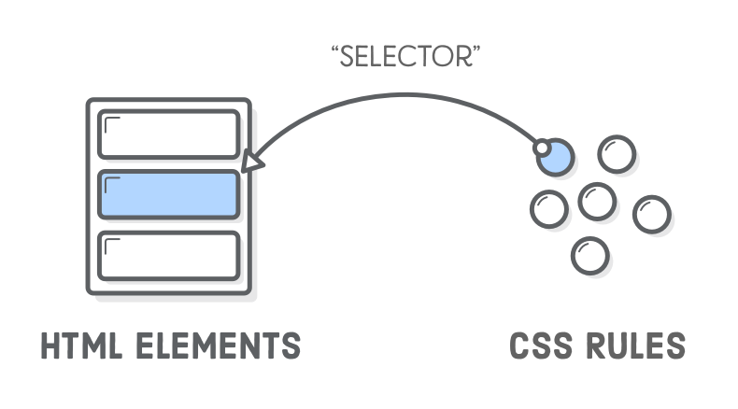
CSS
Similar to XPath, CSS is the selector that looks for elements in the HTML document

Slide 15
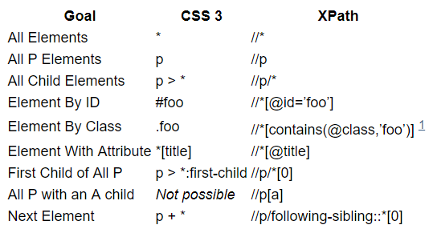
XPath vs CSS

Slide 16
CSS
Demo get locator CSS
<div class=‘win’ style=‘--tile-title-color:rgba(50,50,50,1);’</> (1)
<div class=‘logo’ title=‘Google’ ></td> (2)
<div class=‘utility’> (3)
<span id=‘search’>Search Google or type a URL</span> (4)
<span id =‘highlight’></span> (5)
<a label =‘Zimbra’ href="https://webmail.tma.com.vn/"></a> (6)
<a label=‘Coporate-Intranet’ href="https://intranet.tma.com.vn/"</a> (7)
<a label=‘Google’ href=‘https://google.com.vn’</a> (8)
<a name =‘Google’</a> (9)
Xpath(5)= //span[@id=‘highlight’] => CSS: #highlight
//span[@id=‘highlight’]//chill::a (6)(7)(8) => CSS: #highlight > *:chill
//span[@id=‘highlight’]//parent::div (3) => CSS: No
Xpath(5)=//span[@id=‘search’]/following-sibling::span
=> CSS: #search +* span
Xpath(5)=//span[contains(@id,’search’)] => CSS: span[id *=‘search’]

Slide 17
XPath vs CSS
CSS has a simpler structure than XPath
XPath works on general XML (including well-formatted HTML) while CSS and DOM are implemented on HTML.
One of the important differences between XPath and CSS is that, with XPath, we can search elements back or forth in the DOM hierarchy while CSS only works in the transition direction. This means that with XPath, we can locate parent elements with child elements.
XPath can specify Text() content outside of properties by Contains() while CSS is not executable
XPath of the browser is not always complete (especially in IE).

Slide 18
*Object/Frame/Form:
switchTo (). defaultContent () of Selenium or using javascriptexecutor

Slide 19
How to get locator win, android, ios, web
Win: Using app inspector
Android: Using tool uiautomatorviewer from Android SDK/Appium
IOS: using Appium
Web: Demo

Slide 20
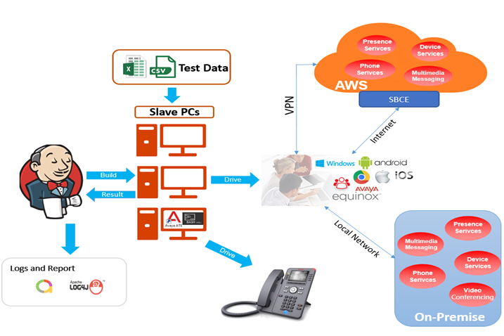


Demo: Scripts for AADS
Scripts
Script
Scripts

