Slide 1
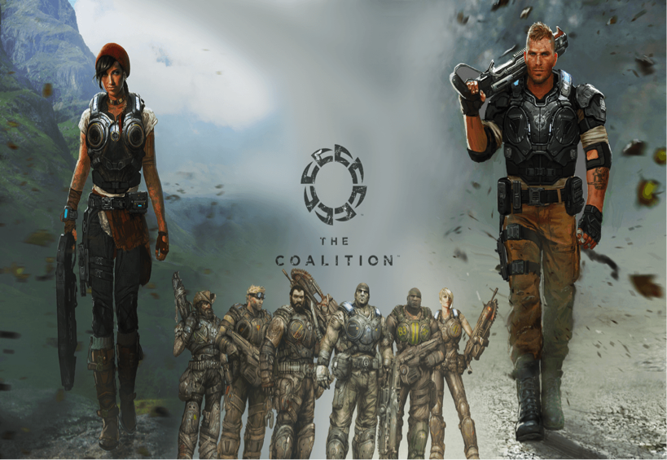
The Coalition
World Unlocked!
Team 2
Daniel Oluwadare
Kent Lopez
Erick Bravo

Slide 2

The Process
Coming up the idea for the web site.
Brainstorm layout
Communication
Planning
Implementation
Building the site
The Go live

Slide 3

The Challenge
Issues we faced:
Design
Database
Layout

Slide 4
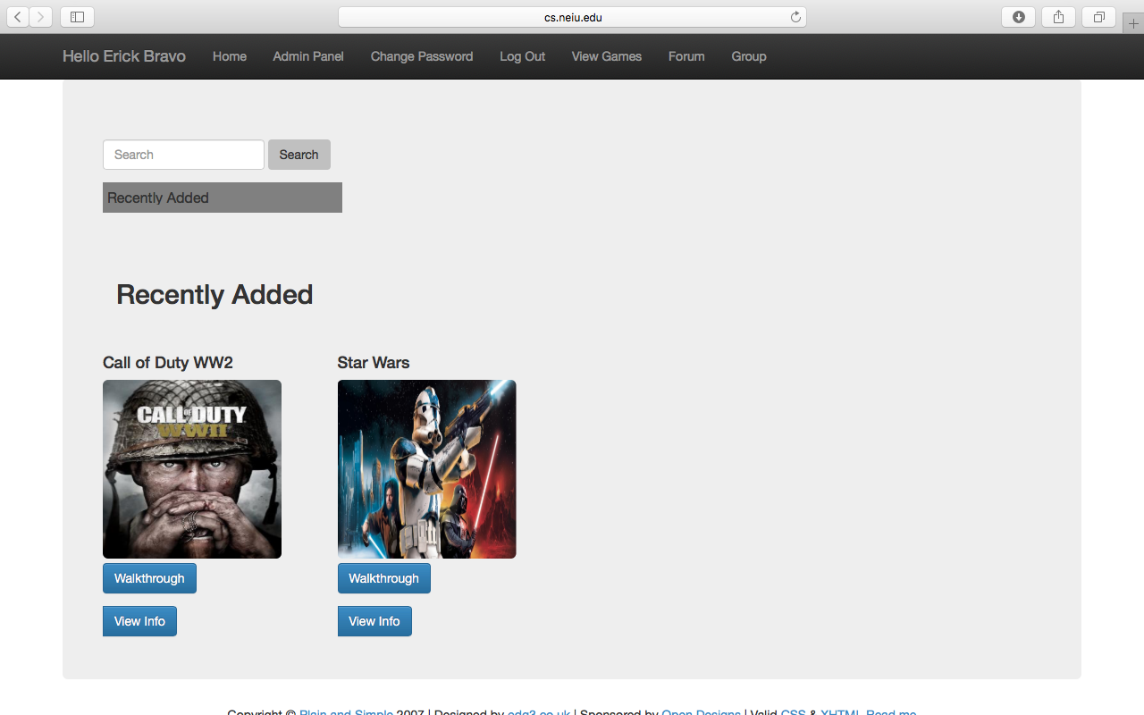
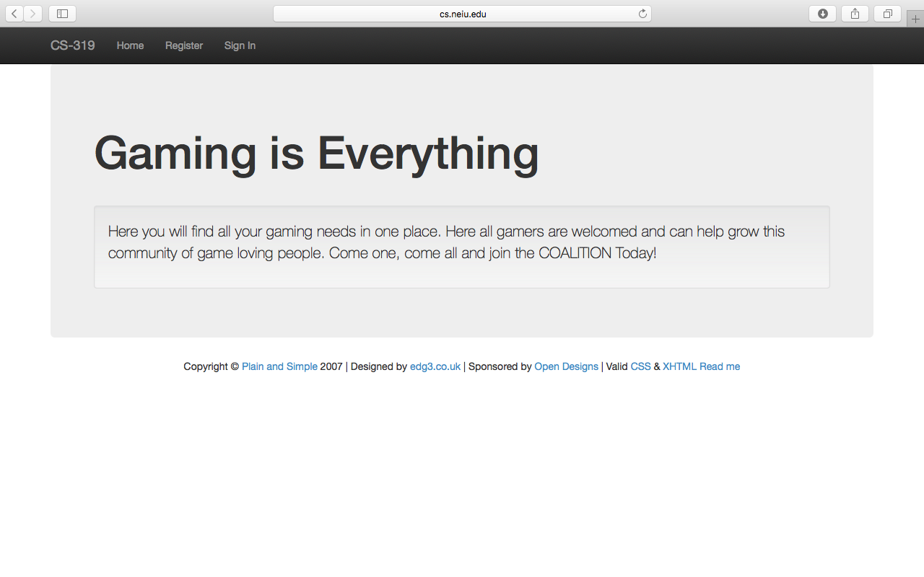
End Result

