Slide 1

週進度報告(10/15)

Slide 2
目錄
Othello
第40個盤面對2.0~2.3版本詳細分析有問題部分
2.3版本關鍵位置測試分析
對第40個盤面
對1~50效能比較
關鍵位置原因和延伸思考

Slide 3


Slide 4
 | 2 | 2.1 | 2.2 | 2.3
depth | 1 | 1 | 1 | 1
Total | 7 | 7 | 7 | 7
Cut | 0 | 0 | 0 | 0
Total - Cut | 7 | 7 | 7 | 7
depth | 2 | 2 | 2 | 2
Total | 54 | 54 | 54 | 54
Cut | 40 | 40 | 9 | 8
Total - Cut | 14 | 14 | 45 | 46
depth | 3 | 3 | 3 | 3
Total | 72 | 72 | 276 | 282
Cut | 27 | 34 | 108 | 65
Total - Cut | 45 | 38 | 168 | 217
depth | 4 | 4 | 4 | 4
Total | 263 | 220 | 1269 | 1642
Cut | 158 | 130 | 413 | 484
Total - Cut | 105 | 90 | 856 | 1158
depth | 5 | 5 | 5 | 5
Total | 632 | 508 | 6141 | 8397
Cut | 321 | 253 | 3152 | 3913
Total - Cut | 311 | 255 | 2989 | 4484
depth | 6 | 6 | 6 | 6
Total | 1993 | 1658 | 24471 | 37316
Cut | 1147 | 907 | 10493 | 15737
Total - Cut | 846 | 751 | 13978 | 21579
depth | 7 | 7 | 7 | 7
Total | 5865 | 5063 | 112579 | 174870
Cut | 3107 | 2214 | 56325 | 85077
Total - Cut | 2758 | 2849 | 56254 | 89793
depth | 8 | 8 | 8 | 8
Total | 18547 | 21480 | 519722 | 833921
Cut | 11350 | 13407 | 250553 | 406847
Total - Cut | 7197 | 8073 | 269169 | 427074
depth | 9 | 9 | 9 | 9
Total | 55151 | 59912 | 2403343 | 3777723
Cut | 26882 | 26115 | 1256061 | 1942335
Total - Cut | 28269 | 33797 | 1147282 | 1835388
depth | 10 | 10 | 10 | 10
Total | 208468 | 277717 | 11668595 | 18480392
Cut | 131023 | 181893 | 6557036 | 10311561
Total - Cut | 77445 | 95824 | 5111559 | 8168831
●
 | 1 | 2 | 3 | 4 | 5 | 6 | 7 | 8
1 |  |  |  | ● | ●
2 |  |  |  | ●
3 |  | ● | ● | ●
4 |  |  |  | ● | ●
5 |  |  |  | ● | ●
6
7
8
1
3
2
1. 在depth2，2.0與2.1相同?
2. 什麼原因導致depth3的2.1比2.0多剪7個?
3. 2.2與2.3在depth2只差1，depth3差距大?

Slide 5
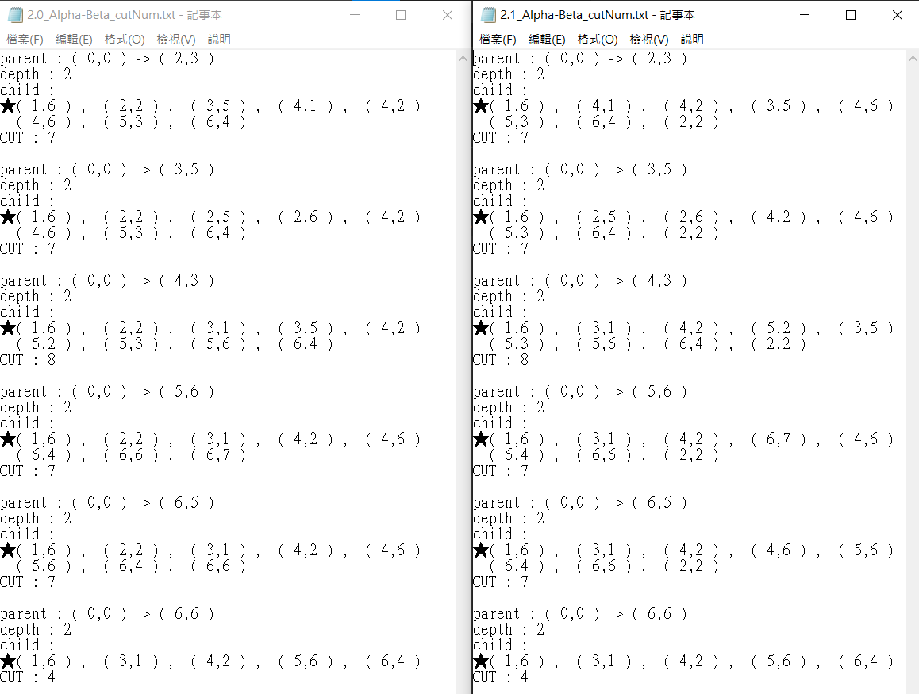
2.1 版 :
1.在depth2，2.0與2.1相同?
 | 1 | 2 | 3 | 4 | 5 | 6 | 7 | 8
1 | 0 | 4 | 1 | 1 | 1 | 1 | 4 | 0
2 | 4 | 4 | 2 | 2 | 2 | 2 | 4 | 4
3 | 1 | 2 | 3 | 3 | 3 | 3 | 2 | 1
4 | 1 | 2 | 3 | ● | ● | 3 | 2 | 1
5 | 1 | 2 | 3 | ● | ● | 3 | 2 | 1
6 | 1 | 2 | 3 | 3 | 3 | 3 | 2 | 1
7 | 4 | 4 | 2 | 2 | 2 | 2 | 4 | 4
8 | 0 | 4 | 1 | 1 | 1 | 1 | 4 | 0
●
 | 1 | 2 | 3 | 4 | 5 | 6 | 7 | 8
1 |  |  |  | ● | ●
2 |  |  |  | ●
3 |  | ● | ● | ●
4 |  |  |  | ● | ●
5 |  |  |  | ● | ●
6
7
8

Slide 6
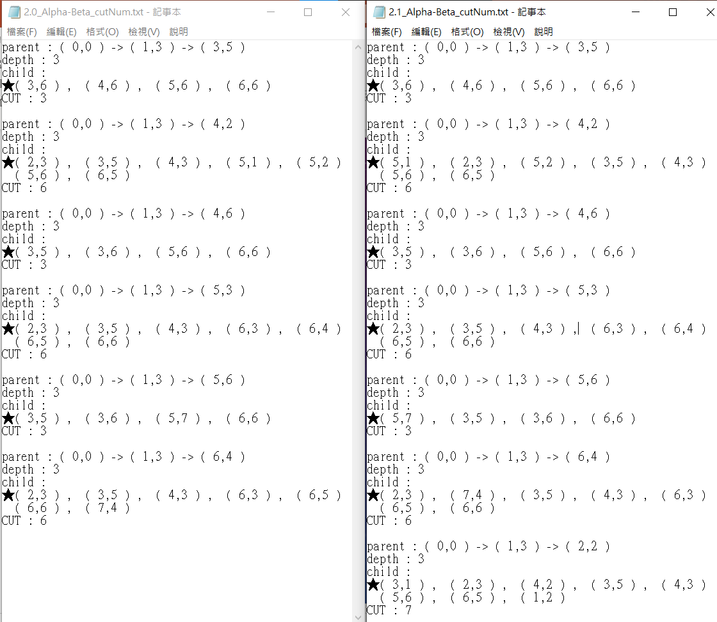
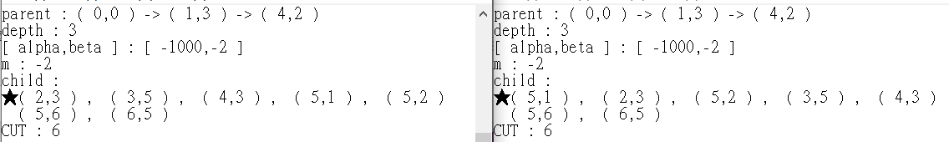
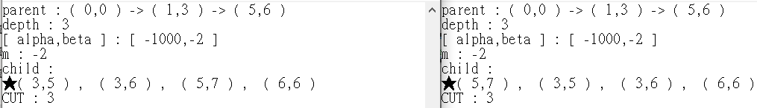
2. 什麼原因導致depth3的2.1比2.0多剪7個?
2.0
2.1

Slide 7

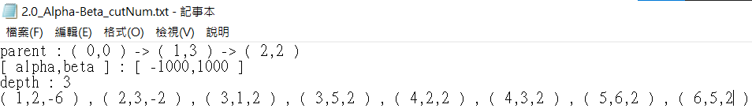


2.0 :
2.1 :
從上一頁2.0沒有出現(2,2)剪枝而2.1出現，是因為(2,2)被擺在最左方，[alpha,beta] = [-1000,1000]，所以子節點傳回值不會大於等於1000
(3,1)雖然2.1被擺在最前方，也沒有剪枝，但在2.0中如果可以剪枝應該在上一頁會有印出，但實際上搜尋(3,1)並沒有發生剪枝

Slide 8

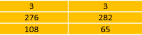
3. 2.2與2.3在depth2只差1，depth3差距大?
2.2 : 2.3 :
2.2與2.3根節點到父節點相同時，剪枝發生在同點
2.2與2.3根節點到父節點相同時，剪枝發生在不同點分析
2.2有但2.3沒有的根節點到父節點，剪枝只發生在2.2分析
2.3有但2.2沒有的根節點到父節點，剪枝只發生在2.3分析
 | 2.2 | 2.3
1 | 47 | 41
2 | 37 | 13
3 | 24 | 0
4 | 0 | 11
剪枝數量 | 108 | 65

Slide 9
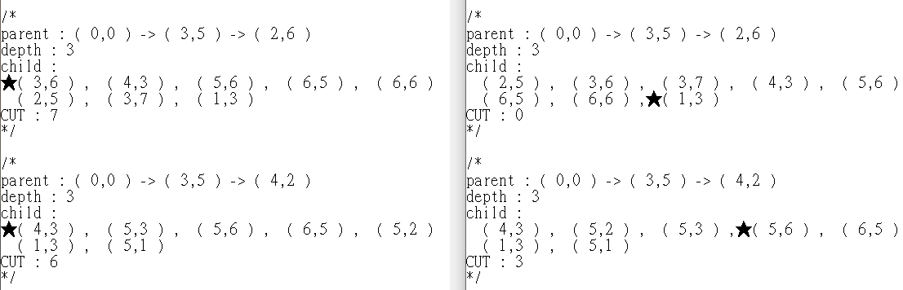
2. 2.2與2.3根節點到父節點相同時，剪枝發生在不同點分析
2.2 :
2.3 :
2.2 :
2.3 :

Slide 10
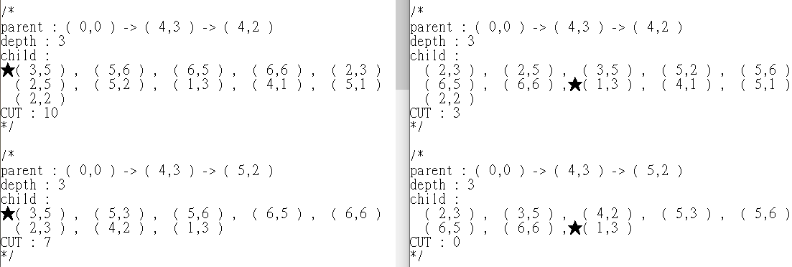
2.2 :
2.3 :
2.2 :
2.3 :

Slide 11
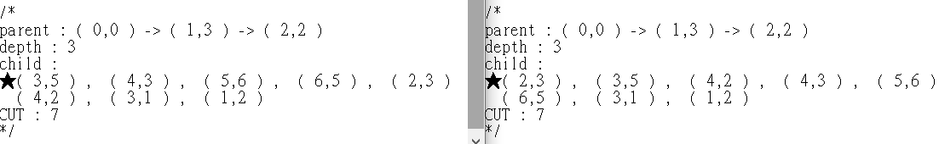
2.2 :
2.3 :
2.2 :
2.3 :

Slide 12
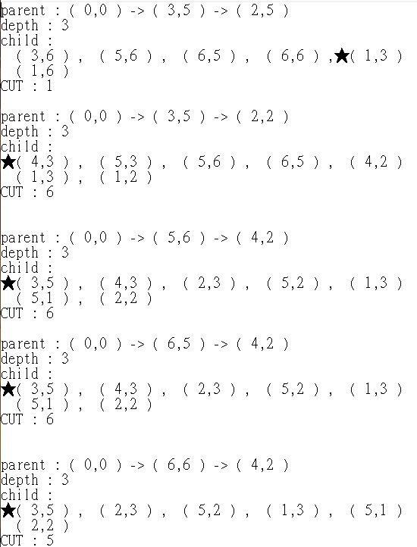


3. 2.2有但2.3沒有的根節點到父節點，剪枝只發生在2.2分析
2.2 :
2.2 :
2.3 :

Slide 13

3. 2.2有但2.3沒有的根節點到父節點，剪枝只發生在2.2分析
2.2 :
2.2 :
2.3 :

Slide 14

3. 2.2有但2.3沒有的根節點到父節點，剪枝只發生在2.2分析
2.2 :
2.2 :
2.3 :

Slide 15




3. 2.2有但2.3沒有的根節點到父節點，剪枝只發生在2.2分析
2.2 :
2.2 :
2.3 :

Slide 16
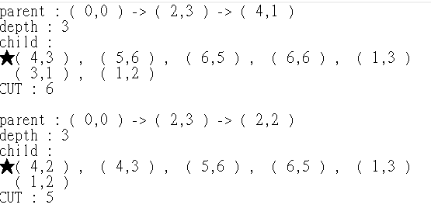
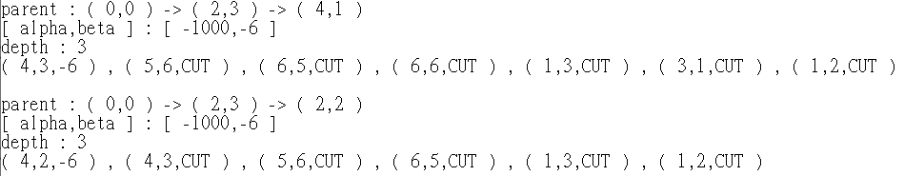
4. 2.3有但2.2沒有的根節點到父節點，剪枝只發生在2.3分析
2.3 :
2.3 :
2.2 :

Slide 17


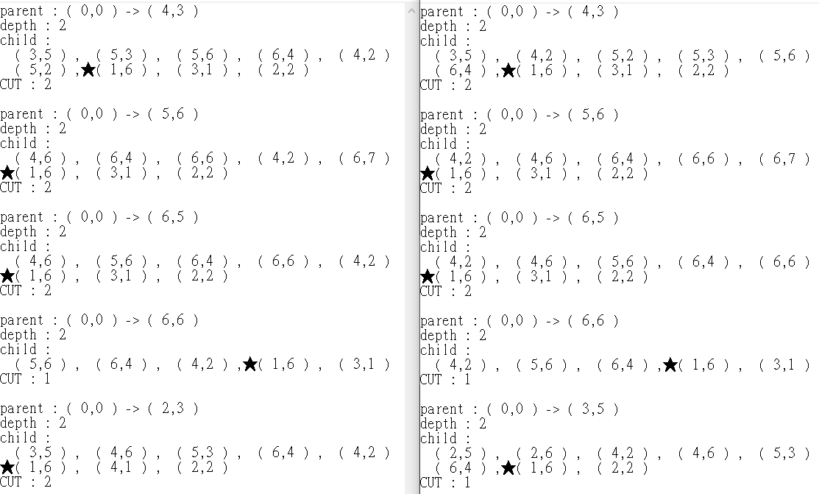
2.2與2.3 depth2剪枝數量只差1
2.2 : 2.3 :
2.2 :
2.3 :
2.2 :
2.3 :

Slide 18


Slide 19


Slide 20
第40初始盤面改善分析 | Time | Node | Frequency(個/秒)
2.3版(全排序) | 11.28 | 23314604 | 2066898
2.3版(當深度<=5排序) | 6.77 | 17306708 | 2556382
2.3版只有(1,6)權重提升 | 0.86 | 2020525 | 2349448
2.3版只有(3,1)權重提升 | 3.92 | 10300774 | 2627748
2.3版對稱白棋(1,6)(3,8)(6,1)(8,3)權重提升 | 0.84 | 1996598 | 2376902
2.3版對稱黑棋(1,3)(3,1)(6,8)(8,6)權重提升 | 0.29 | 673948 | 2323959
2.3版全對稱 (1,6)(3,8)(6,1)(8,3) (1,3)(3,1)(6,8)(8,6)權重提升 | 0.14 | 348624 | 2490171
2.1版Sort<=5 | 0.11 | 271701 | 2470009
當深度<=5排序 :
對稱白 :
排序 | 0 | MAX
排序 | 1 | MIN
排序 | 2 | MAX
排序 | 3 | MIN
排序 | 4 | MAX
排序 | 5 | MIN
 | 6 | MAX
 | 7 | MIN
 | 8 | MAX
 | 9 | MIN
 | 10 | MAX
 | 1 | 2 | 3 | 4 | 5 | 6 | 7 | 8
1 | 0 | 3 | 2 | 2 | 2 | 1 | 3 | 0
2 | 3 | 4 | 1 | 1 | 1 | 1 | 4 | 3
3 | 2 | 1 | 1 | 1 | 1 | 1 | 1 | 1
4 | 2 | 1 | 1 | ● | ● | 1 | 1 | 2
5 | 2 | 1 | 1 | ● | ● | 1 | 1 | 2
6 | 1 | 1 | 1 | 1 | 1 | 1 | 1 | 2
7 | 3 | 4 | 1 | 1 | 1 | 1 | 4 | 3
8 | 0 | 3 | 1 | 2 | 2 | 2 | 3 | 0
對稱黑 :
全對稱 :
2.1版本 :
●
第40初始盤面
 | 1 | 2 | 3 | 4 | 5 | 6 | 7 | 8
1 | 0 | 3 | 1 | 2 | 2 | 2 | 3 | 0
2 | 3 | 4 | 1 | 1 | 1 | 1 | 4 | 3
3 | 1 | 1 | 1 | 1 | 1 | 1 | 1 | 2
4 | 2 | 1 | 1 | ● | ● | 1 | 1 | 2
5 | 2 | 1 | 1 | ● | ● | 1 | 1 | 2
6 | 2 | 1 | 1 | 1 | 1 | 1 | 1 | 1
7 | 3 | 4 | 1 | 1 | 1 | 1 | 4 | 3
8 | 0 | 3 | 2 | 2 | 2 | 1 | 3 | 0
 | 1 | 2 | 3 | 4 | 5 | 6 | 7 | 8
1 | 0 | 3 | 1 | 2 | 2 | 1 | 3 | 0
2 | 3 | 4 | 1 | 1 | 1 | 1 | 4 | 3
3 | 1 | 1 | 1 | 1 | 1 | 1 | 1 | 1
4 | 2 | 1 | 1 | ● | ● | 1 | 1 | 2
5 | 2 | 1 | 1 | ● | ● | 1 | 1 | 2
6 | 1 | 1 | 1 | 1 | 1 | 1 | 1 | 1
7 | 3 | 4 | 1 | 1 | 1 | 1 | 4 | 3
8 | 0 | 3 | 1 | 2 | 2 | 1 | 3 | 0
 | 1 | 2 | 3 | 4 | 5 | 6 | 7 | 8
1 | 0 | 4 | 1 | 1 | 1 | 1 | 4 | 0
2 | 4 | 4 | 2 | 2 | 2 | 2 | 4 | 4
3 | 1 | 2 | 3 | 3 | 3 | 3 | 2 | 1
4 | 1 | 2 | 3 | ● | ● | 3 | 2 | 1
5 | 1 | 2 | 3 | ● | ● | 3 | 2 | 1
6 | 1 | 2 | 3 | 3 | 3 | 3 | 2 | 1
7 | 4 | 4 | 2 | 2 | 2 | 2 | 4 | 4
8 | 0 | 4 | 1 | 1 | 1 | 1 | 4 | 0
 | 1 | 2 | 3 | 4 | 5 | 6 | 7 | 8
1 |  |  |  | ● | ●
2 |  |  |  | ●
3 |  | ● | ● | ●
4 |  |  |  | ● | ●
5 |  |  |  | ● | ●
6
7
8

Slide 21
編號 | 1~50初始盤面平均 | Average Time | Average Node | Frequency(個/秒)
1 | 2.3版(全排序) | 1.98 | 4420170 | 2235570
2 | 2.3版(當深度<=5排序) | 1.27 | 3420504 | 2691191
3 | 2.3版只有(1,6)權重提升 | 1.06 | 2823194 | 2651384
4 | 2.3版只有(3,1)權重提升 | 0.70 | 1901318 | 2702271
5 | 2.3版對稱白棋(1,6)(3,8)(6,1)(8,3)權重提升 | 1.04 | 2758435 | 2644712
6 | 2.3版對稱黑棋(1,3)(3,1)(6,8)(8,6)權重提升 | 0.44 | 1142661 | 2606435
7 | 2.3版全對稱 (1,6)(3,8)(6,1)(8,3) (1,3)(3,1)(6,8)(8,6)權重提升 | 0.43 | 1060040 | 2458347
8 | 2.1版Sort<=5 | 0.19 | 481005 | 2520992

Slide 22
20頁 and 21頁 小結論
排序目的在於希望能剪枝更多點，但當層數過低導致排序成本>剪枝效果，是不希望的結果，因此應該選擇剪枝效果>排序成本的層樹為最好。(上一頁編號1 and 2)
對單個盤面來說，某個節點提升權重可能對這個盤面有較好的改善，但對於整體來說未必。(上一頁編號3 and 4)
需要考慮對稱白棋、對稱黑棋、全對稱哪個較優

Slide 23
20and21頁全對稱 2.3(只對8個點提升，其餘點不更動) :
24頁全對稱 2.3(對8個點提升權重，其餘點只要>=這8個更改完後的權重，都要+1):
原版2.3 :
 | 1 | 2 | 3 | 4 | 5 | 6 | 7 | 8
1 | 0 | 3 | 2 | 2 | 2 | 2 | 3 | 0
2 | 3 | 4 | 1 | 1 | 1 | 1 | 4 | 3
3 | 2 | 1 | 1 | 1 | 1 | 1 | 1 | 2
4 | 2 | 1 | 1 | ● | ● | 1 | 1 | 2
5 | 2 | 1 | 1 | ● | ● | 1 | 1 | 2
6 | 2 | 1 | 1 | 1 | 1 | 1 | 1 | 2
7 | 3 | 4 | 1 | 1 | 1 | 1 | 4 | 3
8 | 0 | 3 | 2 | 2 | 2 | 2 | 3 | 0
 | 1 | 2 | 3 | 4 | 5 | 6 | 7 | 8
1 | 0 | 3 | 1 | 2 | 2 | 1 | 3 | 0
2 | 3 | 4 | 1 | 1 | 1 | 1 | 4 | 3
3 | 1 | 1 | 1 | 1 | 1 | 1 | 1 | 1
4 | 2 | 1 | 1 | ● | ● | 1 | 1 | 2
5 | 2 | 1 | 1 | ● | ● | 1 | 1 | 2
6 | 1 | 1 | 1 | 1 | 1 | 1 | 1 | 1
7 | 3 | 4 | 1 | 1 | 1 | 1 | 4 | 3
8 | 0 | 3 | 1 | 2 | 2 | 1 | 3 | 0
 | 1 | 2 | 3 | 4 | 5 | 6 | 7 | 8
1 | 0 | 4 | 1 | 3 | 3 | 1 | 4 | 0
2 | 4 | 5 | 2 | 2 | 2 | 2 | 5 | 4
3 | 1 | 2 | 2 | 2 | 2 | 2 | 2 | 1
4 | 3 | 2 | 2 | ● | ● | 2 | 2 | 3
5 | 3 | 2 | 2 | ● | ● | 2 | 2 | 3
6 | 1 | 2 | 2 | 2 | 2 | 2 | 2 | 1
7 | 4 | 5 | 2 | 2 | 2 | 2 | 5 | 4
8 | 0 | 4 | 1 | 3 | 3 | 1 | 4 | 0
25頁全對稱 2.3(對4個點(黃色)提升權重，其餘點只要>=這4個更改完後的權重，都要+1):
26 and 27頁全對稱 2.3(對8個點(綠色)提升權重，其餘點只要>=這8個更改完後的權重，都要+1):
 | 1 | 2 | 3 | 4 | 5 | 6 | 7 | 8
1 | 0 | 5 | 1 | 4 | 4 | 1 | 5 | 0
2 | 5 | 6 | 3 | 3 | 3 | 3 | 6 | 5
3 | 1 | 3 | 2 | 3 | 3 | 2 | 3 | 1
4 | 4 | 3 | 3 | ● | ● | 3 | 3 | 4
5 | 4 | 3 | 3 | ● | ● | 3 | 3 | 4
6 | 1 | 3 | 2 | 3 | 3 | 2 | 3 | 1
7 | 5 | 6 | 3 | 3 | 3 | 3 | 6 | 5
8 | 0 | 5 | 1 | 4 | 4 | 1 | 5 | 0
 | 1 | 2 | 3 | 4 | 5 | 6 | 7 | 8
1 | 0 | 6 | 1 | 5 | 5 | 1 | 6 | 0
2 | 6 | 7 | 3 | 4 | 4 | 3 | 7 | 6
3 | 1 | 3 | 2 | 4 | 4 | 2 | 3 | 1
4 | 5 | 4 | 4 | ● | ● | 4 | 4 | 5
5 | 5 | 4 | 4 | ● | ● | 4 | 4 | 5
6 | 1 | 3 | 2 | 4 | 4 | 2 | 3 | 1
7 | 6 | 7 | 3 | 4 | 4 | 3 | 7 | 6
8 | 0 | 6 | 1 | 5 | 5 | 1 | 6 | 0

Slide 24
為什麼重要?
 | 1 | 2 | 3 | 4 | 5 | 6 | 7 | 8
1 | 0 | 4 | 1 | 3 | 3 | ● | 4 | 0
2 | 4 | 5 | 2 | 2 | 2 | 2 | 5 | 4
3 | 1 | 2 | 2 | 2 | 2 | 2 | 2 | 1
4 | 3 | 2 | 2 | ● | ● | 2 | 2 | 3
5 | 3 | 2 | 2 | ● | ● | 2 | 2 | 3
6 | 1 | 2 | 2 | 2 | 2 | 2 | 2 | 1
7 | 4 | 5 | 2 | 2 | 2 | 2 | 5 | 4
8 | 0 | 4 | 1 | 3 | 3 | 1 | 4 | 0
 | 1 | 2 | 3 | 4 | 5 | 6 | 7 | 8
1 | 0 | 4 | 1 | 3 | 3 | 1 | 4 | 0
2 | 4 | 5 | 2 | 2 | 2 | 2 | 5 | 4
3 | 1 | 2 | 2 | 2 | 2 | 2 | 2 | 1
4 | 3 | 2 | 2 | ● | ● | 2 | 2 | 3
5 | 3 | 2 | 2 | ● | ● | 2 | 2 | 3
6 | 1 | 2 | 2 | 2 | 2 | 2 | 2 | 1
7 | 4 | 5 | 2 | 2 | 2 | 2 | 5 | 4
8 | 0 | 4 | 1 | 3 | 3 | 1 | 4 | 0
 | 1 | 2 | 3 | 4 | 5 | 6 | 7 | 8
1 | 0 | 4 | 1 | 3 | ● | ● | 4 | 0
2 | 4 | 5 | 2 | 2 | 2 | 2 | 5 | 4
3 | 1 | 2 | 2 | 2 | 2 | 2 | 2 | 1
4 | 3 | 2 | 2 | ● | ● | 2 | 2 | 3
5 | 3 | 2 | 2 | ● | ● | 2 | 2 | 3
6 | 1 | 2 | 2 | 2 | 2 | 2 | 2 | 1
7 | 4 | 5 | 2 | 2 | 2 | 2 | 5 | 4
8 | 0 | 4 | 1 | 3 | 3 | 1 | 4 | 0
 | 1 | 2 | 3 | 4 | 5 | 6 | 7 | 8
1 | 0 | 4 | 1 | 3 | 3 | ● | ● | 0
2 | 4 | 5 | 2 | 2 | 2 | 2 | 5 | 4
3 | 1 | 2 | 2 | 2 | 2 | 2 | 2 | 1
4 | 3 | 2 | 2 | ● | ● | 2 | 2 | 3
5 | 3 | 2 | 2 | ● | ● | 2 | 2 | 3
6 | 1 | 2 | 2 | 2 | 2 | 2 | 2 | 1
7 | 4 | 5 | 2 | 2 | 2 | 2 | 5 | 4
8 | 0 | 4 | 1 | 3 | 3 | 1 | 4 | 0
1~50初始盤面平均 | Average Time | Average Node | Frequency(個/秒)
20and21頁全對稱 2.3(只對8個點提升，其餘點不更動) | 0.43 | 1060040 | 2458347
24頁全對稱 2.3(對8個點提升權重，其餘點只要>=這8個更改完後的權重，都要+1) | 0.34 | 847435 | 2492456

Slide 25
2.3版改進權重
 | 1 | 2 | 3 | 4 | 5 | 6 | 7 | 8
1 | 0 | 5 | 1 | 4 | 4 | 1 | 5 | 0
2 | 5 | 6 | 3 | 3 | 3 | 3 | 6 | 5
3 | 1 | 3 | 2 | 3 | 3 | 2 | 3 | 1
4 | 4 | 3 | 3 | ● | ● | 3 | 3 | 4
5 | 4 | 3 | 3 | ● | ● | 3 | 3 | 4
6 | 1 | 3 | 2 | 3 | 3 | 2 | 3 | 1
7 | 5 | 6 | 3 | 3 | 3 | 3 | 6 | 5
8 | 0 | 5 | 1 | 4 | 4 | 1 | 5 | 0
優點 : 若下在(3,6)，有機會讓對方下在(2,7)，這樣能夠獲得角落位置
缺點 : 若對方選擇(2,6)，則(3,6)也會被對方搶走，因此會從優勢變成劣勢情況
優點 :
缺點 :
 | 1 | 2 | 3 | 4 | 5 | 6 | 7 | 8
1 | 0 | 5 | 1 | 4 | 4 | 1 | 5 | 0
2 | 5 | 6 | 3 | 3 | 3 | 3 | 6 | 5
3 | 1 | 3 | 2 | 3 | 3 | ● | 3 | 1
4 | 4 | 3 | 3 | ● | ● | 3 | 3 | 4
5 | 4 | 3 | 3 | ● | ● | 3 | 3 | 4
6 | 1 | 3 | 2 | 3 | 3 | 2 | 3 | 1
7 | 5 | 6 | 3 | 3 | 3 | 3 | 6 | 5
8 | 0 | 5 | 1 | 4 | 4 | 1 | 5 | 0
 | 1 | 2 | 3 | 4 | 5 | 6 | 7 | 8
1 | 0 | 5 | 1 | 4 | 4 | 1 | 5 | 0
2 | 5 | 6 | 3 | 3 | 3 | 3 | 6 | 5
3 | 1 | 3 | 2 | 3 | 3 | ● | 3 | 1
4 | 4 | 3 | 3 | ● | ● | ● | 3 | 4
5 | 4 | 3 | 3 | ● | ● | 3 | 3 | 4
6 | 1 | 3 | 2 | 3 | 3 | 2 | 3 | 1
7 | 5 | 6 | 3 | 3 | 3 | 3 | 6 | 5
8 | 0 | 5 | 1 | 4 | 4 | 1 | 5 | 0
1~50初始盤面平均 | Average Time | Average Node | Frequency(個/秒)
20and21頁全對稱 2.3(只對8個點提升，其餘點不更動) | 0.43 | 1060040 | 2458347
24頁全對稱 2.3(對8個點提升權重，其餘點只要>=這8個更改完後的權重，都要+1) | 0.34 | 847435 | 2492456
紅色權重=1 黃色權重=1 | 0.27 | 685297 | 2541901
紅色權重=1 黃色權重=2 | 0.26 | 682586 | 2607280
 | 1 | 2 | 3 | 4 | 5 | 6 | 7 | 8
1 | 0 | 5 | 1 | 4 | 4 | 1 | 5 | 0
2 | 5 | 6 | 3 | 3 | 3 | 3 | ● | 5
3 | 1 | 3 | 2 | 3 | 3 | ● | 3 | 1
4 | 4 | 3 | 3 | ● | ● | 3 | 3 | 4
5 | 4 | 3 | 3 | ● | ● | 3 | 3 | 4
6 | 1 | 3 | 2 | 3 | 3 | 2 | 3 | 1
7 | 5 | 6 | 3 | 3 | 3 | 3 | 6 | 5
8 | 0 | 5 | 1 | 4 | 4 | 1 | 5 | 0
 | 1 | 2 | 3 | 4 | 5 | 6 | 7 | 8
1 | 0 | 5 | 1 | 4 | 4 | 1 | 5 | 0
2 | 5 | 6 | 3 | 3 | 3 | ● | 6 | 5
3 | 1 | 3 | 2 | 3 | 3 | ● | 3 | 1
4 | 4 | 3 | 3 | ● | ● | ● | 3 | 4
5 | 4 | 3 | 3 | ● | ● | 3 | 3 | 4
6 | 1 | 3 | 2 | 3 | 3 | 2 | 3 | 1
7 | 5 | 6 | 3 | 3 | 3 | 3 | 6 | 5
8 | 0 | 5 | 1 | 4 | 4 | 1 | 5 | 0

Slide 26
2.3版改進權重: 優點
 | 1 | 2 | 3 | 4 | 5 | 6 | 7 | 8
1 | 0 | 6 | 1 | 5 | 5 | 1 | 6 | 0
2 | 6 | 7 | 3 | 4 | 4 | 3 | 7 | 6
3 | 1 | 3 | 2 | 4 | 4 | 2 | 3 | 1
4 | 5 | 4 | 4 | ● | ● | 4 | 4 | 5
5 | 5 | 4 | 4 | ● | ● | 4 | 4 | 5
6 | 1 | 3 | 2 | 4 | 4 | 2 | 3 | 1
7 | 6 | 7 | 3 | 4 | 4 | 3 | 7 | 6
8 | 0 | 6 | 1 | 5 | 5 | 1 | 6 | 0
 | 1 | 2 | 3 | 4 | 5 | 6 | 7 | 8
1 | 0 | 6 | 1 | 5 | 5 | 1 | 6 | 0
2 | 6 | 7 | ● | ● | 4 | 3 | 7 | 6
3 | 1 | ● | ● | ● | 4 | 2 | 3 | 1
4 | 5 | 4 | 4 | ● | ● | 4 | 4 | 5
5 | 5 | 4 | 4 | ● | ● | 4 | 4 | 5
6 | 1 | 3 | 2 | 4 | 4 | 2 | 3 | 1
7 | 6 | 7 | 3 | 4 | 4 | 3 | 7 | 6
8 | 0 | 6 | 1 | 5 | 5 | 1 | 6 | 0
優點 : 自己下在(2,3)位置
1. 可能使對方下在(2,2)位置，(2,2)權重是最大最不利的
2. 對自己來說，可下在(4,3)位置，黃色位置優勢在上一頁
3. 可能使對方下在(1,2)位置，(1,2)權重是第二大的，若之後拿下(1,3)位置就可拿下角落
4.可能使對方下在(1,4)位置，雖然綠色位置被搶走，但若(1,3)位置是自己的，則在優勢上可能是對方下在(1,2)
 | 1 | 2 | 3 | 4 | 5 | 6 | 7 | 8
1 | 0 | 6 | 1 | 5 | 5 | 1 | 6 | 0
2 | 6 | ● | ● | ● | 4 | 3 | 7 | 6
3 | 1 | ● | ● | ● | 4 | 2 | 3 | 1
4 | 5 | 4 | 4 | ● | ● | 4 | 4 | 5
5 | 5 | 4 | 4 | ● | ● | 4 | 4 | 5
6 | 1 | 3 | 2 | 4 | 4 | 2 | 3 | 1
7 | 6 | 7 | 3 | 4 | 4 | 3 | 7 | 6
8 | 0 | 6 | 1 | 5 | 5 | 1 | 6 | 0
 | 1 | 2 | 3 | 4 | 5 | 6 | 7 | 8
1 | 0 | 6 | 1 | 5 | 5 | 1 | 6 | 0
2 | 6 | 7 | ● | ● | 4 | 3 | 7 | 6
3 | 1 | ● | ● | ● | 4 | 2 | 3 | 1
4 | 5 | 4 | ● | ● | ● | 4 | 4 | 5
5 | 5 | 4 | 4 | ● | ● | 4 | 4 | 5
6 | 1 | 3 | 2 | 4 | 4 | 2 | 3 | 1
7 | 6 | 7 | 3 | 4 | 4 | 3 | 7 | 6
8 | 0 | 6 | 1 | 5 | 5 | 1 | 6 | 0
 | 1 | 2 | 3 | 4 | 5 | 6 | 7 | 8
1 | 0 | ● | 1 | 5 | 5 | 1 | 6 | 0
2 | 6 | 7 | ● | ● | 4 | 3 | 7 | 6
3 | 1 | ● | ● | ● | 4 | 2 | 3 | 1
4 | 5 | 4 | 4 | ● | ● | 4 | 4 | 5
5 | 5 | 4 | 4 | ● | ● | 4 | 4 | 5
6 | 1 | 3 | 2 | 4 | 4 | 2 | 3 | 1
7 | 6 | 7 | 3 | 4 | 4 | 3 | 7 | 6
8 | 0 | 6 | 1 | 5 | 5 | 1 | 6 | 0
 | 1 | 2 | 3 | 4 | 5 | 6 | 7 | 8
1 | 0 | 6 | 1 | ● | 5 | 1 | 6 | 0
2 | 6 | 7 | ● | ● | 4 | 3 | 7 | 6
3 | 1 | ● | ● | ● | 4 | 2 | 3 | 1
4 | 5 | 4 | 4 | ● | ● | 4 | 4 | 5
5 | 5 | 4 | 4 | ● | ● | 4 | 4 | 5
6 | 1 | 3 | 2 | 4 | 4 | 2 | 3 | 1
7 | 6 | 7 | 3 | 4 | 4 | 3 | 7 | 6
8 | 0 | 6 | 1 | 5 | 5 | 1 | 6 | 0

Slide 27
2.3版改進權重: 缺點
 | 1 | 2 | 3 | 4 | 5 | 6 | 7 | 8
1 | 0 | 6 | 1 | 5 | 5 | 1 | 6 | 0
2 | 6 | 7 | 3 | 4 | 4 | 3 | 7 | 6
3 | 1 | 3 | 2 | 4 | 4 | 2 | 3 | 1
4 | 5 | 4 | 4 | ● | ● | 4 | 4 | 5
5 | 5 | 4 | 4 | ● | ● | 4 | 4 | 5
6 | 1 | 3 | 2 | 4 | 4 | 2 | 3 | 1
7 | 6 | 7 | 3 | 4 | 4 | 3 | 7 | 6
8 | 0 | 6 | 1 | 5 | 5 | 1 | 6 | 0
缺點 :自己下在(2,3)位置
1. 如果對方在(1,3)有棋子，則可能下在(3,3)導致紅黃綠三色優勢全落入對方上
 | 1 | 2 | 3 | 4 | 5 | 6 | 7 | 8
1 | 0 | 6 | 1 | 5 | 5 | 1 | 6 | 0
2 | 6 | 7 | ● | 4 | 4 | 3 | 7 | 6
3 | 1 | 3 | 2 | 4 | 4 | 2 | 3 | 1
4 | 5 | 4 | 4 | ● | ● | 4 | 4 | 5
5 | 5 | 4 | 4 | ● | ● | 4 | 4 | 5
6 | 1 | 3 | 2 | 4 | 4 | 2 | 3 | 1
7 | 6 | 7 | 3 | 4 | 4 | 3 | 7 | 6
8 | 0 | 6 | 1 | 5 | 5 | 1 | 6 | 0
1~50初始盤面平均 | Average Time | Average Node | Frequency(個/秒)
20and21頁全對稱 2.3(只對8個點提升，其餘點不更動) | 0.43 | 1060040 | 2458347
24頁全對稱 2.3(對8個點提升權重，其餘點只要>=這8個更改完後的權重，都要+1) | 0.34 | 847435 | 2492456
紅色權重=1 黃色權重=2 | 0.26 | 682586 | 2607280
紅色權重=1 黃色權重=2 綠色權重=3 | 0.22 | 572013 | 2555911
 | 1 | 2 | 3 | 4 | 5 | 6 | 7 | 8
1 | 0 | 6 | ● | 5 | 5 | 1 | 6 | 0
2 | 6 | 7 | ● | 4 | 4 | 3 | 7 | 6
3 | 1 | 3 | 2 | 4 | 4 | 2 | 3 | 1
4 | 5 | 4 | 4 | ● | ● | 4 | 4 | 5
5 | 5 | 4 | 4 | ● | ● | 4 | 4 | 5
6 | 1 | 3 | 2 | 4 | 4 | 2 | 3 | 1
7 | 6 | 7 | 3 | 4 | 4 | 3 | 7 | 6
8 | 0 | 6 | 1 | 5 | 5 | 1 | 6 | 0
 | 1 | 2 | 3 | 4 | 5 | 6 | 7 | 8
1 | 0 | 6 | 1 | 5 | 5 | 1 | 6 | 0
2 | 6 | 7 | ● | 4 | 4 | 3 | 7 | 6
3 | 1 | 3 | ● | 4 | 4 | 2 | 3 | 1
4 | 5 | 4 | 4 | ● | ● | 4 | 4 | 5
5 | 5 | 4 | 4 | ● | ● | 4 | 4 | 5
6 | 1 | 3 | 2 | 4 | 4 | 2 | 3 | 1
7 | 6 | 7 | 3 | 4 | 4 | 3 | 7 | 6
8 | 0 | 6 | 1 | 5 | 5 | 1 | 6 | 0

Slide 28
2.1版本Sort<=5
2.1_紅
2.1_紅+黃
2.1_紅+黃+綠
 | 1 | 2 | 3 | 4 | 5 | 6 | 7 | 8
1 | 0 | 4 | 1 | 1 | 1 | 1 | 4 | 0
2 | 4 | 4 | 2 | 2 | 2 | 2 | 4 | 4
3 | 1 | 2 | 3 | 3 | 3 | 3 | 2 | 1
4 | 1 | 2 | 3 | ● | ● | 3 | 2 | 1
5 | 1 | 2 | 3 | ● | ● | 3 | 2 | 1
6 | 1 | 2 | 3 | 3 | 3 | 3 | 2 | 1
7 | 4 | 4 | 2 | 2 | 2 | 2 | 4 | 4
8 | 0 | 4 | 1 | 1 | 1 | 1 | 4 | 0
 | 1 | 2 | 3 | 4 | 5 | 6 | 7 | 8
1 | 0 | 5 | 1 | 2 | 2 | 1 | 5 | 0
2 | 5 | 5 | 3 | 3 | 3 | 3 | 5 | 5
3 | 1 | 3 | 4 | 4 | 4 | 4 | 3 | 1
4 | 2 | 3 | 4 | ● | ● | 4 | 3 | 2
5 | 2 | 3 | 4 | ● | ● | 4 | 3 | 2
6 | 1 | 3 | 4 | 4 | 4 | 4 | 3 | 1
7 | 5 | 5 | 3 | 3 | 3 | 3 | 5 | 5
8 | 0 | 5 | 1 | 2 | 2 | 1 | 5 | 0
 | 1 | 2 | 3 | 4 | 5 | 6 | 7 | 8
1 | 0 | 6 | 1 | 3 | 3 | 1 | 6 | 0
2 | 6 | 6 | 4 | 4 | 4 | 4 | 6 | 6
3 | 1 | 4 | 2 | 5 | 5 | 2 | 4 | 1
4 | 3 | 4 | 5 | ● | ● | 5 | 4 | 3
5 | 3 | 4 | 5 | ● | ● | 5 | 4 | 3
6 | 1 | 4 | 2 | 5 | 5 | 2 | 4 | 1
7 | 6 | 6 | 4 | 4 | 4 | 4 | 6 | 6
8 | 0 | 6 | 1 | 3 | 3 | 1 | 6 | 0
 | 1 | 2 | 3 | 4 | 5 | 6 | 7 | 8
1 | 0 | 7 | 1 | 4 | 4 | 1 | 7 | 0
2 | 7 | 7 | 3 | 5 | 5 | 3 | 7 | 7
3 | 1 | 3 | 2 | 6 | 6 | 2 | 3 | 1
4 | 4 | 5 | 6 | ● | ● | 6 | 5 | 4
5 | 4 | 5 | 6 | ● | ● | 6 | 5 | 4
6 | 1 | 3 | 2 | 6 | 6 | 2 | 3 | 1
7 | 7 | 7 | 3 | 5 | 5 | 3 | 7 | 7
8 | 0 | 7 | 1 | 4 | 4 | 1 | 7 | 0
2.1改進 | Average Time | Average Node | Frequency(個/秒)
2.1版本Sort<=5 | 0.19 | 481005 | 2484532
2.1_紅 | 0.19 | 476821 | 2525533
2.1_紅+黃 | 0.18 | 451404 | 2521812
2.1_紅+黃+綠 | 0.19 | 476318 | 2566368

Slide 29
23頁 ~ 28頁 小結論
從24頁得知，改變權重盤面時，不能只對特定幾個提升權重，同時也要更改其餘點，只要>=更改完的特定點，都要+1，效果會比只提升特定點來的好
從25頁可知，多了黃色位置對於2.3盤面有不錯提升，但權重是排在紅色後
26~27頁可知綠色位置對2.3盤面也是有小幅提升
28頁，根據2.3盤面改善後應用在2.1上，原版 < 紅色+黃色+綠色 < 紅色 < 紅色+黃色

Slide 30
報告結束
謝謝

