Slide 1
Imagina Painting
ImaginaPainting is Ebay for artists. It is an ecommerce platform exclusively for artists.

Slide 2
About
Features
User login with backend pages for each type of user (buyer, seller, admin)
Admin can approve or reject pending seller accounts, manage buyer and seller accounts, and change the admin’s account details
Buyer can view orders, view and remove favorites, and change account details
Seller can list their artwork, edit their listed artwork, delete their listed artwork, change their public profile details, change their account details, and view orders involving their artwork
Registration pages for buyers and sellers
Products page that allows filtering
Individual product page to see the product details
Seller public page which lists art for sale
Cart page for buyers only

Slide 3
Technologies used
Front-End
Back-End
HTML | CSS | jQuery | AJAX | Bootstrap
Java | Maven | Spring | Spring Boot REST with jQuery
Spring Boot with Thymeleaf | Spring Data JPA | Spring Security | Java File Upload

Slide 4
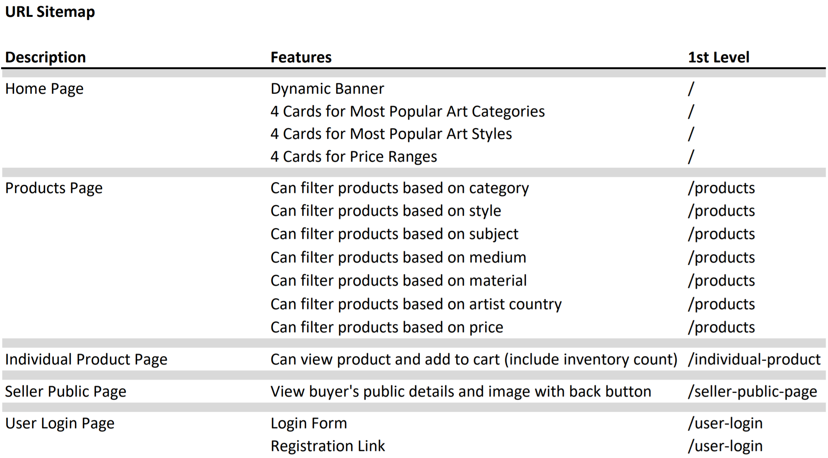

Slide 5
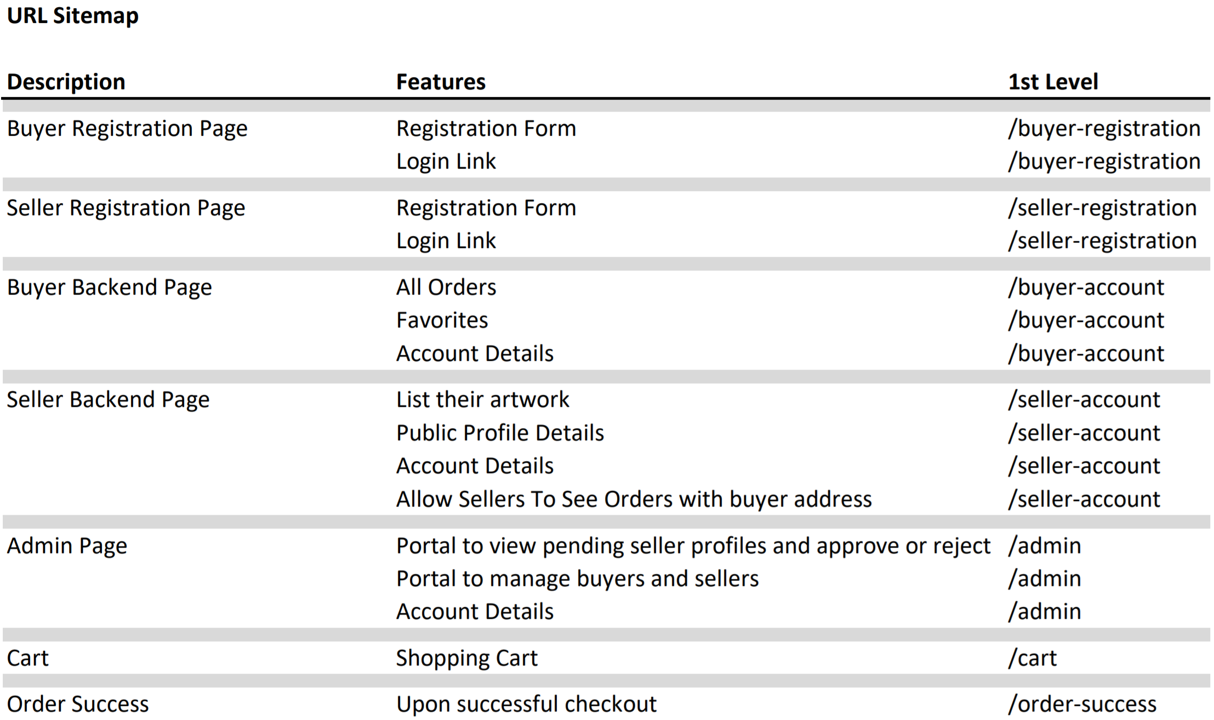

Slide 6
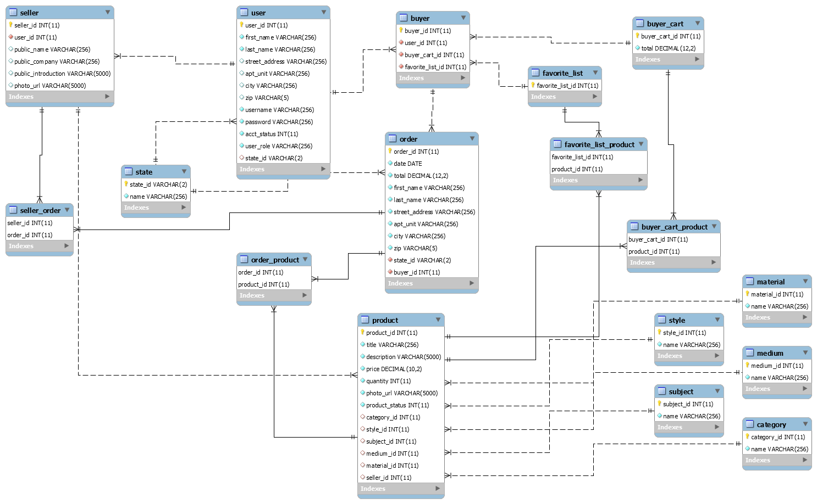

Slide 7
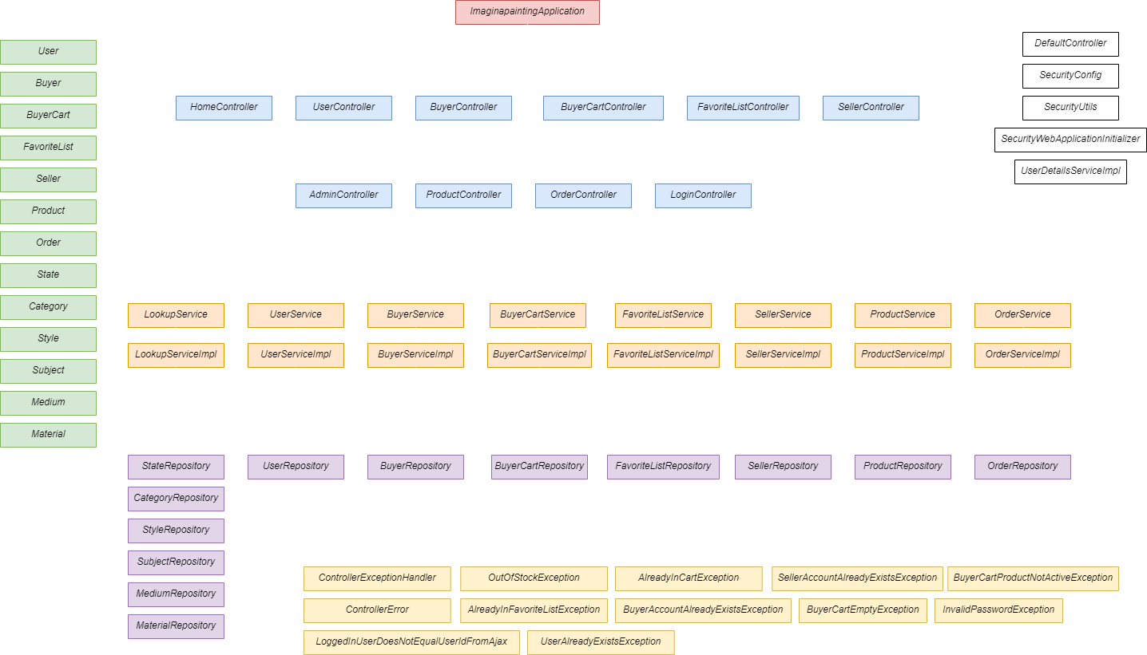

Slide 8
Challenges and Difficulties
JPA did not work with some entities
Used JPA query annotation with native SQL to resolve
Uploading files (extra technology)
Trial and error with Stack Overflow
Business logic of the application
Trying to imitate Amazon when they have thousands of developers
Time constraint

