Slide 1
Digital Privacy Notice Challenge
By Daniel Forrest

Slide 2
Where you can find it
http://dannyforrest.com/ONC_DigitalPrivacyNotice/NPP_HC.html
http://dannyforrest.com/ONC_DigitalPrivacyNotice/NPP_HealthPlan.html
http://dannyforrest.com/ONC_DigitalPrivacyNotice/ONC_DigitalPrivacyNotice.zip

Slide 3
Style
This website is using popular website style known as parallax which allows different elements to move at various speeds as the user scrolls up & down the page.
Additionally, I am minimizing content using an accordion feature so the user is not overwhelmed by the volume of text.
The background gets more opaque on hover to provide an easy reading experience.

Slide 4
Code Used
HTML5, JavaScript/jQuery, CSS3
JavaScript Libraries:
Stellar.js
http://markdalgleish.com/projects/stellar.js/
Waypoints
http://imakewebthings.com/jquery-waypoints/
jQuery Easing Plugin
http://gsgd.co.uk/sandbox/jquery/easing/
CSS:
Google Fonts
https://www.google.com/fonts
Images taken from: http://www.freeimages.com/

Slide 5
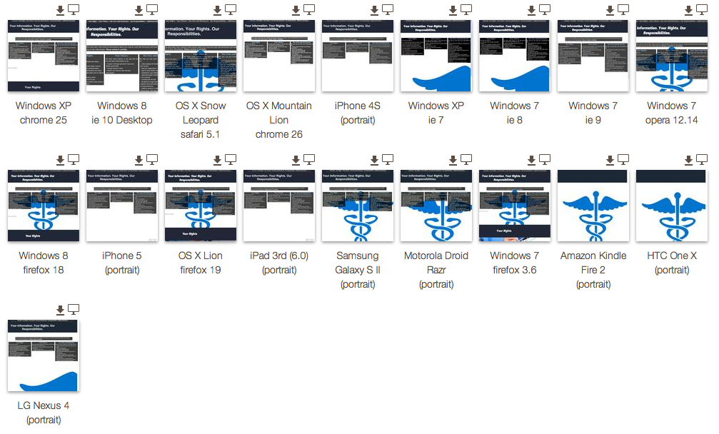
Works on popular browsers & devices

Slide 6
Customization
Files can be opened using a text editor for providers to edit text.
Built using: http://www.sublimetext.com/
Files to edit/customize based on provider information:
NPP_HC.html
NPP_HealthPlan.html
css/style.css (to edit images)

Slide 7
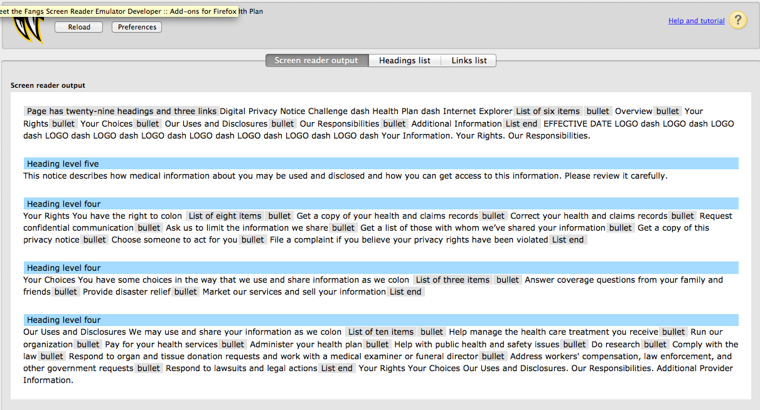
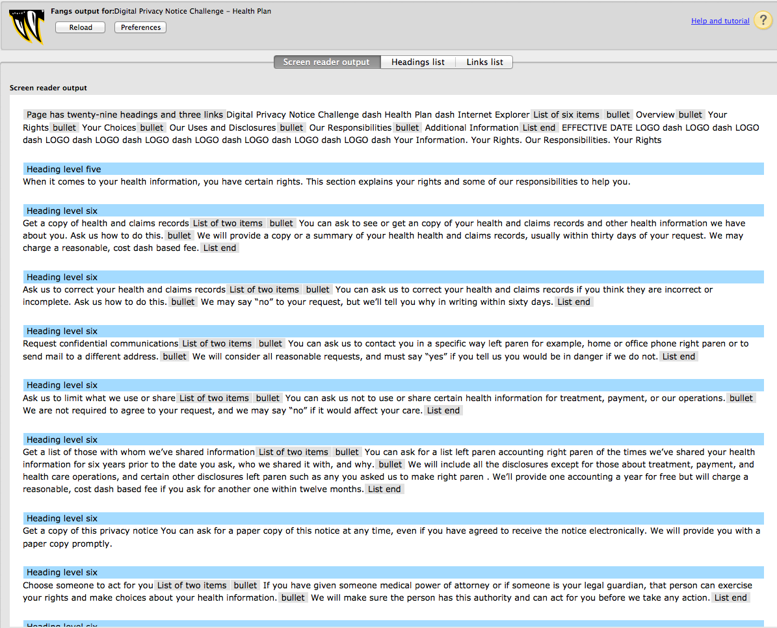
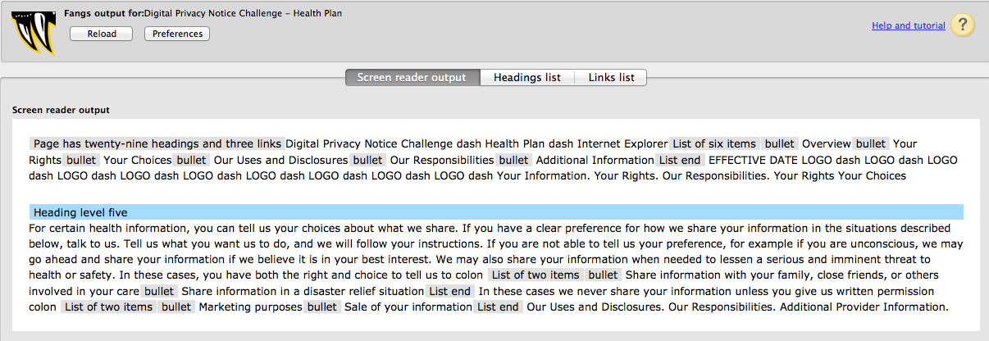
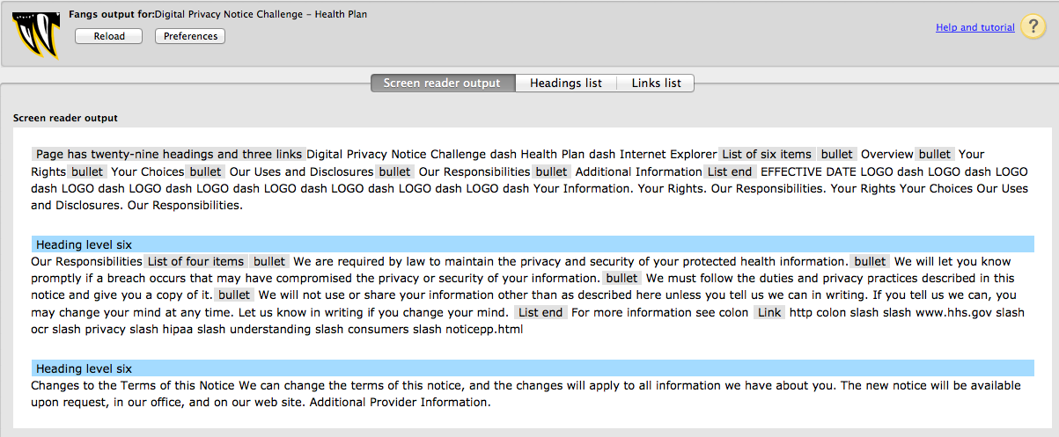
508 Compliance

