Slide 1
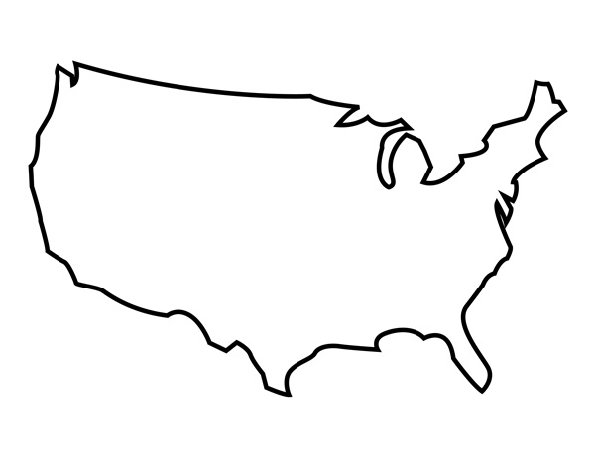




Rules
Decisions Made
SEA
1. Cannot fly in <30 degree weather
1. Delayed take-off due to cold weather
2. Batteries only sustain flight for 5 hrs
NYC
2. Flew south to avoid storm
3. Must avoid storms with wind > 25 mph
3. Landed early due to low battery

Slide 2








Selection of Data Source
Simulations Run
Reports Generated
IS3 Datasets
Adaptation Loop
Simulation Output
User
Datasets
UAV
IoT
Medical Devices
Weather Data
External Uncertainty API Feeds
Remote Server Response Time
?Data?
xxxx

Slide 3
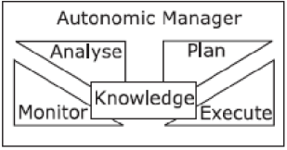

Slide 4














Expected: X
Actual: X
Option #1
Option #2
Option #3
Possible Obstacle
Expected: .2 seconds
Actual: .4 seconds
Unexpected Delay
UAV detects possible missing person
Prepare camera
UAV Past Target

Slide 5
Expected: .2 seconds
Actual: .4 seconds
Unexpected Delay
UAV detects possible target
Prepare camera
UAV Past Target

Slide 6
Option #1
Option #2
Possible Obstacle
Option #3
Option #1
Option #2
Option #3
Possible Obstacle

Slide 7
Self Adaptive Layer
Tactic Volatility Decision Component
Tactic Observations
Adaptation Decisions
Target System

Slide 8
Tactic Options
Utility = 3
Dependability= .1
Tactic Option #1
System
Utility = 2
Dependability= .7
Tactic Option #2
Utility = 1
Dependability= 1.0
Tactic Option #3

Slide 9
Tactic Options
Utility = 3
Availability = .1
Tactic Option #1
System
Utility = 2
Availability = .7
Tactic Option #2
Utility = 1
Availability = 1.0
Tactic Option #3

Slide 10




Rules
14:17 EST
1. Cannot fly in <30 degree weather
SEA
2. Batteries only sustain flight for 6 hrs
3. Must avoid storms with wind > 40 mph
4. Airport is currently experiencing delays
JFK
Decisions Made
* DEN
* LAX
1. Delayed take-off due to cold weather
2. Flew south to avoid storm
MCO
3. Landed early due to low battery
*
4. Take-off is suspended due to delays.
SEA→JFK flight path adjusted due to storm on route.

Slide 11
Rules
14:17 EST
1. Cannot fly in <30 degree weather
SEA
2. Batteries only sustain flight for 6 hrs
3. Must avoid storms with wind > 40 mph
4. Airport is currently experiencing delays
JFK
Decisions Made
* DEN
* LAX
1. Delayed take-off due to cold weather
2. Flew south to avoid storm
MCO
3. Landed early due to low battery
*
4. Take-off is suspended due to delays.
SEA→JFK flight path adjusted due to storm on route

