Slide 1

Mobile Computing Final Project
By Dani Brown, Giovanni Cornejo, Austin Padilla

Slide 2
Group Member Effort
All members contributed an equal amount of effort to the project
Dani Brown
Effort: 100%
API calls, tweets, save/load/delete, service activation code
Giovanni Cornejo
Effort: 100%
Setup for the second raspberry pi and corresponding services, the report/presentation documentation
Austin Padilla
Effort: 100%
Front-end development, redux store and slices

Slide 3
Demo

Slide 4
Conclusions

Slide 5
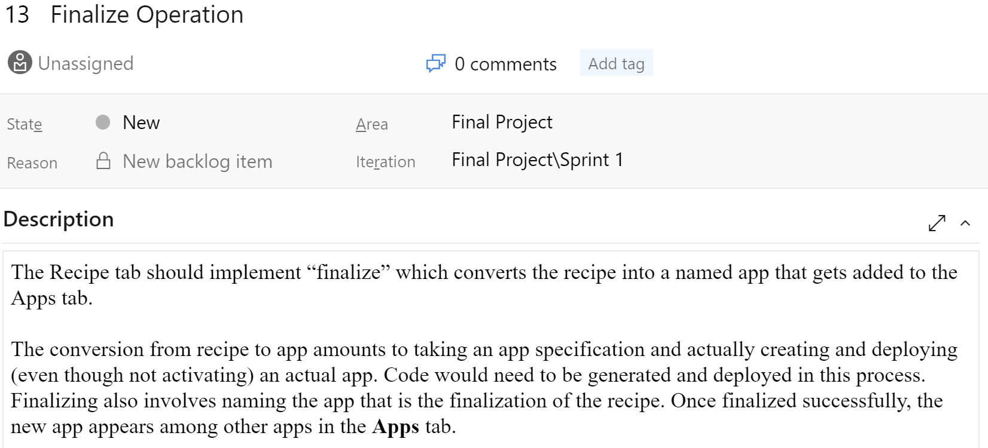
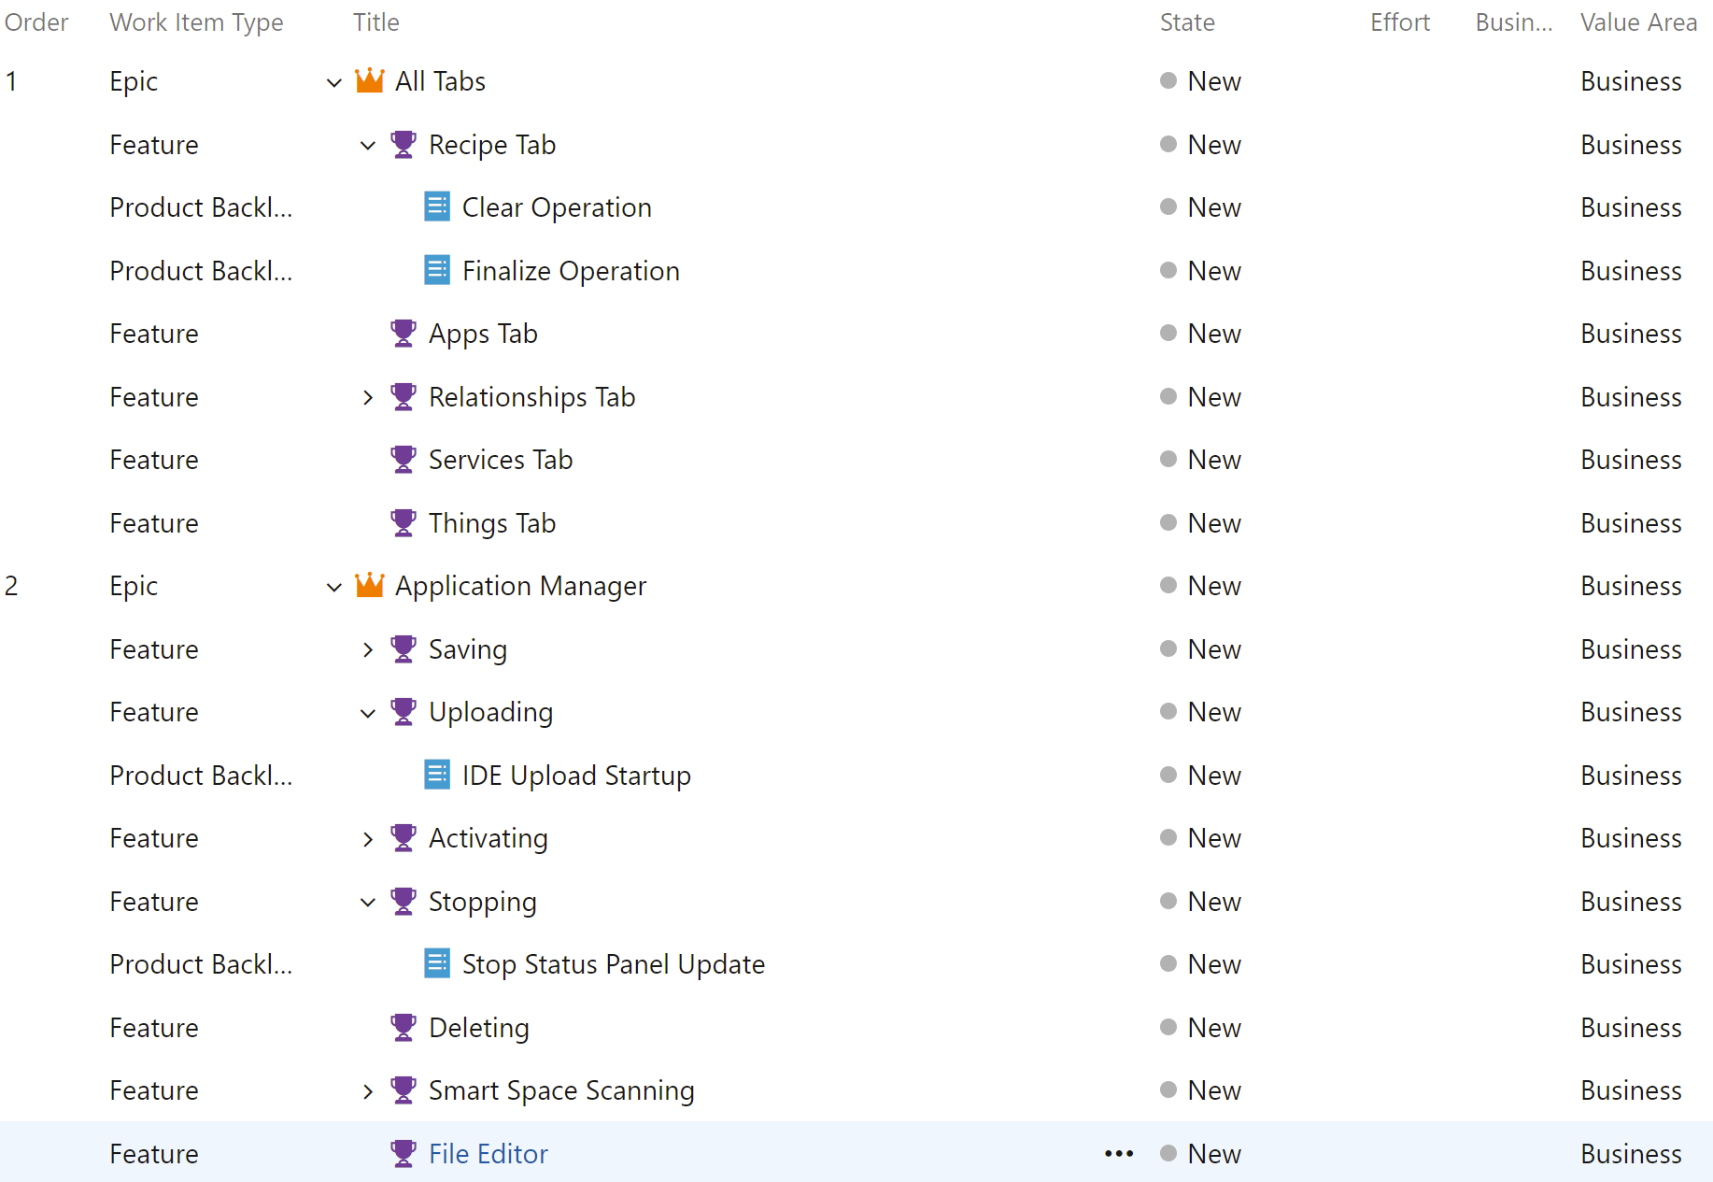
What Went Well
The planning stage was done weeks in advance, and a schedule for sprints and delegation of tasks was done early
Each member’s abilities were a key factor in determining the type of tasks given
Each feature and product backlog item was descriptive and thoroughly outlined the details of each task

Slide 6
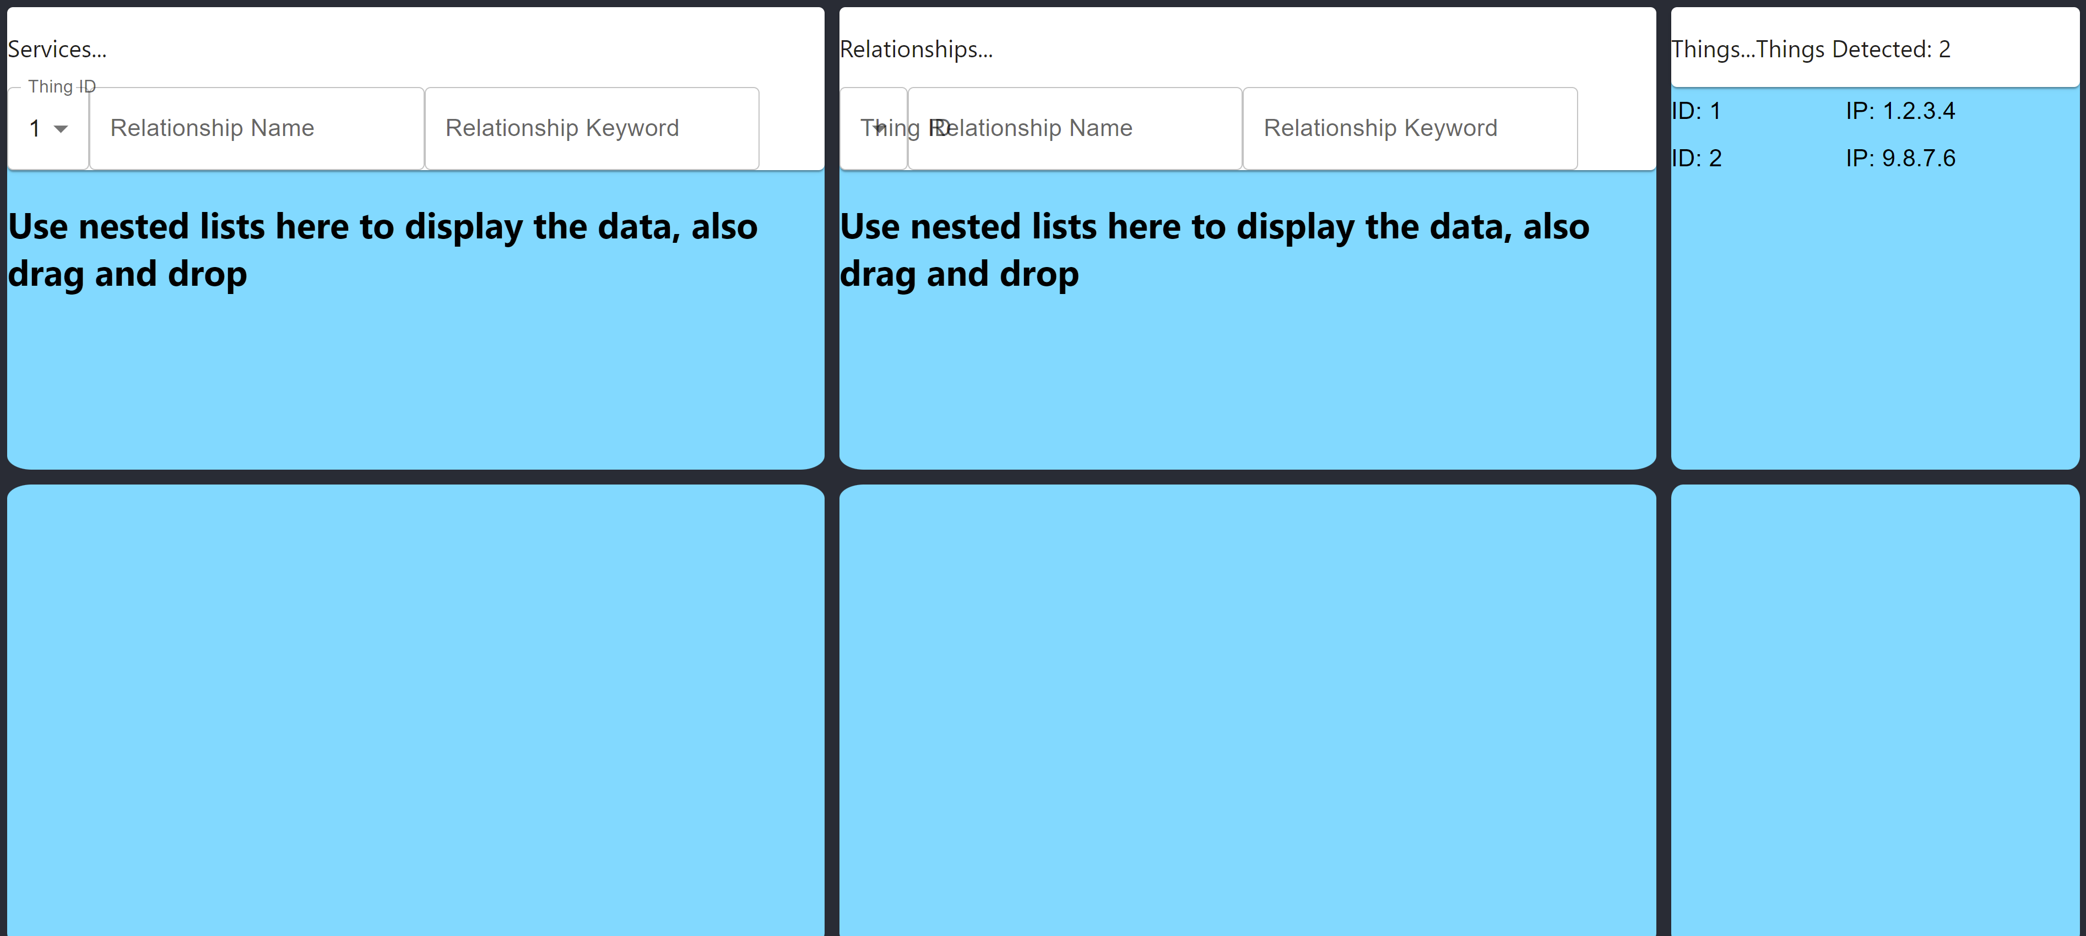
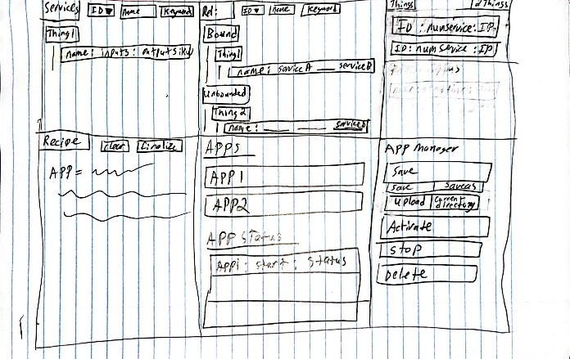
What Went Well
The front-end display was easy to implement thanks to planning in advance what the display should look like
Featured is an early sketch of the IDE and a prototype showing progress towards it

Slide 7
What Went Poorly
Scheduling conflicts meant that working on the VSS became difficult to accomplish. Whether due to jobs, classes, or other projects, rarely were we all available at the same time
Only one pi was fully set up with Atlas prior to beginning the project, so a lot of extra time was required in getting a secondary pi finalized and ready to communicate in the VSS.
Time management was the biggest issue that ultimately led to an incomplete application

Slide 8
Where to Improve
In terms of scheduling, figuring out at the very least one day or time slot for weekly meetings would have kept us on track to finish the project
Sticking to sprint goals would also prevent falling behind and rushing some aspects of the project

Slide 9
The End

