Slide 1
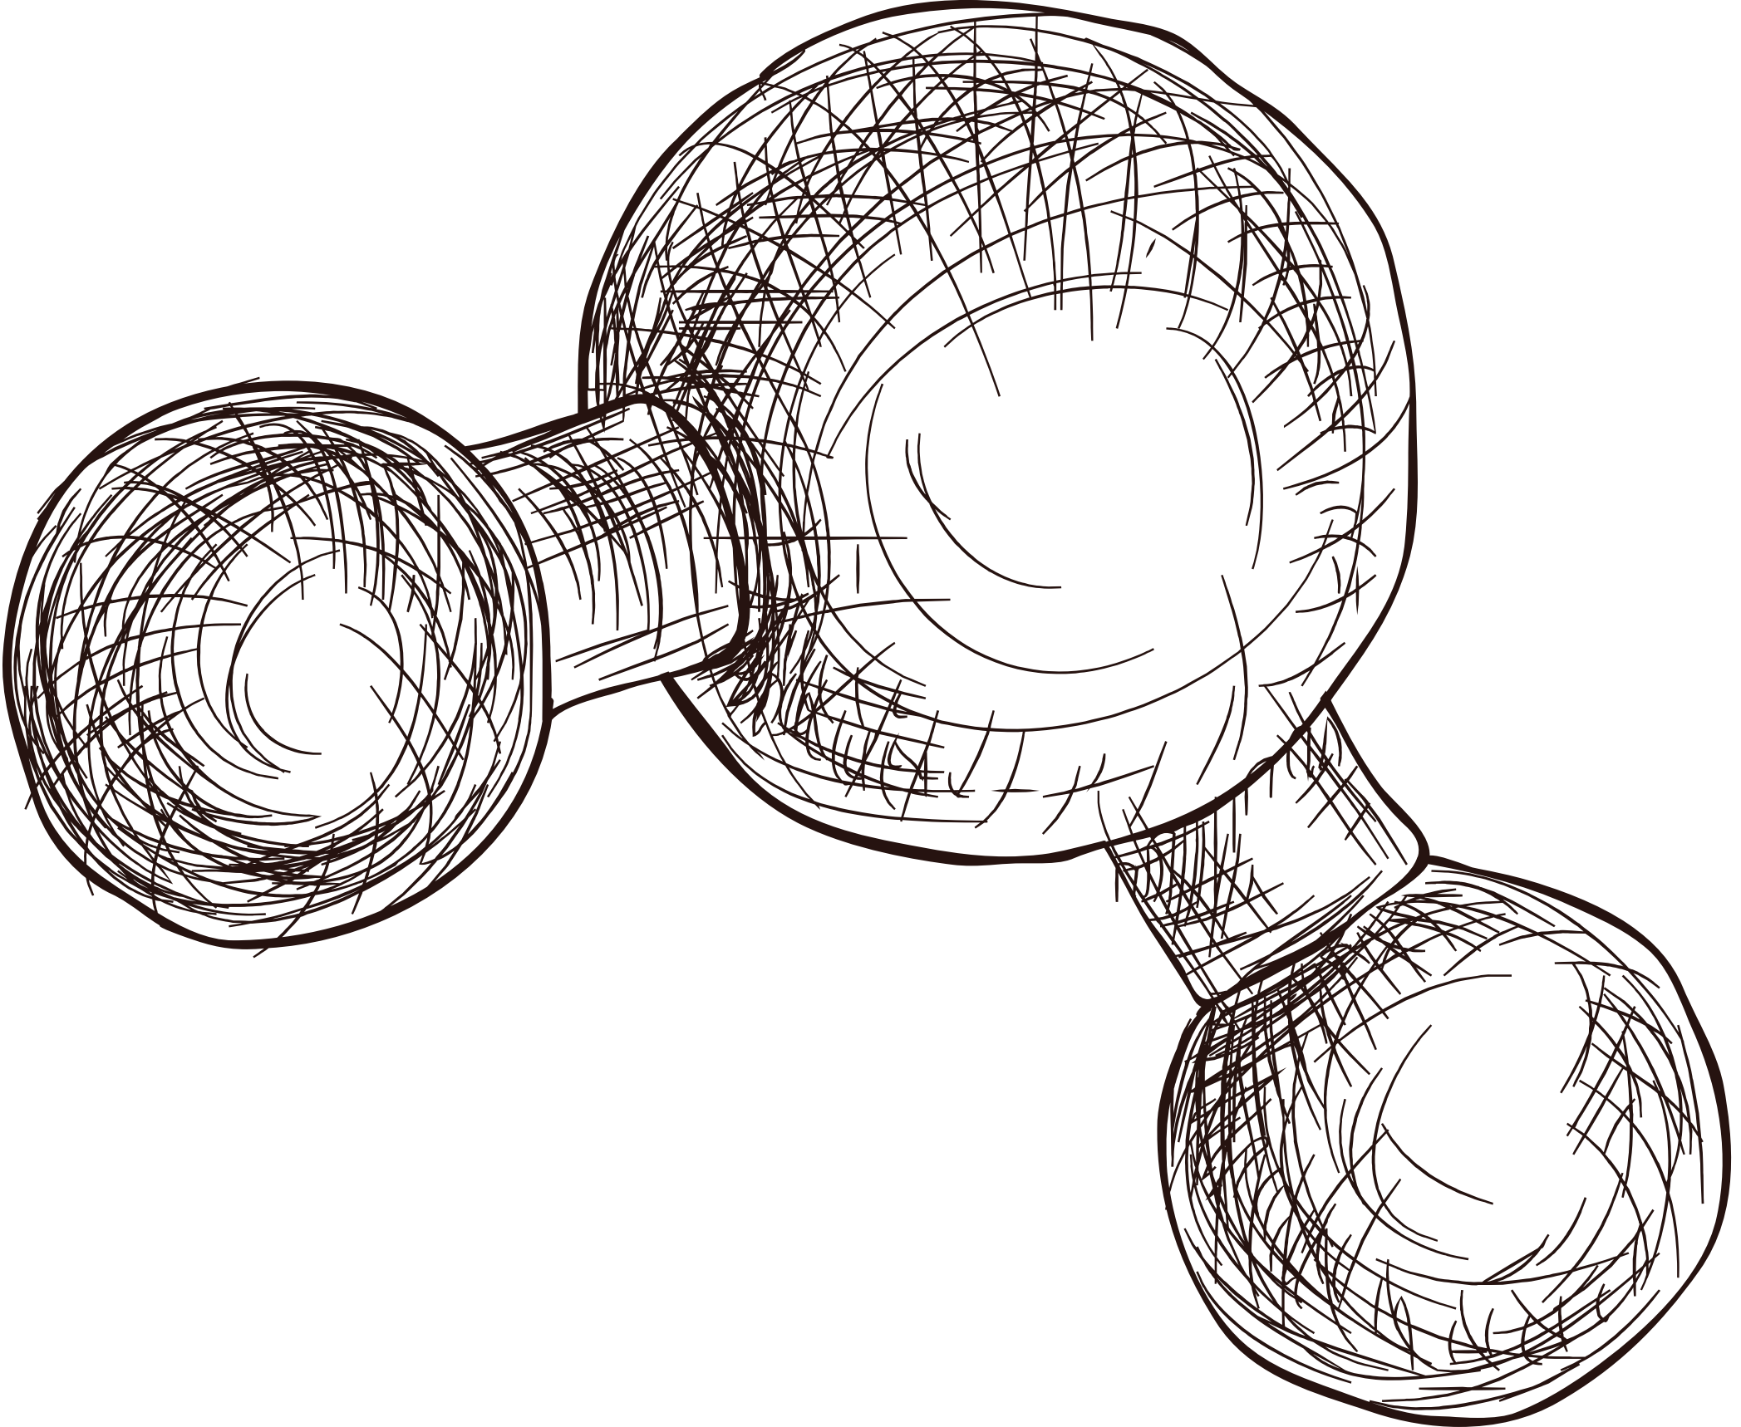


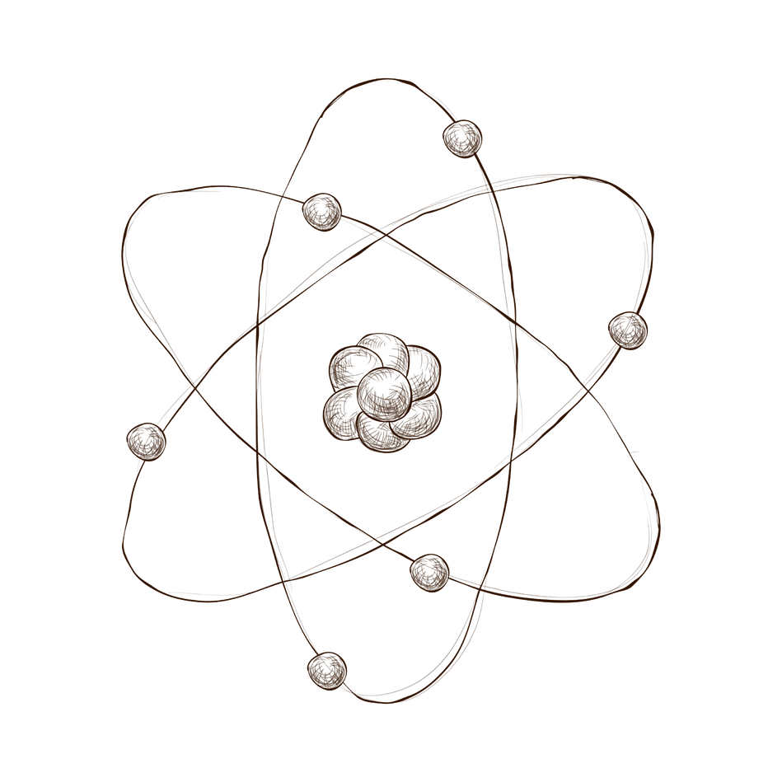

PQC:The future of
Quantum resistance cryptography
Quantum-Safe Hashing Algorithm
Presented by: Dana Abushawesh

Slide 2
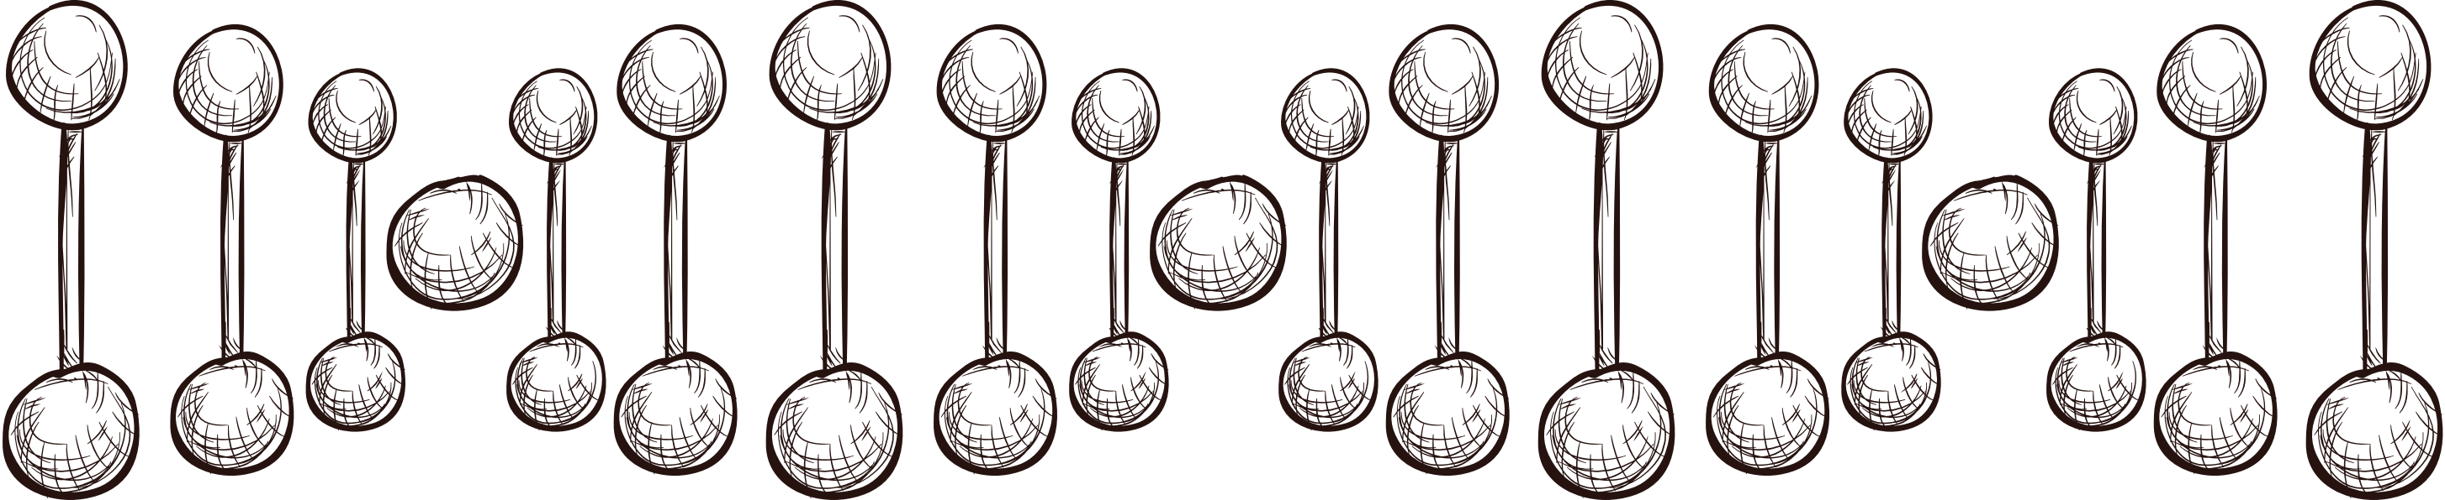
Project
Overview
This Project presents a post-quantum cryptographic hashing algorithm designed to resist quantum attacks, including Grover's algorithm. By utilizing two random oracles and Boltzmann's entropy to generate dynamic entropy, the algorithm produces a quantum-safe hash that is highly resistant to reversal or preimage attacks. Experimental results confirm its robustness, marking a significant advancement in post-quantum cryptography.

Slide 3
What is Quantum computer?
A quantum computer is a type of computer that uses the principles of quantum mechanics to process information. Unlike classical computers, which use bits (0 or 1) for computation, quantum computers use quantum bits, or qubits, which can exist in multiple states simultaneously (superposition) and be interconnected (entanglement). This allows quantum computers to perform certain types of calculations much faster than classical computers, making them powerful for tasks like cryptography, optimization, and simulating quantum systems.
4o

Slide 4

Post Quantum cryptography
Post-quantum cryptography refers to cryptographic methods designed to remain secure against the potential threats posed by quantum computers. Unlike traditional cryptographic algorithms that quantum computers could break (e.g., RSA and ECC), post-quantum algorithms are built to resist attacks from quantum algorithms like Shor's and Grover's, ensuring data security in a quantum computing era.
4o

Slide 5

The
research
01
Identified quantum computing threats to classical cryptography and the need for quantum-resistant hashing.
02
Developed a hashing algorithm with dynamic randomness using two random oracles and Boltzmann entropy, tested for quantum resistance through Grover’s simulation.

Slide 6
Project
Objectives
To design and develop a post-quantum cryptographic hashing algorithm that resists quantum-based attacks, particularly Grover's algorithm, by utilizing dynamic entropy generated through two random oracles and Boltzmann entropy. The objective is to ensure the algorithm’s quantum resistance by creating a robust, computationally infeasible hash function.
This will be validated through extensive testing, including Grover’s simulation, randomness tests, and performance evaluations across different scenarios. The project also aims to contribute to the field of post-quantum cryptography by proposing an innovative approach to enhance cryptographic security against future quantum threats.

Slide 7

Basics of Random Oracles
A random oracle is a model used in cryptography, where a function is considered to produce truly random outputs for every unique input. In this model, the oracle behaves like a "black box" that, for any input, returns a random value from a uniform distribution. This concept is used to simplify the analysis of cryptographic protocols and proofs.

Slide 8

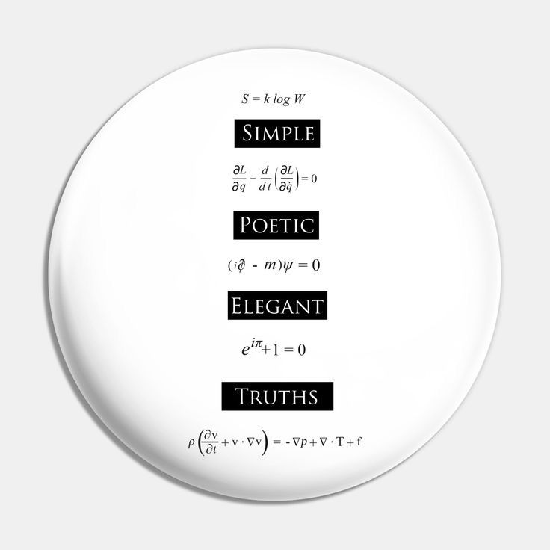
Boltzmann Entropy
In the disorder case of Boltzmann entropy, when two subsystems, each with the same number of energy quanta, are combined, the total number of possible configurations (microstates) increases. This leads to higher entropy, representing greater disorder. The energy quanta continue to move between the subsystems, allowing the system to explore more possible states, which maximizes entropy. Essentially, the system reaches maximum disorder when the energy is distributed in the most random way across both subsystems.

Slide 9
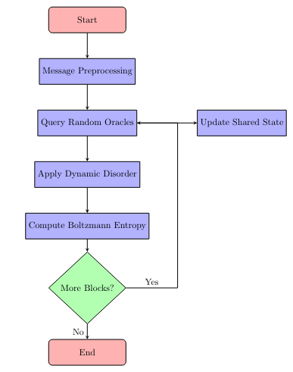
Methodology
01
Preprocessing: Input padding and division into blocks.
02
Random Oracles: Interaction and entropy generation.
03
Dynamic Microstates: Entropy evolution with Boltzmann formula.

Slide 10
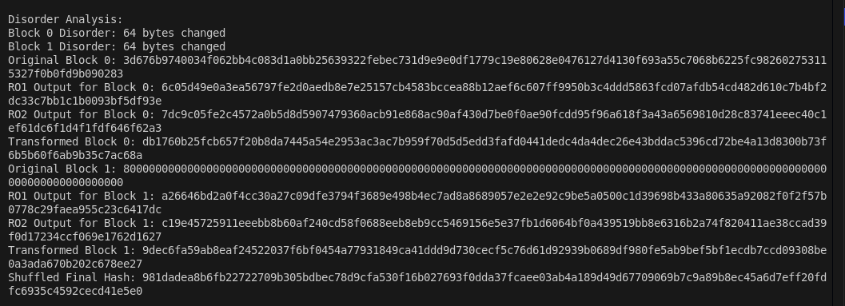
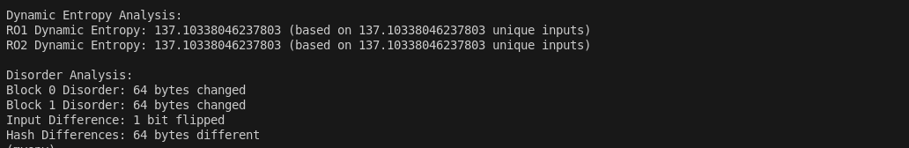

Slide 11
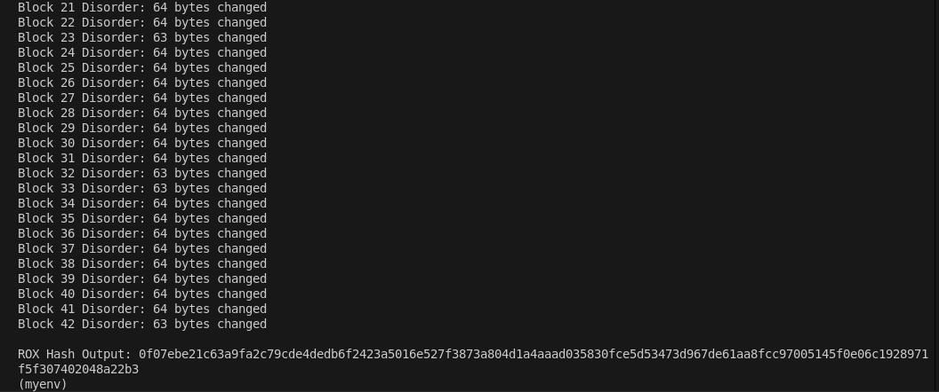
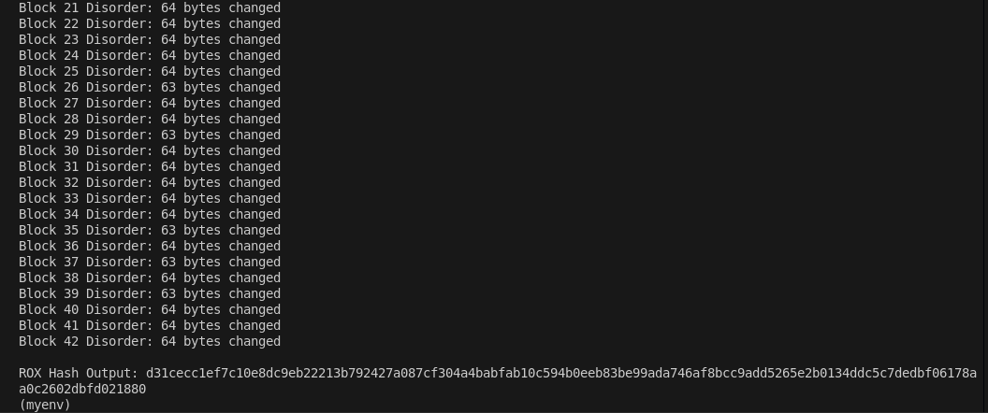

Slide 12

Experimental
Evolution
1
Grover's Algorithm Simulation: Testing quantum resilience.
Statistical Tests: Dieharder results proving randomness.
2

Slide 13
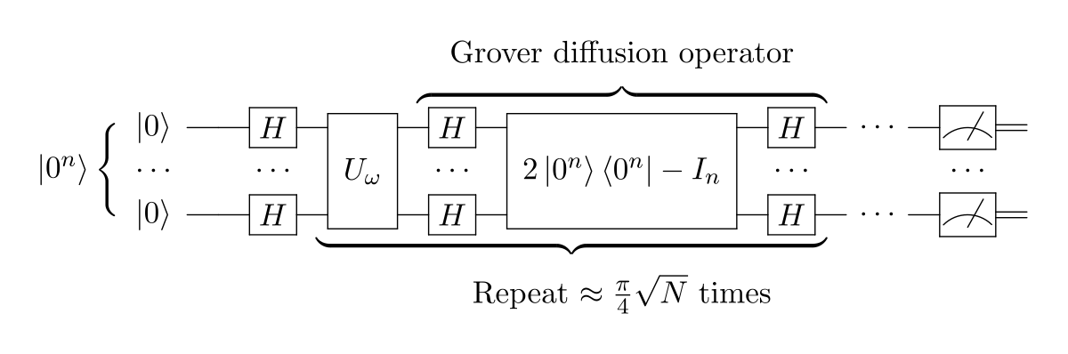
Grover’s Algorithm
Grover's algorithm is a quantum search algorithm that provides a quadratic speedup for searching an unsorted database or solving certain mathematical problems, such as finding the preimage of a hash function.
It searches for a specific item in an unsorted list of N items with a quantum advantage. Classical algorithms require O(N) queries, while Grover's algorithm requires only O(N).
This reduces the effective security of a hash function from 2^{n} to 2^{n/2}. For instance, a 256-bit hash function like SHA-256 would have an effective security of 128 bits against Grover's algorithm.

Slide 14
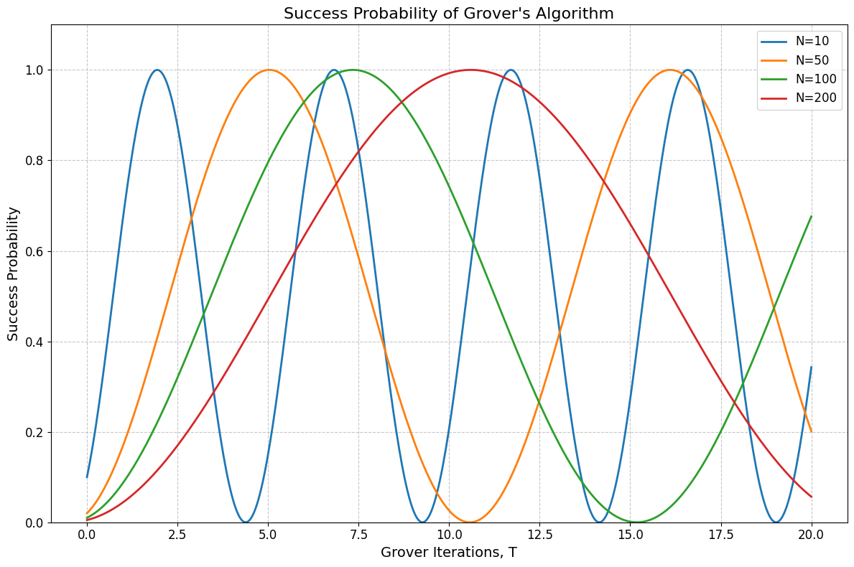
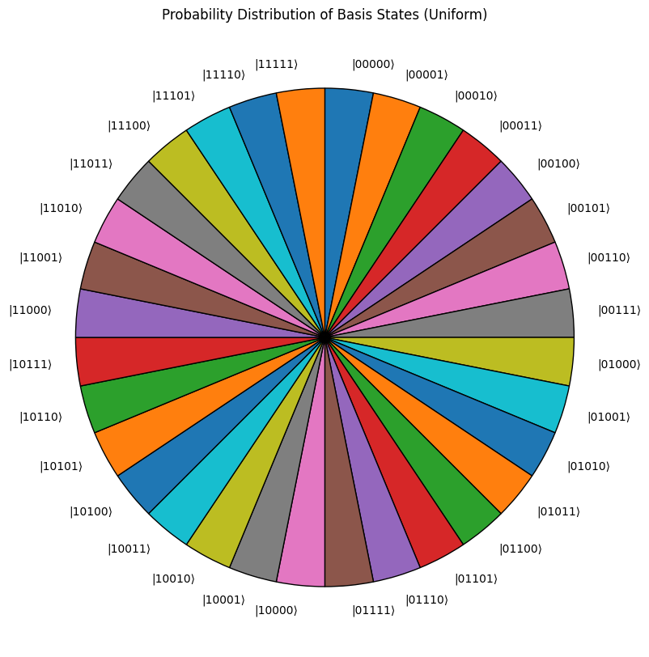
Grover’s Algorithm Iteration

Slide 15
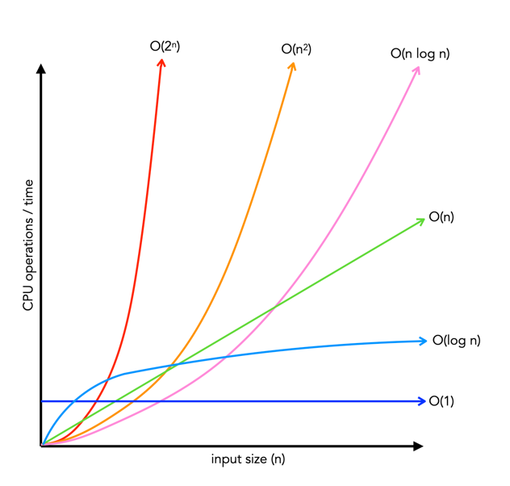
Grover’s Algorithm complexity
Grover’s algorithm demonstrates a quadratic speedup in searching N items, achieving a complexity of O(√N). For an n-bit hash output, N = 2^{n}, and Grover’s search requires O(2^{(n/2)}) iterations. In the Random Oracle Model (ROM), the non-deterministic outputs disrupt amplitude amplification, which is essential for Grover’s algorithm, making it less effective. As the entropy (S = kB ln(W + 1)) increases dynamically, the number of unique microstates (W) grows exponentially with input size. Consequently, the effective complexity of breaking the hash function H becomes O(2^{n}), equivalent to classical exhaustive search.
For a 512-bit hash, classical brute force requires 2⁵¹² operations, while Grover’s algorithm reduces it to 2²⁵⁶. However, this reduction is still impractical with current technology, as O(2²⁵⁶) remains exponentially large and not computationally trivial.

Slide 16



Statistical Test
The Statistical Test tests are essential for evaluating the randomness properties of the generated hash outputs, offering a comprehensive analysis of various aspects of randomness.
Random Collision Test
Bitstream Entropy Test
Evaluates randomness by analyzing collisions in randomly generated numbers, detecting patterns that could weaken cryptographic systems.
Examines randomness at the bit level in binary data, ensuring robustness and resistance to biases critical for secure hashing.
Permutation Randomness Test
Consecutive Value Pattern Test
Assesses randomness in permutations of 5 integers, ensuring small data blocks remain unpredictable to defend against pattern-based attacks.
Analyzes the randomness of consecutive similar values, identifying opportunities to minimize subtle patterns for stronger cryptographic security.

Slide 17
Analyzing the results
The p-values in the chart indicate that the sequences being tested are mostly behaving randomly, as most of the p-values are well above 0.05, suggesting no significant deviations from randomness.
The p-value of 0.94255763 indicates the sequence behaves as expected for randomness, passing the test.
A p-value of 0.89901513 shows the data is consistent with randomness, leading to a pass.
The p-value of 0.03296137 confirms that the sequence meets the expected entropy, passing the test.
A p-value of 0.01021506 suggests the data follows the expected pattern, resulting in a pass.

Slide 18

Future Work
Integrate the lattice concept into the algorithm to achieve full resistance against quantum attacks.
Enhance the random oracle by generating random values based on quantum mechanics, making it fully strong and secure.

Slide 19
Conclusions
01
02
03
The proposed quantum-safe hashing algorithm integrates Boltzmann entropy and random oracles, achieving a high level of security against quantum-based attacks.
By using random oracles and dynamic microstates, the algorithm introduces unpredictability, enhancing resistance to both classical and quantum adversaries.
Through rigorous analysis and mathematical proofs, the algorithm demonstrates robust resistance to quantum attacks, ensuring integrity in post-quantum cryptography.

Slide 20
Thank
you!
Do you have any questions?

