Slide 1
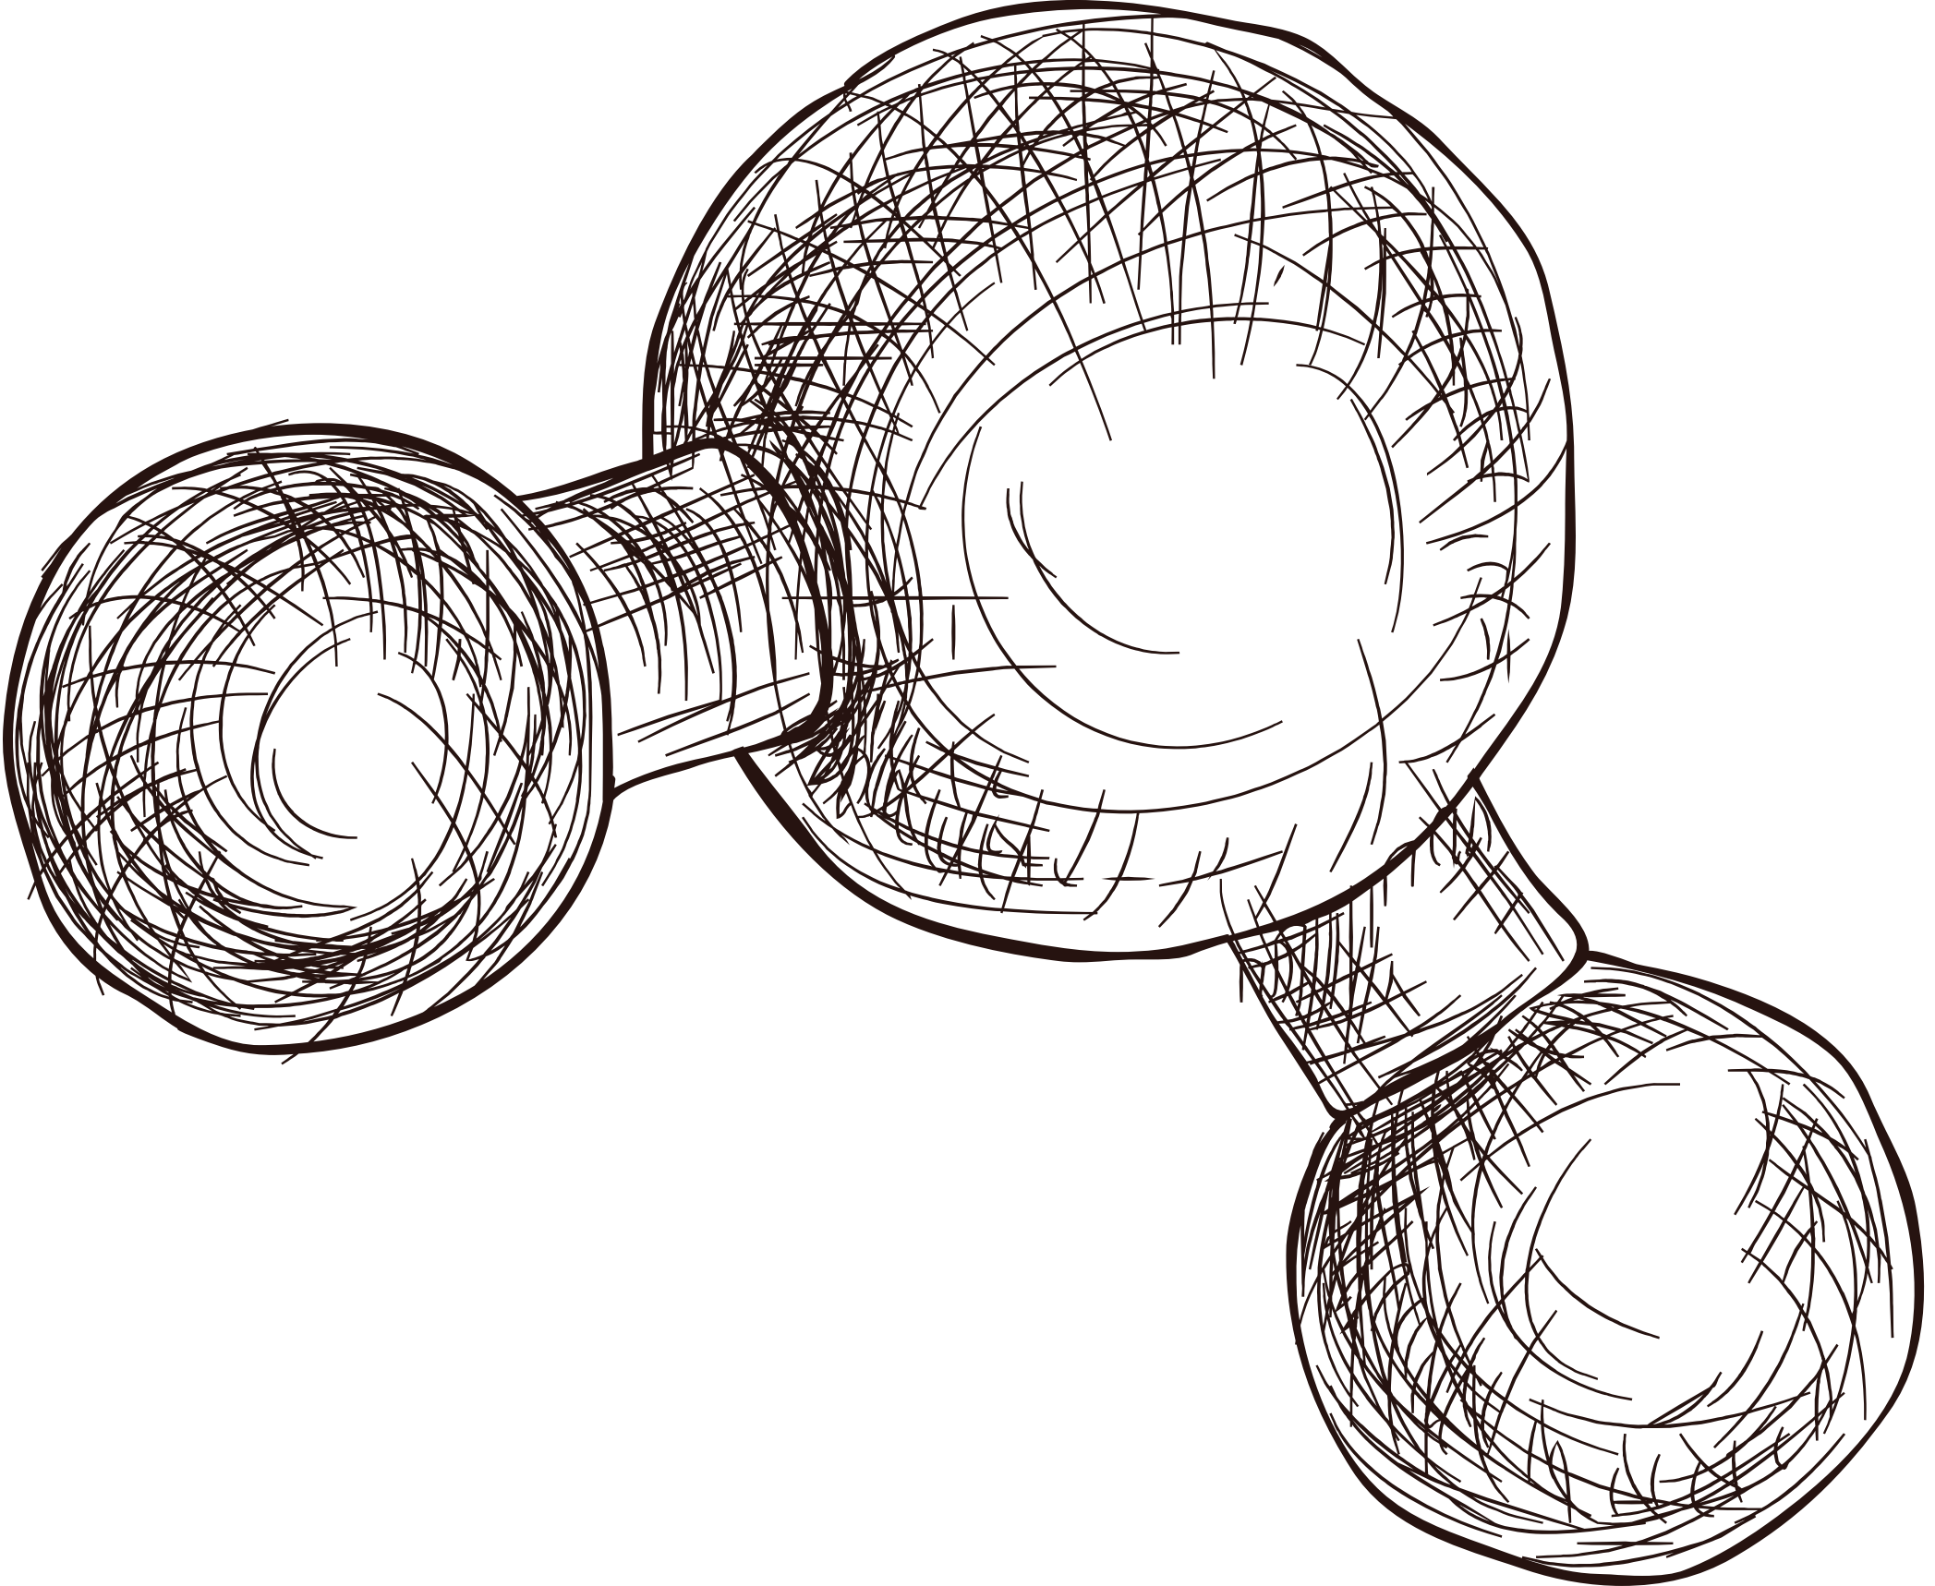


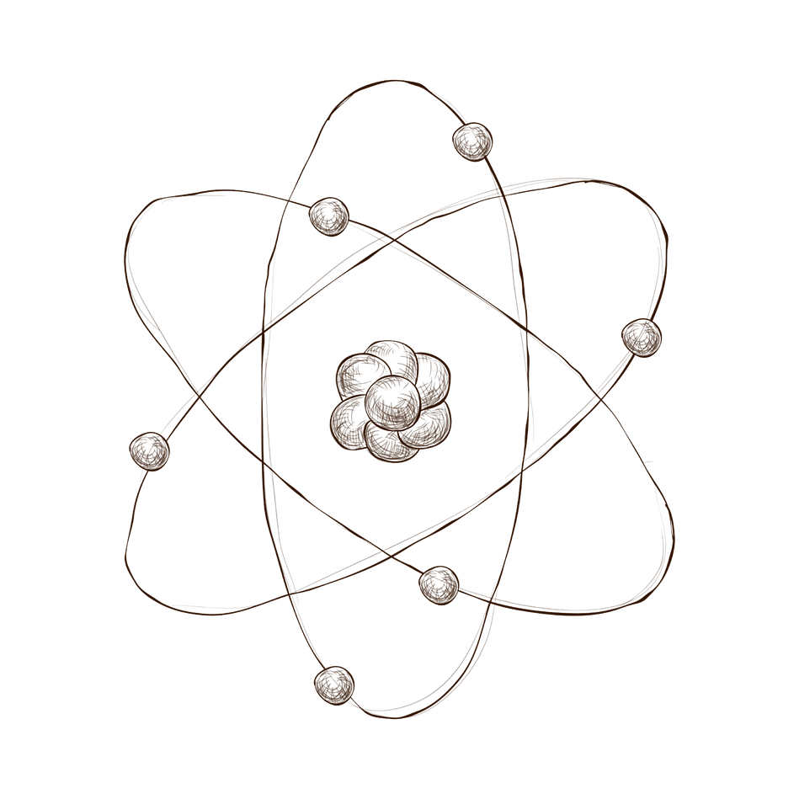

PQC:The future of
Quantum resistance cryptography
Quantum-Safe Hashing Algorithm
Presented by: Dana Abushawesh

Slide 2
Index
Introduction
Project Overview
Methodology
Evaluation
Future Work
Conclusion

Slide 3
Index
Introduction
Project Overview
Methodology
Evaluation
Future Work
Conclusion

Slide 4
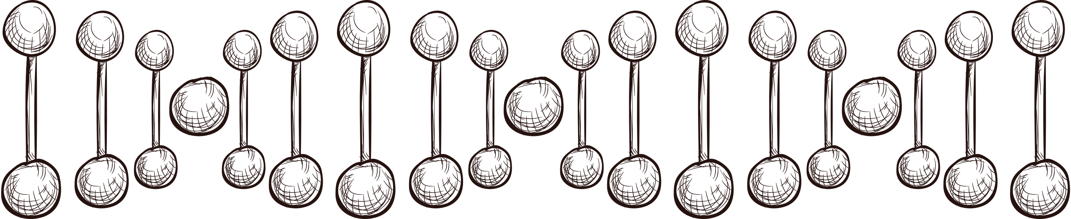
1-Introduction:
What is Quantum Computer?
Quantum computers: quantum mechanics to process data.
Utilize qubits in superposition states.
Superposition: qubits to represent multiple values simultaneously.
Entanglement: multiple qubits to operate in correlated states.
Quantum computing excels in solving complex computational challenges.
Key applications:
cryptography, optimization, and quantum simulations, etc.…

Slide 5

1-Introduction:
Post Quantum cryptography
Post-quantum cryptography: secures data against quantum threats.
protect against vulnerabilities in traditional cryptography.
Ensure robust security in quantum contexts.
Prepares for future computational advances.
Quantum computers can break RSA and ECC algorithms.
Post-quantum methods: resist Shor’s and Grover’s algorithms.
Ensures data protection in quantum eras.

Slide 6

1-Introduction:
Basics of Random Oracles
A random oracle: models functions with random outputs.
Acts as a theoretical black box.
Each unique input produces a truly random result.
Outputs are sampled from a uniform probability distribution.
Random oracle: simplifies analyzing cryptographic protocols and algorithms.
foundational in cryptographic research frameworks.
aids in proving protocol security properties.

Slide 7
Index
Introduction
Project Overview
Methodology
Evaluation
Future Work
Conclusion

Slide 8
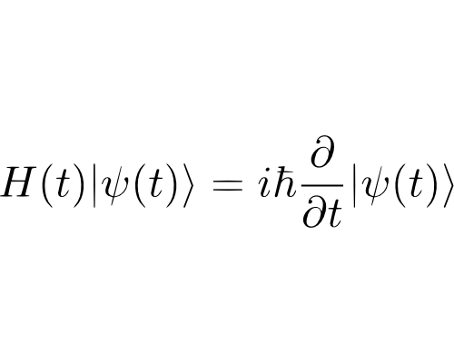
2-Project
Overview
The project introduces a quantum-resistant hashing algorithm.
This work advances the field of post-quantum cryptography.
withstands quantum attacks, including Grover’s algorithm.
Two random oracles enhance security with dynamic entropy.
Boltzmann entropy generates robust, quantum-safe hash functions.
The algorithm resists reversal and preimage attack techniques.
Experimental validation confirms its cryptographic robustness.

Slide 9
Index
Introduction
Project Overview
Methodology
Evaluation
Future Work
Conclusion

Slide 10


3- Methodology
Boltzmann Entropy
Boltzmann entropy
measures disorder in physical systems.
Combines:
entropy
and probability concepts.
Combining two subsystems: increases the total configurations.
higher entropy and greater disorder.
Energy quanta move: enabling exploration of more states.
Maximum entropy with random energy distribution.
The system reaches peak disorder through energy transfer.

Slide 11
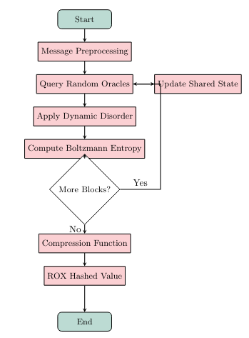
3- Methodology
01
Preprocessing: Input padding and division into blocks.
02
Random Oracles: Interaction and entropy generation.
03
Dynamic Microstates: Entropy evolution with Boltzmann formula.

Slide 12
Index
Introduction
Project Overview
Methodology
Evaluation
Future Work
Conclusion

Slide 13

4- Evaluation
Disorder Analysis
Same Input , Twice = different ROX hash outputs.
How much bytes are changed in each Unique input.

Slide 14

4- Evaluation
Disorder Analysis
Equal number of quanta in each oracle , dynamic entropy for each input.
Flip One bit from the input = check file integrity.

Slide 15

4- Evaluation
Experimental Tests
1
Grover's Algorithm Simulation: Testing quantum resilience.
Statistical Tests: Dieharder results proving randomness.
2

Slide 16
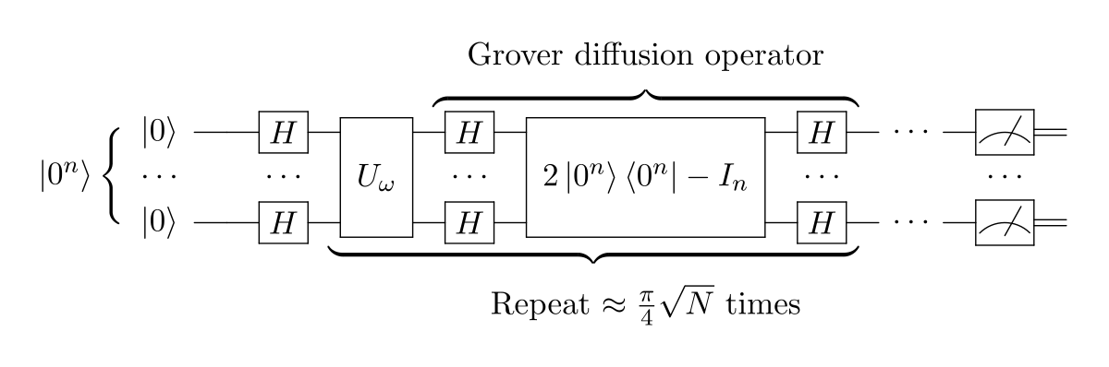
Grover’s Algorithm
Grover's algorithm: quantum search method.
quadratic speedup for unsorted searches.
Classical algorithms require O(N) queries; Grover’s only O(√N).
It reduces hash function security from 2n to 2n/2.
For example, SHA-256 has 128-bit security against Grover’s.

Slide 17
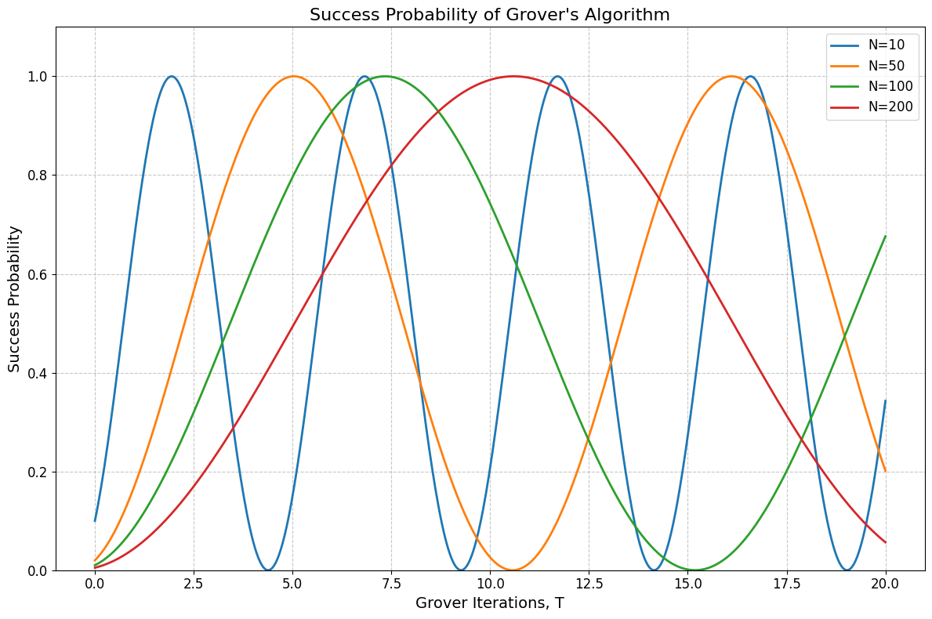
Grover’s Algorithm Iteration
ROM algorithm

Slide 18
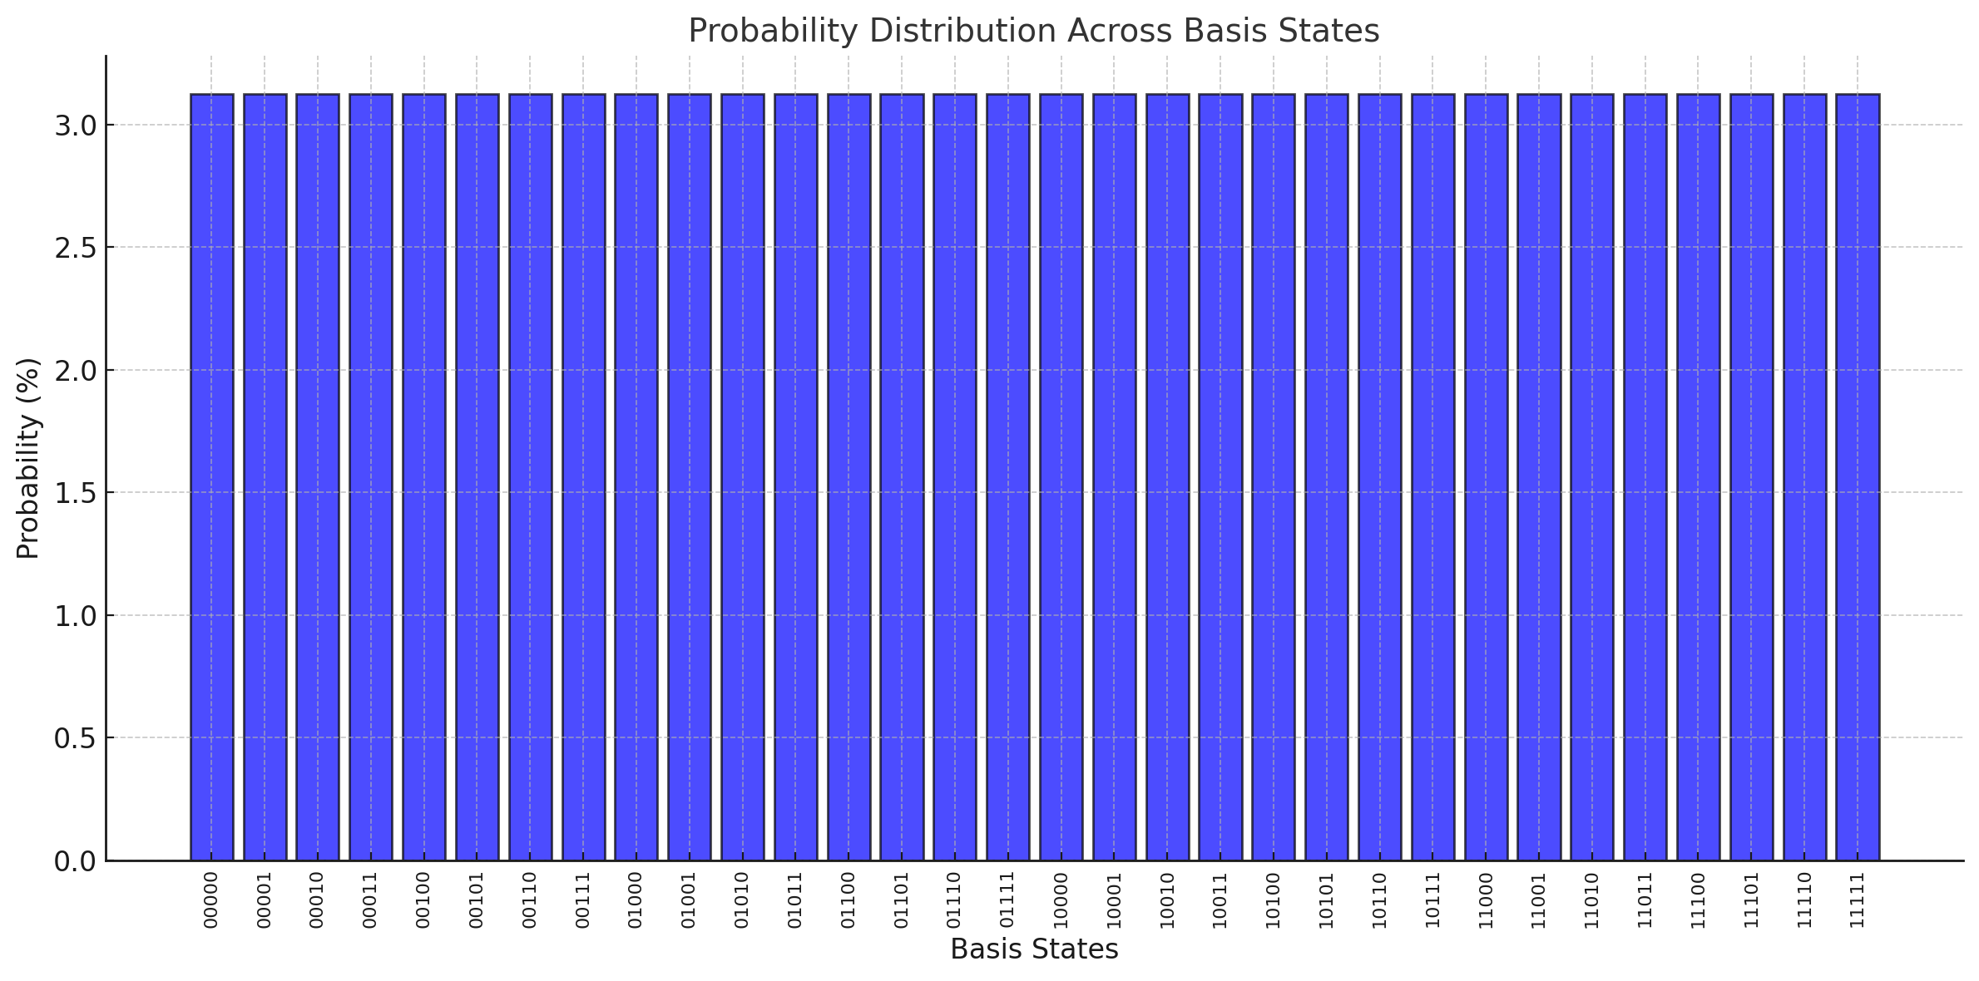
Grover’s Algorithm Marked State
ROM algorithm

Slide 19
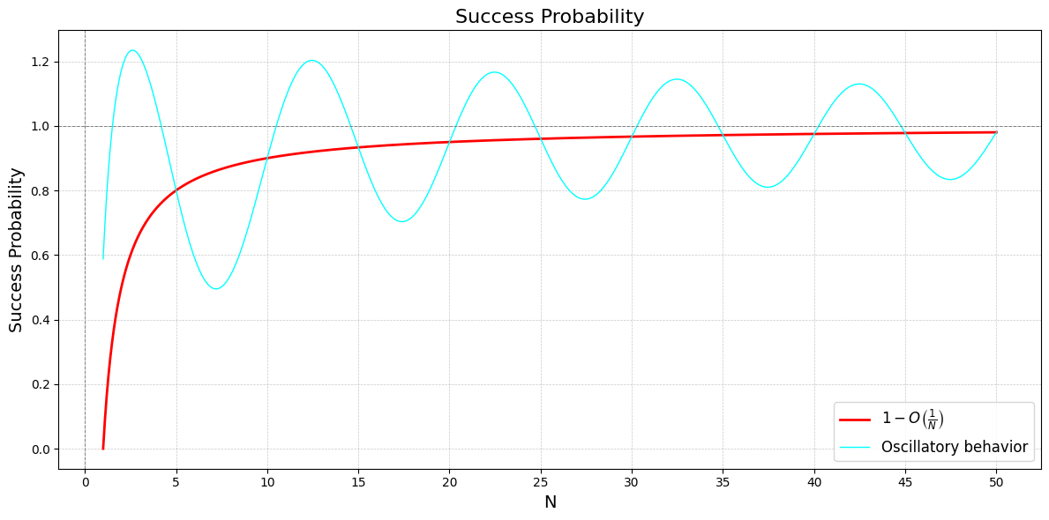
Grover’s Algorithm Iteration
SHA-1

Slide 20
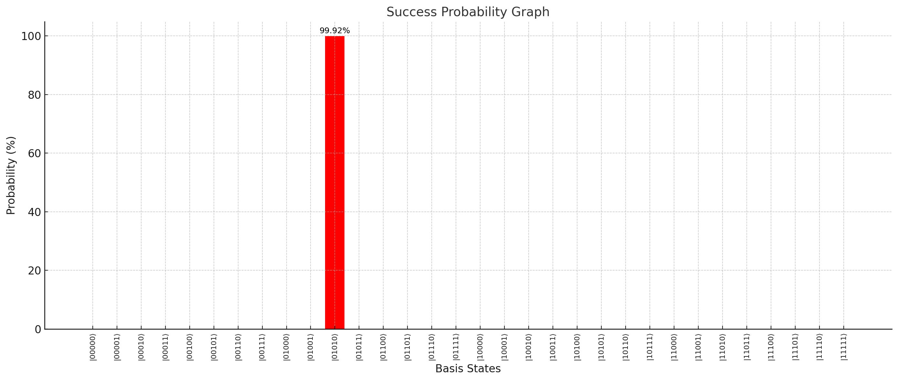
Grover’s Algorithm Marked State
SHA-1

Slide 21
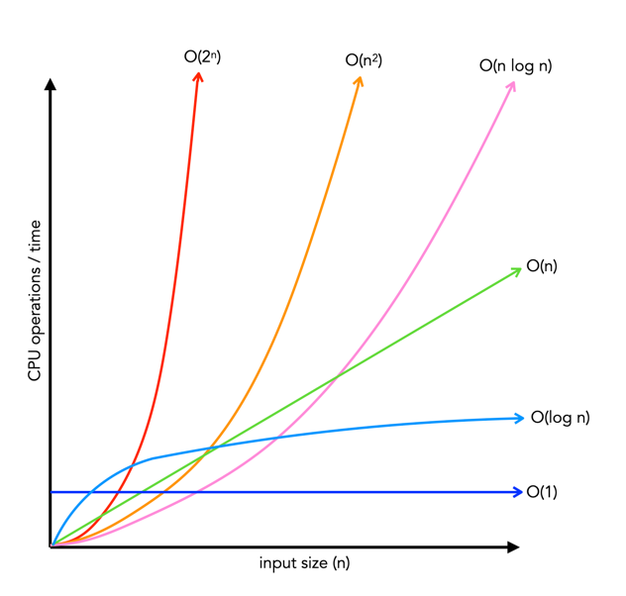
Grover’s Algorithm complexity
Grover’s algorithm quadratic speedup with O(√N).
For an n-bit hash, N = 2^{n}, requiring O(2^{(n/2)}) iterations.
The Random Oracle Model: disrupts amplitude amplification in Grover’s.
Increasing entropy (S = kB ln(W + 1)) grows microstates exponentially.
This leads to O(2^{n}) complexity, equivalent to brute force.
For a 512-bit hash, Grover’s reduces operations to 2²⁵⁶.
However, O(2²⁵⁶) remains computationally impractical with current tech.
The ROX algorithm have O(n) complexity.

Slide 22



4- Evaluation
Statistical Test
Statistical Test tests: essential for evaluating the randomness properties of the generated hash,
comprehensive analysis of various aspects of randomness.
Recommended by NIST for cryptographic security. ( NIST SP 800-22)
Random Collision Test
Bitstream Entropy Test
Evaluates randomness by analyzing collisions in numbers.
Examines bit-level randomness for robust data security.
Permutation Randomness Test
Consecutive Value Pattern Test
Assesses randomness in permutations of five integers.
Analyzes consecutive similar values for pattern minimization.

Slide 23
Analyzing the results
The p-values in chart indicate —> sequences tested, mostly behaving randomly.
Most p-values above 0.05 —> suggesting no significant deviations from randomness.
p-value of 0.94255763 —> sequence behaves as expected for randomness, passing the test.
p-value of 0.89901513 —>the data is consistent with randomness, leading to a pass.
p-value of 0.03296137 —> confirms the sequence meets the expected entropy, passing the test.
p-value of 0.01021506 suggests —> data follows the expected pattern, resulting in a pass.

Slide 24
Index
Introduction
Project Overview
Methodology
Evaluation
Future Work
Conclusion

Slide 25

5-Future Work
Integrate the lattice concept into the algorithm to achieve full resistance against quantum attacks.
Enhance the random oracle by generating random values based on quantum mechanics, making it fully strong and secure.

Slide 26
Index
Introduction
Project Overview
Methodology
Evaluation
Future Work
Conclusion

Slide 27
6-Conclusions
01
02
03
The algorithm combines Boltzmann entropy with random oracles for quantum resilience.
Dynamic microstates and inherent unpredictability strengthen defenses against quantum and classical threats.
Experimental tests confirm its robustness in post-quantum cryptographic applications

Slide 28
Index
Introduction
Project Overview
Methodology
Evaluation
Future Work
Conclusion

Slide 29
Thank
you!
Do you have any questions?

