Slide 1

Project Hecate
HACKATHON

Slide 2

-Hi Cortana!
I am ready for my data now.

Slide 3
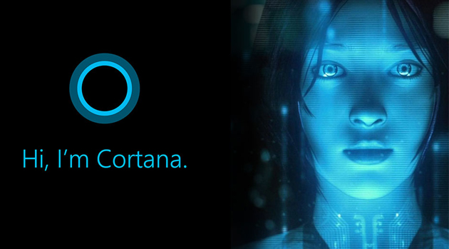

Hi!
One moment while I check your authentication.
checking systems…
checking app authentication…
checking products and services….

Slide 4

Setup is complete

Slide 5
Work
Dream
Finances
Learn
Play
Family

Slide 6






Bot Services: (Blockchain/DMS) Transactions Security Services Network
Entities
Workload Data Workers - ML/SQL Aggregations Blockchain
Security
Person Private Cloud
Health
Services
Security Blockchain/DMS Intelligence/ML Personal assistant
Products
Bot Workers - ML/SQL Aggregations Blockchain
Security
Bot Workload Workers - ML/SQL Aggregations Blockchain
Security
Workload Data Workers - ML/SQL Aggregations Blockchain
Security
TIME

Slide 7
UPDATES, February 2022

Slide 8




AUTONOMOUS HUMAN ORACLE
SECURITY
Person Private Cloud
EDUCATION
HUMAN RIGHTS
HEALTH
CIVIL RIGHTS
HOME
SOCIAL
CAREER
JUSTICE

Slide 9
METAVERSE DEFINED
Metaverse
Standards / Governance
Tech Laws & Rights of an Autonomous Person
THE POWER IS IN THE #InfinityStone
All of which are American Dreams
Corp/Gov Laws
WEB 3

Slide 10
Project Hecate
The Sky is Just the Beginning!
***Please see the vision statement and team site for more info**

