Slide 1
Module 6: Database Management and Archiving
This module examines some of the system administrative tasks that you may encounter in the Greenplum environment.
Upon completion of this module, you should be able to:
  Perform system administrative tasks, including managing and checking the state of the Greenplum Database and its data as well as checking the distribution of data
  Perform backup and restoration of Greenplum data from and into the Greenplum Database respectively
Notes:
System maintenance is one of the key services that administrators provide for the environment they support. You may be required to make changes to parameters that require restarting the Greenplum environment. Monitoring the system requires knowing not only its current state, but also the state of any applications it supports. Data backup and restoration services are key to reducing the chances of data loss.
In this module, you will:
Perform system administrative tasks for the Greenplum environment which includes managing and checking the state of the Greenplum Database as well as the state and distribution of data.
Perform backup and restoration of Greenplum data from the Greenplum Database and back into the Greenplum Database.

Slide 2
Module 6: Database Management and Archiving
Lesson 1: Managing the Greenplum Database
In this lesson, you examine the administrative tasks that should be performed to maintain an optimal environment.
Upon completion of this lesson, you should be able to:
Start and stop the Greenplum Database
Verify the state of the Greenplum Database
Use the Greenplum administrative schema to view which tables are exhibiting data skew
Access log files and logging parameters
Maintain the system catalog and reclaim physical disk space
Gather data for troubleshooting issues
Notes:
As an administrator, you will encounter times where you must perform specific administrative tasks to keep the Greenplum Database environment running smoothly. You should be aware of how to start, stop, and restart the Greenplum Database and to keep track of the current state of the database. You may also be required to monitor the state of data and log files to maintain an optimal environment.
Upon completion of this lesson, you should be able to:
Start and stop the Greenplum Database.
Verify the state of the Greenplum Database using Greenplum commands.
Use the Greenplum administrative schema to view which tables are exhibiting data skew.
Access log files and logging parameters.
Maintain the system catalog and reclaim physical disk space.
Gather data that can be used for troubleshooting the environment should an issue arise.

Slide 3





System Administration Tasks – Overview
The following are routine administrative tasks:
Starting and stopping Greenplum
Obtaining the state of Greenplum
Checking for data skew
Accessing log files and parameters
Maintaining the system catalog and reclaiming disk space
Recover Down Segments
Notes:
There are several routine tasks that you will perform while maintaining the Greenplum Database. These include:
Starting and stopping the Greenplum Database – Changing a global parameter may necessitate a restart of the Greenplum Database. Because the Greenplum Database is distributed across segments and the master server, it is necessary to understand the shutdown and startup procedures before undertaking this task.
Obtaining the state of Greenplum – A segment failure may go undetected if you do not have notifications configured and mirrors are enabled. Checking the state of the Greenplum environment lets you to verify the state of components and processes.
Checking for data skew – Data skew can impact the performance of queries submitted to the Greenplum Database. Using the Greenplum administrative schema, gp_toolkit, you can verify how data is distributed across the segments. There are other commands that allow you to achieve that same goal.
Accessing log files and parameters – Log files act as your audit trail for how components within the Greenplum Database are behaving. You must be aware of how to access these log files as part of your monitoring tasks as well as how to rotate them, if necessary.

Slide 4
Notes:
System Administration Tasks – Overview
Maintaining the system catalog and reclaiming disk space – Numerous database drops and create can cause growth in the size of the system catalog that could affect performance. Regular maintenance helps optimize system performance. If data is constantly changing, vacuuming tables should be on the list of tasks that you regularly perform.
Recover Down Segments– In a system with mirrors enabled, the gprecoverseg utility reactivates a failed segment instance and identifies the changed database files that require resynchronization. Once gprecoverseg completes this process, the system goes into resynchronizing mode until the recovered segment is brought up to date. The system is online and fully operational during resynchronization.

Slide 5
Starting and Stopping Greenplum
The following commands start and stop Greenplum:
Action | Greenplum Application
Start the Greenplum Database | gpstart
Stop the Greenplum Database | gpstop
Restart the Greenplum Database | gpstop –r
Start the Greenplum Database in restricted mode | gpstart -R
Reload master postgresql.conf and pg_hba.conf | gpstop –u
Start the master in utility mode | gpstart -m
Stop the master that was started in utility mode | gpstop –m
Notes:
In a Greenplum DBMS, each database server instance must be started or stopped across all of the hosts in the system in such a way that they can all work together as a unified DBMS. This is because the Greenplum Database system is distributed across many machines and database instances.
Greenplum provides the following commands to change the state of the database:
gpstart – This command starts all instances in the array in the correct order.
gpstop – This command stops all instances in the array in the correct ordering.
These scripts call the postmaster process on each segment instance with the correct flags. The master instance is always started last and is shut down first.
There may be cases where you want to start or stop only the master. This is called utility mode. In utility mode, you can:
Connect to a database on the master instance only.
Edit system settings in the system catalog, without affecting user data on the segment instances.
This is a very rare occurrence, but may be necessary in some situations, such as when reconfiguring the array to use different hosts.

Slide 6




Segment Failures on Startup
Master instance
Standby master instance
Segment instances (started in parallel)
Successful startup of Greenplum instances
Segment failure – segment
is marked as invalid
Startup will attempt to connect
to invalid segment
Notes:
If at startup a segment instance is not reachable:
The system will mark it as invalid, meaning that the segment instance is offline and is not operational.
The startup process skips segments marked as invalid and does try to start the server process, postmaster, on invalid segments.
This is a protective measure in case the segment instance needs some administrative action before it can safely be made operational again. When troubleshooting failed segment instances, you may at times need to force a startup of segment instances marked as invalid. For example, if a simple error, such as incorrect file permissions or an offline host, prevents startup of a segment instance, you will want to fix the problem that caused the error in the first place, and then retry the startup. Once the segment instance is up and running then it will be marked valid again next time the master tries to connect to it.

Slide 7
Checking System State
The following commands are used to check the Greenplum state:
Action | Greenplum Application
Check system status | gpstate
Show complete system configuration and status | gpstate –s
Ports used by the system | gpstate –p
Segment mirror configuration | gpstate –m
Primary to mirror mapping | gpstate –c
Show details on primary/mirror segment pairs that have potential issues | gpstate –e
Obtain Greenplum Database version information | gpstate -i
Notes:
The gpstate command displays status information about the Greenplum Database system, including:
Current system configuration consisting of the number of configured segments, segment ports, hosts, data directories, primary/mirror status, mapping of the primary segment to its respective mirror segment.
Segments that are marked as invalid.
Mirror segment status.

Slide 8
Recovering Down Segments
Recover Greenplum Database primary and mirror segments with the following:
Action | Greenplum Application
Recovers a primary or mirror segment instance that has been marked as down. | gprecoverseg
Rebalances primary and mirror segments by returning them to their preferred roles. | gprecoverseg -r
Performs a full copy of the active segment instance in order to recover the failed segment. The default is to only copy over the incremental changes that occurred while the segment was down. | gprecoverseg –F
Notes:
In a system with mirrors enabled, the gprecoverseg utility reactivates a failed segment instance and identifies the changed database files that require resynchronization. Once gprecoverseg completes this process, the system goes into resynchronizing mode until the recovered segment is brought up to date. The system is online and fully operational during resynchronization.
A segment instance can fail for several reasons, such as a host failure, network failure, or disk failure. When a segment instance fails (primary or mirror), its status is marked as down in the Greenplum Database system catalog. In the case of a primary segment failure, its mirror is activated as the primary in change tracking mode. In order to bring the failed segment instance back into operation again, you must first correct the problem that made it fail in the first place, and then recover the segment instance in Greenplum Database using gprecoverseg.

Slide 9
Checking for Data Distribution Skew
Check for data skew with the following:
gp_toolkit administrative schema offers two views:
  gp_toolkit.gp_skew_coefficients
  gp_toolkit.gp_skew_idle_fractions
To view the number of rows on each segment, run the following query:
Check for processing skew with the following query:
SELECT gp_segment_id, count(*)
FROM table_name GROUP BY gp_segment_id;
SELECT gp_segment_id, count(*) FROM table_name
WHERE column='value' GROUP BY gp_segment_id;
Notes:
Performance can be inhibited if data is not equally distributed across all active segments. You can use any or a combination of the following to check for data skew:
The gp_toolkit schema provides two views that can be used to identify data skew.
The skccoef column of the gp_skew_coefficients view is calculated as the standard deviation divided by the average. A higher value indicates greater data skew. The view also provides the table’s name and namespace.
The siffraction column of the gp_skew_idle_fractions view gives a percentage of the system that is idle during a table scan. This is an indicator of uneven data distribution or query processing skew. A value of .1 indicates a 10% skew. Tables with more than a 10% skew should be reevaluated.
Data distribution can be viewed with the following SQL command:
SELECT gp_segment_id, count(*) FROM table_name GROUP BY gp_segment_id;
This lists the number of rows on each segment. If all of the segments have roughly the same number of rows, the table is considered to be balanced.
Processing skew, or the amount of time one query spends on acquiring data over another, can be determined with the following command:
SELECT gp_segment_id, count(*) FROM table_name WHERE column='value' GROUP BY gp_segment_id;
This returns the number of rows returned by segment for the given WHERE clause.

Slide 10
Log Files
Greenplum Database server log files:
Are located in the data directory
Are stored daily as CSV files
Are stored on the master in $MASTER_DATA_DIRECTORY/pg_log
Are stored on each segment in /segment_datadir/gpseg#/pg_log
For management scripts, log files are located in /superuser_home/gpAdminLogs
Can be searched and filtered with the gplogfilter command
Notes:
The log files for each Greenplum database server instance can be found in the data directory of that instance. If you are not sure of the location of the data directories, you can use gpstate -s to determine the location of the log files.
Log files for the Greenplum management scripts are written to the gpAdminLogs directory in the home directory of the superuser by default. These logs are on the master only. The log file for a particular script execution is appended to its daily log file each time that script is run.
Greenplum Database uses Postgres write ahead logging (WAL) for transaction logging on the master and each segment instance. WAL is on automatically. Refer to PostgreSQL documentation has more information about WAL.

Slide 11
Logging Configuration Parameters
The following are commonly used for log configuration:
Log Parameter | Description
client_min_messages | Controls which message levels are sent to the client; accepts range from DEBUG5 to PANIC
log_min_messages | Controls which message levels are written to the server log; accepts range from DEBUG5 to PANIC
log_connections | Each successful connection is logged; accepts on|off
log_statement | Controls which SQL statements are logged; accepts NONE, DDL, MOD, or ALL
log_rotation_age | Determines the maximum lifetime of an individual log file; accepts values in minutes
log_rotation_size | Determines the maximum size of an individual log file; accepts values in kilobytes
log_duration | Causes the duration of every completed statement to be logged; useful for query profiling
Notes:
The slide lists several configuration parameters to set log levels, connection attempts, log rotation age and size, and query duration. These are numerous other parameters that can be used to fine tune logging to your requirements.
Refer to the Greenplum Database Administrator Guide for the complete list and details of each logging parameter.

Slide 12
Greenplum Server Log Troubleshooting
Use the following tips to troubleshoot server problems:
Check the master log to find the relevant log entry
  Log lines have the format of:
  timestamp | user | database | statement_id | con# cmd# |:-MESSAGE _TYPE: <log_message>
  The following is a sample of a log entry:
  2006-08-19 19:00:58 PDT|lab1|names|11085|con107 cmd1|:-LOG: statement: select * from topten where year='2005' and gender='F' order by rank;
Search the segment logs gpssh and gplogfilter
gpssh -f seg_host_file
=> source /usr/local/greenplum-db/greenplum_path.sh
=> gplogfilter -n 3 /gpdata/*/pg_log/gpdb*.log
Notes:
To investigate an error or a log entry:
First examine the master log file. This log file contains the most information.
Each entry in the log has this information by default:
timestamp, user, database
statement_id – Each statement issued to the Greenplum Database is assigned a statement_id. All processes working on the same statement will have the same statement ID. The master increments this ID each time it receives a new SQL statement from the client.
con# – This number identifies a client session and connection.
cmd# – This is the command count number of the related session.
Message type can be one of PANIC, FATAL, ERROR, WARNING, NOTICE, INFO, DEBUG1, DEBUG2, DEBUG3, DEBUG4, DEBUG5. It is then followed by the actual log message text.
Use the statement_id, connection number, and command count to find any related log entries on the segment instances. Note that a master log entry will not always have related segment entries.
The gplogfilter utility provides a way to search all segment logs at once.

Slide 13
Maintaining the System Catalog and Reclaiming Disk Space
Growth in the system catalog size:
Can be caused by numerous database updates with CREATE and DROP commands
Can be controlled with the VACUUM command or vacuumdb Greenplum application for regular system maintenance
Can be controlled with VACUUM FULL for intensive system maintenance
Notes:
Numerous database updates with CREATE and DROP commands cause growth in the size of the system catalog. This can affect system performance.
For example, after a large number of DROP TABLE statements:
The overall performance of the system begins to degrade due to excessive data scanning during metadata operations on the catalog tables.
The performance loss may occur between thousands to tens of thousands of DROP TABLE statements, depending on your system.
Greenplum recommends that you regularly run a system catalog maintenance procedure to reclaim the space occupied by deleted objects. If a regular procedure has not been run for a long time, you may need to run a more intensive procedure to clear the system catalog.
Periodically use VACUUM on the system catalog to clear the space occupied by deleted objects. This can be executed while the system is up, but should be run during a quiet period at off-peak hours.
A VACUUM FULL can be performed if regular system catalog cleaning is not performed regularly and the catalog has become bloated with dead space. This must be performed during system down time due to exclusive locks in use against the system catalog.
Periodic vacuuming reclaims unused space. VACUUM FULL is not recommended in large databases. It locks all tables and can take a really long time. A regular VACUUM is sufficient and is best to do at low-usage times. ANALYZE makes sure the planner always has the latest database statistics.

Slide 14
Script for Reclaiming Disk Space
The following script can be used for periodic maintenance:
#!/bin/bash
DBNAME="<database_name>"
VCOMMAND="VACUUM"
psql -tc "select '$VCOMMAND' || ' pg_catalog.' || relname || ';' from pg_class a,pg_namespace b where a.relnamespace=b.oid and b.nspname= 'pg_catalog' and a.relkind='r'" $DBNAME | psql -a $DBNAME
Notes:
The script shown can be used to dynamically obtain the list of system tables found in the catalog for a specified database and execute a VACUUM against these tables. The script can be executed on a regular basis to remove bloat from the system catalog and remove the need to execute a VACUUM FULL on catalog tables. This is particularly useful for databases that are frequently updated, where tables are added and removed frequently.

Slide 15



Checking Database Object Sizes and Disk Space
gp_toolkit schema views for disk usage (in bytes):
Action | gp_toolkit View
Total size of all indexes for a table | gp_size_of_all_table_indexes
Size of a database | gp_size_of_database
Total size of an index | gp_size_of_index
Size of schemas in this database | gp_size_of_schema_disk
Disk size of a table | gp_size_of_table_disk
Uncompressed table size for append-only tables | gp_size_of_table_uncompressed
Amount of disk free, as determined by the OS df command | gp_disk_free
Note: Objects are shown by their object IDs. Look up the
relation name in the pg_class table.
A fly and a flea in a flue
Were imprisoned, so what could they do
Said the fly, let us flee. Let us fly said the flee
So they flew through a flaw in the flue.
A canner exceedingly canny
One morning remarked to his granny
A canner can can anything that he can
But a canner can’t can a can can he?
Notes:
Monitoring disk space ensures that you have enough storage space on your segment hosts as your data grows. The gp_size_* family of views available from the gp_toolkit administrative schema, can be used to determine the disk space usage for a Greenplum database, table, schema, or index.
Objects are listed by their object ID and not by name. To check the size of a table or index by name, you must look up the relation name in the pg_class table. For example:
SELECT relname as name, sotdsize as size, sotdtoastsize as toast, sotdadditionalsize as other
FROM gp_toolkit.gp_size_of_table_disk as sotd, pg_catalog.pg_class
WHERE sotd.sotdoid=pg_class.oid ORDER BY relname;

Slide 16
Detecting Bloated Tables and Tables with Missing Statistics
The following views provide information on bloated tables and tables missing statistics:
Action | gp_toolkit View
List tables that have bloat | gp_bloat_diag
List tables that do not have statistics | gp_stats_missing
Notes:
Bloated tables or tables that do not have statistics can adversely affect query performance. It is important to use VACUUM or VACUUM ANALYZE to clean bloated tables and clean and generate statistics respectively. The following gp_toolkit views provide information on the tables with regards to bloat and statistics:
The gp_bloat_diag view lists the tables that have bloat. A table is bloated when the actual number of pages on disk exceeds the expected number of pages given the table statistics. Use VACUUM to reclaim disk space occupied by deleted or obsolete rows. This view is accessible to all users, however non-superusers will only be able to see the tables that they have permission to access.
The gp_stats_missing lists tables that do not have statistics and therefore may require an ANALYZE or VACUUM ANALYZE be run on the table. Empty tables do not have statistics associated with them and will be displayed when selecting this view.

Slide 17

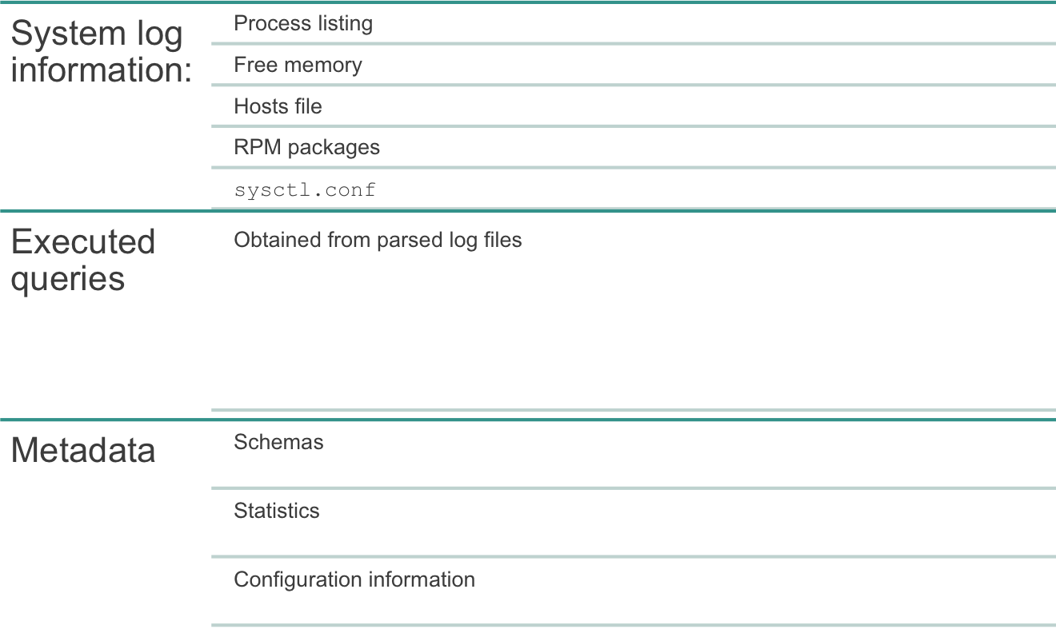


Data Gathering for Troubleshooting with gpsupport
Notes:
The gpsupport utility is a separate downloadable g-zipped compressed binary used to gather Greenplum Database information. The gathered data is used to troubleshoot and diagnose issues for GPDB 4.2.x and 4.3.x in a Linux operating system environment. The collected information can be provided to support personnel to help troubleshoot the environment.
Information is collected from the masters and segment servers and is stored to the master. The type of information or data that can be collected includes:
Log files from segments, including, process listings, memory information, the hosts file, a listing of the packages installed on the system, and the contents of the sysctl.conf file. Information is collected from all segments you specify, master, standby, and segment servers, either directly on the command line or from a specified hosts file. The utility pushes an agent to the segment servers to collect information. This agent, gpsupport_segment, is pushed to the /tmp directory by default. Its location can be changed however.
Executed queries collected from parsing log files. By default, the log files are collected from /data/master/gpseg-1.
Metadata from the database, including schemas, statistics, and configuration information. This includes global objects, database statistics information collected from the pg_statistic catalog table, and planner statistics information collected from the pg_class catalog table.

Slide 18


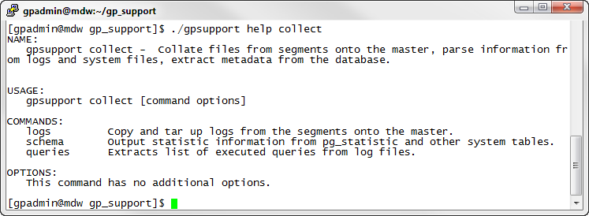
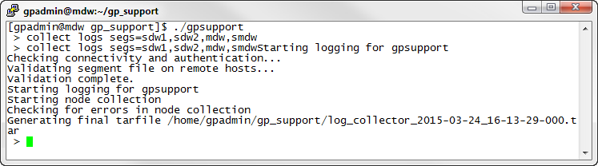
gpsupport Collection Examples
Example: Obtain help on the collect command
Example: Collect logs from several segments
Notes:
gpsupport provides both an interactive interface and a command line interface. Command usage is obtained with the help command. It can also be used to obtain additional information on other commands as shown in the first example where help is obtained on the collect command.
In the second example, gpsupport is executed in interactive mode. The collect logs command is executed with the segs option which allows you to specify which segment servers to collect information from. This is a comma separated list and overrides the hostfile global option which is used to specify the location of a host file. The host file requires that each host be listed on a line by itself.
The logs are saved to the directory from which you have executed the gpsupport command. You will require read and write permission to the directory you use for saving the captured information. You can specify a different output directory by using the masterDataDir option to this command. For example, to save the output from the second example to the /tmp directory, use the following command:
$ gpsupport collect logs segs=sdw1,sdw2,mdw,smdw masterDataDir=/tmp

Slide 19
Lab: Managing the Greenplum Database
In this lab, you use Greenplum utilities to check the state of the Greenplum environment and check for data and processing skew.
You will:
Perform system administration tasks on the Greenplum environment
Notes:
In this lab, you use Greenplum utilities to check the state of the Greenplum environment and check for data and processing skew.

Slide 20
Module 6: Database Management and Archiving
Lesson 1: Summary
During this lesson the following topics were covered:
Starting and stopping the Greenplum Database
Verifying the state of the Greenplum Database
Using the Greenplum administrative schema to view which tables are exhibiting data skew
Accessing log files and logging parameters
Maintaining the system catalog and reclaim physical disk space
Using gpsupport to gather troubleshooting data
Notes:
This lesson covered several database management tasks, including starting, stopping, and verifying the state of the Greenplum Database. The administrative schema lets you find the tables that are exhibiting data skew, which can impact overall performance when querying tables. Other administrative tasks include accessing log files and logging parameters as well as maintaining the system catalog and reclaiming physical disk space, particularly in environments where there are a large number of deletes or updates for both system tables and user tables.
Troubleshooting involves gathering information from several different areas to analyze the underlying issue. The gpsupport utility is used to collate data from named segments from logs, metadata, system processes and information to create a complete picture of the system.

Slide 21
Module 6: Database Management and Archiving
Lesson 2: Backups and Restores
In this lesson, you examine how to backup and restore data from and to Greenplum Database.
Upon completion of this lesson, you should be able to:
Describe the process of parallel backup
Describe the process of parallel restore
Describe the process of non-parallel backup
Identify the commands used to perform backup and restoration of data
Identify command options to perform incremental archival
Identify the strategy to perform backup and restores with Data Domain
Notes:
Regular backups improve the chances of recovering data in the event of a system failure or data corruption. Backups can also be used to migrate data from one system to another.
In this lesson, you will:
Describe the process of a parallel backup.
Describe the process of a parallel restore.
Describe the process of a non-parallel backup.
Identify the commands used to perform backup and restoration of data.
Identify the options to support incremental backup and restore of append-only tables
Identify the overall strategy for performing backup and restore with Data Domain.

Slide 22

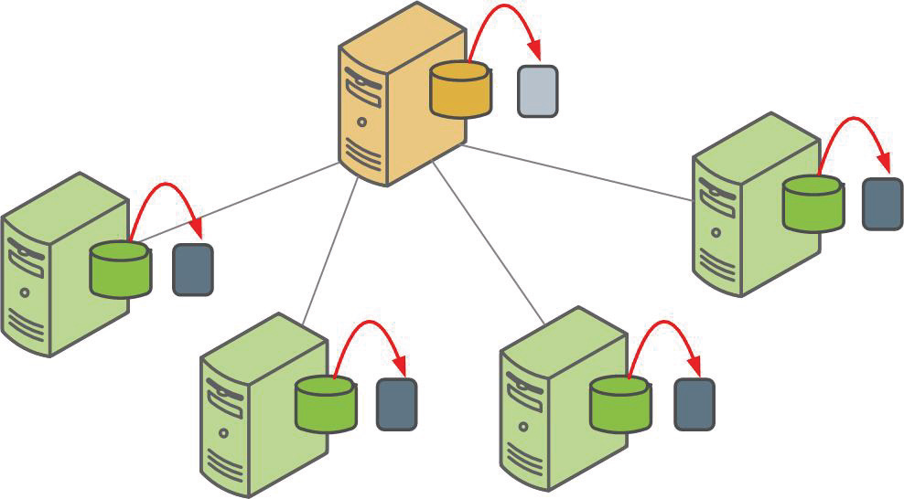

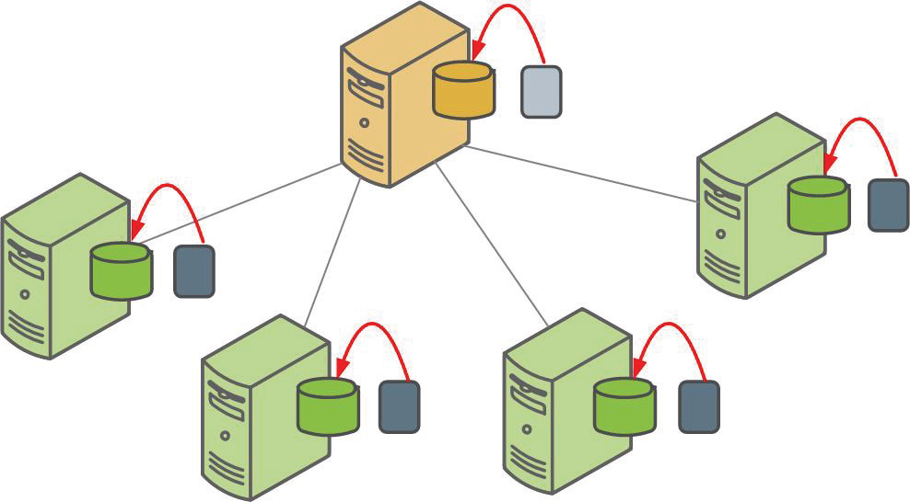
About Parallel Backups and Restores
Parallel Backup
Parallel Restore
Notes:
In Greenplum Database:
You initiate a parallel dump operation from the master which dumps DDL for the database, schemas, and system catalog.
This starts dump agents on the segments to dump all segment databases in parallel.
Likewise during a parallel restore, restore agents load each of the segment databases in parallel from their corresponding dump file as well as the data definitions for the master.

Slide 23



Creating Parallel Backups
All backup files in a set contain the same unique 14-digit timestamp key
Data dumps on all segments are performed in parallel
gpseg3/db_dumps/yyyymmdd
gpseg-1/db_dumps/yyyymmdd
Gzipped segment data is created
Dump includes:
DDL
System catalogs
Metadata files
Gzipped data
Notes:
When performing a parallel backup, several actions occur:
Every primary segment is dumped in parallel.
A single dump file is created in the data directory for each of these segments. Within the data directory for the primary segment, two additional levels are created: db_dumps/<yyyymmdd>. The dump file created for the segment contains the data for an individual segment instance.
The backup files are identified by a unique 14-digit timestamp key as part of the filename. All files within the same backupset are identified by this unique identifier.
The master dumps the configuration of the database, or the system catalog, as well as DDL statements for recreating the database and schemas. This is saved to the master data directory under the same hierarchy.
As the dump files are created on the local file system for each segment, you must ensure there is sufficient disk space for the dump files both on the master and the primary segments.

Slide 24
Dump Files Created During Parallel Backup
Master Segment Dump File | Description
gp_cdatabase_1_<dbid>_<timestamp> | CREATE DATABASE statement
gp_dump_1_<dbid>_<timestamp> | Database schemas
gp_dump_status_1_<dbid>_<timestamp> | Log file
gp_dump_1_<dbid>_<timestamp>_post_data | Post database setup (GUCs and search paths)
gp_dump_1_<dbid>_<timestamp>_ao_state_file | List of append-optimized tables
gp_dump_1_<dbid>_<timestamp>_co_state_file | List of column-oriented tables
gp_dump_<timestamp>.rpt | Database dump report
Primary Segments Dump File | Description
gp_dump_0_<dbid>_<timestamp> | Data for the segment
gp_dump_status_0_<dbid>_<timestamp> | Log file
Note: Each backup set shares the same unique timestamp.
This timestamp is required for restoring a backup set.
A fly and a flea in a flue
Were imprisoned, so what could they do
Said the fly, let us flee. Let us fly said the flee
So they flew through a flaw in the flue.
A canner exceedingly canny
One morning remarked to his granny
A canner can can anything that he can
But a canner can’t can a can can he?
Notes:
By default, the dump files are created under the data directory of the instance that was dumped. Files are saved to <data_directory>/db_dumps/yyyymmdd.
On the master, dump files of the following are created:
CREATE DATABASE statement
DDL to recreate schema and database objects
Log or status of the backup
Post-database creation operations
State files for append and column-oriented tables
Report file that details the status of each segment with regards to the backups.
On the segments, dump files of the following are created:
COPY statements and user data
Log or status of the backup
You can identify which instance a dump file belongs to by the dbid in the dump file name. The master instance is always 1_<dbid>, with the dbid usually being a 1 for the primary master. The segment instances are usually 0_<dbid>. This is assigned in the gp_configuration system catalog table.
Note that each dump file has the timestamp key which identifies the backup set. This timestamp is needed by a restore to identify the backup set.

Slide 25





Performing Parallel Restores
Timestamp key is used for restoring data
gpseg3/db_dumps/yyyymmdd
gpseg-1/db_dumps/yyyymmdd
Notes:
A parallel restore takes all the files associated with a backupset and restores the database objects and data to the distributed database in parallel. The unique timestamp key generated during the parallel backup is used to define the backupset. The data is validated and restored to the master and primary segments for the database captured in the backupset.

Slide 26
Scheduling Routine Backups – gpcrondump
The gpcrondump utility:
Can be called directly or can schedule using cron
Should be scheduled on the master host
Sends email notifications
Flexible dump options
Can copy configuration files
Can dump system catalogs
Can dump global objects
Can include a post-dump script
Notes:
Scheduling routine backups is a recommended practice to implement for disaster recovery sites. This includes automating nightly backups, moving backup files to a disaster recovery site, and providing a quick restoration option if needed.
The gpcrondump utility:
Allows you to schedule routine backups of a Greenplum database using cron, a scheduling utility for Unix operating systems.
Should be scheduled on the master host.
Sends email notifications on the status.
Provides a multitude of flexible dump options and checks.
Copies the configuration files.
Can dump only the system catalog.
Can dump only the global objects.
Can include a post-dump script for rebuilding the data.

Slide 27
Restoring Archived Data
The gpdbrestore utility:
Restores gpcrondump files
Reconfigures for compression
Validates the number of dump files
Restores to active segment instances even with a failed segment
Does not require you to retrieve the timestamp key
Can restore from an archive host
Does not require dump files to be placed on segments
Identifies the database name automatically
Detects the type of backup set available
Notes:
The gpdbrestore utility provides the following additional functionality on top of gp_restore:
Restores from backup files created by gpcrondump.
Automatically reconfigures for compression.
Validates the number of dump files are correct for primary only, mirror only, primary and mirror, or a subset consisting of some mirror and primary segment dump files.
If a failed segment is detected and if gp_fault_action=continue, restores to active segment instances.
Does not need to know the complete timestamp key of the backup set to restore. Additional options are provided to instead give a date, directory, or database name to restore.
Lets you restore from a backup set located on a host outside of the Greenplum Database array (archive host). To do this, it ensures that the correct dump file goes to the correct segment instance.
Identifies the database name automatically from the backup set.
Allows you to drop the target database before a restore in a single operation.

Slide 28
Incremental Backups
Incremental backups:
Were Introduced in the 4.2.5 release and above
Allow users to specify a point in time to restore the database to
Are supported with:
  Column- and row-oriented append-only tables
  At the partition level of AO tables
Back up an AO table if one of the following operations is performed:
  ALTER TABLE, INSERT, TRUNCATE, DELETE, UPDATE
  DROP and then re-create the table
Cannot be used with Data Domain Boost
Notes:
Starting in GP 4.2.5, options for incremental backup for append-optimized (AO) tables have been added to your support strategy. All other tables and database objects are backed up in a full backup mode.
Incremental backups are supported on both column-oriented and row-oriented AO tables. Support for incremental backups is also provided on AO tables that are partitioned.
When an incremental backup is executed on an AO partitioned table, only the partitions that have been modified will be captured. Changes to the table that are captured by incremental backups are tables that have been modified with one of the following:
Alter table
Insert
Table truncate
Dropping and recreating the AO table.
Updating the table
Deleting the table
If using Data Domain for the backup, the complete backupset must be on the Data Domain system. The complete backupset consists of the full backup along with the incremental backups. Note that Data Domain Boost is not supported with incremental backups.

Slide 29
Managing Incremental Backups
To create an incremental backup with gpcrondump, include the --incremental option
You cannot use the Data Domain Boost options with a full backup if you plan to perform incremental backups.
To restore data from an incremental backup you need a complete backup set, which consists of the following:
  The last full backup before the current incremental backup
  All incremental backups created between the time of the full backup the current incremental backup
  The full backup and incremental backups need to be in the same directory location (the gpcrondump -u option will ensure this)
Notes:
To run an incremental backup using the gpcrondump utility you must specify the option --incremental. As stated before incremental backups are not supported with DDBoost.
NOTE that if you are performing incremental backups, you have to ensure that your full backups are not executed with any of the DDBoost option found with the gpcrondump utility.
Restoring from an incremental backup requires the following
A Full backup has been perform (exists) before the current incremental that you want to restore from.
All incremental backups created between the time of the full backup the current incremental backup that you want to restore from exist.
All backups (full and incremental) are stored in the same directory location. A -u option can be used with gpcrondump to insure this.

Slide 30


Incremental Backup Example
Example: Creating a full backup of the faa database to /backupdir
$ gpcrondump -x faa -u /backupdir
Example: Creating a series of incremental backups to /backupdir
$ gpcrondump -x faa -u /backupdir --incremental
Notes:
The first command shown on the slide will perform a full backup of the faa database found in Greenplum. It will store all archive files in the directory backupdir.
The second command will perform an incremental backup on the faa database in Greenplum and place the archive files in the directory backupdir.
Note that the incremental backup only backs up changes performed on append-only tables found in the faa database. If no AO tables exist, or no AO tables have changed, a full backup will be performed.

Slide 31
Incremental Backup Example (Cont)
Full and incremental backups are saved in the user specified directory and named with an appropriate timestamps. After a series of backups you might see something like this in the backup directory:
  20120514054532 (full backup)
  20120714095512
  20120914081205
  20121114064330 (full backup)
  20130114051246
Restore a backup by specifying a point in time that corresponds to an existing incremental backup:
  gpdbrestore -t 20130114051246 -u /backupdir
The result of this command will be to restore the database using the last full backup (20121114064330) and the last incremental backup (20130114051246)
Notes:
We can see that a number of full and incremental backup have occurred. Archive files are named using the following timestamp format (YYYYMMDDHHMMSS) . So you can see that the archive files ending in 4532 and 4330 are full backups, and the other backups are incrementals.
Running the gpdbrestore utility and specifying the archive file ending in 1246 will restore the database back to a time of the full backup ending in 4330 and the incremental backup ending in 1246.
NOTE: the other archive files in this example are not needed and will not be used with this restore command.

Slide 32
Non-Parallel Backups and Restores
Non-parallel backups and restores:
Are supported with the pg_dump and pg_restore utilities
Are useful for migrating data to and from other DBMS
The pg_dump utility:
Creates a single dump file
Can be slow on very large databases
Should be run at low-usage times
Supports compression
Can dump data as INSERT or COPY commands
Includes the DISTRIBUTED BY statements in DDL with the --gp-syntax option
Notes:
The pg_dump utility creates a single dump file to the master server, instead of to the individual segments.
To use this command, you must have adequate file system space on the master to store the resulting backup file. This should be used when the system is quiet, as it has the potential to impact the overall performance, especially on very large databases.

Slide 33
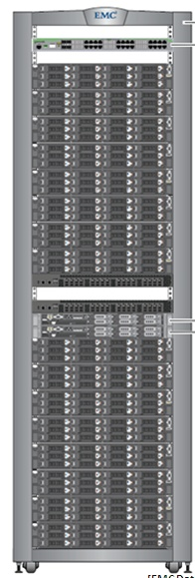

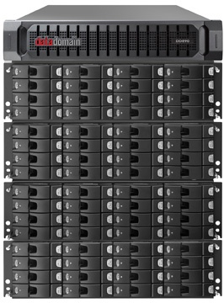


EMC Greenplum DCA and the Data Domain Solution
Data Domain:
Provides backup and recovery with Greenplum DB 4.1+
Offers deduplication
Supports:
  NFS mounts with GPDB 4.1
  DDBoost with GPDB 4.2
Leverages gpcrondump and gpdbrestore
Must be connected on the interconnect
Provides access to each Greenplum Database instance
10GBe
Greenplum DCA
Data Domain 890
Notes:
Starting with Greenplum Database 4.1 and 4.2, NFS mounted and native integration with Data Domain 880 and 890 was introduced to support backup and recovery services for the Greenplum Database. Data Domain offers a comprehensive backup management, offloading many of the duties a database administrator has with backup and recovery services to the device.
Deduplication offers a form of incremental backup not offered with the native Greenplum Database backup and recovery utilities.
There are two integration options offered for Greenplum Database with Data Domain:
Backup and recovery with NFS mounted directories.
Backup and recovery with DDBoost, a client library integrated with the database.
EMC Data Domain:
Leverages the Greenplum backup utility, gpcrondump, to perform the backup and gpdbrestore for restores.
Must be connected to the DCA on the interconnect switches. This enables 10 GbE connectivity between every DCA server and the Data Domain Appliance.
Provides access to the Greenplum DCA using internal 10GbE network.

Slide 34



Data Domain Integration: NFS Solution
NFS integration:
Is available to GPDB 4.1 and 4.2
Requires each server has its own mount point
Performs deduplication and compression after data is sent over the network
segserver 16 mount point
segserver 15 mount point
segserver 14 mount point
segserver 13 mount point
…
Greenplum DCA
Data Domain 890
Notes:
The NFS integration solution is available for both Greenplum Database 4.1 and 4.2. Once connected to the Data Domain, each segment server and the master server has its own mount point to the Data Domain appliance.
When performing a backup, data is sent over the network to the Data Domain appliance over the mount point. All deduplication and compression is applied after the information has been sent to the Data Domain appliance. While this is transparent to you, it can incur high costs for network bandwidth as all data is sent. At this point, there is no sense of incremental backup or deduplication until the data is fully sent to the Data Domain appliance.

Slide 35







Data Domain Integration: DD Boost Solution
DD Boost integration:
Is a client library integrated with GPDB
Uses native communication protocol
Performs deduplication on the segments and master
Only captures changed data
Takes advantage of MPP design
DDBoost
Changed data is
written to DD
Greenplum DCA
Data Domain 890
Notes:
DD Boost is a client library integrated into the Greenplum Database, fully integrated with the Greenplum Database utilities for backup and recovery, and runs on all segments.
It is a native communication protocol which then performs deduplication on the segments and master themselves, reducing network traffic. The only data that is transferred is data that has changed. This immediately takes advantage of deduplication and provides a form of incremental backup. In addition to taking advantage of deduplication, the data is compressed before it is sent over the network.
DD Boost takes advantage of the Greenplum Database cluster by pushing deduplication processing to the segment hosts and utilizing the CPU cores available to perform deduplication and compression. The more CPU cores are available, the better the performance. This enables faster backup as the Greenplum Database scales.

Slide 36








Data Domain Integration: Managed File Replication
Managed File Replication (MFR)
  Introduced with the 4.2.5 release of GP
  Allows replication of Greenplum Database backup images stored on a local Data Domain system to a remote Data Domain system.
  Data Domain login credentials have to be configured with gpcrondump utility on both the local and remote Data Domain systems.
  The master segment must be able to connect to both the local Data Domain system and the remote Data Domain system.
Local
gpmfr
utility
Remote
Notes:
Managed File Replication is a feature found in Data Domain software. Collection Replication is the other type of replication supported.
Managed file replication directly transfers a backup image from one Data Domain system to another, one at a time on request from the backup software.
Collection replication performs whole system mirroring in a one-to-one topology continuously transferring changes in the underlying collection, including logical directories and files of the Data Domain filesystem.
Prior to Greenplum 4.2.5 only collection replication was supported. In the 4.2.5 and above releases of Greenplum you know can perform a Managed File Replication (MFR).
MFR allows you to take backup data sets (a set of archive files) and copy them over to a remote Data Domain system (a disaster recover site). The remote site data sets can then be used to perform restore operations of the Greenplum Database.
The Master server must be able to communicate with both Data Domain systems (local and remote) and do require additional setup steps. These additional steps require running the gpcrondump utility with certain --ddboost options to establish user credentials on the Data Domain systems.

Slide 37


Data Domain Integration: Managed File Replication
The gpmfr utility manages the Greenplum Database backup sets on the local and remote Data Domain systems.
The gpmfr utility provides these capabilities:
  Lists the backup data sets that are on the local or the remote Data Domain system.
  Replicates a backup data set that is on the local Data Domain system to the remote system.
  Recovers a backup data set that is on the remote Data Domain system to the local system.
  Deletes a backup data set that is on the local or the remote Data Domain system.
Local
gpmfr
utility
Remote
Notes:
A new utility called gpmfr has been created that lets you manage your backup data sets on the local and remote Data Domain systems. gpmfr allows you to list, replicate, recover, and delete your backup sets on both Data Domain systems.

Slide 38
Data Domain Integration: MFR Example
The following example replicates the latest backup set on the local Data Domain sever to the remote server. The maximum number of I/O streams that can be used for the replication is 30.
  gpmfr --replicate LATEST --max-streams 30
Local
gpmfr
utility
Remote
Notes:
The following example replicates the latest backup set on the local Data Domain sever to the remote server. The maximum number of I/O streams that can be used for the replication is 30.

Slide 39
Comparing the EMC Greenplum DCA Integration Solutions
Feature | NFS | DD Boost
Deduplication | Deduplication on Data Domain appliance | Deduplication on Greenplum DB segment and master instance
CPU Usage on Segments | As needed for NFS | Increased CPU usage on GPDB due to de-duplication and compression
Network Utilization | All data is sent over the network | Only changed, deduplication data is sent over the network
Scalability | Increasing the number of racks can result in saturation of DD appliance or network | Minimal data transfer
Management | Each segment server and master server requires its own mount point | Integrated native solution with no static system configuration
Backup Performance | Full backup | Initial backup is full; follow-on backups are incremental
Data Domain Replication | Directory level | Collection and Managed File
Notes:
To use the Data Domain for backup and restore:
All servers in the DCA must have NFS access to the Data Domain. Data Domain provides a dedicated NFS export to each of the servers in the DCA. For example, Data Domain will export the directory, /backup/DCA-01/mdw, which is available to the master server as /backup. Each segment will have its own directory available as well.
The superuser account, gpadmin, must have full read and write access to the backup directory.
Once the NFS configuration has been completed, the Greenplum backup and restore utilities can be used to write to or read from the mount points.

Slide 40
Lab: Backups and Restores
In this lab, you use the Greenplum backup utilities to process a backup in your environment.
You will:
Create and retrieve full backups
Create and retrieve incremental backups
Notes:
In this lab, you use the Greenplum backup utilities to backup databases in your environment. You will perform both incremental and full backups of your data.

Slide 41
Module 6: Database Management and Archiving
Lesson 2: Summary
During this lesson the following topics were covered:
Process of parallel backup
Process of parallel restore
Process of non-parallel backup
Commands used to perform backup and restoration of data
Command options to perform incremental archival
Strategy to perform backup and restores with Data Domain
Notes:
This lesson covered various archival topics, including the difference between parallel and non-parallel backup and restore and how to perform each of these using the Greenplum backup and restore utilities. Greenplum backup utilities include options both for incremental support for append-only storage as well as storing and restoring data to a Data Domain.

Slide 42
Module 6: Summary
Key points covered in this module:
Performed system administrative tasks, including managing and checking the state of the Greenplum Database and its data as well as checking the distribution of data
Performed backup and restoration of Greenplum data from and into the Greenplum Database respectively
Notes:
Listed are the key points covered in this module. You should have learned to:
Perform system administrative tasks, including managing and checking the state of the Greenplum Database and its data as well as checking the distribution of data.
Perform backup and restoration of Greenplum data from and into the Greenplum Database respectively.

