Slide 1
LS 225 Lesson 2: Function Context of Objects
April 22, 2020

Slide 2
List of assignments
Global object
Practice
Implicit and explicit function execution contexts
Practice
Hard binding functions with contexts
E.g. changing function context
Practice
Dealing with context loss (1, 2, 3)
Practice
`this` in JS
Practice 1, 2
Quiz

Slide 3
Global object (intro)
Precursor: what is a first class function?
Function can be added to objects, executed in context of objects, removed from object, passed to other functions, run in different contexts
They also have no initial context, one is received when program executes them
So what’s the big deal about first class functions?
Dev must control the execution context since JS is both OOP and language with first class functions

Slide 4


Global object (1)
A global object is created when JS runs, which is the implicit context
The default global object is the window object
What are global values? Infinity, NaN
What are global functions? isNaN, parseInt
Global entities are properties of the global object
You can also add properties to the window object

Slide 5
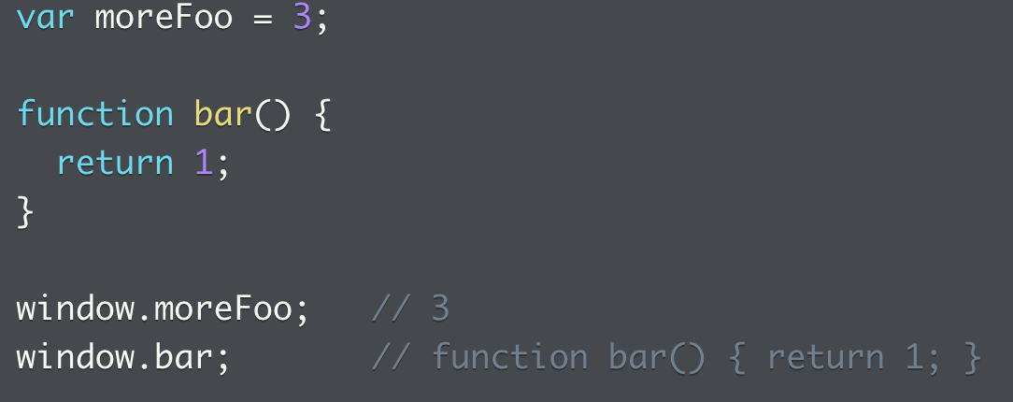
Global object: implicit context
Global object is the implicit context when expressions are evaluated
If no local var is found when a var is declared, then the global context is found for the object, that means a var has implicit global context
Even if an object is not explicitly declared to be local or global, the implicit context of the global object finds the foo object and it’s the same as window.thisProperty
This is how you can add a global variable:

Slide 6
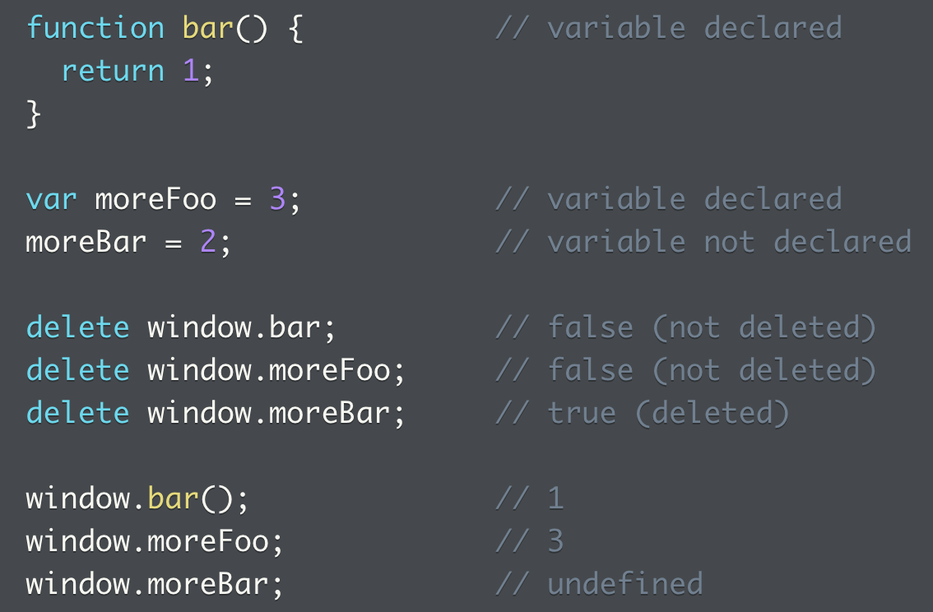
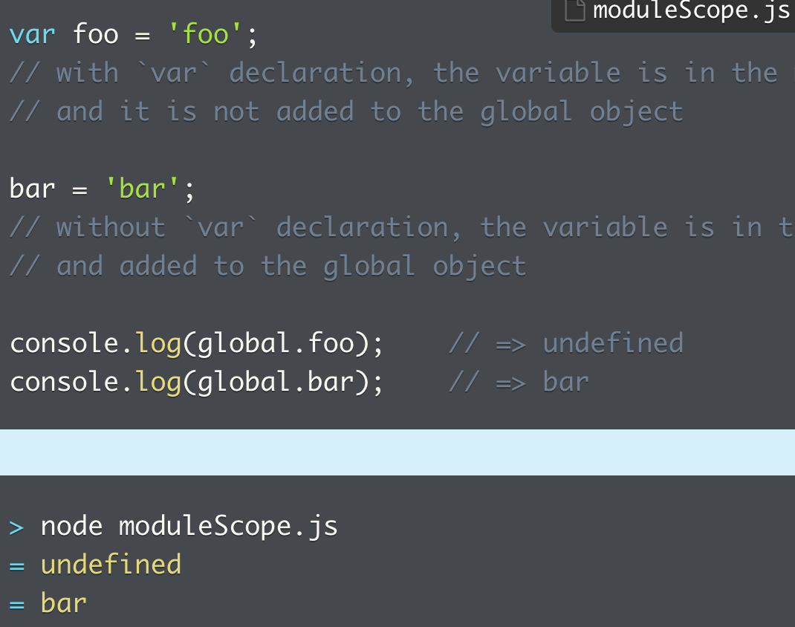
Global object: manipulating global vars
Is not declaring a global var the same as declaring one?
The subtle difference is that you can’t delete a variable declared explicitly, but can delete the ones that are declared explicitly
In Node (non browser JS) the global object is global and not window, and it introduces another module scope
Var in the module scope are declared at top level, module-scoped variables are not added to the global object
Only accessible from within file but not anywhere else

Slide 7
Practice: Global Object
Implicit execution context
What the global variable is in a browser environment
Function local variable versus global variable scope, when a var is declared within the the local scope with or without being assigned to a var
Difference between a global variable added explicitly to the global object versus those added implicitly, viewed when attempting to delete
Can a function be deleted in the global window

Slide 8
Implicit & explicit function exec contexts
What is the execution context of a function?
When a function is invoked, the object it has access to
Accessible through `this`
How to invoke a JS function?
In a variety of ways, and `this` refers to how function was invoked
Implicitly and explicitly (what JS sets vs. what you set)
What governs how `this` is applied?
Different than rules for determining scope of a variable
Variable scope is determined at time of writing code
`this` gets bound based on HOW a function is invoked

Slide 9
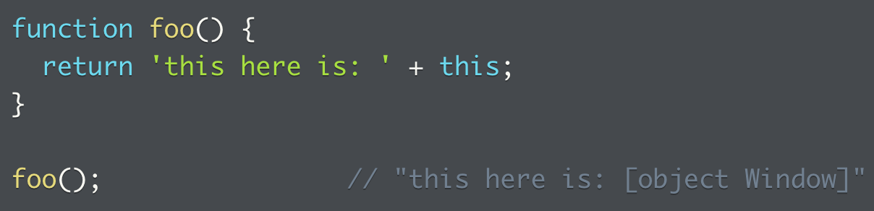
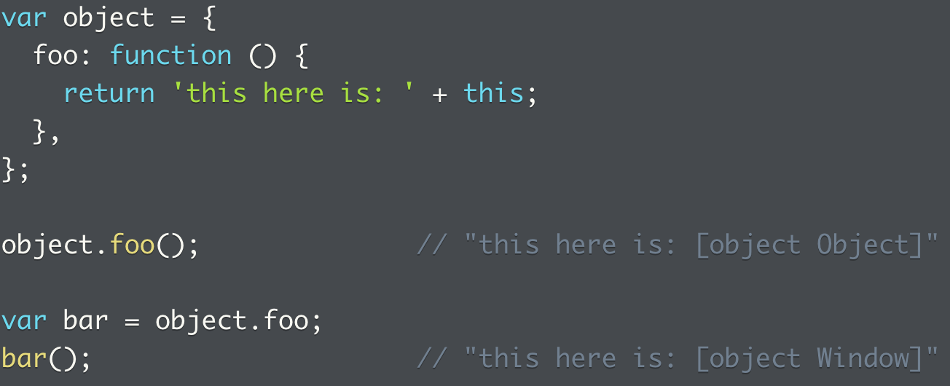
Implicit function exec contexts (2)
What is the implicit binding for functions (implicit function execution context)?
When no explicit context is supplied
In which case, function is bound to the global object
See the second example on the right, binding a function to context happens when function is executed
In the first case, object.foo() is bound to the object
In the second case, bar() points to the foo() method, method is implicitly bound to the global object
What’s interesting is that if we change the last two lines to:
var bar = object.foo(); bar; => then the result is the object Object, and not the object Window
The key is execution, when a method() is executed, the execution context is searched for and bound to there
Therefore, if foo() is executed, then the context is global
But if bar is assigned to the method, and then bar executes as a function, then the execution context at the time is global
However, if bar is assigned to the execution of the method, then the context is bound at execution time which is the local object
That’s why the constant stress on the importance of execution in how context is determined

Slide 10
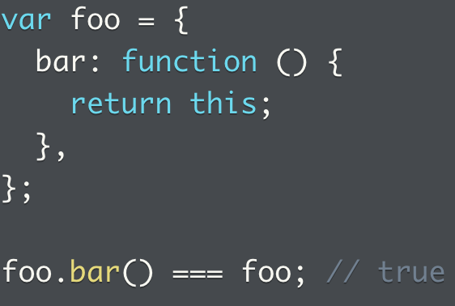
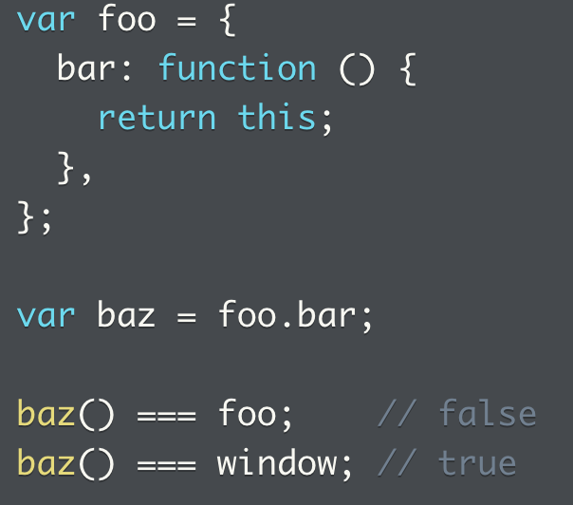
Implicit method execution context (3)
Implicit execution context happens when no explicit context is provided, methods are bound to the calling object by default
Implicit execution context is bound upon invocation, not definition
This was also observed in the example previously, a function can start off being an object property where it’s implicitly bound to its calling object, but when assigned to a variable and called, it becomes implicitly bound to the global object

Slide 11
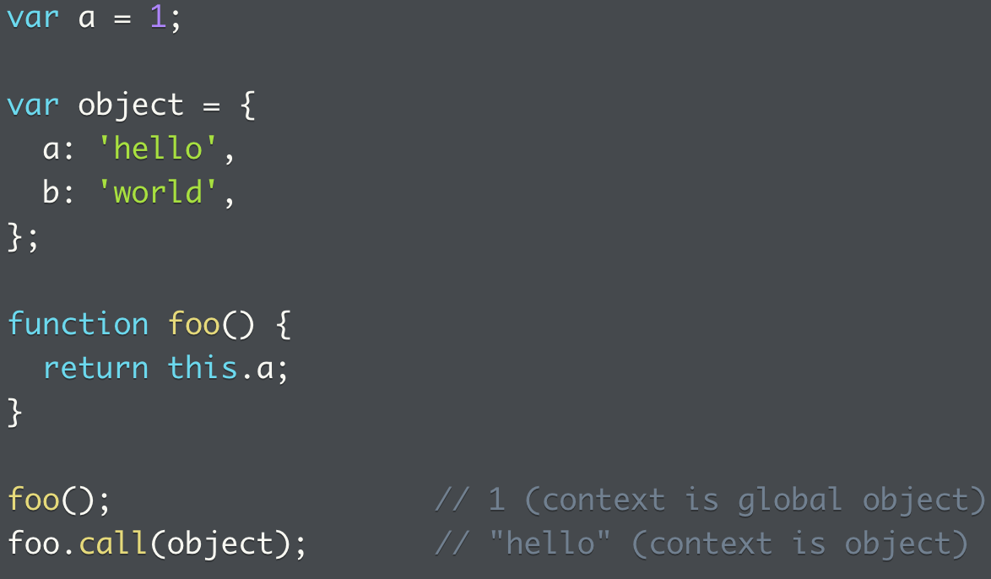
Explicit function execution context
Two methods to change function’s execution context are `call` and `apply`
This way, you can explicitly bind function’s execution context to object when function is executed
Without explicit binding, this would return the global object
See how the method calls the object specifically
We say in this case, the execution context of the method is bound to the object, and that’s what `this` refers to

Slide 12
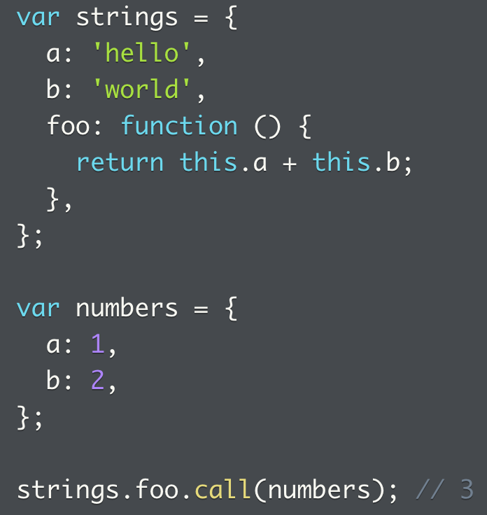
Explicit execution context (2)
We can also borrow a method from an object to use with another object
In this case, method foo from object strings is run in the numbers context
`call()` method can pass multiple arguments to the function, one after the other

Slide 13
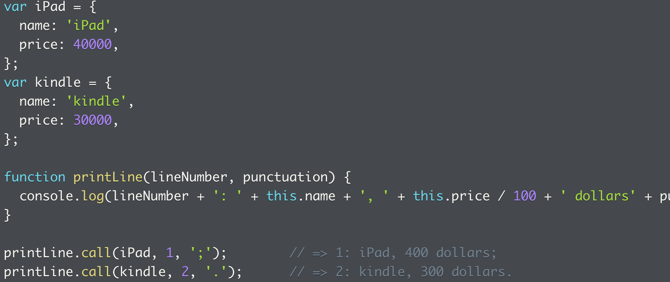
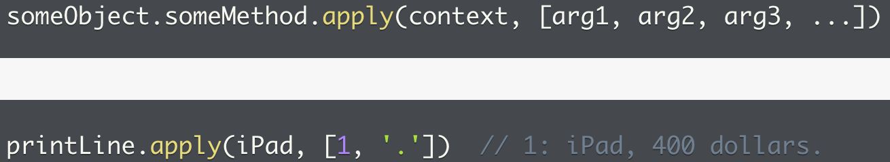
Explicit execution context using call (2)
A method can also be bound to an object, while calling in multiple arguments
`apply` is identical to `call`, but can pass in an array

Slide 14
Practice: implicit and explicit execution contexts
1. What a function implicitly returns, also when the function is assigned to a variable (then context becomes the global context)
2. What happens when an object method is assigned to a variable, what has the execution function become
3. What happens when a global scope function is assigned to a function scope method? The execution context at the moment of invocation becomes the function scope.
4. How `this` affects variables referenced.
5. Methods that allows one to explicitly specify execution context
6. Using an object method to call another object, how `this` will recognize the execution context
7. Using `call` versus `apply` on a function
8. Details of how the argument object works in JS. It’s array like but not an array, so needs some processing before it can be iterated over.

Slide 15
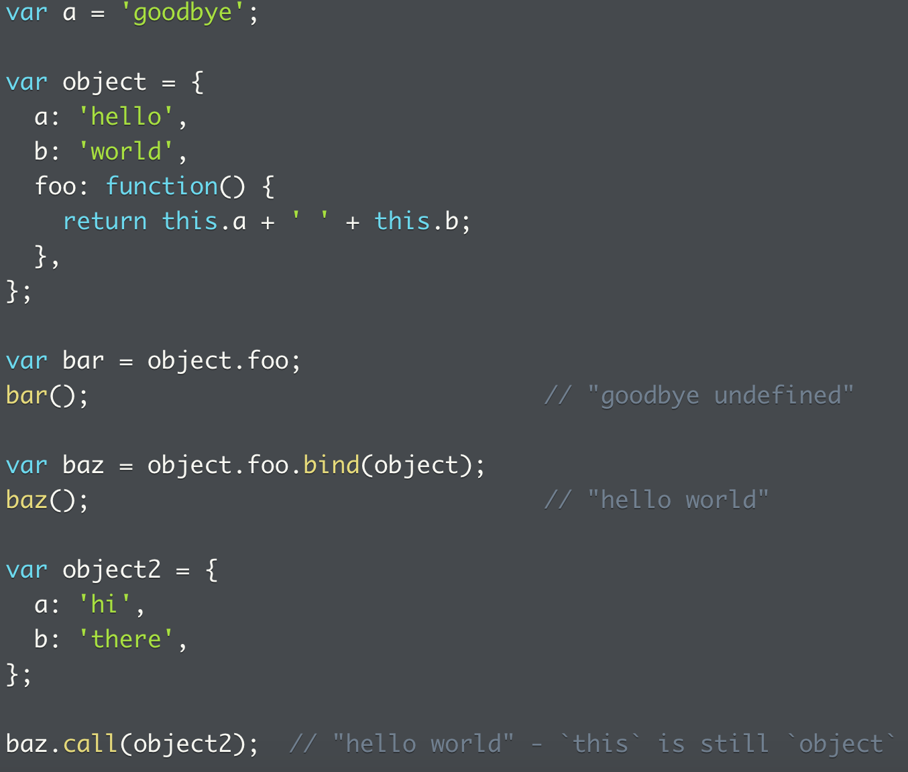
Hard binding (with context)
While call and apply can change a function context, we can also use `bind()` to bind a function to context object permanently
Without binding or a call/apply context change, `this` could default to the global object
With binding, no other objects can be called
Note it creates and returns new function instead of executing a function, and the bind is permanent

Slide 16
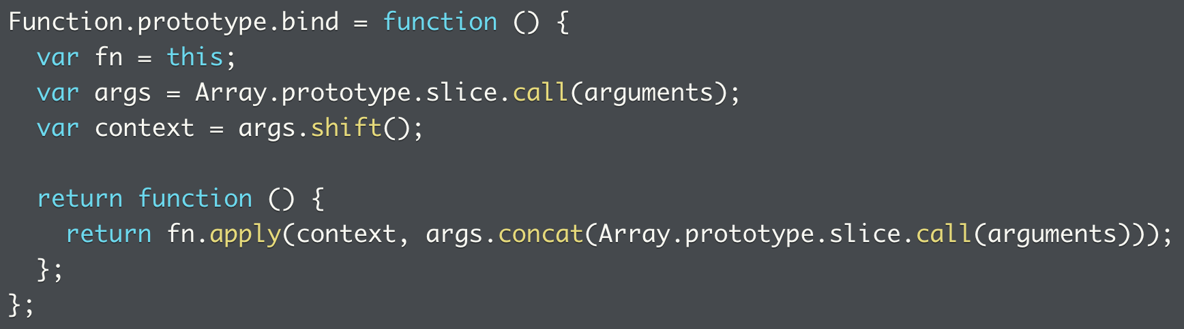
How bind is implemented
See how it uses an apply function and returns the context as an object
E.g. `return fn.apply(newContext, args)`
Not sure why args is again concatenated with another version of the args?
Returns new function that calls original function with context supplied to bind

Slide 17
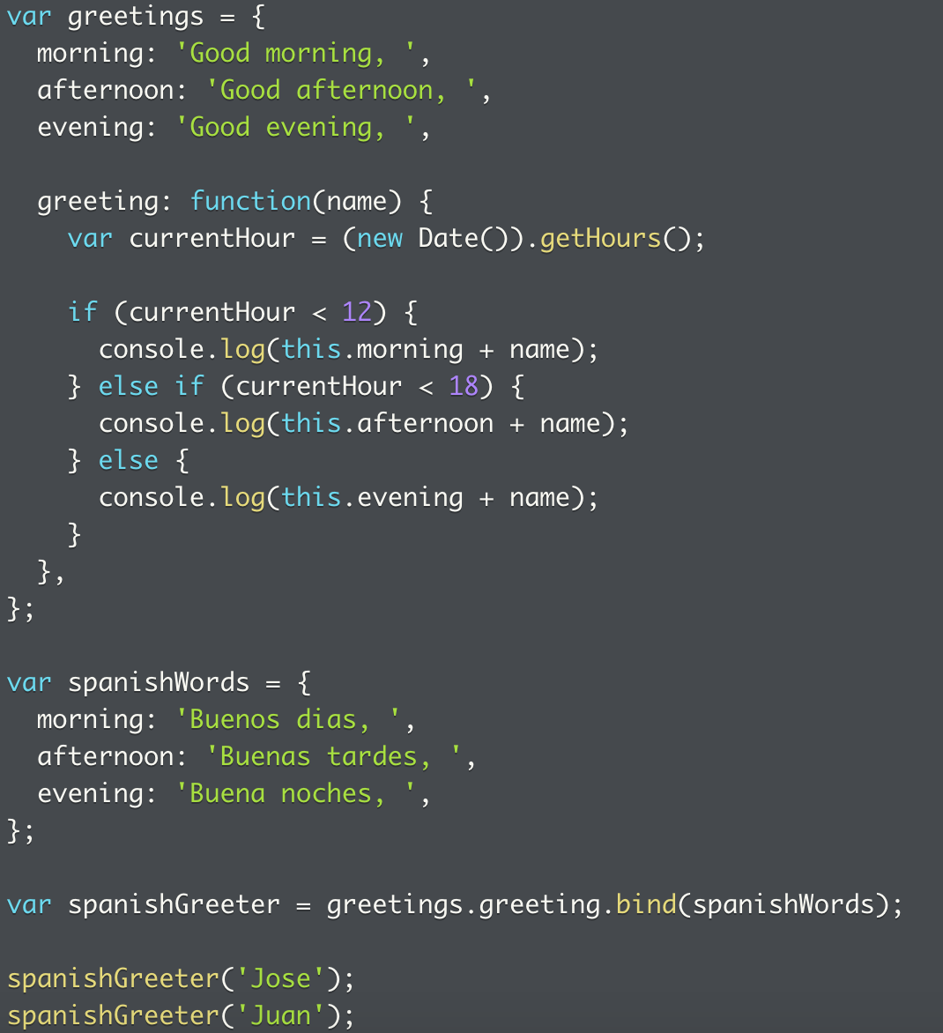
Another example of bind
A useful way of using bind is to assign a method with a bind function to a variable, so that variable will only call the bound version of the object
In this case, a general object with useful methods is bound to an object with a specific set of inputs, which is useful when invoked
Another example of an object method calling another object

Slide 18
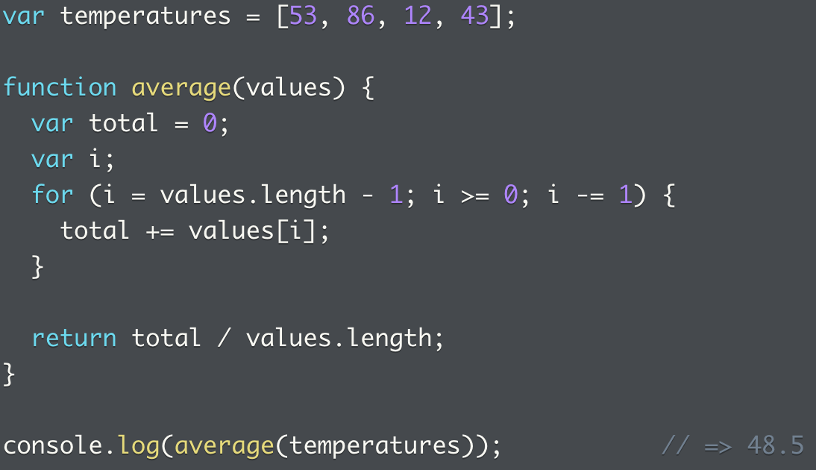
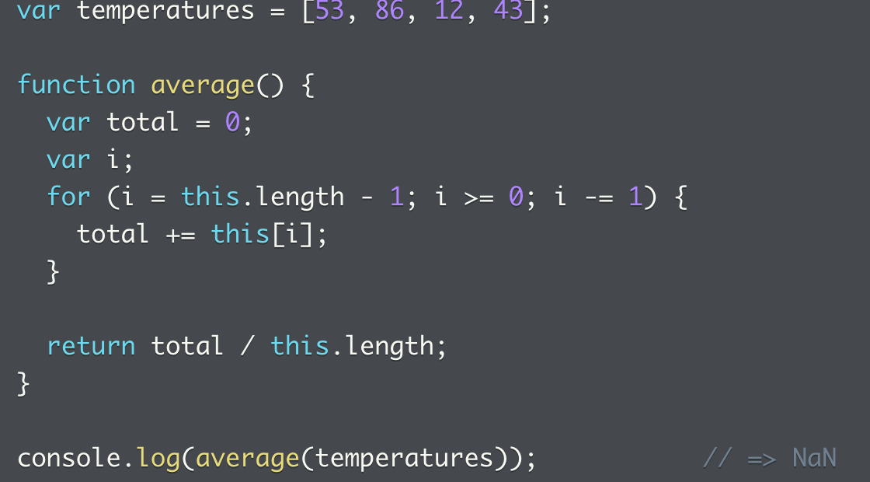
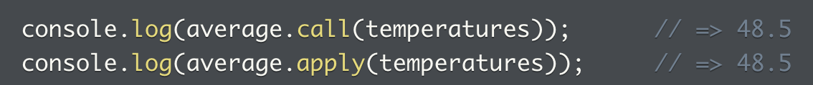
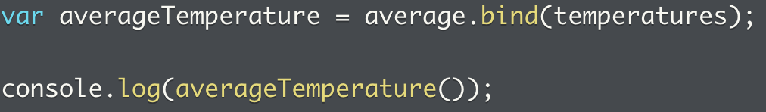
Example: changing function context
THREE methods to change function context
First, pass the array in as an argument
Then we replace that with `this`, but the default context is global
We use one of the three methods to bind
Call/apply
Bind
Define method in object, this assigns the function to the object and context is always parent object unless bound otherwise

Slide 19
Problems: hard binding functions with contexts
1. Function to permanently bind a function to context
2. Output from bound object
3. Differences between binding and not binding an object
4. Binding changes the context
5. And the binding is permanent

Slide 20
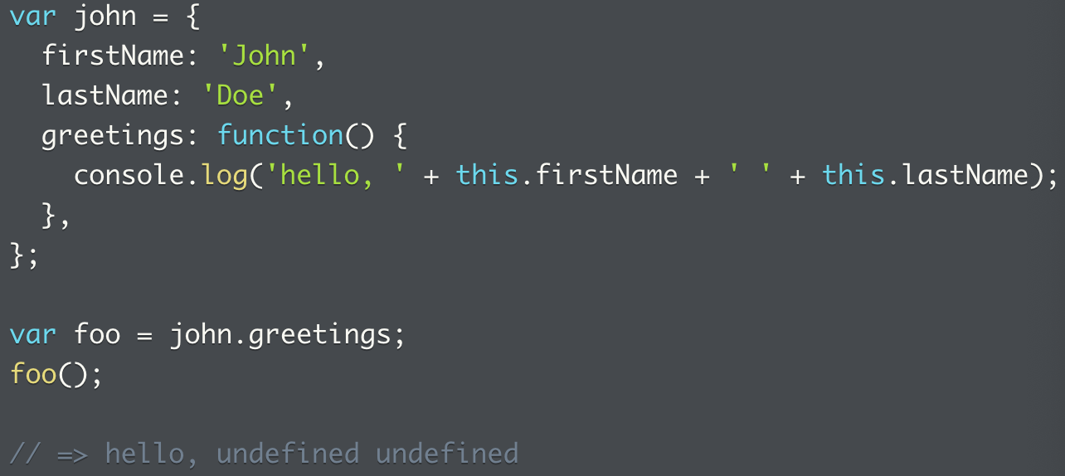
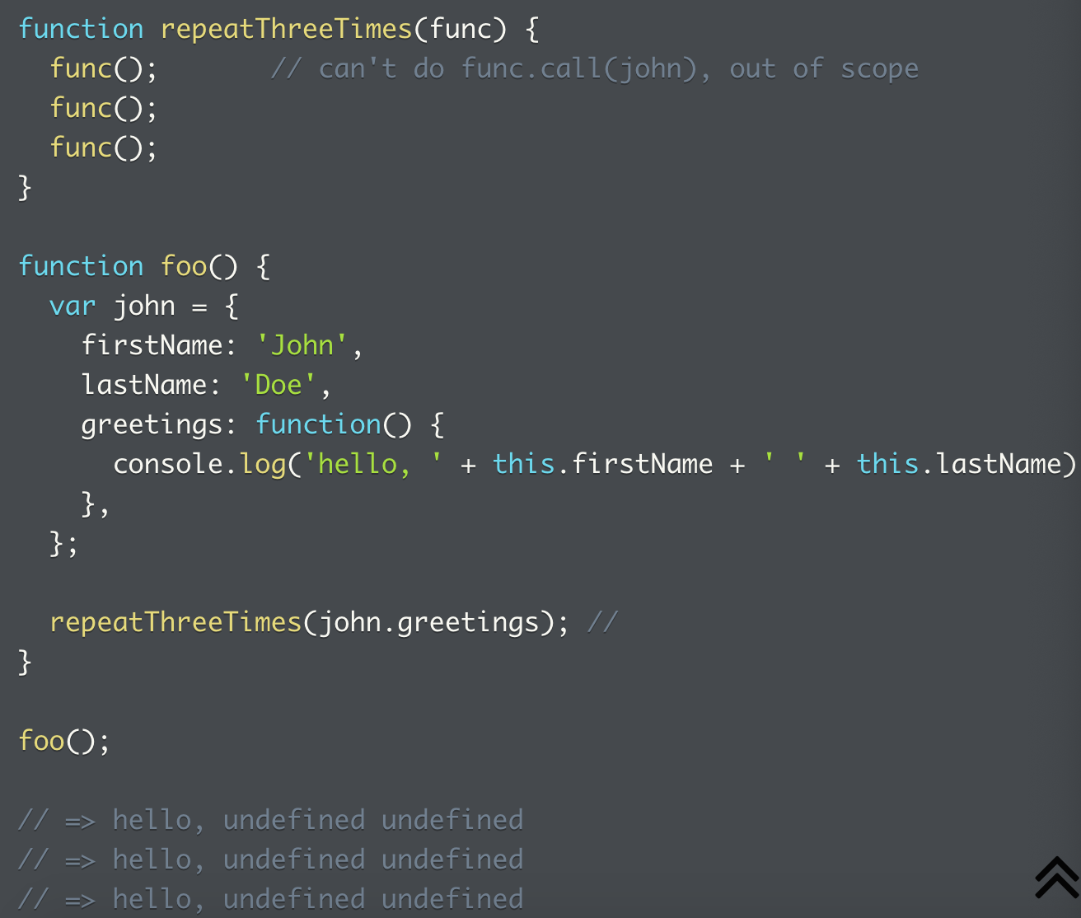
Dealing with context loss (1)
This one was seen before, when a method is removed from its containing object, and assigned to another variable, context is lost
In this case, use `foo.call(john)` to restore context
And if the function is not executed right away? Or to pass it to another function?

Slide 21
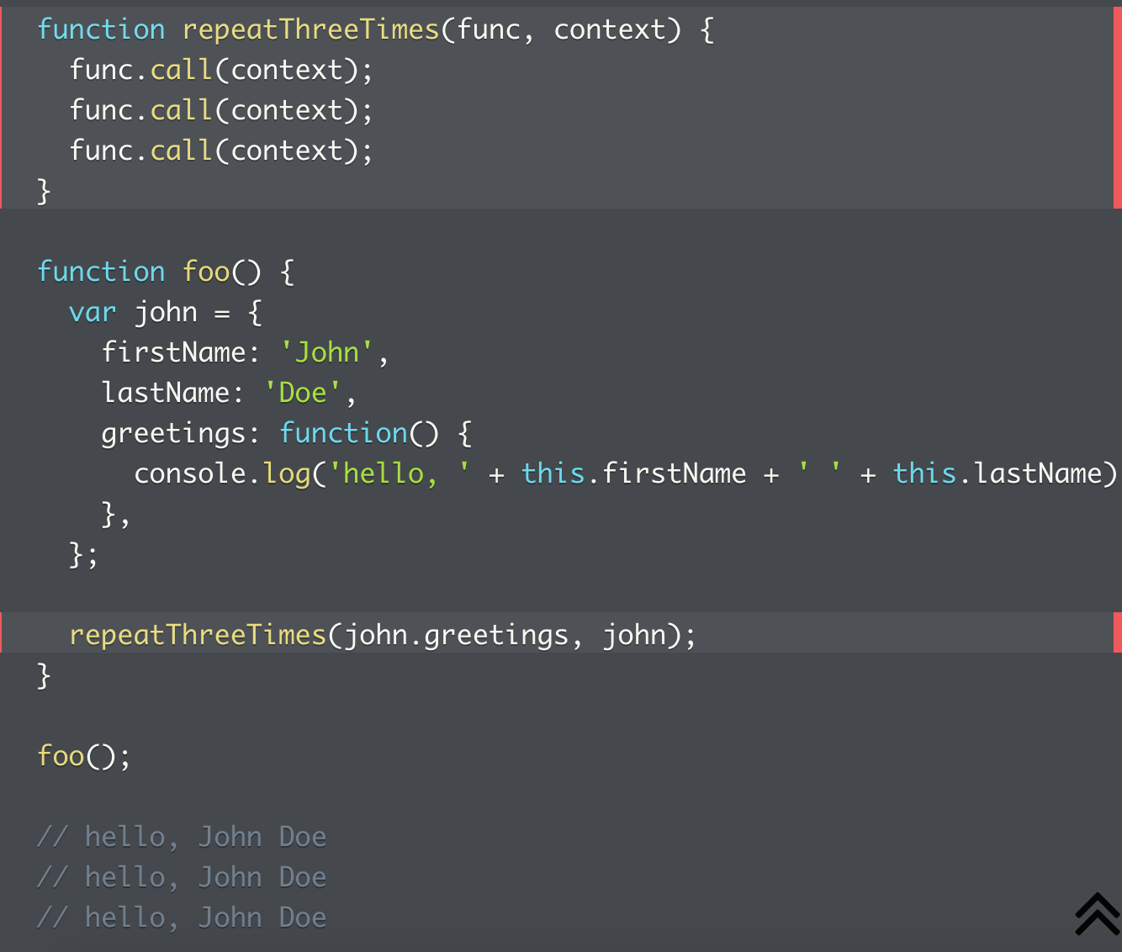
Context loss (1: when method is removed from containing object)
What happened to cause the context loss?
When the object method john.greetings() was invoked by the method repeatThreeTimes(), the context was lost
Solution: update receiving function by adding parameter with desired context
Note the context loss needs to be fixed at two spots
Where the receiving function is, the context is called
When the function is invoked within the object, both the object method and the context are called)

Slide 22
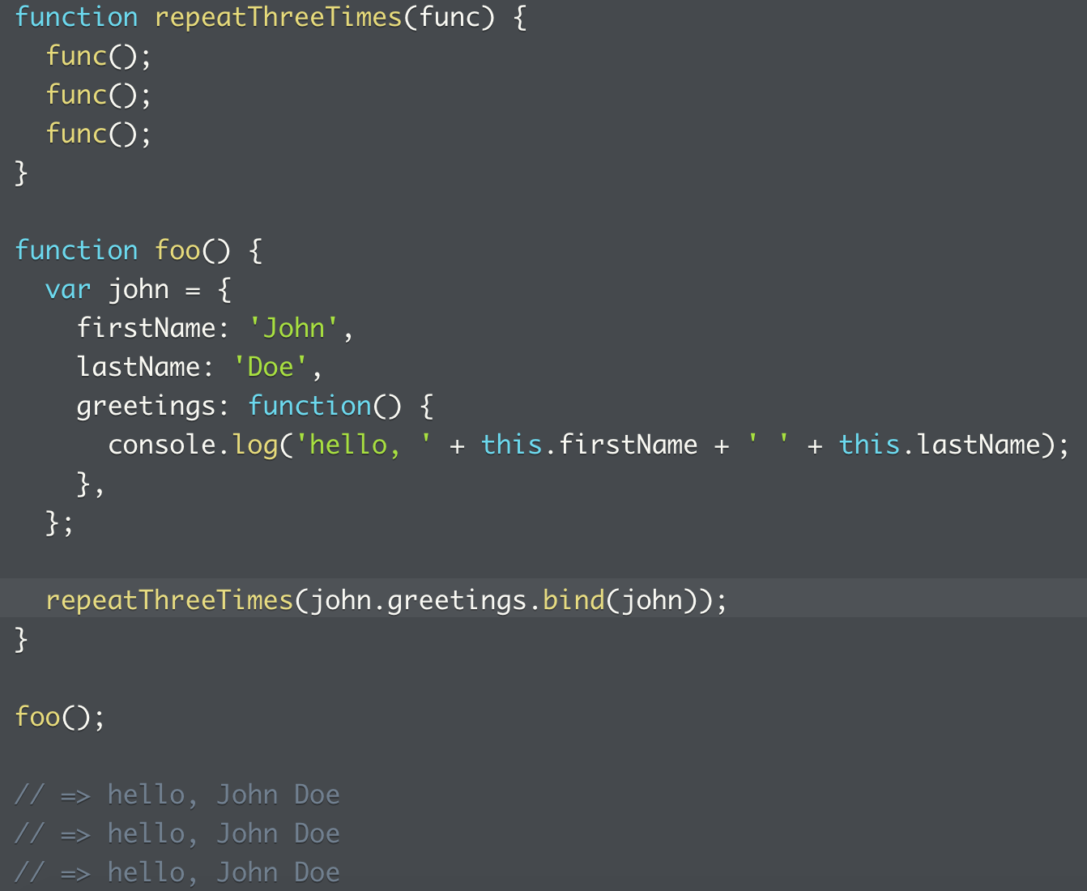
Context loss 1: if function can’t be updated and no context object can be supplied
Hard binding might be the way to go
Same problem as above, but this time solved without supplying an additional context
This means the method will only work with its container object
And leaves the receiving object relatively “clean”
Extra reading, how JS’s optional `thisAr` argument does the same thing to maintain context:
https://developer.mozilla.org/en-US/docs/Web/JavaScript/Reference/Global_Objects/Array/forEach#Using_thisArg

Slide 23
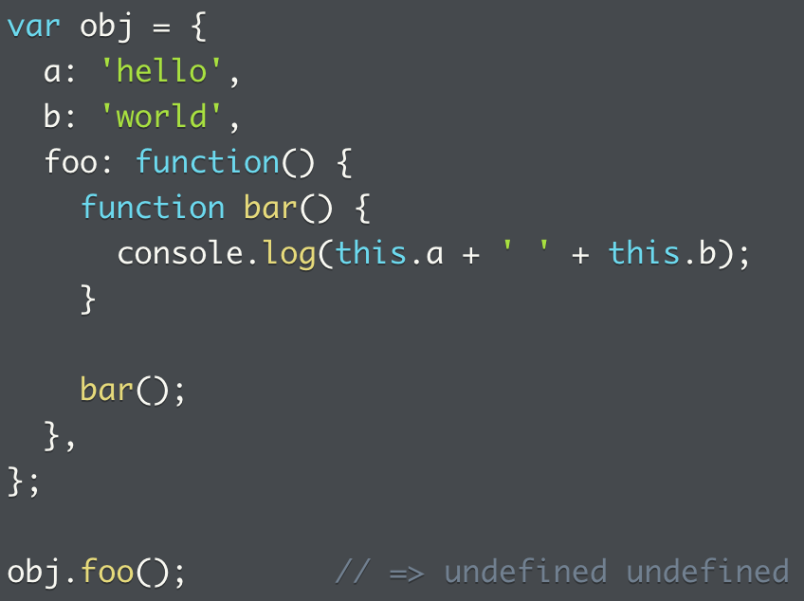
Context loss 2: internal function losing method context
Context does not propagate to its internal functions, so context can be lost when a function is created within another function and then called
So foo() executes within the obj context, but the call to bar() does not, and it’s bound to the global object

Slide 24
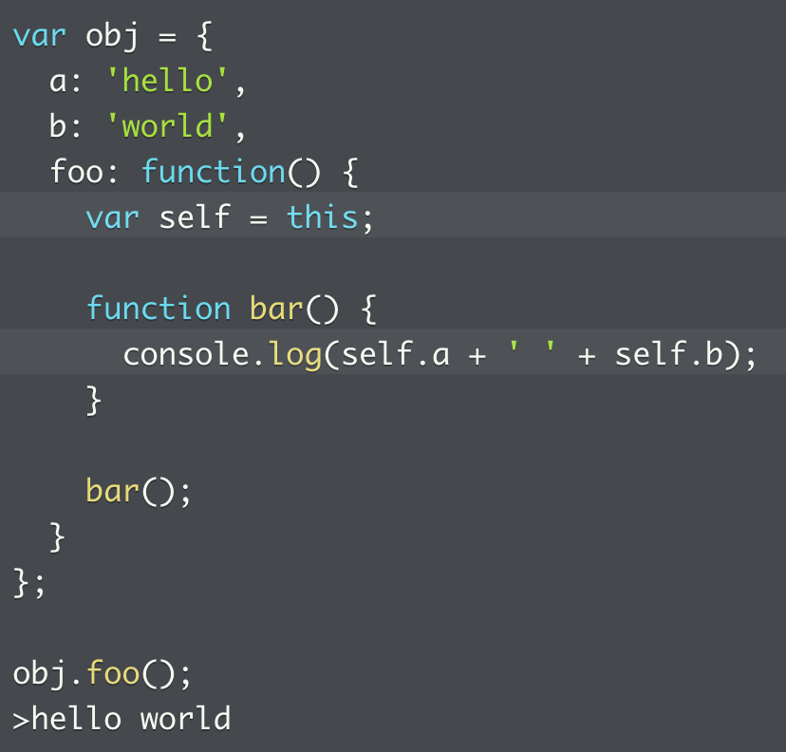
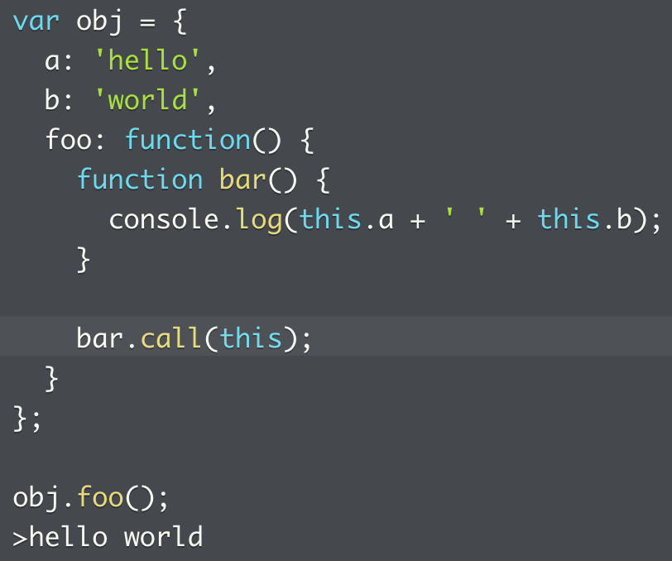
Context loss 2 (internal function context loss) solution 1 + 2
Solution 1: save `this` as a var before calling the function, and reference that in the inner function
Lexical scope means `bar` has access to `self`
Add a line to pass context from one scope to another
Solution 2: pass context to function using call/apply
Explicitly state the object called

Slide 25
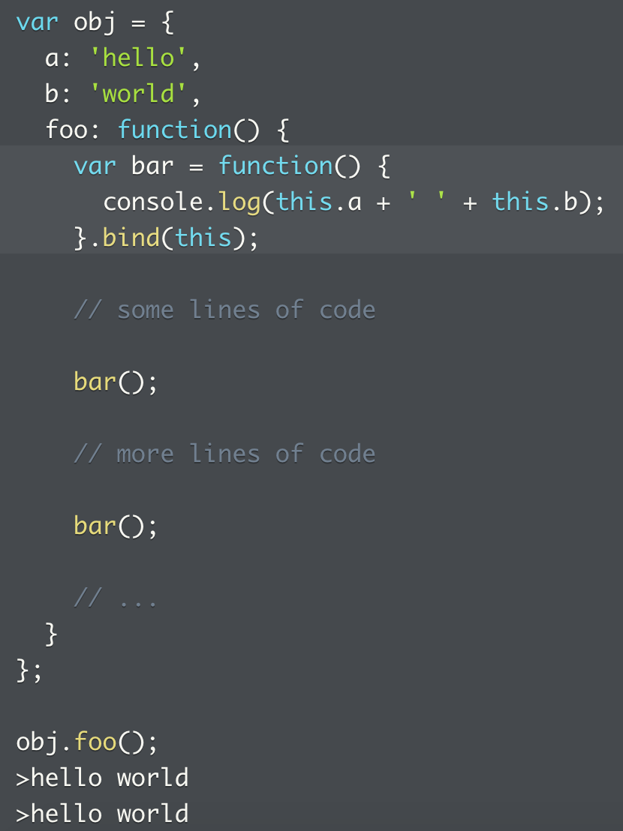
Context loss 2 (internal function context loss) solution 3
Solution 3: bind context permanently
This only works with a function expression and not a function declaration
So it only works when var bar = function(), and not bar(): function()
Also, bind once and reuse is possible, without explicit context called every time

Slide 26
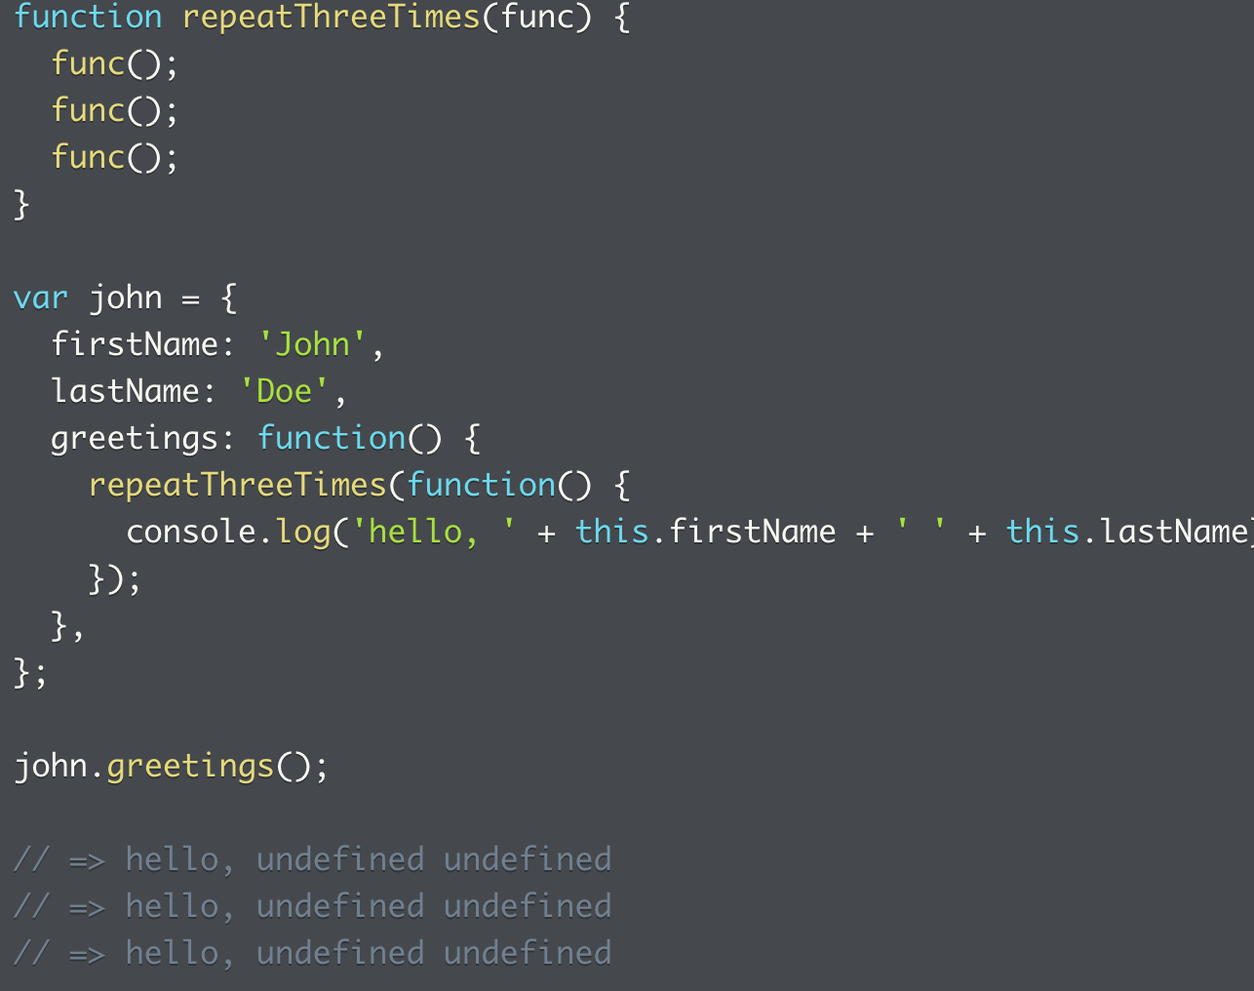
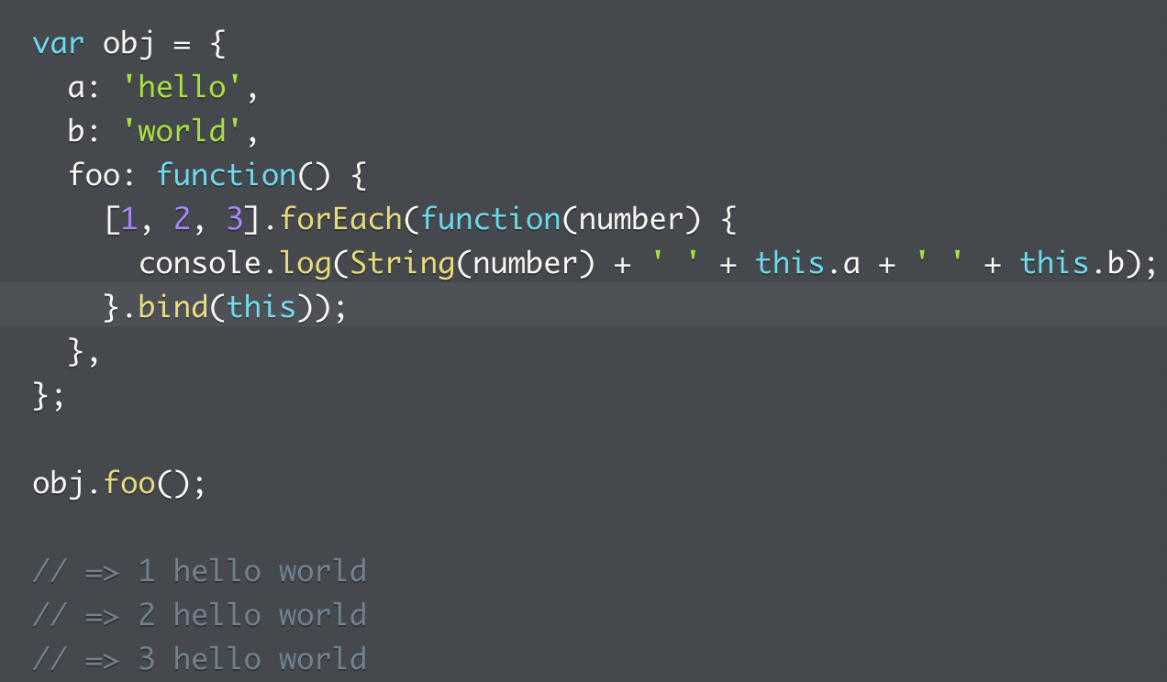
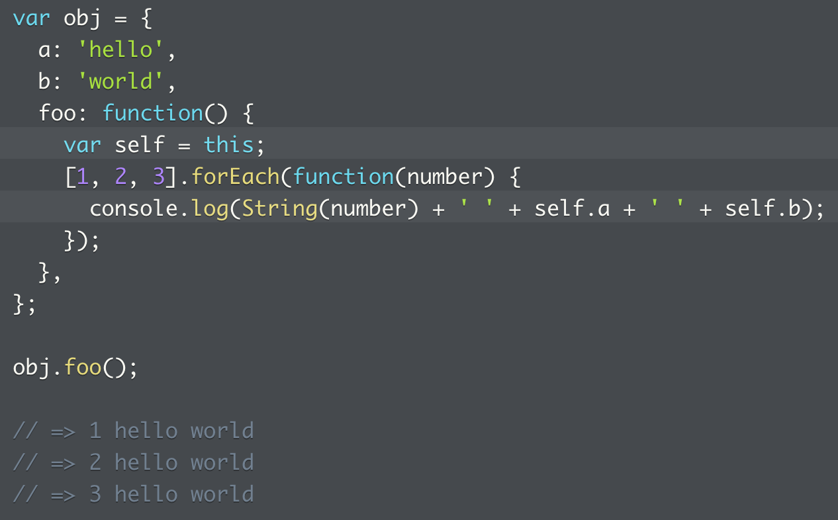
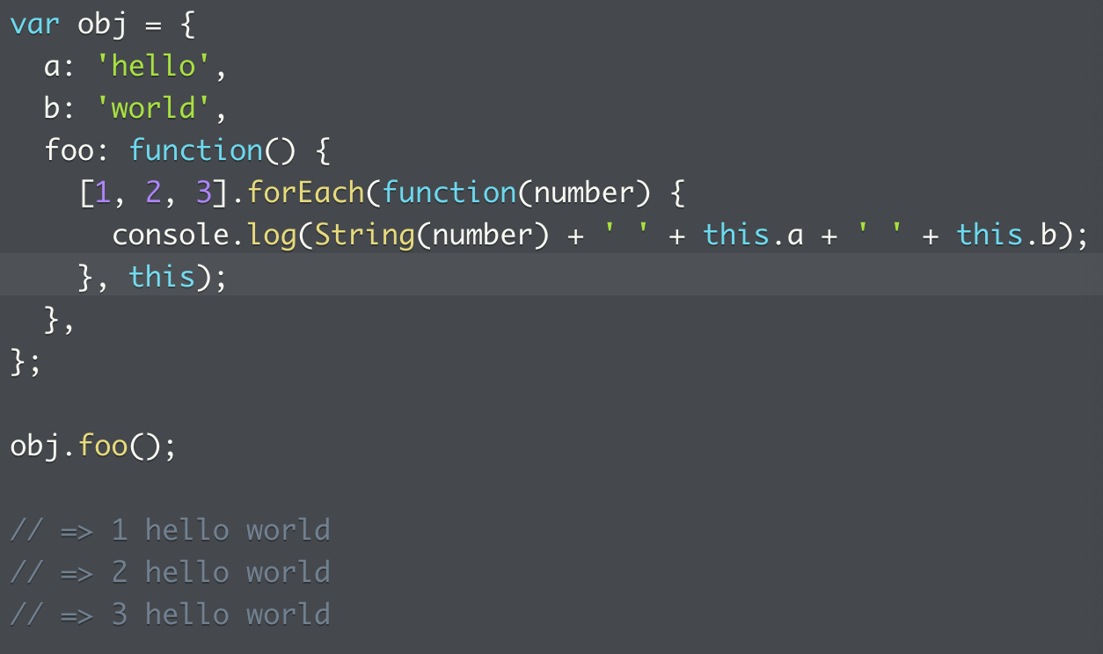
Context loss 3 (function as argument losing surrounding context)
Example 1: slide 21, the john.greetings() example
Example 2:
forEach executes the anonymous function passed to it, and gets executed with the global object as context
This has the wrong value
Three ways to fix this
Use local var in the lexical scope to store this
Bind argument with surrounding context
(is this considered a function expression? Because only that can be used with bind())
Use `thisArg()`, as seen earlier on slide 23
Some methods take function arguments allowing optional arguments that defines context when executed
forEach() has this optional argument for context, and so does map, every, and some

Slide 27
Problems: context loss
1. Context loss when method is removed from the containing object
2. One way to supply context to a function that has no explicit context
3. Another way to supply context by binding
4. Context loss when an internal function loses its context
5. Use adding a local variable to supply context
6. Use the thisArgs parameter available in forEach to supply another execution context
7. Internal function loses context
8. Add explicit context to internal context loss
9. Use a function expression to hard bind context to an object method

Slide 28
More practice problems on `this`
1. What is `this` for an internal function?
2. How to change context for an internal function?
3. Using bind to prevent the loss of context for an object method removed from its containing object
4. What happens when an object method is executed, either with an explicit context or not
5. Fix functions with internal functions that loses its execution context

Slide 29
This keyword and problems
Understanding the execution context of this is important
Read: https://web.archive.org/web/20180209163541/https://dmitripavlutin.com/gentle-explanation-of-this-in-javascript/, skipping sections 4 and 7
Problems
What does this refer to by default? And what does it return for a function
What is `this` in each layer of an internal function?
Does an object method hold onto its context when called?
What’s the implicit context of a function?
What happens to the execution context of a function when called by another object method? Demonstrate how execution context is all that matters
How context is lost when an object method is assigned to a variable

Slide 30
Summary
Function invocations rely on implicit execution context that resolves to the global object, e.g. parseInt(numStr)
Method invocations like array.forEach(processElement) rely upon implicit context that resolves to object that holds the method
All code executes with context, top level for browser is global (Node is module), all global methods and objects (isNaN/Math) are properties of the object
Can’t use `delete` to delete variables/functions declared at global scope
`this` = current execution context of a function, changes based on how functions are invoked, not defined
JS has first-class functions (functions attached to objects)
Can add to objects and execute in object contexts
Can remove from their objects, pass around, or execute in different contexts
Initially unbound, but bound at execution time to context
Call/apply invoke function with explicit execution context
Bind permanently binds function to context, returns new function (see earlier slide on how this is implemented)
Method invocations operate on data of owning object

