Slide 1
GENDER BIAS IN MACHINE TRANSLATION: A SURVEY
Dana Dăscălescu
Miruna-Andreea Zăvelcă

Slide 2


Introduction
Notes:
We will begin by defining the problem statement and providing a quick introduction to gender bias and its underpinnings in NLP.
\textit{Do men make better scientists than women?} Until recently, even widely-used Large Language Models such as GPT-3 shared this perspective. Although such machine learning models may be beneficial, they are only as good as the data they are trained on, thus we cannot criticize them for presenting their findings. With ChatGPT and other technologies that will make more and more data available on the Internet, we will have a way to see how our social biases affect us.
If the training data incorporates prejudices or other types of bias, the model may perpetuate unwanted outcomes, such as the dissemination of disinformation or preconceptions, as in the old saying "garbage in, garbage out". The primary issue is thus the data itself, which is nothing more than a historical record of our gender imbalance. The studies conducted over the years provide empirical evidence that men are favored in many areas and that women face more challenges and obstacles than men. They have also shown that women are underrepresented in many scientific fields, and particularly in leadership positions. This is often referred to as the "leaky pipeline" phenomenon, as women are disproportionately lost at every step of the academic and professional advancement process.
Furthermore, the research field is still heavily influenced by the stereotype that scientists are men, which can make it harder for women to be taken seriously, to be seen as equals to their male colleagues, or to succeed and move up in their careers.
All these factors can make it harder for women to succeed in the research field; however, it's important to note that many women have overcome these barriers and achieved great success in their careers. It's important to continue to work towards creating more inclusive and equitable environments for all researchers, regardless of their gender.
Consequently, it is essential to be aware of these possible biases and to take steps to minimize them, with a potential first step consisting of mitigating these impacts on ML models. Ideally, inclusive and diverse training data, gender-neutral languages, and non-binary gender terms should be used. Since this data may be hard or impossible to gather for large language models, the focus of the research has changed from eliminating the bias in the data to teaching the model not to learn it from the data.
Approaches in this area, which will be later presented, include frequently evaluating the model's performance to ensure it is accurate and unbiased; utilizing a combination of techniques to debias the data and model, such as counterfactual data augmentation; debiasing the word embeddings, adversarial training; or having a diverse team in the development and maintenance of these machines, including gender diversity and multicultural and multilingual perspectives, which can help to identify and address potential biases.

Slide 3
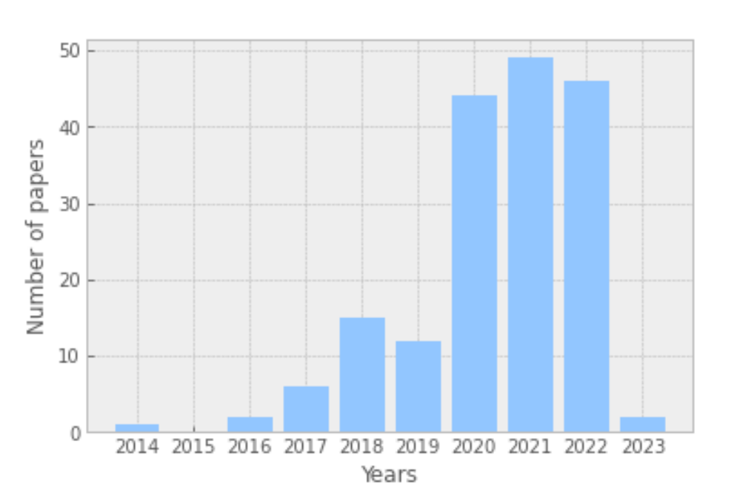
Interest in the Topic in Recent Years

Slide 4

Categorizing Bias
Task | Example of Representation Bias in the Context of Gender | D | S | R | U
Machine Translation | Translating “He is a nurse. She is a doctor.” to Hungarian and back to English results in “She is a nurse. He is a doctor.”
Caption Generation | An image captioning model incorrectly predicts the agent to be male because there is a computer nearby
Speech Recognition | Automatic speech detection works better with male voices than female voices
Sentiment Analysis | Sentiment Analysis Systems rank sentences containing female noun phrases to be indicative of anger more often than sentences containing male noun phrases
Language Model | “He is doctor” has a higher conditional likelihood than “She is doctor”
Word Embedding | Analogies such as “man : woman :: computer programmer : homemaker” are automatically generated by models trained on biased word embeddings
After (Crawford, 2017) in (Sun et al., 2019): (D)enigration, (S)tereotyping, (R)ecognition, (U)nder-representation
Notes:
Denigration - use of culturally or historically derogatory terms
Stereotyping - reinforces existing societal stereotypes
Recognition- a given algorithm’s inaccuracy in recognition tasks
Under-representation - the disproportionately low representation of a specific group

Slide 5

Approaches for Reducing Bias
Dataset alignment
Debiasing through External Components via Inference-time
Model debiasing
Notes:
Dataset alignment - altering already existing datasets
Model debiasing – Equalizing Gender Bias in Neural Machine Translation with Word Embeddings Techniques
Debiasing through External Components via Inference-time – changing first person references into masculine / feminine forms
Extra: (Costa-jussà and de Jorge, 2020) propose a gender-balanced dataset built from Wikipedia biographies. While this generally improves the generation of feminine forms, the approach is not as effective as it does not account for stereotypes that arise from the qualitative different ways in which men and women are portrayed (Wagner et al., 2021)

Slide 6



Dataset Alignment
Gender tagging
(Vanmassenhove et al., 2018), (Elaraby et al., 2018b), (Stafanovics et al., 2020), (Saunders et al., 2020)
Adding context
(Basta et al., 2020), (Stanovsky et al., 2019), (Sharma et al., 2022)
Gender swapping
(Zhao et al., 2018a),
(Lu et al., 2018), (Kiritchenko and Mohammad, 2018)
Notes:
Vanmassenhove – prepend with M or F; I am a nurse -> Je suis un(e) infirmier(e)
Elaraby – cross-lingual rules based on POS tagging
Stafanovics –
Saunders – non-binary translations
Basta – concatenate sentence with previous one
Stanovsky – fighting bias with bias; The pretty doctor asked the nurse to help with the operation
Sharma – template based on morphological taggers
Gender swapping – can lead to nonsense (He gave birth)

Slide 7
Model debiasing
(Bolukbasi et al., 2016b),
(Zhao et al., 2018a),
(Elazar and Goldberg, 2018)
Static Word Embeddings
Contextual Word Embeddings
(Zhao et al., 2019),
(Kaneko and Bollegala, 2021)
Notes:
Bolukbasi - Man is to Computer Programmer as Woman is to Homemaker
Zhao - Gender Bias in Coreference Resolution: Evaluation and Debiasing Methods
Elazar - Adversarial Removal of Demographic Attributes from Text Data
Zhao - Gender Bias in Contextualized Word Embeddings Kaneko and Bollegala - Debiasing Pre-trained Contextualised Embeddings

Slide 8



Debiasing through External Components via Inference-time
Black-box Injection
Lattice Re-scoring
(Saunders and Byrne, 2020)
(Moryossef et al., 2019)
Gender Re-inflection
(Alhafni et al., 2020), (Habash et al., 277
2019)
Notes:
Moryossef - attempts to control the production of feminine and plural references by adding a prepended construction: “She said to them“
Saunders and Byrne - he gender marked words are mapped to all their possible inflectional variants and the sentences corresponding to the paths in the lattice are re-scored with a gender debiased model
Alhafni - feeds to the component the preferred gender of the speaker together with the translated Arabic sentence
Habash - i) a two-step system that first identifies the gender of 1st person references in an MT output, and then re-inflects them in the opposite form
ii) a single-step system that always produces both forms from an MT output

Slide 9

Limitations
Lack of consensus on how to measure bias
Data availability
Implicit bias
Selection bias
Difficulty in disentangling bias from structural inequalities
Limited understanding of intersectionality
Confounding variables

Slide 10
Thank you for your attention!

Slide 11
Minimalist thesis defense infographics
This template contains an assortment of complementary infographic resources for the Minimalist Thesis Defense presentation.
These infographics are adapted to the style of the aforementioned presentation, so you can insert them easily and have them completely integrated at once. You just need to do the following:
Select the element that you want to copy
Right-click and choose “Copy”
Go to the slide where you want the element to appear
Right-click and choose “Paste”

Slide 12
Minimalist thesis defense infographics
Saturn was named after the Roman god of wealth and agriculture
Saturn
Jupiter
Jupiter is a gas giant and the biggest planet in the Solar System

Slide 13
A Categorization of Approaches for Reducing Bias
Mars
Despite being red, Mars is actually a cold place. It's full of iron oxide dust
Venus
Venus is the second planet from the Sun. It is named after a Roman goddess
Neptune
Neptune is the fourth-largest planet by diameter in the Solar System

Slide 14
Minimalist thesis defense infographics
Saturn
Mercury
Saturn was named after a Roman god
Mercury is a very small planet
Neptune
Venus
Neptune is very far away from us
Venus has a very toxic atmosphere
Jupiter
Jupiter doesn’t have a solid surface

Slide 15
Minimalist thesis defense infographics
70%
50%
30%
Venus
Earth
Mars
Venus is the second planet from the Sun. It is named after a Roman goddess
Earth is the third planet from the Sun and the only one that harbors life
Despite being red, Mars is actually a cold place. It's also full of iron oxide dust

Slide 16
Minimalist thesis defense infographics
Team 1: Research
Team 3: Writing
Sam Allen
Team 2: Interviews
Lisa Lewis
John Black
Tim White
Kim Stone
Beth Cole

Slide 17
Minimalist thesis defense infographics
Neptune
Venus
Neptune is very far away from the Sun
Venus is the second planet from the Sun
Saturn
Mars
Saturn is composed of hydrogen and helium
Despite being red, Mars is very cold

Slide 18
Minimalist thesis defense infographics
Earth
Earth is the third planet from the Sun
Venus
Mars
Venus has extremely high temperatures
Despite being red, Mars is a cold place
Neptune
Jupiter
Neptune is far away from us
Jupiter doesn’t have a solid surface

Slide 19
Minimalist thesis defense infographics
 | Venus | Mercury | Jupiter | Neptune
Phase 1 | x | x | v | x
Phase 2 | x | x | v | v
Phase 3 | x | v | x | v
Phase 4 | v | v | x | v
Phase 5 | v | v | v | v

Slide 20
Minimalist thesis defense infographics
Venus
Saturn
Venus is the second planet from the Sun. It is named after
Saturn is the second-largest planet in the Solar System
Neptune
Neptune is the fourth-largest planet in the Solar System

Slide 21
Minimalist thesis defense infographics
Jupiter
Mars
Jupiter doesn’t have a solid surface
Despite being red, Mars is very cold
Mercury
Earth
Mercury is the closest planet to the Sun
Earth is the planet where we all live

Slide 22
Minimalist thesis defense infographics
Mars
31%
Mars is very cold
Neptune
28%
Neptune is far away
Venus
22%
Venus is a hot planet
Saturn
19%
Saturn is a gas giant

Slide 23
Minimalist thesis defense infographics
 | Neptune | Jupiter | Saturn | Mars
Step 1 | 163,000 | No | 15% | Venus is a very hot planet
Step 2 | 215,000 | Yes | 36% | We all live on the Earth
Step 3 | 341,000 | Yes | 72% | Mars is full of iron oxide dust
Step 4 | 521,000 | No | 97% | Neptune is very far away

Slide 24
Minimalist thesis defense infographics
Jupiter doesn’t have a solid surface
Saturn was named after a Roman god
Jupiter
Saturn
01.
02.
03.
04.
05.
Mars
Venus
Earth
Despite being red, Mars is very cold
Venus has extremely high temperatures
The Earth is the planet with life

Slide 25
Minimalist thesis defense infographics
Neptune is very far away from us
87%
Neptune
63%
Jupiter
Jupiter doesn’t have a solid surface

Slide 26
Minimalist thesis defense infographics
Venus
Saturn
Venus has a very beautiful name
Saturn is not the only planet with rings
Mercury
Neptune
Mercury is the smallest planet of them all
Neptune is the farthest planet from the Sun

Slide 27
Minimalist thesis defense infographics
Mars
63%
Despite being red, Mars is very cold
Jupiter
42%
Jupiter doesn’t have a solid surface
Saturn
91%
Saturn was named after a Roman god

Slide 28
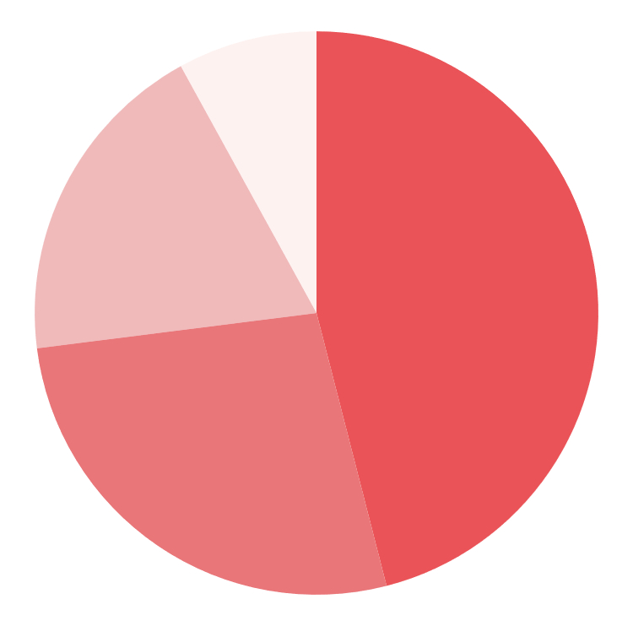
Minimalist thesis defense infographics
46%
27%
Neptune
Earth
Neptune is very far away from the Sun
Earth is the planet where we all live
19%
8%
Mercury
Venus
Mercury is the closest planet to the Sun
Venus has extremely high temperatures
Follow the link in the graph to modify its data and then paste the new one here. For more info, click here

Slide 29
Minimalist thesis defense infographics
Neptune
Mars
Neptune is very far away from the Sun
Despite being red, Mars is very cold
Venus
Mercury
Venus is the second planet from the Sun
Mercury is the closest planet to the Sun

Slide 30
Minimalist thesis defense infographics
Earth
38%
Earth is also known as the blue planet
Saturn
80%
Saturn is composed of hydrogen and helium
Jupiter
62%
Jupiter is a gas giant and the biggest planet

Slide 31
Minimalist thesis defense infographics
Earth
Neptune
Earth is the planet where we all live
Neptune is very far away from the Sun
Ceres
Ceres is located in the main asteroid belt
Mars
Venus
Despite being red, Mars is actually cold
Venus is the second planet from the Sun
Jupiter
Mercury
Saturn
Jupiter doesn’t have a solid surface
Mercury is the smallest planet of them all
Saturn is not the only planet with rings

Slide 32
Minimalist thesis defense infographics
Mercury
Mars
Saturn
Mercury is the closest planet to the Sun
Despite being red, Mars is very cold
Saturn is composed of hydrogen and helium

Slide 33
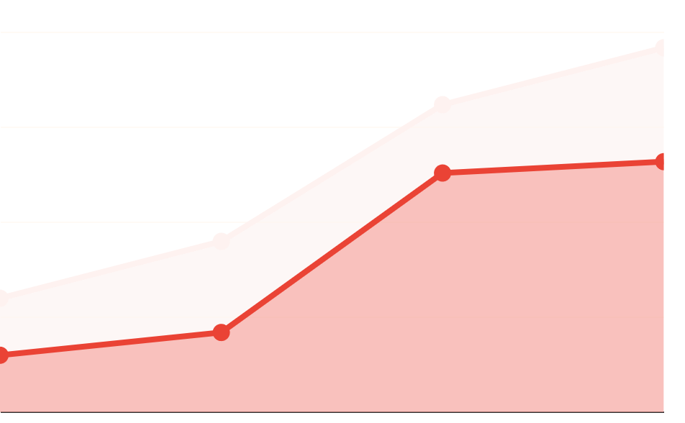
Minimalist thesis defense infographics
100
 | Saturn | Neptune
Period 1 | 30 | 15
Period 2 | 45 | 21
Period 3 | 81 | 63
Period 4 | 96 | 66
75
50
25
0
Period 1
Period 2
Period 3
Period 4
Follow the link in the graph to modify its data and then paste the new one here. For more info, click here

Slide 34
Minimalist thesis defense infographics
Saturn
Saturn is not the only planet with rings
Earth
Earth is also known as the blue planet
Mercury
Mercury is the closest planet to the Sun
Jupiter
Jupiter was named after a Roman god

Slide 35
Minimalist thesis defense infographics
Earth
Mars
Earth is the planet where we all live
Despite being red, Mars is a cold place
Mercury
Jupiter
Mercury is the closest planet to the Sun
Jupiter is the biggest planet of them all
Neptune
Ceres
Neptune is the farthest planet from the Sun
Ceres is located in the main asteroid belt

Slide 36
Minimalist thesis defense infographics
Topic 01
Topic 02
Saturn
Neptune
Saturn is composed of hydrogen and helium
Neptune is the farthest planet from the Sun
Venus
Ceres
Venus has extremely high temperatures
Ceres is located in the main asteroid belt

Slide 37
Minimalist thesis defense infographics
A
B
Venus
Mars
Venus has a beautiful name and is the second planet from the Sun. It’s terribly hot, even hotter than Mercury, and its atmosphere is extremely poisonous.
Earth
Despite being red, Mars is very cold
Earth is the planet with life
C
D

Slide 38
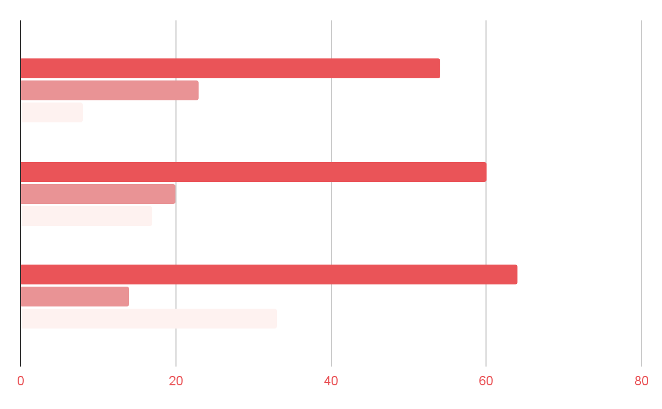
Minimalist thesis defense infographics
Mars
2017
Mars is very cold
2019
Saturn
Saturn is a gas giant
2021
Venus
Venus is a hot planet
Follow the link in the graph to modify its data and then paste the new one here. For more info, click here

Slide 39
Minimalist thesis defense infographics
Phase 1
Phase 2
Phase 3
Saturn
Jupiter
Mercury
Saturn is not the only planet with rings
Jupiter doesn’t have a solid surface
Mercury is the smallest planet of them all
85k
24k
37k

Slide 40
Minimalist thesis defense infographics
Neptune
Neptune is very far away from the Sun
Earth
Venus
Earth is the only planet that harbors life
Venus is the second planet from the Sun

Slide 41
Minimalist thesis defense infographics
It was named after the Roman god of the skies and lightning
Venus has a beautiful name, but also very high temperatures
Jupiter
Venus
It's full of iron oxide dust, which gives the planet its reddish cast
Saturn was named after the Roman god of wealth and agriculture
Mars
Saturn

