Slide 1

mice::feature.selector()

Slide 2
Goal function
feature.selector(data, method)
method = “filter”, “wrapper”, or “hybrid”
Outputs the predictorMatrix

Slide 3
Idea
More computationally intense than quickpred(), but better imputation results
feature.selector() offers a filter, wrapper or hybrid method
Which specific algorithm is chosen for each method is based on our simulation study

Slide 4
Feature Selection Algorithms we consider:
Filter methods: ReliefF, Minimal Redundancy Maximal Relevance (mRMR)
Wrapper methods: Genetic Algorithm (GA), Particle Swarm Optimization (PSO), Ant Colony Optimization (ACO)
Hybrid methods: ReliefF or mRMR + GA, PSO, ACO
(keep in mind that the feature subsets are biased towards the modelling algorithm)
Notes:
Relief and ReliefF are good for classification and regression tasks

Slide 5
Simulation Study Design
Outcome | Missingness | Noise
Binary | Low | Low
Multiclass | Medium | Medium
Continuous | High | High
Method | Compare
Filter | ReliefF vs. mRMR vs. quickpred()
Wrapper | GA vs PSO vs ACO
Hybrid | All combinations of Filter + Wrapper (6 or 9 combinations, depending if quickpred is included)

Slide 6
Comparisons
Comparisons
Mice with quickpred()
Mice with feature.selector()
Mice with all predictors
Truth
Evaluation metrics: entropy for categorical outcomes (?), something with difference in sigma^2 for regression (?)
Save all the metrics to be able to compute various things later on
Create your data in a non-linear way. Always use the same imputation approach cart

Slide 7
After the Simulation
We keep the best method from every category
Make our own functions
Implement them to mice

Slide 8
Appendix

Slide 9
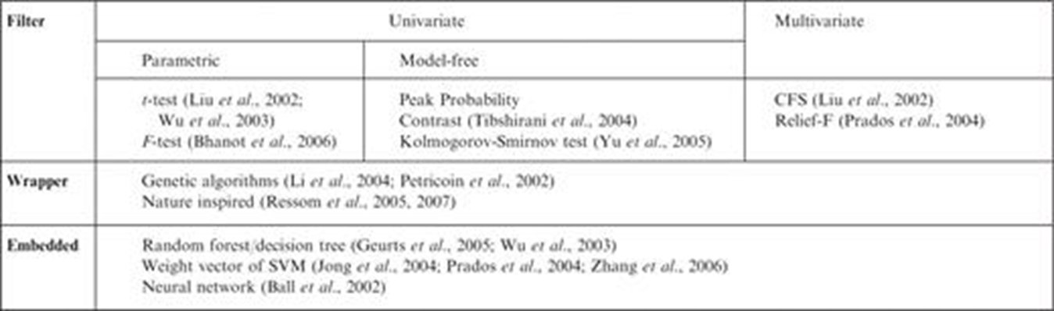
The methods
Filters (univariate and multivariate)
Wrappers
Embedded
Hybrids (Filter-Wrapper)
For the purpose of FS, classifiers (supervised machine learning methods) are used the most.

Slide 10
Feature selection
For our purposes we need to pay attention to chose a method that doesn’t discard missing information listwise. Also ideally the method should be generalizable (the feature selected shouldn’t be selected based on influential model assumptions). It should be able to handle a large range of data types.
Based on the literature search in general the most influential[9] and versatile methods are:
LVF/LVW(Las Vegas Filter/Wrapper) – 600 articles- using the approach [1]
MIFS Mutual Information Feature Selection -1400 articles- (heuristic search technique) [2] [3]: Mutual information is calculated between two variables and measures the reduction in uncertainty for one variable given a known value of the other variable. There is an algorithm developed for incomplete data in [4][5].
Relief [6] -1600 citations- developed with the distance-based metric function that weights each feature based on their relevancy (correlation) with the target-class. By itself it is ineffective as it can handle only the two-class problems and also does not deal with redundant features. On the other hand ReliefF [7] can handle the multi-class problems and deal with incomplete and noisy datasets too.
mRMR (Minimum Redundancy Maximum Relevance)[8] -2700 articles- It selects features that are more relevant (have a large score of correlation with the target class), and not redundant (have a small correlation score with other features) – I couldn’t find any application for incomplete data
[1] H Liu, R. Setiono A probabilistic approach to feature selection- a filter solution. (1996) : https://sci2s.ugr.es/keel/pdf/algorithm/congreso/liu-3.pdf
[2] H. Peng, F. Long, C. Ding Feature selection based on mutual information: criteria of max-dependency, max-relevance, and min-redundancy. IEEE Trans. Pattern Anal. Mach. Intell., 27 (8) (2005), pp. 1226-1238
[3] F.F. Xu, D.Q. Miao, L. Wei Fuzzy-rough attribute reduction via mutual information with an application to cancer classification
Comput. Math. Appl., 57 (2009), pp. 1010-1017
[4] Wenbin Qian, Wenhao Shu,Mutual information criterion for feature selection from incomplete data, Neurocomputing, Volume 168,2015,https://doi.org/10.1016/j.neucom.2015.05.105.
(https://www.sciencedirect.com/science/article/pii/S0925231215008036)
[5] G. Doquire, M. Verleysen, Feature selection with missing data using mutual information estimators, Neurocomputing, Volume 90, 2012, https://doi.org/10.1016/j.neucom.2012.02.031.(https://www.sciencedirect.com/science/article/pii/S0925231212001841)
[6] Kira, K & Rendell, LA 1992, „A practical approach to feature selection‟, Proceedings of the ninth international workshop on Machine learning, Aberdeen, Scotland, UK (pp. 249-256).
[7] Kononenko, I 1994, „Estimating attributes: analysis and extensions of RELIEF‟. Proceeding of European Conference on Machine Learning, Catania, Italy, pp. 171-182.
[8] Stein, G, Chen, B, Wu, AS & Hua, KA 2005, „March. Decision tree classifier for network intrusion detection with GA-based feature selection‟ Proceedings of the forty-third ACM Annual Southeast regional conference, Kennesaw, GA, USA, vol. 2, pp. 136-141
[9] S. García, J. Luengo, F. Herrera, Tutorial on practical tips of the most influential data preprocessing algorithms in data mining, Knowledge-Based Systems, Volume 98, 2016, (https://www.sciencedirect.com/science/article/pii/S0950705115004785)

Slide 11
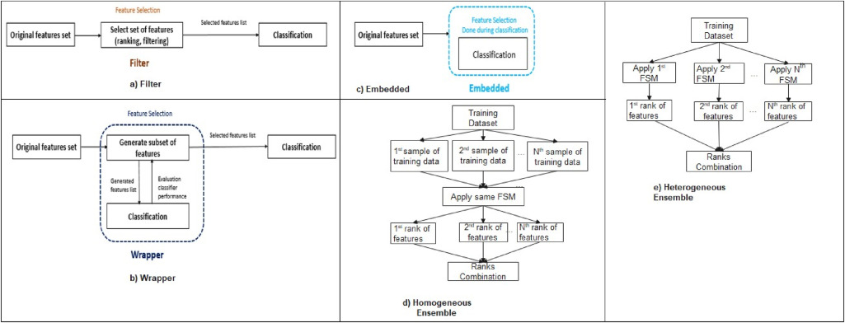
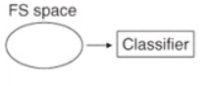
Filters
Univariate filter: evaluates and independently provides ranks for each feature using a specific criterion for selecting the k-features with the highest ranks. This type of filters cannot detect the redundant features as it ignores dependencies between features which affect the classification results.
Multivariate filter: takes care of the relationships within features. Therefore, it can remove irrelevant features in addition to redundant ones.
Best methods[1]:
Cons
ReliefF It selects random instances then searches for a specific number of the nearest neighbours that have the same classes (hits) and for K nearest neighbours that have different classes (misses). After that, the average of all hits and misses are computed by repeating this process for a specific time for each feature.
Minimal redundancy maximal relevance It selects features that are more relevant (have a large score of correlation with the target class), and not redundant (have a small correlation score with other features).
Univariate method ignore the interaction with the classifier. It lead to worse classification performance when compared to other types of feature selection techniques.
Multivariate approach incorporates feature dependencies to some degree.
[1] Danasingh, Asir Antony & Balamurugan, Suganya & EPIPHANY, JEBAMALAR LEAVLINE. (2016). Literature Review on Feature Selection Methods for High-Dimensional Data. International Journal of Computer Applications. 136. 10.5120/ijca2016908317.

Slide 12
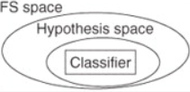
Wrappers
Best methods[1]:
GA (Genetic Algorithm) It is an evolutionary-based meta-heuristic algorithm that was developed in 1992. It simulates the process of natural selection. It searches for the best solutions for any research problem using mutation, crossover, and selection operators [2].
PSO (Particle Swarm Optimization) It is a swarm-based meta-heuristic algorithm that was originally developed by Kennedy et al. [3]. It simulates the social behaviour of organisms in a bird flock or a fish school. https://pyswarms.readthedocs.io/en/development/examples/feature_subset_selection.html
ACO (Ant Colony Optimization) It is a swarm-based meta-heuristic algorithm that was proposed in 1992 by an author in Ref. [4]. It depends on the behaviour of ants in ant colony through their journey of searching for food.
Cons
Wrapper method has the problems such as searching overhead, overfitting, and increased runtime.
Less generality since they use the supervised learning algorithm for evaluating the generated subsets by the searching method.
[1] Danasingh, Asir Antony & Balamurugan, Suganya & EPIPHANY, JEBAMALAR LEAVLINE. (2016). Literature Review on Feature Selection Methods for High-Dimensional Data. International Journal of Computer Applications. 136. 10.5120/ijca2016908317.
[2] Buntine, W 1991, „Theory refinement on Bayesian networks‟ Proceedings of the Seventh conference on Uncertainty in Artificial Intelligence, Barcelona, Spain, pp. 52-60.
[3] Loughrey, J & Cunningham, P 2005, „Overfitting in wrapper-based feature subset selection: The harder you try the worse it gets‟ Proceedings of Research and Development in Intelligent Systems, Springer London. pp. 33-43.
[4] Freeman, C, Kulić, D & Basir, O 2015, „An evaluation of classifier-specific filter measure performance for feature selection, Pattern Recognition, vol.48, no.5, pp.18121826.

Slide 13
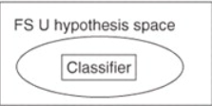
Embedded methods have the advantage that they include the interaction with the classification model, while at the same time being far less computationally intensive than wrapper methods.
It is developed for exploiting advantages of multiple FS methods which may obtain better results than the output of any individual method. An ensemble FS method has two categories: Homogeneous and Heterogeneous. The first category works by splitting the dataset into different training datasets, then by applying the same FS method. In Heterogeneous strategy, different FS methods are applied over the same training data. The final set of selected features in both categories is generated using specific combining and thresholding processes. Combination can be done using union, intersection, or voting processes. Thresholding can be done using static thresholds based on a fixed percentage, or by using complexity measures automatically [7].

